Slide 1


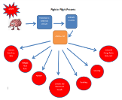
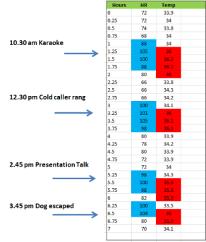

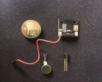
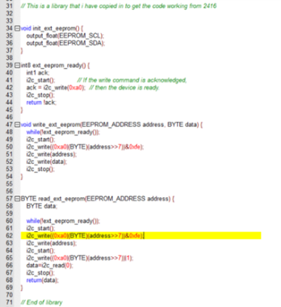
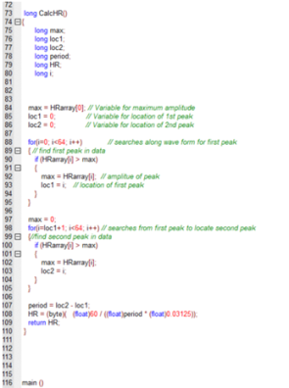
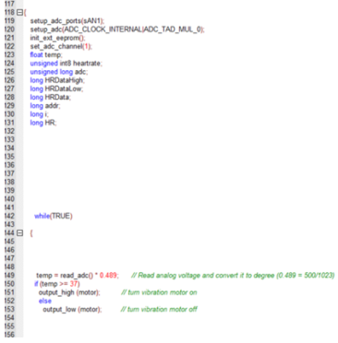
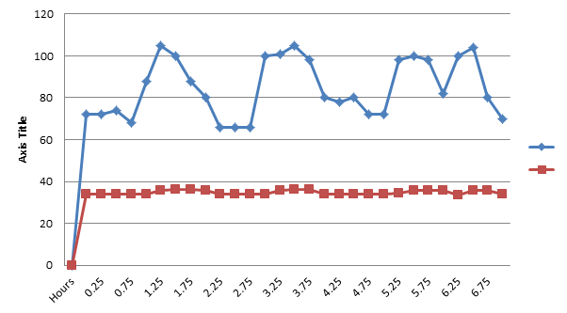
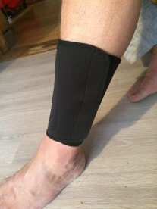
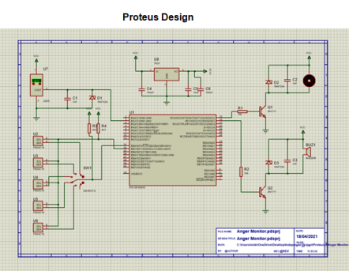
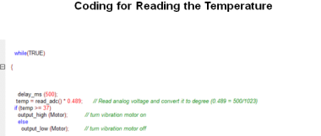
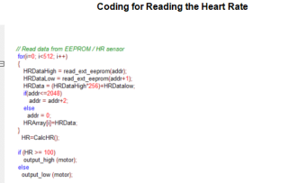
Wearable device to detect physiological symptoms of anger –with alert
By Nick Regan Student No 1803871) Department of Engineering BEng (Hons) Electrical & Electronic Engineering
Conclusion
Anger does manifest in physical symptoms that can be measured
Wearers would benefit from this device
Choice of symptoms to measure are crucial for success
There are challenges in designing a suitable device that is discrete and comfortable.
There are challenges in isolating anger from other causes that change symptoms
Results of Simulation
A trial was carried out using a diary to record times of events and measurement results of heart rate and skin temperature each 15mins over 7hour period.
Simulated stressors were used to mimic anger as stress has the same physical effects.
Heart rate and skin temperature increased in unison, during simulated and naturally occurring stress.
INTRODUCTION
MANAGE THE ANGER
Anger has been identified as a significant problem, leading to detrimental effects on health, and on occasions leading to domestic violence, physical and verbal abuse or self-harm.
This project puts forward the idea of designing a wearable device which can detect and monitor the build-up and expression of anger by measuring physiological symptoms which happen when anger is experienced.
Significant change in the results of the measurements would then initiate an alert would be felt by the wearer which would enable them to become aware of the build-up of anger and prevent it escalating. It would also allow them to realise the triggers that start the anger.
AIMS AND OBJECTIVES
To verify that symptoms do manifest and can be measured
Design of an appropriate device to measure chosen symptoms and alert wearer
DESIGN PROCESS -PROTEUS AND CODING
Materials and Methods
Literature Review: Identified feasibility with statistical evidence of increase of anger , data on symptoms already measured and previous attempts at designing wearables. This formed the foundation of the design process.
The physiological symptoms chosen to be measured
are heart rate and skin temperature both of which alter during anger. The wearable portable device consists of an optical sensor, a thermistor and a vibrating disc on a neoprene band worn around the ankle.
Literature cited:
Image: Business man head in hands from: https://www.shutterstock.com/image-vector/businessman-panic-hold-on-head-emotions-699732913
E. Leslie and R. Wilson, Article Title, Sheltering in Place Domestic Violence: evidence for Calls of Abuse in Covid 19, Sept 20, found online at: https://www.sciencedirect.com/science/article/abs/pii/S0047272720301055 Accessed 2.11.20.
Stack of books from: http://clipart-library.com/clipart/pcqKd9nRi.htm
Acknowledgments
To Steve Mosey Supervising Tutor for advice and support
Further information
Email: nickregan@rocketmail.com

