Slide 1


This Girl Can Campaign
Task – 3 groups :
Group1- This Girl Can- Introduce the campaign and its objectives / how it aims to impact female participation
Group2- Set the scene- Does the campaign highlight a need? Why ?
Group3- What has been achieved?

Slide 2
Social class, health and physical activity

Slide 3
Outline
Class – meaning and definitions
Poverty – absolute and relative
Social class and health inequalities
Explanations
Childhood Obesity
Young Ambassador scheme

Slide 4

Images of class

Slide 5
What do we mean by class?
Can be used to describe economic relationships – e.g. employer/worker
Can be used to describe social status – e.g. professional/manual
Class is also about a sense of identity

Slide 6
Ways of defining class: early writers
Karl Marx (1818-1883) – class as primarily an economic relationship (i.e. employer and worker)
Max Weber (1864-1920) – saw class as reflecting economic inequalities, but also emphasised the importance alongside this of status (i.e. social prestige), and other sources of power.

Slide 7
Measurements of social class:
1. The Registrar General’s scale
One of the most frequent used classification system during 20th century
Categories:
  I Professional
  II Intermediate professional
  IIIN Skilled non-manual
  IIIM Skilled manual
  IV Semi-skilled manual
  V Unskilled manual

Slide 8
Measurements of social class:
2. National Statistics Socio- economic Classification (NS-SEC)
Replaced Registrar Generals’ scale in official statistics
Categories:
  Higher managerial & professional occupations
  Lower managerial & professional occupations
  Intermediate occupations
  Small employers & own account workers
  Lower supervisory and technical occupations
  Semi-routine occupations
  Routine occupations
  Never worked & long-term unemployed

Slide 9
Class identity – British Social Attitudes Survey
No decline in the overall proportion of people identifying themselves as belonging to a social class;
Increasing numbers of people identify themselves as middle class, with fewer describing themselves as working class;
57% still identify themselves as working class, and 37% as middle class. (British Social Attitudes Survey, 2007)
According to a YouGov poll (2024), 56% identified as working class, while 36% identified as middle class- Job and income are seen as the most important factors in determining social class.

Slide 10
Poverty – ‘absolute’ and ‘relative’
“Individuals, families and groups in the population can be said to be in poverty when they lack the resources to obtain the types of diets, participate in the activities and have the living conditions and amenities which are customary, or are at least widely encouraged or approved, in the societies to which they belong”
  Townsend, P., in Wedderburn, D. (1974) Poverty, Inequality and Class Structure (p15)

Slide 11
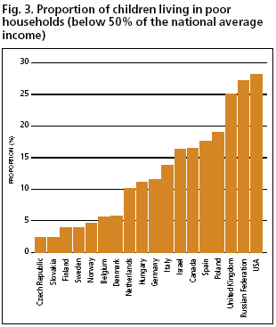
Child poverty in Britain
Bradshaw J. Child poverty in comparative perspective. In: Gordon D, Townsend P. Breadline Europe: the measurement of poverty. Bristol, The Policy Press, 2000.

Slide 12
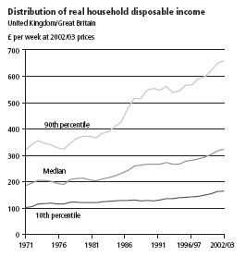
Widening inequalities in income in the UK

Slide 13
Widening inequalities in income in the UK
Median household disposable income in the UK was £34,500, a decrease of 2.5% from FYE 2022, based on estimates from the Office for National Statistics (ONS) Household Finances Survey (HFS)
Median household disposable income for the poorest fifth of the population increased by 2.3% to £16,400, partly because of government cost of living support measures; however, this figure remains 2.4% below FYE 2020 pre-coronavirus (COVID-19) pandemic levels
Median household disposable income for the richest fifth of the population decreased by 4.9% to £68,400; this is 4.3% below pre-pandemic FYE 2020 levels
(ONS, 2024)

Slide 14
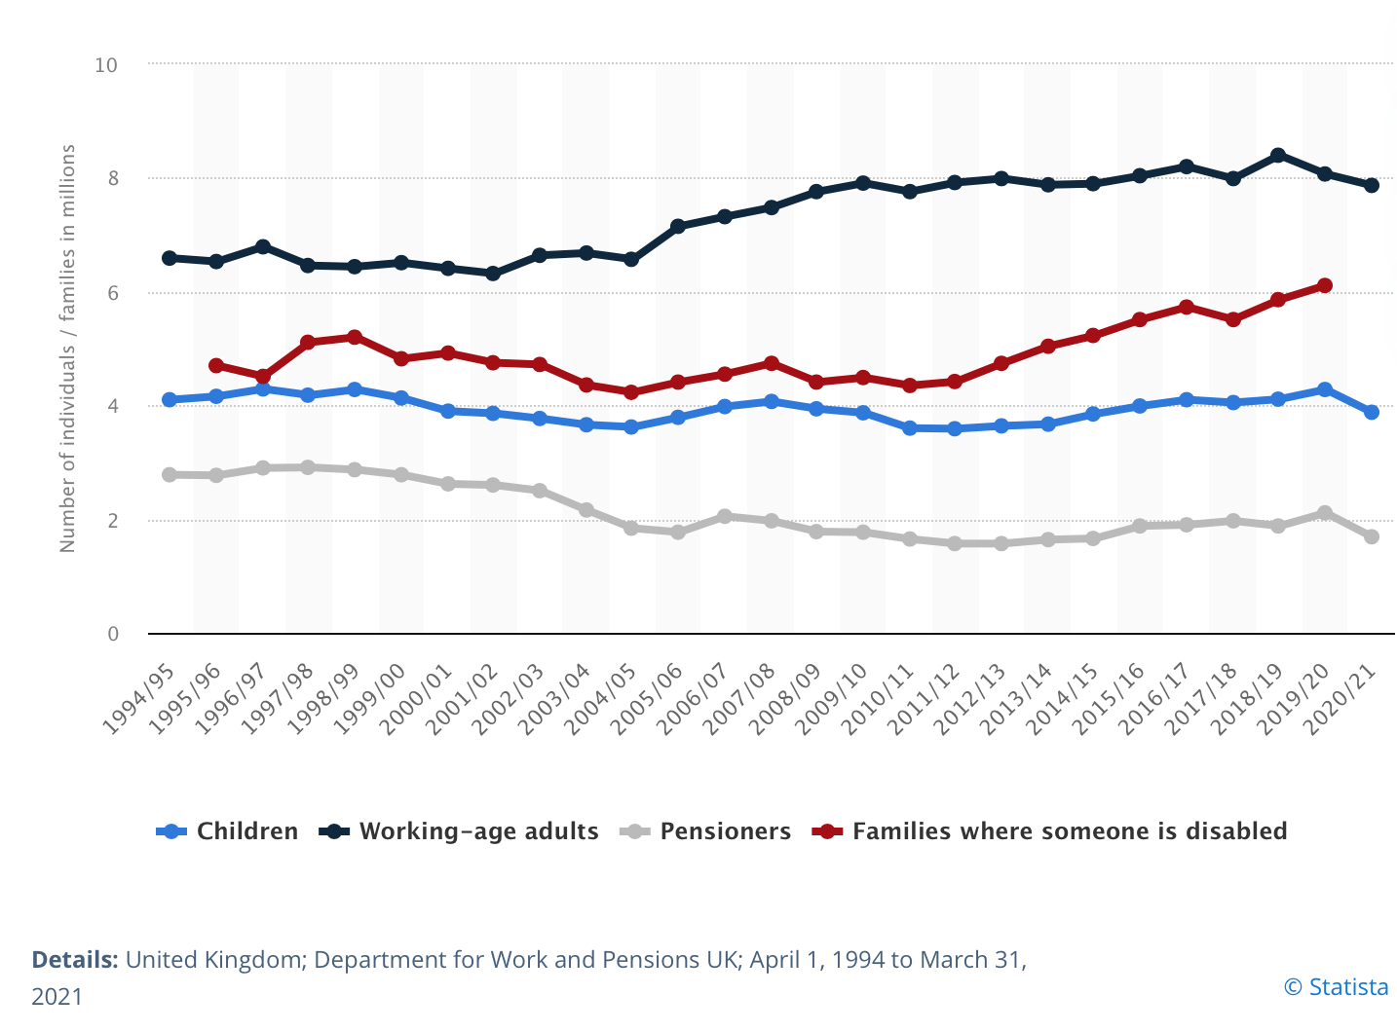
Number of individuals in relative low income after housing costs in United Kingdom from 1994/95 to 2020/21, by demographic

Slide 15
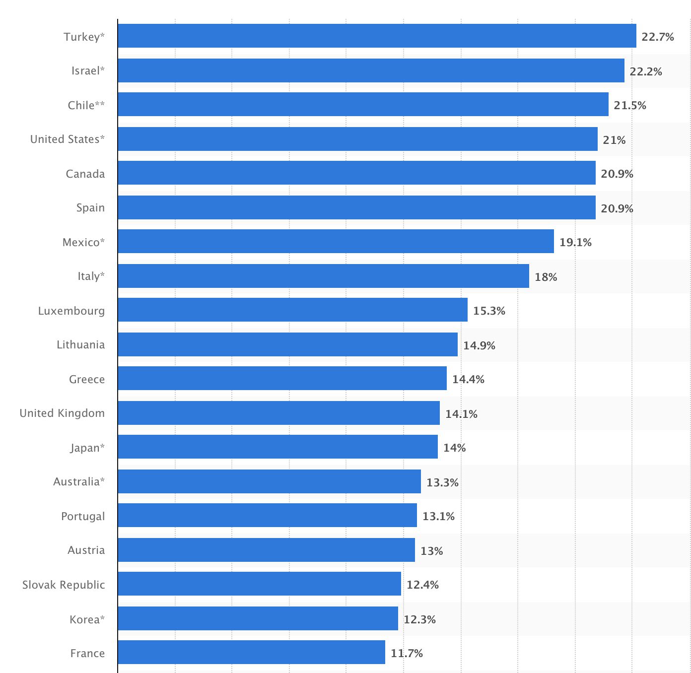
Proportion of children living in poverty in the Organisation of Economic Co-operation
Development (OECD) countries in 2019

Slide 16
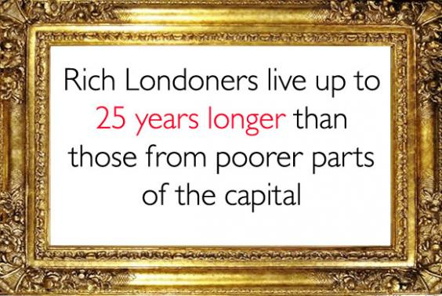

Slide 17
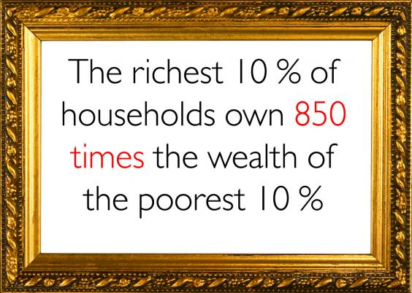

Slide 18
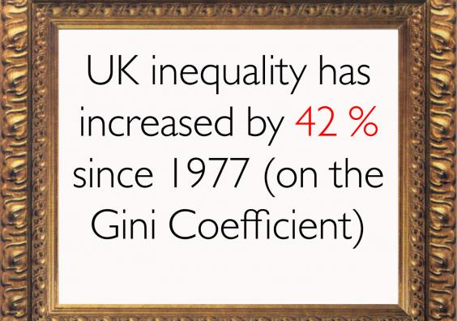

Slide 19
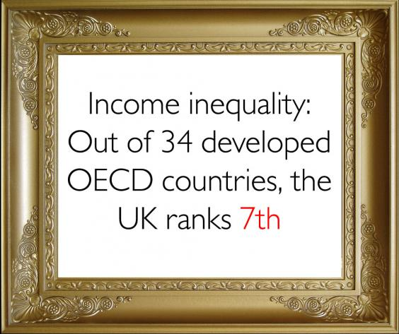

Slide 20
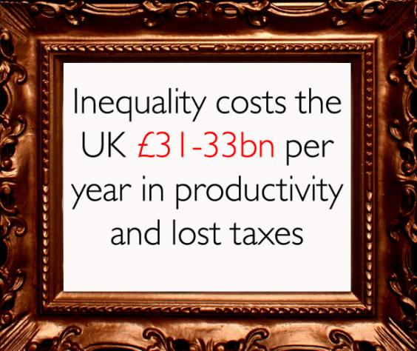

Slide 21
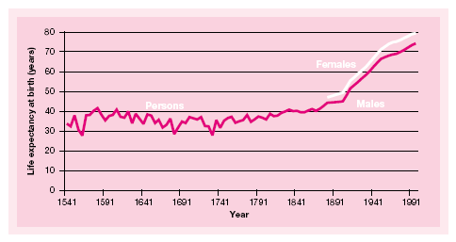
Life expectancy at birth: England 1541 - 1994

Slide 22
Despite rising life expectancy, inequalities remain
“In Manchester, boys can expect to live almost eight years fewer, and girls almost seven years fewer than their contemporaries in Kensington, Chelsea and Westminster”
  UK Government report, ‘Tackling Health Inequalities: 2002 Cross-Cutting Review’
The gap in life expectancy between men in Kensington & Chelsea and in Glasgow increased from 9.8 years in 1992-4 to 11.00 years in 2001-03
  Shaw, M., Smith G.D. & Dorling, D. (2005) Health inequalities and New Labour: how the promises compare with real progress. British Medical Journal, 330: 1016-1021

Slide 23
How successful has Government been in reducing health inequalities?
Social Class / Geography
The health gap between most affluent/most deprived areas in society is, if anything, widening. Since 1999, the average life expectancy among males in the poorest areas of Scotland has increased 1.4 years compared to 2.1 years for the rest of the country. For women the figures are 1.2 years and 1.6 years respectively.
Note: Scotland remains behind many of our European neighbours in terms of life expectancy.

Slide 24
Recent focus
Material factors – home environment, neighbourhood and workplace; income and living standards
Behavioural factors – routines and habits, including diet, exercise and smoking
Psychosocial factors – e.g. “perceiving oneself to be worse off relative to others may carry a health penalty, in terms of increased stress and risk-taking behaviour”
From Graham, H. Understanding Health Inequalities (2000: 14-15)

Slide 25
Individual lifestyle and behaviour
Policy has often focused on individual behaviour:
“The prime responsibility for improving the health of the public does not rest with the NHS nor with the Government, but with the public themselves. . .
“no government or doctor can make a person healthy on their own. Ultimately, that responsibility has to lie with the individual. Only they can make the choice to healthy lives, to change their lives for the benefit of themselves and their families.
John Reid, Secretary of State for Health, 3rd February 2004

Slide 26
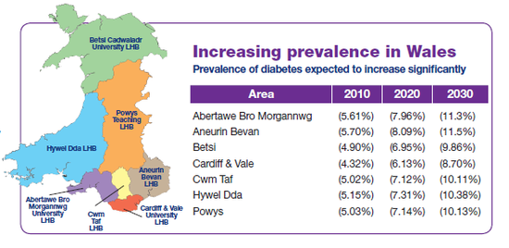
Diabetes

Slide 27
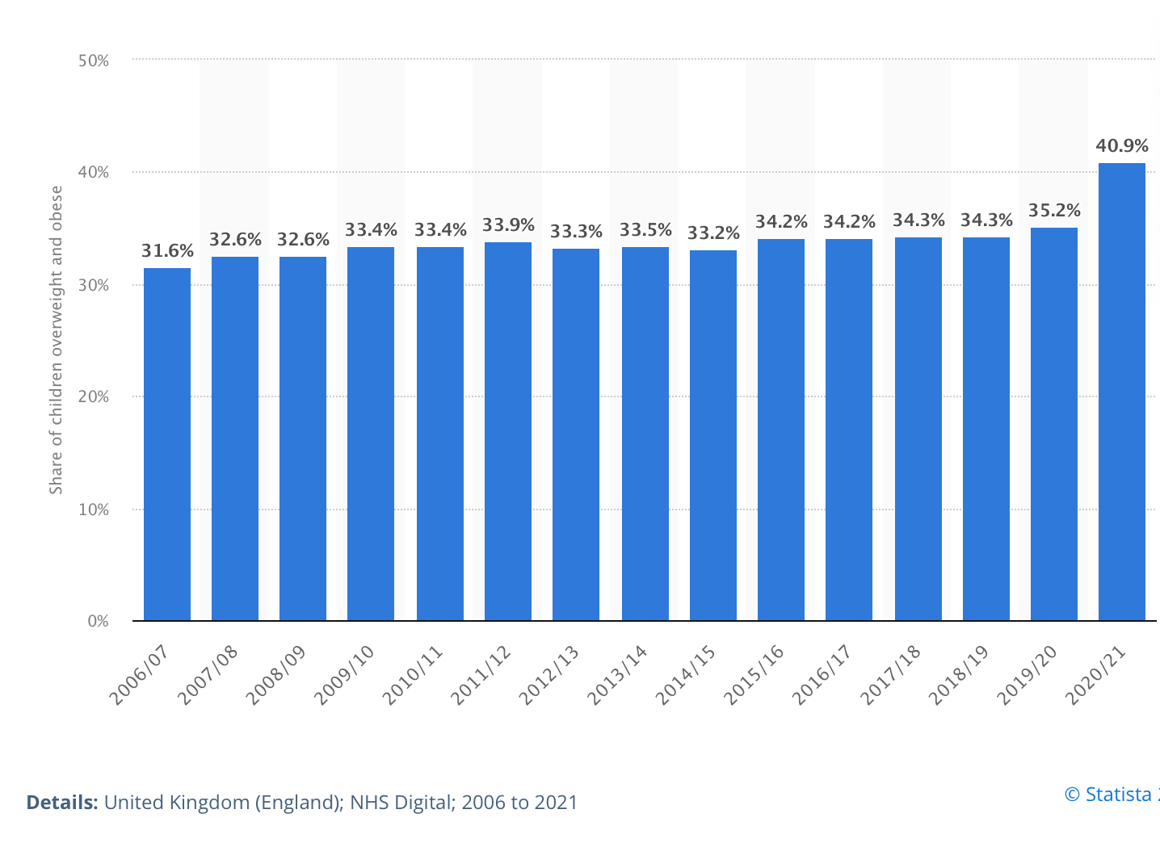
Share of children aged 10-11 years overweight and obese in England from 2006/07 to 2020/21
Source- NHS Digital, November 2021

Slide 28
Student Task
In 2 groups
Use whiteboard to create a mind map highlighting the factors that are contributing to childhood obesity
Present your findings back to the group

Slide 29
Task in pairs
How are we going to tackle the obesity crisis?
What type of project is needed?
Think- type of activity, target audience, content, parental engagement, facility, costing, how you will get the children there

Slide 30
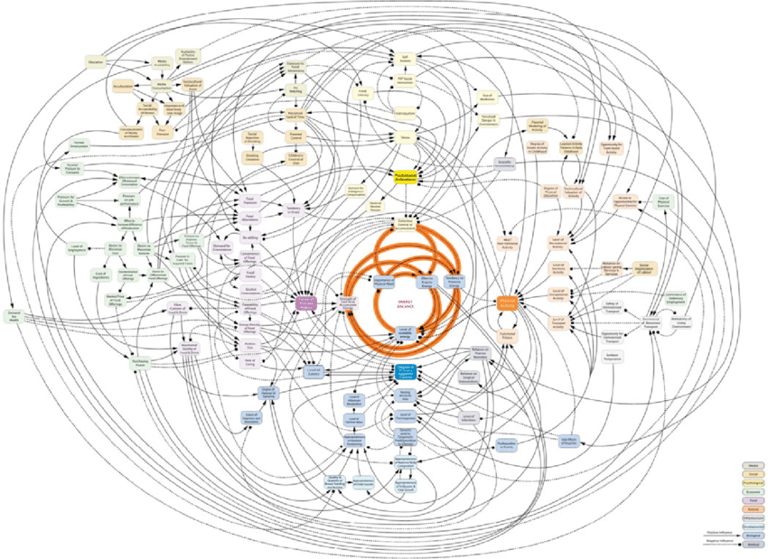
Obesity System Map
From Vandenbroeck et al. 2016

Slide 31
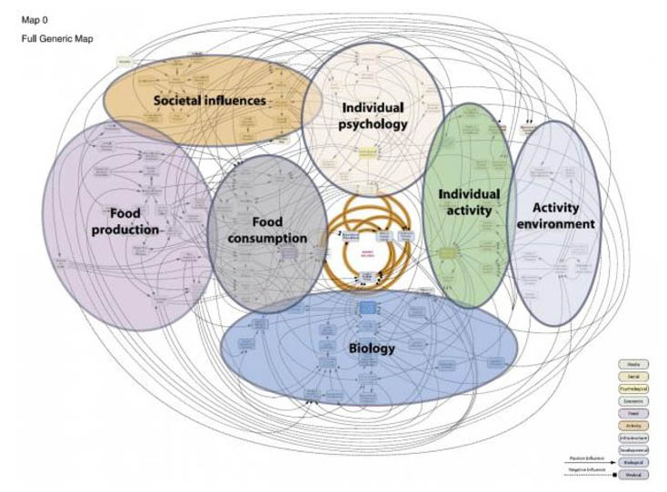
Obesity System Map

Slide 32

MEND

Slide 33
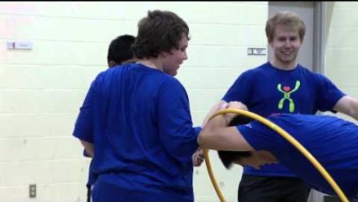
MEND
Notes:
https://www.youtube.com/watch?v=OjyiOhImGQg

Slide 34


Port Talbot MEND

Slide 35
Use the Moodle resource to read the report on the Mend project
Research Mind exercise nutrition do it on the online library. Find a report that evaluates the scheme
1
Make notes as you read through
2
Highlight the key findings
3
Share your findings with the group
4
If you do not understand please ask for help
5

Slide 36
Obesity programmes- Task for next week- 3 groups
What other programmes that target obesity can you find?
Present your programme to the group
Has it worked? What is the challenge?

