Slide 1
Master of Business Administration
LCMB7003 - Strategic Management
Lesson 5:
Competitive Rivalry and Competitive Dynamics
Notes:
Hwb - IT overview – YouTube
https://youtu.be/b7wLZZ33MCA

Slide 2
LEARNING OBJECTIVES
This session should provide you with the strategic management knowledge needed to:
Define competitors, competitive rivalry, competitive behavior, and competitive dynamics.
Describe market commonality and resource similarity as the building blocks of a competitor analysis.
Explain awareness, motivation, and ability as drivers of competitive behavior.
Describe how strategic actions and tactical actions drive competitive rivalry between firms.
Discuss factors affecting the likelihood a firm will take actions to attack or respond to its competitors.
Explain competitive dynamics in slow-cycle, fast-cycle, and standard-cycle markets.

Slide 3

Previous Week Recap Starter Activity - Discussion
What is business-level strategy?
What is corporate-level strategy?
What are the differences among the cost leadership. Differentiation, focused cost leadership, focused differentiation, and integrated cost leadership/differentiation business-level strategies?
How can firms use each of the business-level strategies to position themselves favourably relative to the five forces of competition?
How do firms create value when using a related diversification strategy?
What motives might encourage managers to over diversify their firm?

Slide 4
Introduction
Competitors are firms operating in the same market, offering similar products, and targeting similar customers.
Competitive rivalry is the ongoing set of competitive actions and competitive responses that occur among firms as they maneuver for an advantageous market position.
  The outcomes of competitive rivalry influence the firm’s:
    Ability to develop and then sustain its competitive advantages
    Level (average, below average, or above average) of financial returns
Competitive behavior is the set of competitive actions and responses a firm takes to build or defend its competitive advantages and to improve its market position.
Multimarket competition occurs when firms compete against each other in several product or geographic markets.
Competitive dynamics is the total set of competitive actions and responses taken by all firms competing within a market.

Slide 5
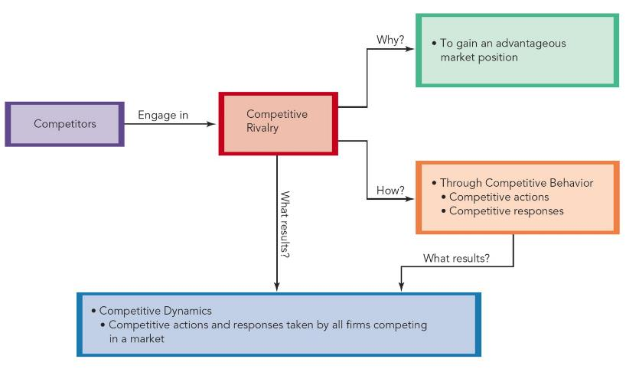
Figure 5.1 - From Competition to Competitive Dynamics

Slide 6
Strategy Success
A strategy’s success is a function of:
  The firm’s initial competitive actions
  How well the firm anticipates competitors’ responses to them
  How well the firm anticipates and responds to its competitors’ initial actions
  Competitive rivalry affects all types of strategies, but its dominant influence is on business-level strategy.

Slide 7

Group Activity – Rivalry Brainstorm (5 mins)
Activity 1.1
  List firms in a familiar industry (e.g., smartphones). Discuss which are competitors and why. Reference Figure 5.1.

Slide 8
A Model of Competitive Rivalry
Competitive rivalry evolves from the pattern of actions and responses as one firm’s competitive actions have noticeable effects on competitors, eliciting competitive responses from them.
  This pattern suggests that:
    Firms are mutually interdependent.
    Competitors’ actions and responses affect them.
    Marketplace success is a function of both:
      Individual strategies
      The consequences of their use

Slide 9
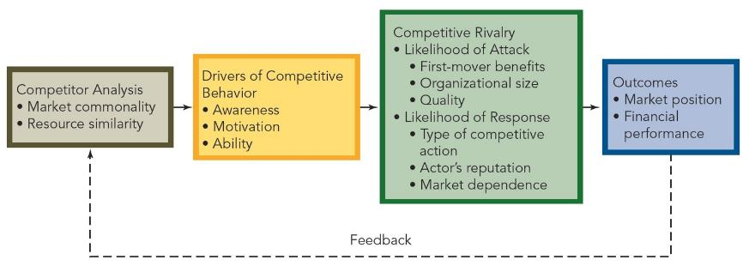
A Model of Competitive Rivalry

Slide 10
Competitor Analysis
A competitor analysis is the first step the firm takes to be able to predict its competitors’ actions and responses.
Competitor analysis is a technique firms use to understand their competitive environment by studying competitors’:
  Future objectives
  Current strategies
  Assumptions
  Capabilities
Once firms understand their competitors, they can use competitor analysis to predict competitors’ behavior in the form of their competitive actions and responses.
  Being able to predict rivals’ likely competitive actions and responses accurately helps a firm avoid competitive blind spots—situations in which it is unaware of competitors’ objectives, strategies, assumptions, and capabilities.

Slide 11
Competitor Analysis
To complete a competitor analysis, firms study:
  Market commonality
  Resource similarity
In general, the greater the market commonality and resource similarity, the more firms acknowledge that they are direct competitors.

Slide 12
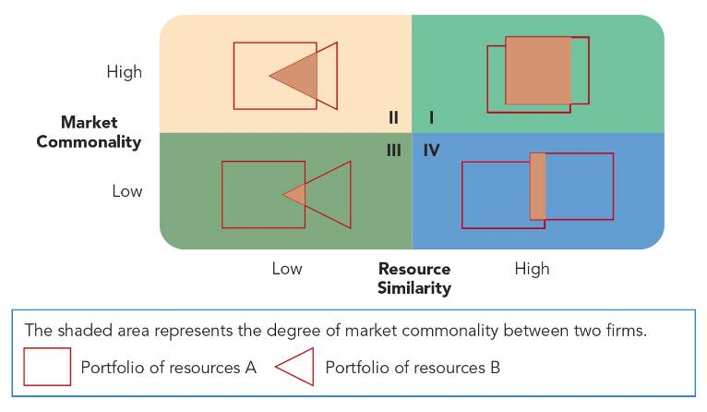
A Framework of Competitor Analysis

Slide 13
Market Commonality
Market commonality is concerned with the number of markets with which the firm and a competitor are jointly involved and the degree of importance of the individual markets to each.
Firms competing against one another in several markets engage in multimarket competition.
  In general, multimarket competition reduces competitive rivalry, but some firms will still compete when the potential rewards (e.g., potential market share gain) are high.

Slide 14
Resource Similarity
Resource similarity is the extent to which the firm’s tangible and intangible resources compare favorably to a competitor’s in terms of type and amount.
Firms with similar types and amounts of resources tend to:
  Have similar strengths and weaknesses
  Use similar strategies in light of their strengths to pursue what may be similar opportunities in the external environment

Slide 15

Activity 1.2 – Competitor Mapping (10 Mins)
  In pairs, students pick two firms (e.g., Nike vs. Adidas). Plot them on a 2x2 grid (high/low market commonality vs. resource similarity). Discuss rivalry intensity.

Slide 16
Drivers of Competitive Behavior
Market commonality and resource similarity shape the firm’s:
  Awareness
  Motivation
  Ability
Awareness refers to the extent to which competitors recognize the degree of their mutual interdependence.
  Awareness tends to be greatest when firms have highly similar resources (in terms of types and amounts) to use when competing against each other in multiple markets.
Motivation concerns the firm’s incentive to take action or to respond to a competitor’s attack.
  A firm may not be motivated to engage in competitive rivalry if it perceives that its market position will neither improve nor suffer if it does not respond.
Ability refers to the quality of the resources available to the firm to attack and respond.
  Without available resources (such as financial capital and people), the firm is not able to attack a competitor or respond to its action.

Slide 17
Drivers of Competitive Behavior
Resource dissimilarity also influences the competitive actions and responses firms choose to take.
  The more significant the difference between resources, the longer is the delay by the firm with a resource disadvantage.
Even when facing competitors with greater resources or more attractive market positions, firms should eventually respond, no matter how daunting the task seems.
  Choosing not to respond can ultimately result in failure.

Slide 18
Competitive Rivalry
The ongoing competitive action / response sequence between a firm and a competitor affects the performance of both companies.
  Thus, it is important for companies to carefully analyze and understand the competitive rivalry present in the markets in which they compete.

Slide 19
Activity 1.3 – Scenario Analysis (10 Mins)
Groups analyze a scenario (e.g., Tesla entering battery storage). Identify one driver (awareness, motivation, ability) inducing a competitor’s response. Share findings.

Slide 20
Strategic and Tactical Actions
Firms use both strategic and tactical actions when forming their competitive actions and competitive responses in the course of engaging in competitive rivalry.
  A strategic action or a strategic response is a market-based move that involves a significant commitment of organizational resources and is difficult to implement and reverse.
  A tactical action or a tactical response is a market-based move that firms take to fine-tune a strategy; these actions and responses involve fewer resources and are relatively easy to implement and reverse.
  A competitive action is a strategic or tactical action the firm takes to build or defend its competitive advantages or improve its market position.
  A competitive response is a strategic or tactical action the firm takes to counter the effects of a competitor’s competitive action.

Slide 21
Likelihood of Attack
In addition to market commonality, resource similarity, and the drivers of awareness, motivation, and ability, three more specific factors affect the likelihood a competitor will take competitive actions:
  First-mover benefits
  Organizational size
  Quality

Slide 22
First-Mover Benefits
A first mover is a firm that takes an initial competitive action to build or defend its competitive advantages or to improve its market position.
First movers emphasize research and development (R & D) as a path to developing innovative products that customers will value.
First-mover benefits are often critical to a firm’s success in industries:
  Experiencing rapid technological developments
  With relatively short product life cycles
In addition to earning above-average returns until its competitors respond to its successful competitive action, the first mover can gain:
  The loyalty of customers
  Market share

Slide 23
First-Mover Benefits
First movers tend to:
  Be aggressive
  Be willing to experiment with innovation
  Take higher yet reasonable levels of risk
To be a first mover, the firm must have the readily available resources to:
  Invest significantly in R & D
  Rapidly and successfully produce and market a stream of innovative products
Organizational slack makes it possible for firms to have the ability to be first movers.
  Slack is the buffer provided by actual or obtainable resources not in use currently and that exceed the minimum resources needed to produce a given level of organizational output.

Slide 24
First-Mover Benefits
A second mover is a firm that responds to the first mover’s competitive action, typically through imitation.
The second mover:
  Studies customers’ reactions to product innovations
  Tries to find any mistakes the first mover made so that it can avoid them and the problems they created
  Has the time to develop processes and technologies that:
    Are more efficient than those the first mover used
    Create additional value for consumers
    The most successful second movers can interpret market feedback with precision in order to respond quickly yet successfully to first movers’ successful innovations.

Slide 25
First-Mover Benefits
A late mover is a firm that responds to a competitive action a significant amount of time after the first mover’s action and the second mover’s response.
Late movers:
  Achieve considerably less success than do first and second movers
  Require considerable time to understand how to create at least as much customer value as that offered by the first and second movers’ products
    Thus, late movers typically only earn average returns.

Slide 26
Activity 1.4 – Response Prediction (10 Mins)
Groups pick a firm’s action (e.g., Aldi’s U.S. expansion). Predict competitor response based on one factor (action type, reputation, dependence). Share with class.

Slide 27


Slide 28
Organizational Size
An organization’s size affects the likelihood it will take competitive actions as well as the types and timing of those actions.
  Small firms:
    Are more likely to launch competitive actions
    Tend to launch competitive actions more quickly
    Have the capacity to be nimble and flexible competitors
    Tend to rely on speed and surprise to defend their competitive advantages
    Develop variety in their competitive actions
  Large firms typically have a greater number of slack resources that allows them to initiate a larger total number of competitive actions and strategic actions during a given period.

Slide 29
Quality
Quality exists when the firm’s products meet or exceed customers’ expectations.
Customers:
  Perceive quality as doing the right things relative to performance measures that are important to them
  Measure the quality of products against a broad range of dimensions
  Will not buy a product or use a service until they believe it can satisfy at least their base-level expectations in terms of quality dimensions that are important to them
Quality is a base denominator for:
  Competing successfully in the global economy
  Achieving competitive parity, at a minimum
  Quality is a necessary but insufficient condition for achieving an advantage.

Slide 30
Quality Dimensions of Products and Services
Product Quality Dimensions
1. Performance—Operating characteristics 2. Features—Important special characteristics 3. Flexibility—Meeting operating specifications over some period of time 4. Durability—Amount of use before performance deteriorates 5. Conformance—Match with pre-established standards 6. Serviceability—Ease and speed of repair 7. Aesthetics—How a product looks and feels 8. Perceived quality—Subjective assessment of characteristics (product image)
Service Quality Dimensions
1. Timeliness—Performed in the promised period of time 2. Courtesy—Performed cheerfully 3. Consistency—Giving all customers similar experiences each time 4. Convenience—Accessibility to customers 5. Completeness—Fully serviced, as required 6. Accuracy—Performed correctly each time
Source: Adapted from J. Evans, 2008, Managing for Quality and Performance, 7th Ed., Mason, OH: Thomson Publishing.

Slide 31
Likelihood of Response
In general, a firm is likely to respond to a competitor’s action when either:
  The action leads to better use of the competitor’s capabilities to develop a stronger competitive advantage or an improvement in its market position.
  The action damages the firm’s ability to use its core competencies to create or maintain an advantage.
  The firm’s market position becomes harder to defend.
In addition to market commonality, resource similarity, and awareness, motivation, and ability, firms evaluate three other factors to predict how a competitor is likely to respond to competitive actions:
  Type of competitive action
  Actor’s reputation
  Market dependence

Slide 32
Type of Competitive Action
In general, the number of tactical responses firms take exceed the number of strategic responses they take.
  This is because:
    Strategic responses involve a significant commitment of resources.
    Strategic responses are difficult to implement and reverse.
    The time needed to implement a strategic action and to assess its effectiveness can delay the competitor’s response to that action.

Slide 33
Actor’s Reputation
An actor is the firm taking an action or a response.
Reputation is the positive or negative attribute ascribed by one rival to another based on past competitive behavior.
Competitors respond more frequently to the actions taken by the firm with a reputation for predictable and understandable competitive behavior, especially if that firm is a market leader.

Slide 34
Market Dependence
Market dependence denotes the extent to which a firm derives its revenues or profits from a particular market.
In general, competitors with high market dependence are likely to respond strongly to attacks threatening their market position.

Slide 35
Competitive Dynamics
Whereas competitive rivalry concerns the ongoing actions and responses between a firm and its direct competitors for an advantageous market position, competitive dynamics concerns the ongoing actions and responses among all firms competing within a market for advantageous positions.
Competitive dynamics differ in slow-, fast-, and standard-cycle markets.
  The sustainability of the firm’s competitive advantages differs by market type.

Slide 36
Slow-Cycle Markets
Slow-cycle markets are markets in which competitors lack the ability to imitate the focal firm’s competitive advantages that commonly last for long periods, and where imitation would be costly.
In a slow-cycle market:
  Firms may be able to sustain a competitive advantage over longer periods.
  Building a unique and proprietary capability produces a competitive advantage and success.
    Examples: Copyrights and patents
    The competitive actions and responses a firm takes are oriented to protecting, maintaining, and extending that advantage.
    Major strategic actions usually carry less risk.
In slow-cycle markets, the competitive advantage generated by a firm gradually erodes over time.
  The firm launches a product it developed through a proprietary advantage.
  It then exploits that advantage for as long as possible while the product’s uniqueness shields it from competition.
  Eventually, competitors respond to the action with a counterattack.

Slide 37
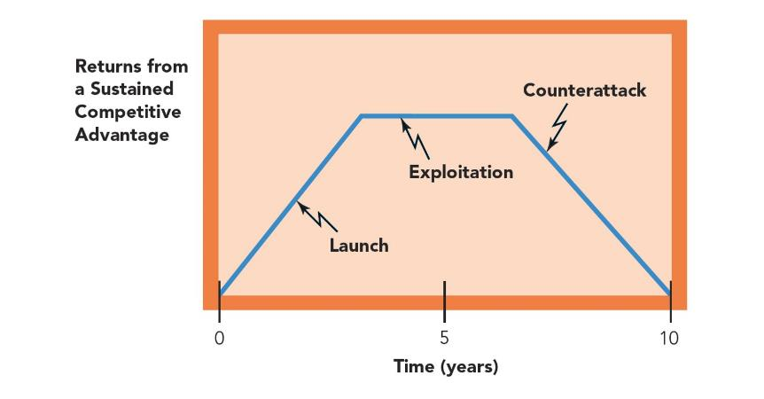
Figure 5.4 - Gradual Erosion of a Sustained Competitive Advantage

Slide 38
Fast-Cycle Markets
Fast-cycle markets are markets in which competitors can imitate the focal firm’s capabilities that contribute to its competitive advantages and where that imitation is often rapid and inexpensive.
In a fast-cycle market:
  Competitive advantages are not sustainable.
  The velocity of change places considerable pressure on top-level managers to make quick and effective strategic decisions.
  Reverse engineering is often used to gain quick access to the knowledge required to imitate or improve the firm’s products.
  Technology diffuses rapidly.
  The technology firms use often is not proprietary.
  Companies focus on forming the capabilities and core competencies that will allow them to develop new competitive advantages continuously and rapidly.

Slide 39
Fast-Cycle Markets
In fast-cycle markets, competition is substantial as firms concentrate on developing a series of temporary competitive advantages.
  The firm launches a product to achieve a competitive advantage.
  It then exploits that advantage for as long as possible.
  It also tries to develop another competitive advantage before competitors can respond to the first one.

Slide 40
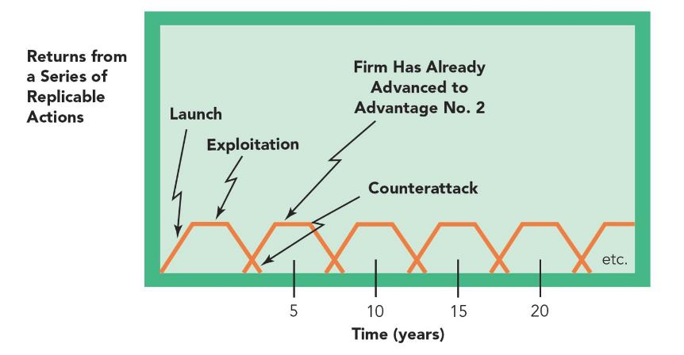
Figure 5.5 - Developing Temporary Advantages to Create Sustained Advantage

Slide 41
Standard-Cycle Markets
Standard-cycle markets are markets in which some competitors may be able to imitate the focal firm’s competitive advantages and where that imitation is moderately costly.
In a standard-cycle market:
  Competitive advantages are partially sustainable but only if the firm can upgrade the quality of its capabilities continuously.
  The capabilities and core competencies in which firms base their competitive advantages are less specialized.
  Imitation is faster and less costly than in slow-cycle markets.
  Imitation is slower and more expensive than in fast-cycle markets.
  Both incremental and radical innovations are critical to firms’ efforts to achieve strategic competitiveness.

Slide 42
Standard-Cycle Markets
Firms imitate competitive actions and responses in standard-cycle markets to:
  Seek large market shares
  Gain customer loyalty through brand names
  Control a firm’s operations carefully
  The competition for market share is intense in standard-cycle markets because of:
  Large volumes
  The size of mass markets
  The need to develop scale economies

Slide 43
Activity 1.5 – Market Type Match (10 Mins)
  Provide industries (e.g., luxury watches, smartphones, detergents). In pairs, classify as slow-, fast-, or standard-cycle and explain. Discuss using Figures 5.4-5.5.

Slide 44

Exit Quiz
  Please complete the week 5 quiz on Moodle:
Notes:
Collaboration between leaders and followers: Leadership is centered on the communication between leaders and followers rather than on the unique qualities of the leader. Thought of as a relationship, leadership becomes a process of collaboration that occurs between leaders and followers.
Interactive event: Leadership is not a linear one-way event, but rather an interactive event. In traditional leadership, authority is often top down; in the interactive type of leadership, authority and influence are shared. It is not restricted to the formally designated leader in a group.
Ethical overtone of including followers’ interests: Thinking of leadership as a relationship suggests that leaders must include followers and their interests in the process of leadership. This approach has an ethical overtone because it stresses the need for leaders to work with followers to achieve their mutual purposes. Stressing mutuality lessens the possibility that leaders might act toward followers in ways that are forced or unethical.

Slide 45
References
Essential:
Hitt, M. A., Ireland, R. D. and Hoskisson, R. E. (2019, Ch. 5) Strategic Management: Competitiveness & Globalization: Concepts & Cases. Cengage learning.
David F. R., David, F. R and David, M. E.(2017). Strategic Management: Concepts and Cases: A Competitive Advantage Approach. Pearson
Further reading:
Johnson, G and Schole, K. (2010). Exploring Strategy. Harlow: FT Prentice Hall.
Lynch, R., Corporate Strategy, Harlow: FT Prentice Hall, 2010.
Mintzberg, H., Ahlstrand, B., and Lampel, J. (2008). Strategy Safari: The Complete Guide Through the Wilds of Strategic Management. Harlow: FT Prentice Hall, 2008.
Hayes, J., (2010). The Theory and Practice of Change Management. Palgrave

Slide 46
Notes:
Please make sure you take a note of the contact details on the screen
Q&A

