Slide 1
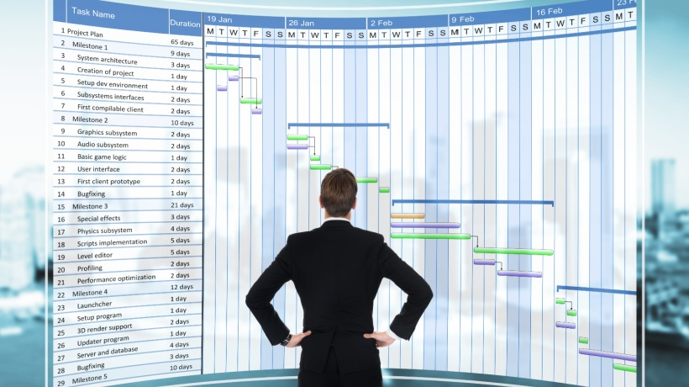
18/02/2025
ACNA5000:
Lecture 15: Project Risk Management
Dr Alisdair Cunningham
Senior Lecturer
2024 / 2025
18/02/2025
Slide 1 / 19

Slide 2
Module ACNA5000: 2024 / 2025 Lecture contents
18/02/2025
This lecture will contain the following:
Slide(s) | Topic
3 | Recap
4 | Sources of Change
5 | Proactive vs Reactive
6 | Timing
7 | Risk Identification
8 – 9 | Risk Register
10 | Risk Matrix
11 | Risk Register – Matrix
12 | Risk Matrix Scenario Exercise
13 – 14 | Mitigation
15 | Live document
16 | Summary
17 | Next Session
18 | Assignment guidance
A. Cunningham Lecture 15: Project Risk Management
Slide 2 / 19

Slide 3
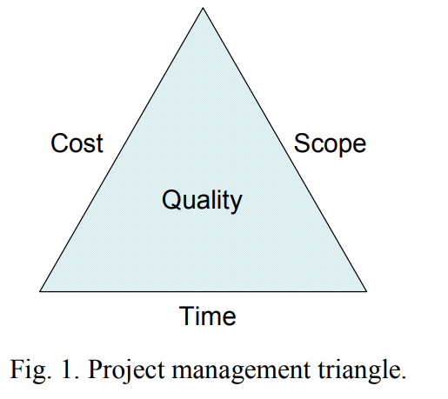
Module ACNA5000: 2024 / 2025 Recap
18/02/2025
In previous lectures we have covered:
That all projects are susceptible to change, in face the management of change is the reason behind the role of project manager.
The success of a project is determined by the ability to keep it within time, budget, and scope (the project management triangle)
Source: Van Wyngaard, C.J., Pretorius, J.H.C. and Pretorius, L., 2012
A. Cunningham Lecture 15: Project Risk Management
Slide 3 / 19
Notes:
Van Wyngaard, C.J., Pretorius, J.H.C. and Pretorius, L., 2012, December. Theory of the triple constraint—A conceptual review. In 2012 IEEE International Conference on Industrial Engineering and Engineering Management (pp. 1991-1997). IEEE.

Slide 4
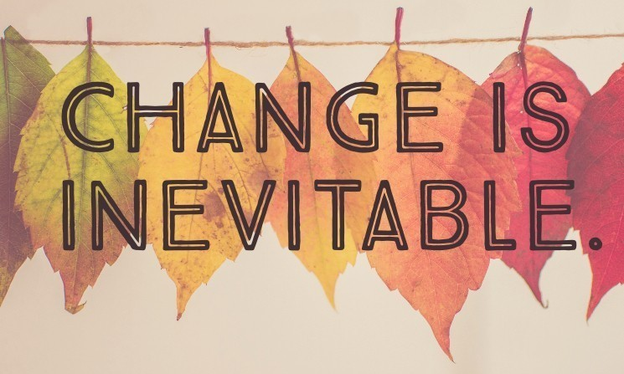
Module ACNA5000: 2024 / 2025 Sources of Change
18/02/2025
Remember: The role of the Project Manager is to manage the many changing variables to ensure project success
Change can come from many sources:
Environment
Software / hardware
Logistics
Extreme events
Resources
Budgets / expenses
Availability
Customer
change their mind on the requirement
have a different expectation from the one understood
Team
Sickness
Availability
Circumstances
Skill-base
Contractors / suppliers
Availability
Costs
Resources
A. Cunningham Lecture 15: Project Risk Management
Slide 4 / 19

Slide 5
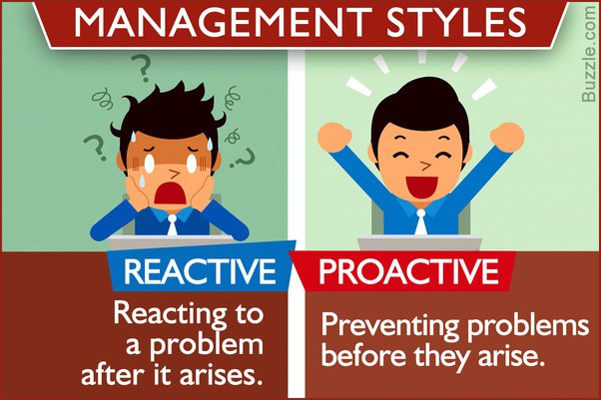
Module ACNA5000: 2024 / 2025 Proactive vs Reactive
18/02/2025
If change is inevitable, then risk is embedded in every project before it starts
Thinking this was is not negative, because ultimately a project
manager has two choices:
Reactive management
  dealing with the outcome after it has happened
  The damage / issue has already taken place
  Work can be done to resolve or mitigate, but this may further affect the project success e.g. more funds / resources / time / different outcome than scoped
  Ultimately, this method is more costly overall and can result in a failed project
Proactive management
  Investing effort into reducing the likelihood of a known potential issue before it happens
  It requires less resources that the reactive clean-up, and can be included in the initial project proposal e.g. accounted for in budget and resources (items and time)
A. Cunningham Lecture 15: Project Risk Management
Slide 5 / 19

Slide 6
Module ACNA5000: 2024 / 2025 Timing
18/02/2025
If the aim is to identify risks before they happen, then a good project manager accounts for risk in the planning stage
This way:
The Time Management Plan can incorporate edits to mitigate against issues – add buffer / padding to critical paths
The project costing (Budget Management Plan) can account for the potential use of resources or man-hours to resolve potential issues – the added benefit being that if no issues occur, the project comes in under-budget
Additional Roles and Responsibilities can be assigned to monitor for the potential issues
The customer confidence increases – their project brief has a higher chance of success
A. Cunningham Lecture 15: Project Risk Management
Slide 6 / 19

Slide 7
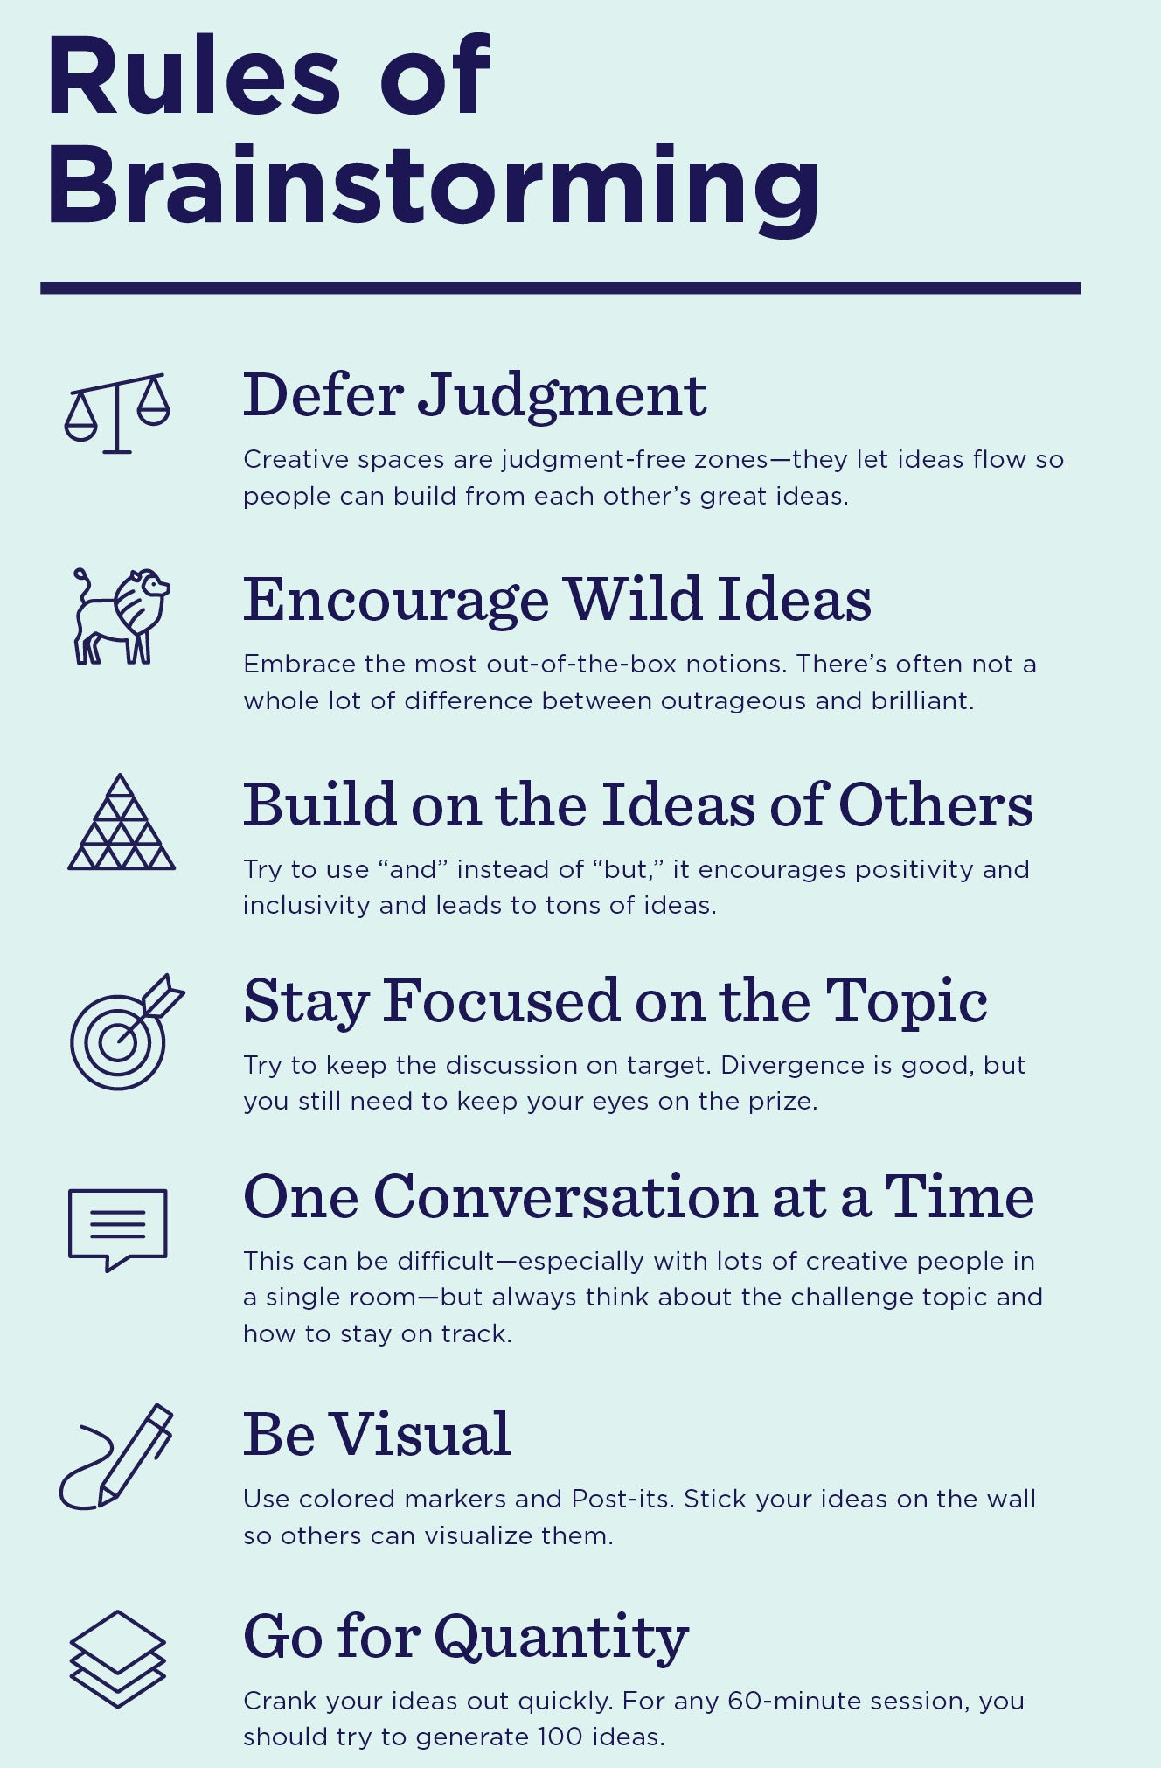
Module ACNA5000: 2024 / 2025 Risk Identification
18/02/2025
Question: If the risk of change is inevitable, but they need to be determined / identified during planning stage, what processes / actions can you take as PM to do so?
A number of strategies can be employed, typically these four are used:
Brain-storming
  Working within the team, with the customer, or with stakeholders, discuss your project and work through various scenarios to understand all the internal processes and potential conditions for risk to occur
Interviews
  Formulate a series of questions for your team to get them thinking about potential risk
Previous projects
  Review historic projects, as there may be examples of issues which could occur in your project
Project Life cycle evaluation
  Theorise each aspect of the project from beginning to end and ask questions on what could go wrong.
A. Cunningham Lecture 15: Project Risk Management
Slide 7 / 19

Slide 8
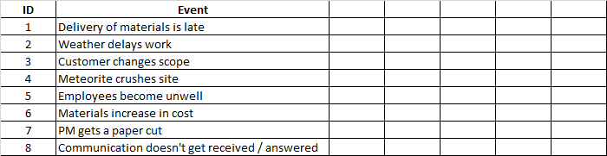
Module ACNA5000: 2024 / 2025 Risk Register
18/02/2025
This process should identify a number of potential risks.
This list needs to be documented – and this document made accessible by the team
Example documentation (table) of potential risks
Question: The potential risks have been identified in advance, listed, documented, and communicated…so what now…is the process complete?
A. Cunningham Lecture 15: Project Risk Management
Slide 8 / 19

Slide 9
Module ACNA5000: 2024 / 2025 Risk Register
18/02/2025
Listing the risks is just the starting point, but essential for the subsequent steps
Activity: Review the list of potential events in the below table – describe their potential to influence the project
A list is a starting point, but no two risks are the same in either potential likelihood or severity.
Risk evaluation is required to order and prioritise risks – turn qualitative assessment into quantitative evaluation
A. Cunningham Lecture 15: Project Risk Management
Slide 9 / 19

Slide 10
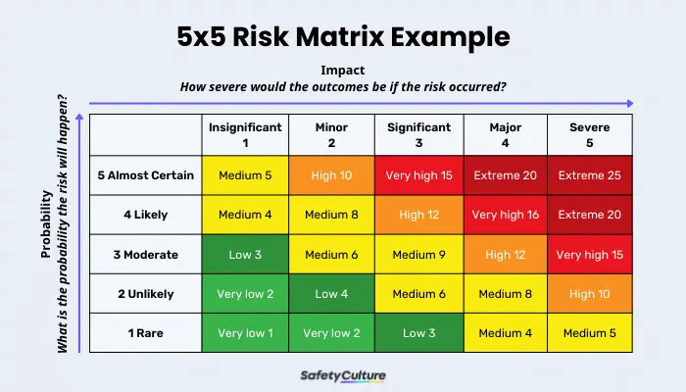
Module ACNA5000: 2024 / 2025 Risk Matrix
18/02/2025
A risk matrix can be used to quantify the relative variations in potential risk to the project
By assessing the Probability and the Impact, the final risk score can be calculated
A. Cunningham Lecture 15: Project Risk Management
Slide 10 / 19

Slide 11
Module ACNA5000: 2024 / 2025 Risk Register - Matrix
18/02/2025
Now that the risk scores have been calculated, the PM can document these:
With real quantitative values to compare, the list can be reprioritised:
Now the team (including PM) know the greatest potential risks!
A. Cunningham Lecture 15: Project Risk Management
Slide 11 / 19

Slide 12
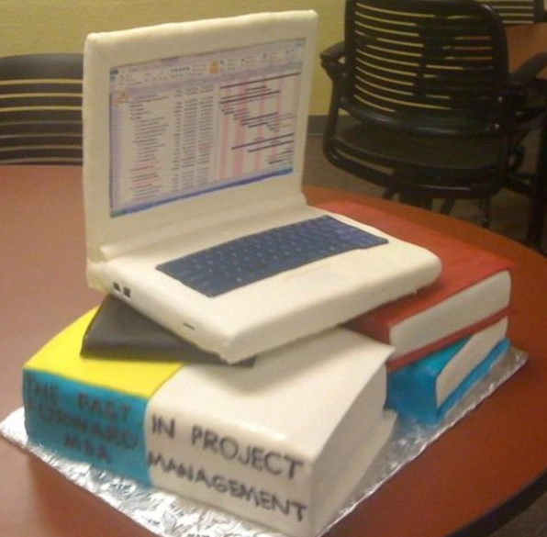


Module ACNA5000: 2024 / 2025 Risk Matrix Scenario Exercise
20/03/2024
Either, using the scenario of a cooked breakfast or making a celebration cake:
ACTIVITY: In groups, evaluate the potential risks
1. Brainstorm the potential risks
2. Document them
3. Evaluate likelihood and impact
4. Produce a prioritised risk register
A. Cunningham Lecture 15: Project Risk Management
Slide 12 / 19

Slide 13
Module ACNA5000: 2024 / 2025 Mitigation
18/02/2025
Demonstrating the identification, evaluation, and prioritisation of the potential risks is a good start
Through documentation and communication with the customer / stakeholder, can build confidence.
However, it is the first half of the process.
Ultimately, it evidences to all stakeholders that you are responsible, and you are aware of potential risks
QUESTION: Does this proactively stop them happening?
Imagine the previous scenarios, what would you do next?
A. Cunningham Lecture 15: Project Risk Management
Slide 13 / 19

Slide 14
Module ACNA5000: 2024 / 2025 Mitigation
18/02/2025
In order to manage risks, the PM needs to put into planning a process for how to mitigate them
Prevention - where events can be prevented from happening
Impact reduction – where events are inevitable
The second part of the process is to identify the best response and assign responsibility to monitor and manage the event if it occurs.
The team need to be aware of their responsibility to manage tasks / processes to known avoid issues occurring
Therefore, the Risk Register needs to be updated and communicated
A. Cunningham Lecture 15: Project Risk Management
Slide 14 / 19

Slide 15
Module ACNA5000: 2024 / 2025 Live document
18/02/2025
Communicate this Risk Register internally and externally so everyone is aware of their responsibility.
Most importantly, remember this process is not complete for as long as the project is running.
All staff should regularly review risks and communicate any further risks / changes to existing risks.
The document can be updated, and communicated either routinely or after each edit.
A. Cunningham Lecture 15: Project Risk Management
Slide 15 / 19

Slide 16
Module ACNA5000: 2024 / 2025 Summary
18/02/2025
In this lecture we covered:
  The inevitability and sources of change (and therefore, risk)
  The need for being proactive as opposed to reactive
  Methods for identifying potential risks
  The use of a Risk Register to calculate risk scores and prioritise risks
  The need to assign roles and responsibilities to mitigate against known risks
  The need to communicate risks and keep the review live
A. Cunningham Lecture 15: Project Risk Management
Slide 16 / 19

Slide 17
Module ACNA5000: 2024 / 2025 Next Session
18/02/2025
The next lecture will cover:
Report Writing
Suggested activities:
  Begin to assess the potential risks in your theoretical project design
  Visit the Association of Project Managers website
  (APM | Chartered Membership Organisation.: https://www.apm.org.uk/)
Suggested reading:
  Lock, D., 2020. Project management. Routledge.
  (Accessible online: http://103.62.146.201:8081/xmlui/bitstream/handle/1/6080/project%20management.pdf?sequence=1&isAllowed=y)
A. Cunningham Lecture 15: Project Risk Management
Slide 17 / 19

Slide 18
Module ACNA5000: 2024 / 2025 Assignment guidance
18/02/2025
For your assignment, you are expected to write a project proposal.
Please note:
You are not expected to carry out the actual project for your assignment!
Consider the projects to be ‘fictional’ – the settings and motivations are real, but a real project will not depend on the outcome of your assignment, these are just real-world environmental projects that are being used to allow you to apply your knowledge.
The purpose of this assignment is to demonstrate your understanding of the PM role, and what is required in the planning stage (and throughout the project) to optimise a theoretical successful project
A. Cunningham Lecture 15: Project Risk Management
Slide 18 / 19

Slide 19
Module ACNA5000: 2024 / 2025 Questions
18/02/2025
Any questions?
Please contact via:
Email: a.cunningham@uwtsd.ac.uk
Teams: “ACNA5000_Changemakers_2024_25_GRP”
A. Cunningham Lecture 15: Project Risk Management
Slide 19 / 19

