Slide 1
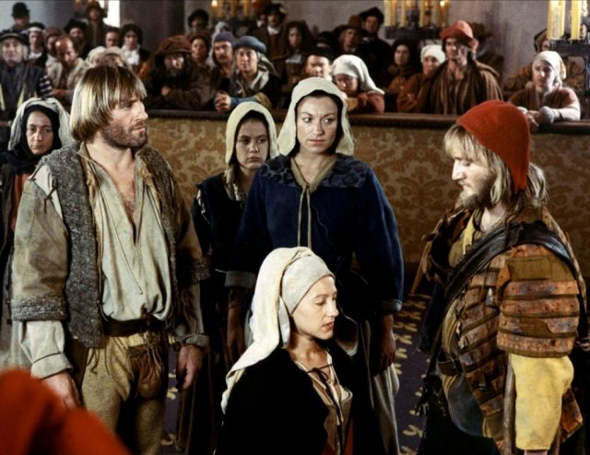
'A New Way to Tell about the Past': Big Screen Microhistory in The Return of Martin Guerre

Slide 2
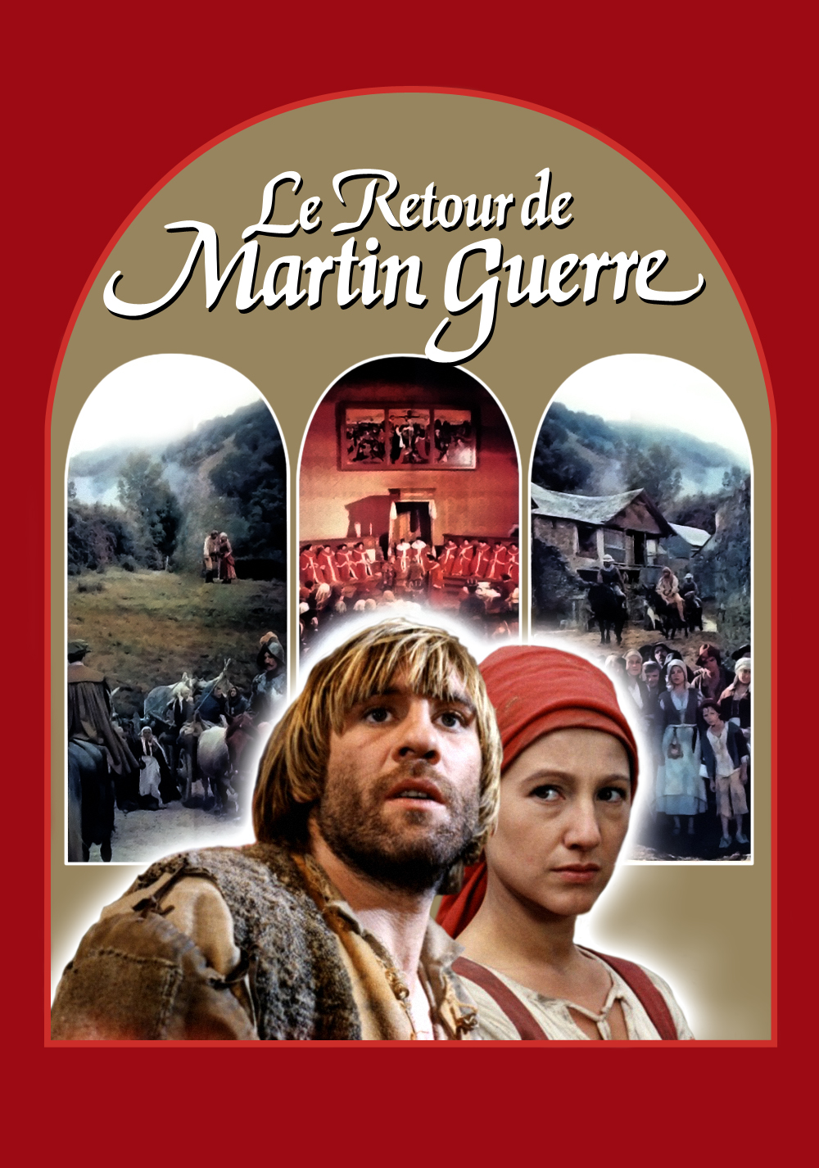
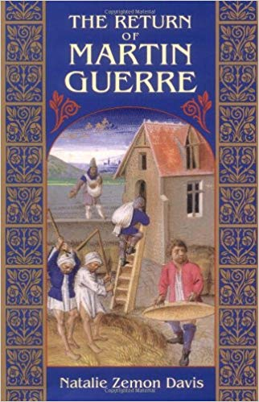

Slide 3
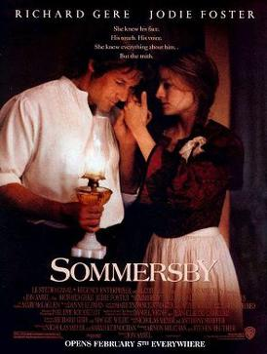

Slide 4
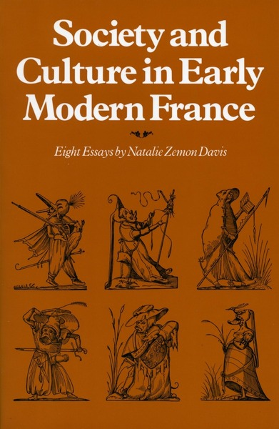
Natalie Zemon Davis: pre-Martin Guerre
Society and Culture in Early Modern France: Eight Essays (1975)
‘Women's History in Transition: the European Case’ (1975)
‘Ghosts, Kin, and Progeny: Some Features of Family Life in Early Modern France’ (1977)
‘Gender and Genre: Women as Historical Writers, 1400–1820’ (1980)
‘Anthropology and History in the 1980s: the Possibilities of the Past’ (1981)
‘The Sacred and the Body Social in 16th-century Lyon’ (1981)
‘Women in the Crafts in Sixteenth-century Lyon’ (1982)
‘Beyond the Market: Books as Gifts in Sixteenth-century France’ (1983)

Slide 5
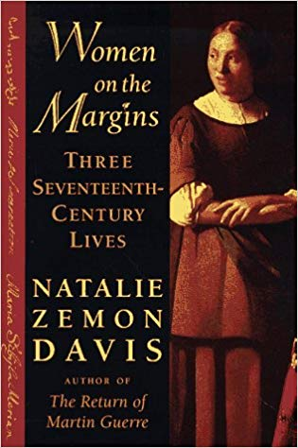
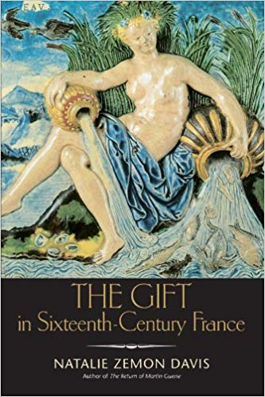
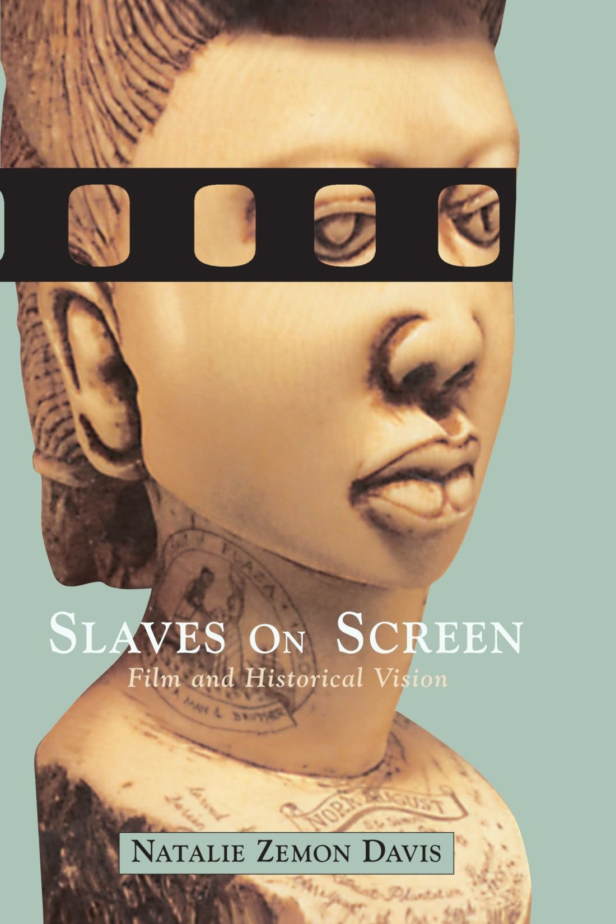
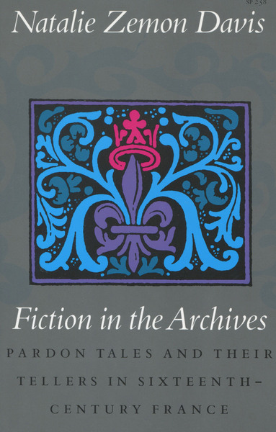
Natalie Zemon Davis: post-Martin Guerre

Slide 6

What is microhistory?

Slide 7
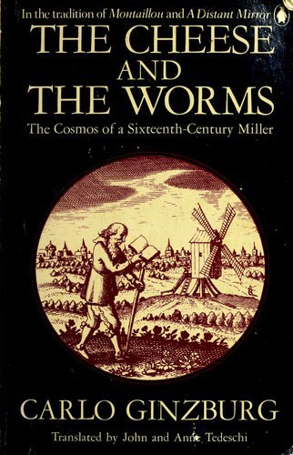
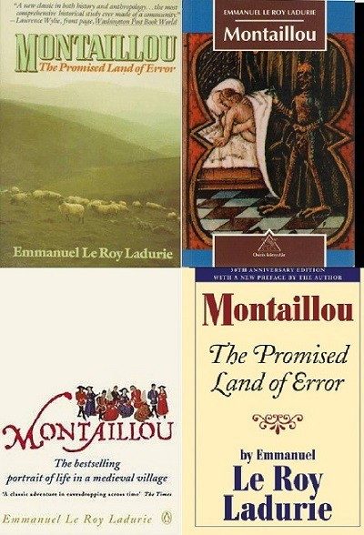
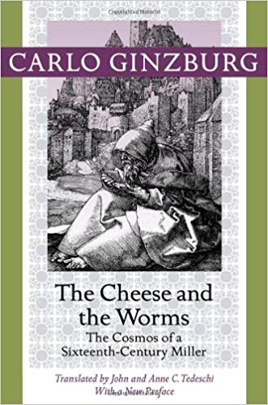
Microhistory
Part of movement towards social history
Influence of Annales School
Reaction against existing macrohistorical models
Opportunity examine the experiences of all sections of society
Opportunity to examine the individual
Opportunity to see the margins as well/instead of the centre
Opportunity to examine everyday life
Influence of anthropology
Emphasis on the ‘Exceptional Normal’ (Ginzburg)

Slide 8
What might make The Return of Martin Guerre an example of ‘cinematic microhistory’? Or ‘social history’?

Slide 9
Ed Benson, ‘Martin Guerre, the Historian and the Filmmakers: An Interview with Natalie Zemon Davis,’ Film & History: An Interdisciplinary Journal of Film and Television Studies, 13:3 (September 1983), pp. 49-65.
“ … A lot of historical movies have been made about the upper classes and I love to see them when they're good. But my historical expertise is in the lower orders … Martin Guerre gave me a chance to do something with sixteenth-century peasants that would be different from, say, a peasant scene in a Shakespeare play.”

Slide 10
Ed Benson, ‘Martin Guerre, the Historian and the Filmmakers: An Interview with Natalie Zemon Davis,’ Film & History: An Interdisciplinary Journal of Film and Television Studies, 13:3 (September 1983), pp. 49-65.
Davis on her involvement with cinema:
“ … There were several things about my work that pushed me toward finding a new way to tell about the past. One was a long-term interest in reaching a larger audience. Even though I worked in the 16th century, rather than, say, on American slavery or World War II, I always hoped that some of my work could have a significance for a group other than just university people.”

Slide 11
Benson, ‘Martin Guerre, the Historian and the Filmmakers,’ p. 50
Davis on her involvement with cinema:
“ … A second thing was the interest in anthropology … An anthropologist tries to flesh out the living experience of people: smell, taste, posture, gestures. Many of the things our documents don't reveal to us can be observed by an anthropologist working in the field. This made me want to visualize the people in the "lower orders" that I studied about, the peasants, more than ever before. Then I began to think that maybe you could tell about what you "saw" not just through stringing words together, but through a film. Your eye would choose from what's being experienced and then you could retell it very economically by images.”

Slide 12
What might make The Return of Martin Guerre ‘anthropological’ in its approach?

Slide 13
Benson, ‘Martin Guerre, the Historian and the Filmmakers,’ p. 50
“Fieldwork with living persons makes it possible to observe a very wide range of behavior, behavior that goes beyond the abstract analysis of class or region or religion. When you're reading sources about the relations a landlord and his peasants, you might have a wealth of concrete examples and still not realize how much was missing. You might read about an insult and not know what it really meant or how it fit into the life of the village or the urban neighbourhood …. Anthropologists in the field can see these processes going on; their books can give us suggestions about the type of lived experience that may be left out of our documents.”

Slide 14
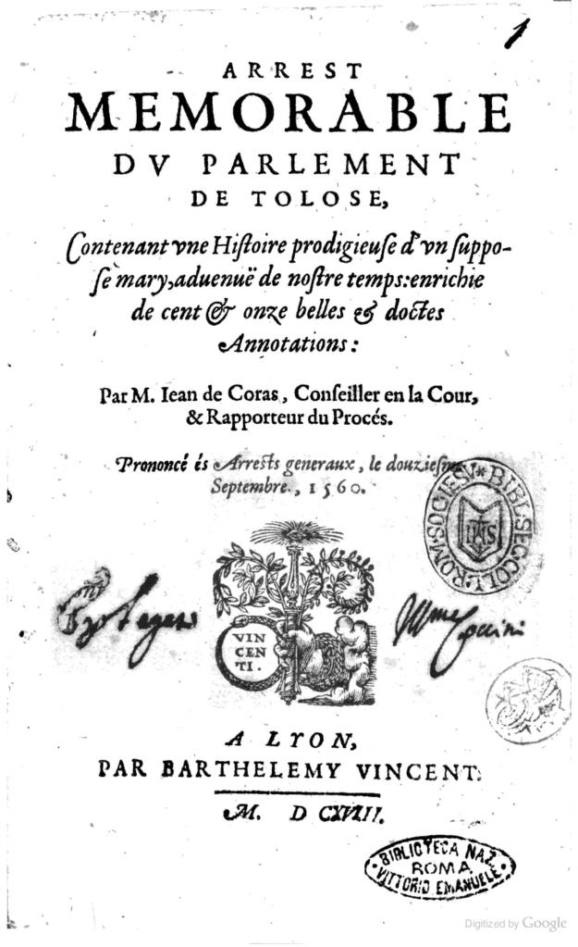
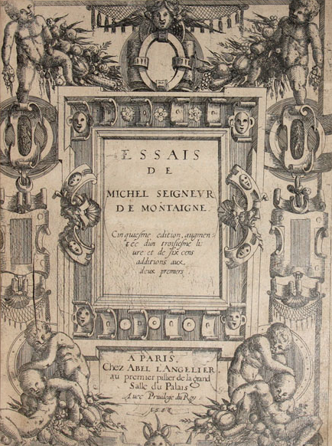
Benson, ‘Martin Guerre, the Historian and the Filmmakers,’ p. 50
BENSON: What was your first contact with Martin Guerre?
DAVIS: In 1976 I read Jean de Coras 's book Arrest Memorable du Parlement de Toulouse, first published in 1561 and referred to by Montaigne. I had come across it in a perfectly ordinary historian's way in the process of giving a seminar on family and kinship. I even wrote an essay called ‘Ghosts, Kin and Progeny’ … in which I cited the Coras book the way you do as an historian. But what I really thought when I read it, as I said later in the preface to my book was, this should be a movie. This is fantastic – a natural storyline!”

Slide 15
‘To Tell About the Past’
“… I used earlier the verb phrase to tell about the past rather than to show it, to recreate it, or even to represent it.”
Natalie Zemon Davis, “Any Resemblance to Persons Living or Dead”: Film and the Challenge of Authenticity,’ Historical Journal of Film, Radio and Television 8:3 (1988), p. 270

Slide 16
‘To Tell About the Past’
“… I used earlier the verb phrase to tell about the past rather than to show it, to recreate it, or even to represent it.”
Why does Davis think that historical films should aspire to ‘tell about the past’ rather than show, recreate or represent the past?

Slide 17
Natalie Zemon Davis, “Any Resemblance to Persons Living or Dead”: Film and the Challenge of Authenticity,’ Historical Journal of Film, Radio and Television 8:3 (1988)
What key weaknesses does Davis identify as off-putting features of historical film? What does she see as drawbacks of cinematic attempts to show, represent or recreate the past?

Slide 18
Natalie Zemon Davis, “Any Resemblance to Persons Living or Dead”: Film and the Challenge of Authenticity,’ Historical Journal of Film, Radio and Television 8:3 (1988)
What key strengths does Davis identify as attractive features of historical film? What does she see as cinema’s potentialities for ‘telling about the past?

Slide 19
Natalie Zemon Davis, “Any Resemblance to Persons Living or Dead”: Film and the Challenge of Authenticity,’ Historical Journal of Film, Radio and Television 8:3 (1988)
“ … Let me conclude with a set of ideas drawn from existing films to inspire us to expand the repertory of cinematic techniques for good telling about the past.”

Slide 20
Natalie Zemon Davis, “Any Resemblance to Persons Living or Dead”: Film and the Challenge of Authenticity,’ Historical Journal of Film, Radio and Television 8:3 (1988)
Reminding viewers of the distance between past and present
Suggesting multiple tellings
Ways of showing where knowledge of the past comes from

Slide 21
Natalie Zemon Davis, “Any Resemblance to Persons Living or Dead”: Film and the Challenge of Authenticity,’ Historical Journal of Film, Radio and Television 8:3 (1988)
Reminding viewers of the distance between past and present
Suggesting multiple tellings
Ways of showing where knowledge of the past comes from
Why might these be important to Davis? What examples does she use? Can you think of examples where these are done well or badly?

Slide 22
“A recreation of history, rather than of a literary text, can work in an analogous way. Even where such a recon­ struction fails to convince, it may form a coherent imaginative challenge compelling one to question, to try to resolve one's own mental image of a time and place. As for recognizing the actors, while it might create some disturbance, it can nevertheless prove an advantage rather than a difficulty. In Le Retour de Martin Guerre, when the man claiming to be Martin makes his first appearance, which initiates a major theme in the film about the nature of identity and how it is that we "know" any person at all, that mo­ ment is immeasurably enriched by our knowledge that "Martin" is "really" the actor Gerard Depardieu. When denounced as an impostor, this character's attempt to convince his abandoned wife and the neighbors is paralleled and deepened by the audience's response to the star. However much we want him to be Martin, we all along suspect him pre­cisely because in another sense we "know" him already.”
David John Williams, ‘Looking at the Middle Ages in the Cinema: An Overview,’ Film & History: An Interdisciplinary Journal of Film and Television Studies 29:1-2 (1999), p. 10

