Slide 1
Contemporary Challenges
Assessment

Slide 2
Handbook + ‘Making a Difference’
These documents outline the module’s content and intended impact.
You will see how the module content activities guide you through the themes of the online work well.
As previously mentioned, it is very important that you engage with the online content to advance your understanding of the themes presented.

Slide 3
Handbook + ‘Making a Difference’
The contextually connected ‘face to face’ sessions pick up of key themes and apply them to the creative industries and inter-related performing arts discipline.

Slide 4
Learning Outcomes
Identify and evaluate historical and contemporary issues and their impact on today's global society.
Apply appropriate collaborative working practices to manage conflict and support effective decision making.
Implement Design Thinking techniques to investigate problems in order to generate and evaluate solutions.

Slide 5
The journey so far…
Unit 1: Visions of the Future
Unit 2: The Future is Human
Unit 3: Change by Design
[Unit 4: Problem Solving Challenge]

Slide 6
Aims
To develop student’s awareness and appreciation of contemporary challenges relevant to the discipline facing individuals, organisations, communities and society, from a local, national and global perspective.
To develop creative problem-solvers through the application of knowledge to real-world problems.

Slide 7
Aims
What are these aims from our perspective?
Mentimeter: 8994 2936
Having read the module Learning Outcomes and Aims; what are our discipline Contemporary Challenges?

Slide 8
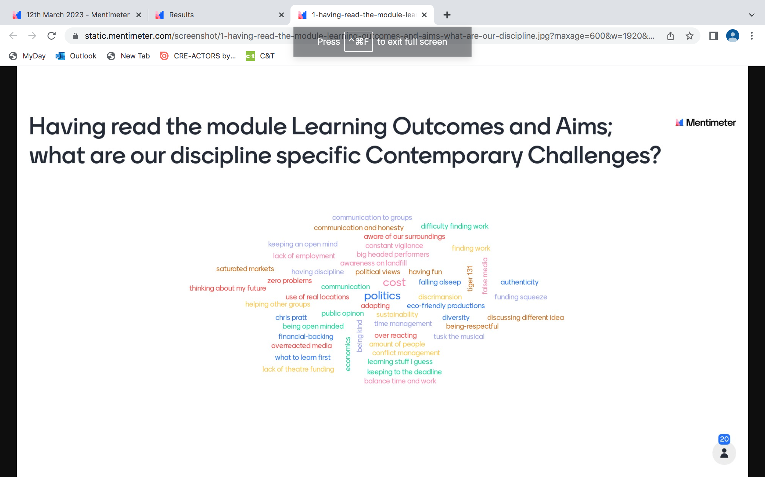
Menti 13th March

Slide 9
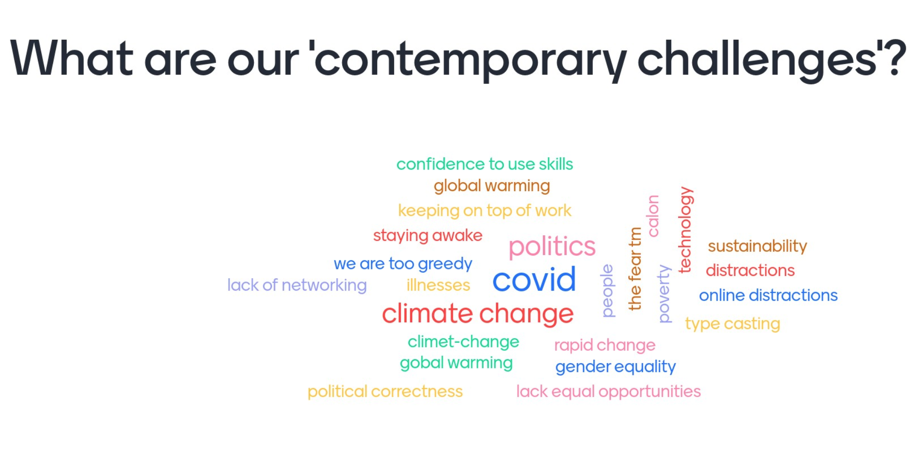
From 6th February session:
Notes:
You were asked to start on the module last week – so what challenges struck a chord?

Slide 10
Are your opinions more informed?
If yes – great – how can we evidence this in your assignments?
If not – not great – how can we link module content to your ideas within the context of the module…to evidence this in your assignments?

Slide 11
Are your opinions more informed?
If yes – great – how can we evidence this in your assignments?
If not – not great – how can we link module content to your ideas within the context of the module…to evidence this in your assignments?
You need motivation and confidence to challenge yourselves to respond to this module.
Notes:
What is motivation?
What is confidence?
Where do they come from?

Slide 12
The journey so far…
Unit 1: Visions of the Future
Unit 2: The Future is Human
Unit 3: Change by Design
[Unit 4: Problem Solving Challenge]

Slide 13
The journey so far…
Unit 1: Visions of the Future
The potential impact of theatre on society and society on theatre
Unit 2: The Future is Human
Unit 3: Change by Design
[Unit 4: Problem Solving Challenge]
Notes:
What should theatre do for society? What stories should we explore?

Slide 14
The journey so far…
Unit 1: Visions of the Future
The potential impact of theatre on society and society on theatre
Unit 2: The Future is Human
‘How’ we share our stories shapes who we are and who we want to appear to be + professional conflict resolution.
Also adaptation – perspectives on creativity, intertextuality and postmodern production
Unit 3: Change by Design
[Unit 4: Problem Solving Challenge]

Slide 15
The journey so far…
Unit 1: Visions of the Future
The potential impact of theatre on society and society on theatre
Unit 2: The Future is Human
‘How’ we share our stories shapes who we are and who we want to appear to be + professional conflict resolution.
Also adaptation – perspectives on creativity, intertextuality and postmodern production
Unit 3: Change by Design
Collaboration for creativity, group work and meaningful devising
[Unit 4: Problem Solving Challenge]

Slide 16
Your voices
What subject matter can you express in your assignments?

Slide 17
Your voices
What subject matter can you express in your assignments?
Suggestion:
Identify a focal point for discussion in relation to the module learning outcomes.
Your individual, personal but critically informed opinions.
Evaluation of your professional area –well referenced.

Slide 18
Learning Outcomes
By the end of this module students will be able to:
Identify and evaluate historical and contemporary issues and their impact on today's global society.
Apply appropriate collaborative working practices to manage conflict and support effective decision making.
Implement Design Thinking techniques to investigate problems in order to generate and evaluate solutions.

Slide 19
Components
There are 2 Assessment Components to this module.
The word ‘component’ is the name for a section of the assessment and represents a percentage of the overall assessment load for the module.
The 2 components for this module are worth 50% each.
However Component 1 has 3 parts – blog posts.

Slide 20
Component 1
Produce an e-portfolio that address the following task:
Create a blog site and make 3 posts.
Create your own personal blog on Wordpress at https://wordpress.com, or similar. Ensure that the settings are on private, not public viewing, as otherwise everyone including your fellow students can see your work. Your lecturers need permission to view the blog.

Slide 21
Component 1
You will create a blog with three posts (approximately 500-600 words each). The expectation is that you create a professional blog, so please consider the layout and presentation (writing in the first person is acceptable).
Any visuals you use to support your post will be considered as a maximum of 300 word-equivalent in total

Slide 22
Component 1
Post 1: Based on your learning from Unit 1, what do you consider to be the biggest threat to human kind and why?
Post 2: Based on your learning from Unit 2, evaluate the skills you will need to be successful in your chosen field. Identify those you think are the most significant and justify your selection.
Post 3: Based on your learning from Unit 3, discuss the merits or shortcomings of design thinking to your chosen areas of study.

Slide 23
Component 1
The small print – guess what it says…?
Please support your discussion with appropriate reference to evidence in the form of citations.

Slide 24
Component 1
Reference

Slide 25
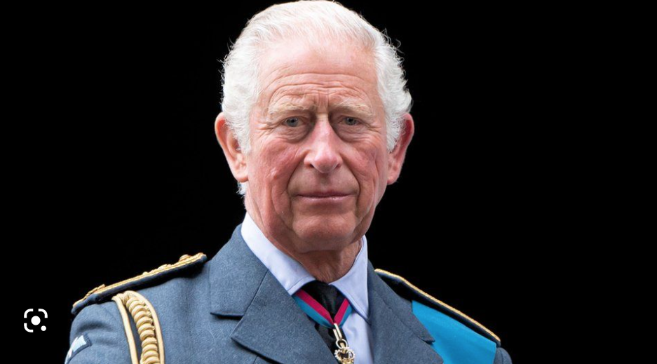
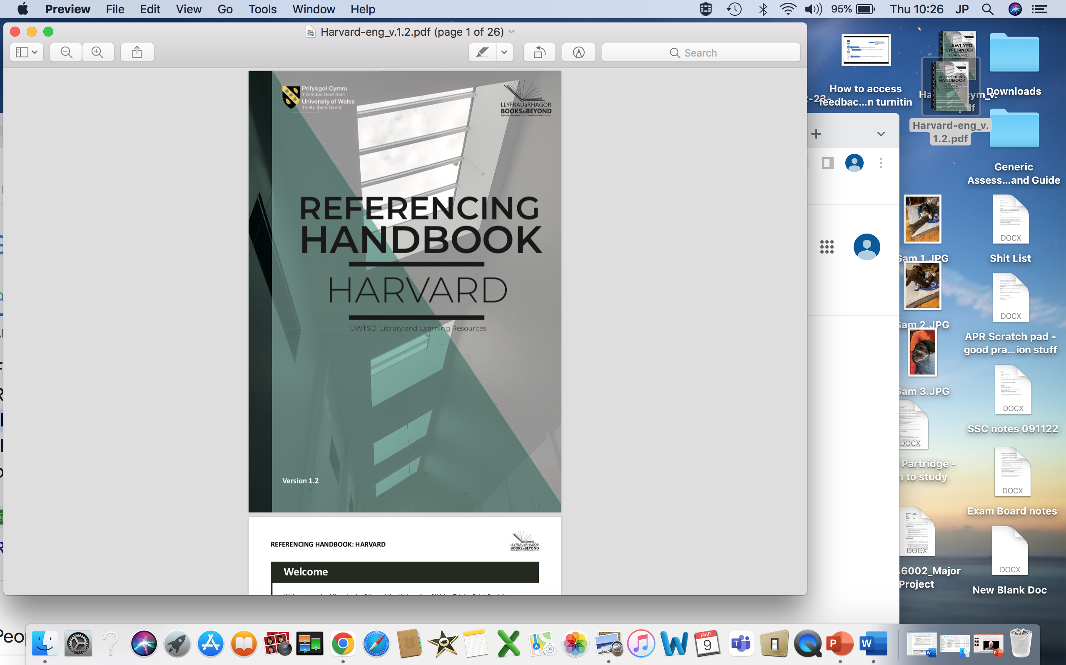
HRH right?
One approves…
Notes:
https://www.google.com/search?q=king+charles&rlz=1C5CHFA_enGB690GB690&source=lnms&tbm=isch&sa=X&ved=2ahUKEwiA1tGm0M79AhVgQkEAHYHhC6sQ_AUoAnoECAEQBA&biw=1116&bih=594&dpr=2#imgrc=andC-HhHFhlH0M

Slide 26
HRH – the King of Referencing!
Reference.
Use the King of referencing sources – the HRH – our Harvard Referencing Handbook.
p.s. Reference.

Slide 27
Component 1
Submit a final copy of all posts to Turnitin as a Word document or a pdf file, including a working link to your blog site. This document should also include a reference list of sources used.

Slide 28
Component 2
This assignment will be a group presentation (max 6 in a group) with appropriate supporting material.
Each individual student in a group will contribute 2 minutes to an online presentation that answers the question:
‘Is working for the ‘exposure’ a satisfactory situation for an up-and-coming creative artist?’

Slide 29
Component 2
Each individual student will also contribute 1,000 words in supporting materials to be uploaded to Turnitin. This work will evidence significant individual creative industries research, be in line with individual programme or discipline requirements, and be referenced using the Harvard system.

Slide 30
Component 2
Submission:
You are required to submit a working link to your presentation video and your ‘supporting materials’ to Turnitin by the submission deadline.

Slide 31
Wordpress
Wordpress
Brett Aggersberg in class presentation.
See ‘Additional Resources’ for 2 guidance videos.

Slide 32
Homework
Take a look at this:
https://thriftytheatrethinker.wordpress.com/2016/03/08/intertextuality-in-musical-theatre/

Slide 33
Homework
Look for the word ‘intertextuality’ on line.
Read about intertextuality and work out a definition* – what it means, what is does, how is does it…
Think about intertextuality through the lens of theatre work you have viewed this academic year (Buffini’s ‘LovePlay’ and Rees’ ‘Now the Hero’ for starters).
Notes:
*You can do this in groups if you’d like.

Slide 34
Homework
Does this post-modern framework alter how you think about, evaluate, appreciate, the theatre work that you have viewed?

