Slide 1
Organisational & Individual Behaviour
Based on Mullins chapter 1, 9ed.
the Nature of Organisational Behaviour
THE WORLD OF WORK, ORGANISATION MANAGEMENT & BEHAVIOUR IS CHANGING.

Slide 2
Individual Behaviour &
Organisational Behaviour.
Individual Behaviour has a significant effect on Organisational Behaviour.
Consider the effect a Senior Manager with a certain Leadership / management style 'autocratic' or 'democratic‘ has on an organisation e.g. With large authority throughout the organisation, consider the effect on structure, policies, culture / atmosphere etc...
Consider the role the HRM dept. has in safeguarding not only health and safety but also employee well-being within the current transition to more democratic, collaborative, empowered and supportive style, working with managers throughout the organisation.
Could you have a nerf gun fight at the MOD? lol could you at Google?

Slide 3
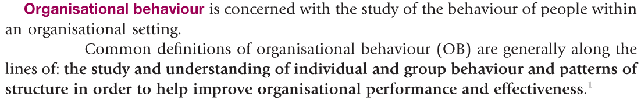

Organisational Behaviour

Slide 4
Effective Management
The study and applications of individual and organisational behaviour lead to the effective management of people, productivity and happiness at work.
Individuals manage their own behaviour.
Organisations manage structure, culture, policies and can support ‘self development and management’ for the benefit of both the individual and the organisation.

Slide 5
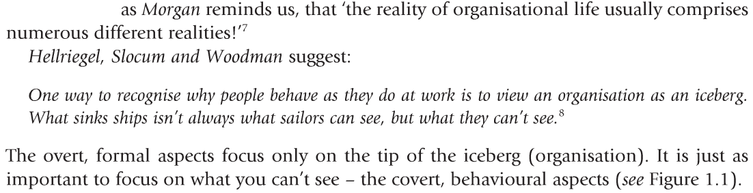
Organisational Iceburg
(fig1.1 next slide)

Slide 6
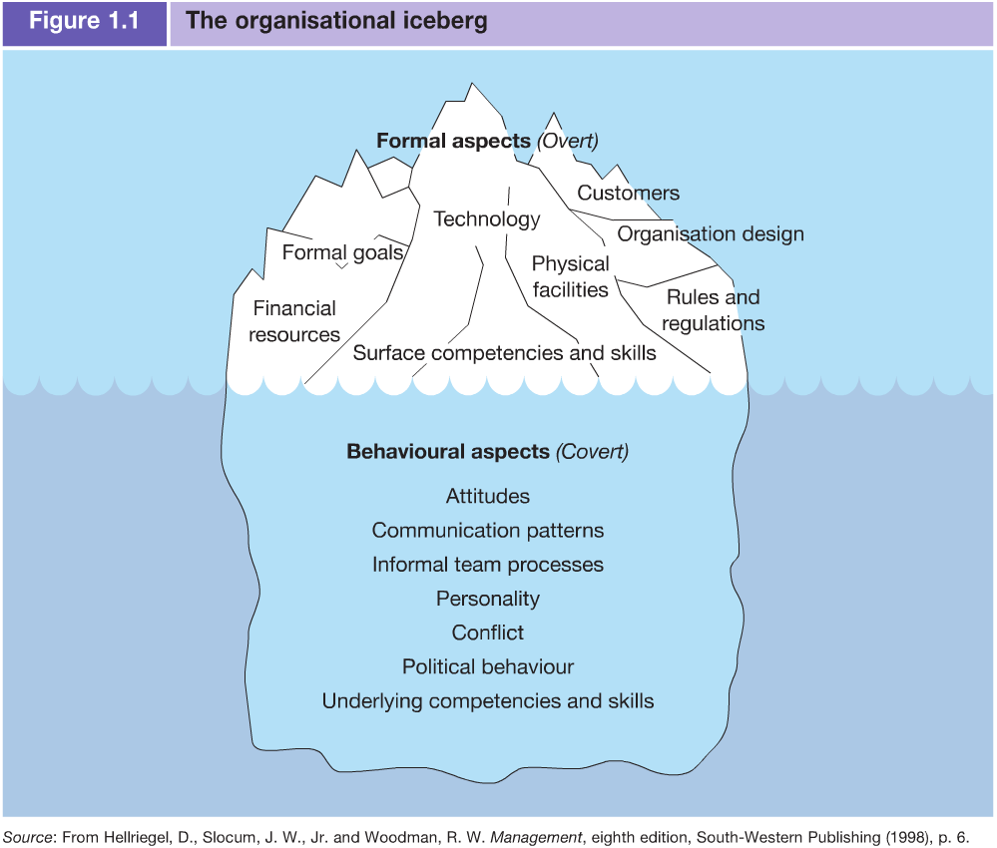

Slide 7
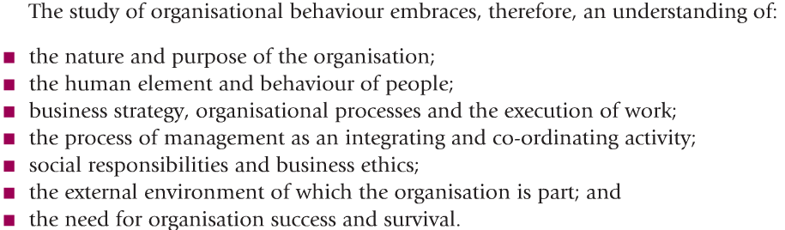
OB consists of

Slide 8
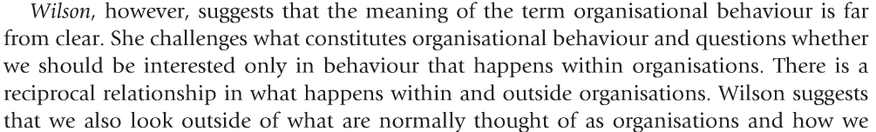

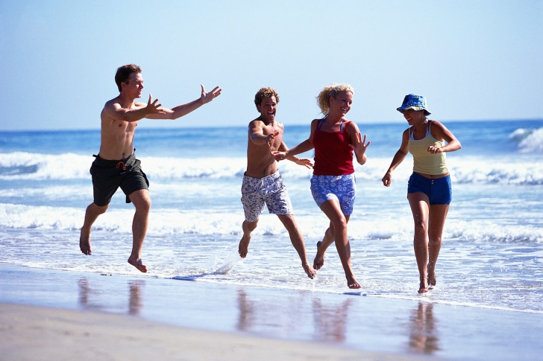
Organisational & Individual Behaviour
Ref: http://www.amazon.co.uk/Organizational-Behaviour-Work-Critical-Introduction/dp/0199261415/ref=sr_1_2?ie=UTF8&qid=1296478716&sr=8-2

Slide 9
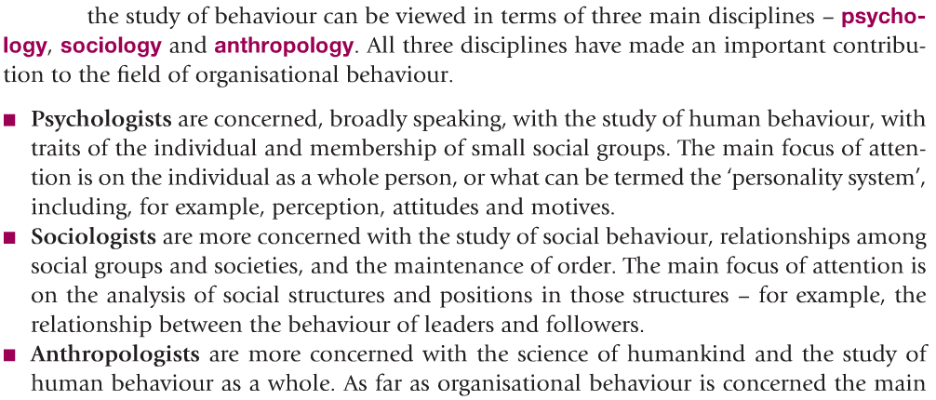
OB: A Multidisciplinary approach

Slide 10
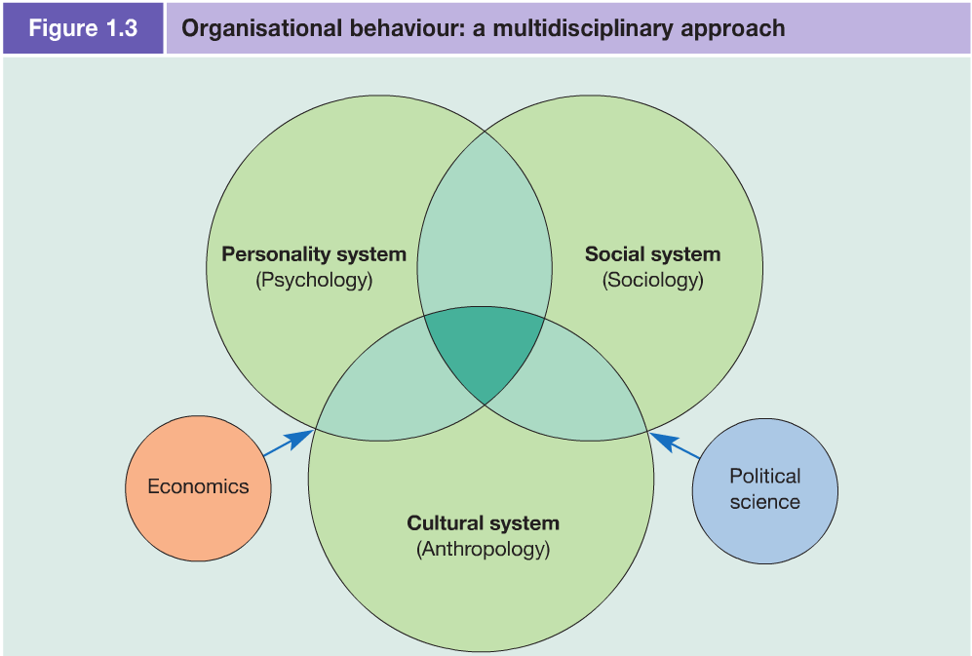
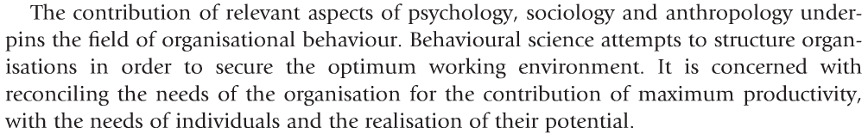

Slide 11
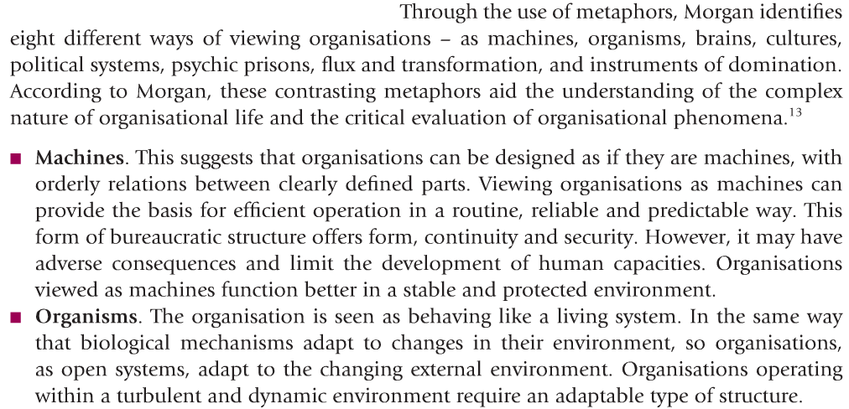
Organisational Metaphors or
Viewing Organisations
NOTE: For complete list please read Mullins OB 9ed, page 9.
Notes:
Note: different people have different perceptions and beliefs about Organisations (metaphors) usually based on what they have been told or past/old experience. This can be seen in the different Organisation metaphors.

Slide 12
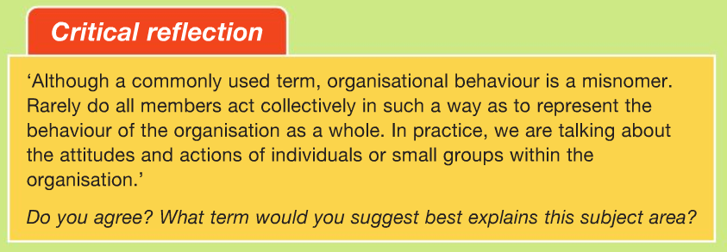
Organisational & ‘Individual’ behaviour
Activity: Read, Reflect, Remark

Slide 13
OB, Motivation & Needs
Reflect on the different needs employees are striving to meet at different ages and different levels of the organization.
It is important for managers/leaders to understand and support employees satisfaction of needs in a co-operate culture to enhance individual productivity/creativity (e.g. Physical/self-esteem/family needs are met) where everyone is more capable and empowered and have the energy and inspiration to contribute towards achieving the Organisations vision, usually altruistic and benefits society (see Microsoft & Bill Gates charity).
Meeting individual, stakeholder and organisational needs (Mission) multiple ‘need sets’ can be achieved in a symbiotic mutual relationship where all parties support the achievement of these needs e.g. employee gains income, personal development and actualisation, the customer a quality product/service and the organisation fulfils it’s Mission and own physical/survival needs and benefits society / stakeholders.

Slide 14
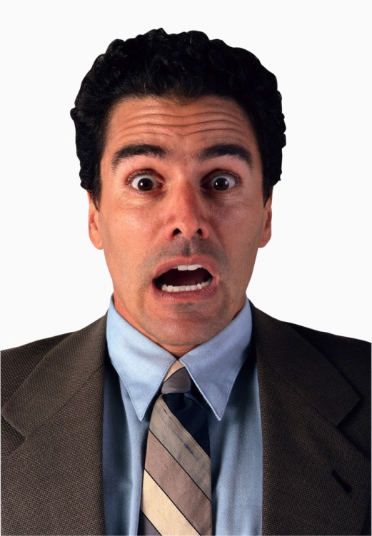
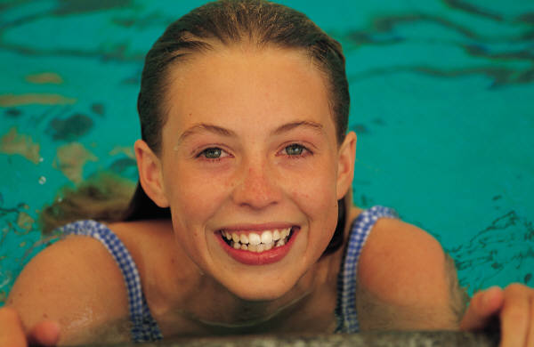


Activity:
Which feeling/emotion is being expressed here? What does it sound like?
Home: Research and find and up-to-date Organisation Metaphor?
Home: What makes up Individual behaviour?
Home: How does this effect Organisational behaviour?

Slide 15
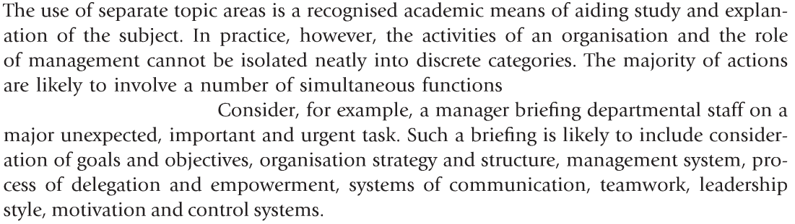
The Study of Organisational Behaviour

