Slide 1
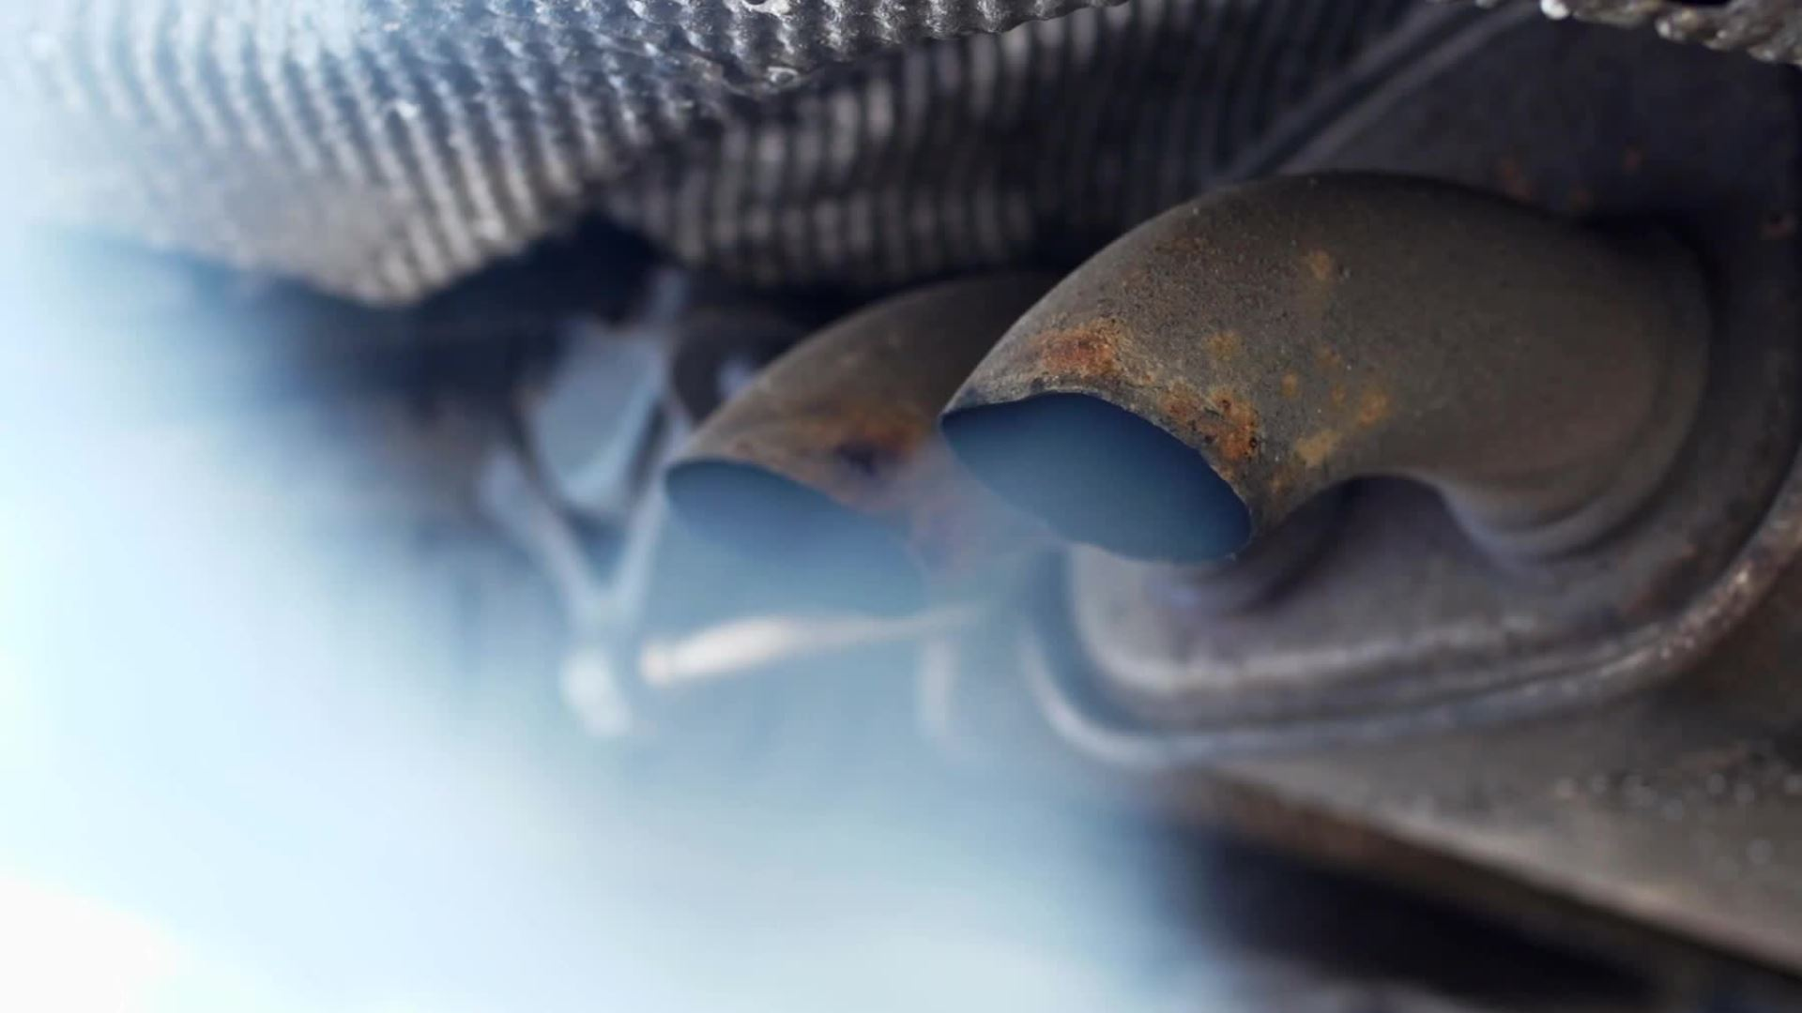
What is greenwashing in the automobile industriy?

Slide 2
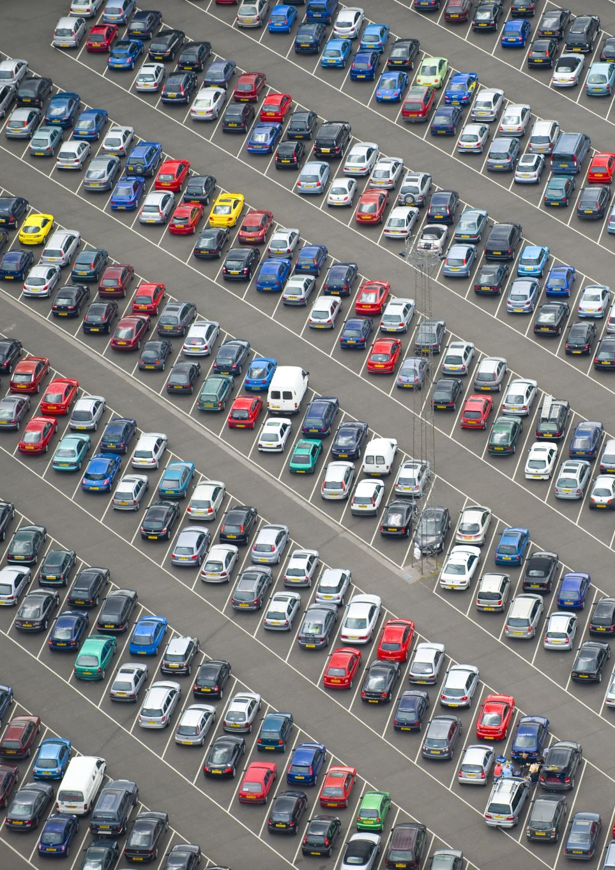
Greenwashing in the automobile industry involves deceptive marketing claims that exaggerate a vehicle's or company's environmental friendliness, misleading consumers into believing products or practices are more sustainable than they are.

Slide 3
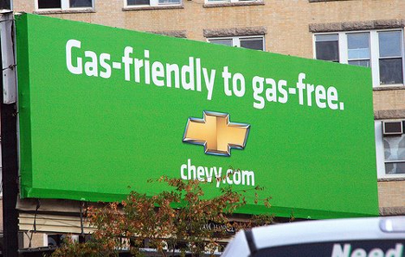
The Business Protection from Misleading Marketing Regulations, 2008
It prohibits misleading advertising. In Uk
Notes:
General Motors has changed the colour of its logo from blue to green in order to portray its green “gas-friendly to gas-free” image. This is sheer greenwashing as only one of its brands “Chevrolet Volt” is an electric eco-friendly car, not its entire range. Moreover, GM is observed to be among the top 10 most polluting car manufacturers in the world.

