Slide 1
Number: 4
Presentation: communication barriers
Age/ generational
Name: Kaitlyn Telemaque
Id no. 2516559

Slide 2
Age/ generational differences in flight foods Ltd
This presentation will explain the age/generational communication barriers between workers
Describing the difference between workers
Based on the Shannon and weaver model of communication (1948)
Shows why they are lacking in communication

Slide 3
Age/generational barrier
Workers range from ages 16-60 years old
The older generation prefers phone calls or face to face communication whilst the younger generation prefer digital communication e.g. messaging
Different understandings with new technology and equipment
Older generations value direct, formal feedback as the younger generation value frequent, informal feedback
Differences in interpretation

Slide 4
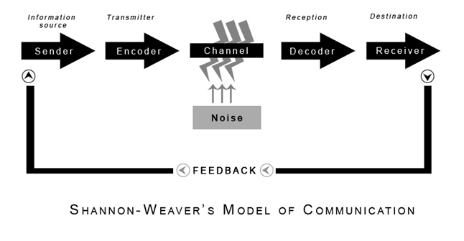
Shannon and weaver model of communication in flight foods ltd
Workers
Gary
Age/Generational differences
Image: Shannon and Weaver (1947)- edited by Kaitlyn Telemaque

Slide 5
Impact on the business
Conflict between workers
Poor food standards/ quality
Multiple complaints
Loss of business
Reduced customer loyalty
Misunderstanding between colleges
Inconsistent service delivery

Slide 6
solutions:
Implement reverse mentoring- where younger employees teach older employees about new technologies, while seasoned workers provide guidance on leadership and company history.
Inclusive Training Programs- Use diverse training methods to match learning preferences
Carry out training to raise awareness about generational differences and break down stereotypes. Focus on open communication where team members can discuss their preferences.

Slide 7
Conclusion
In conclusion, flight foods Ltd can improve its business performance by recognising and effectively managing the differences between generations in the workplace. By creating an inclusive workplace, offering flexible working options, and encouraging knowledge sharing between experienced and younger employees, the company can strengthen teamwork and employee satisfaction. Understanding generational preferences in customers can also help improve products and services. Overall, effectively managing generational differences will help increase productivity, improve workplace culture, and support long-term business success.

Slide 8
References
https://www.linkedin.com/pulse/multi-generational-restaurant-making-work-when-speaks-billings-9vuuc#:~:text=The%20%22Over%2DCommunication%22%20Trap,Gen%20Z%20across%20all%20positions.
https://harryevanscom.wordpress.com/2017/02/13/media-audiences-week-3-models-of-communication-shannon-and-weaver-hall/
https://www.oysterhr.com/library/generational-differences-in-the-workplace

