Slide 1
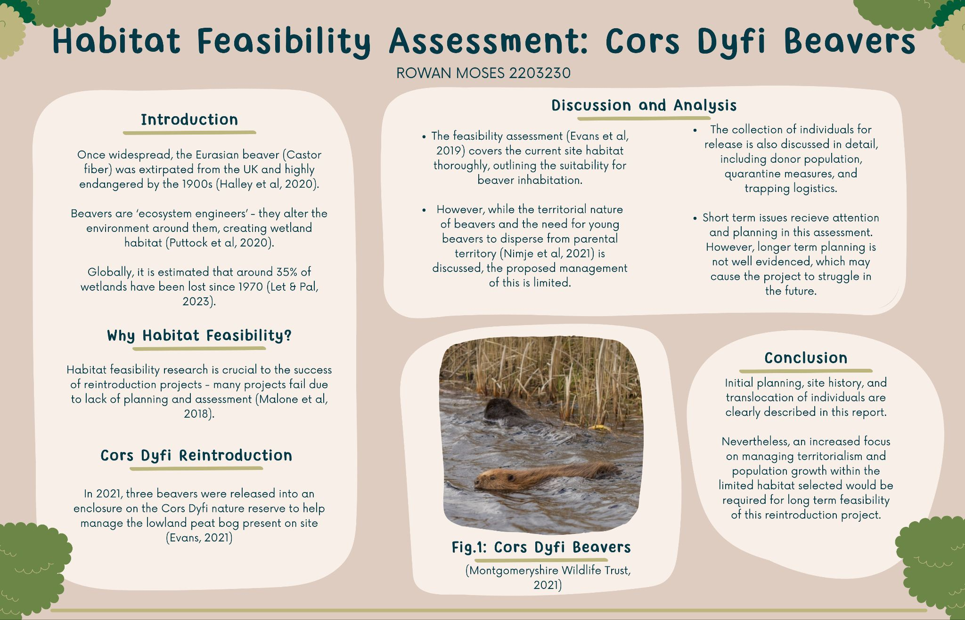

Slide 2
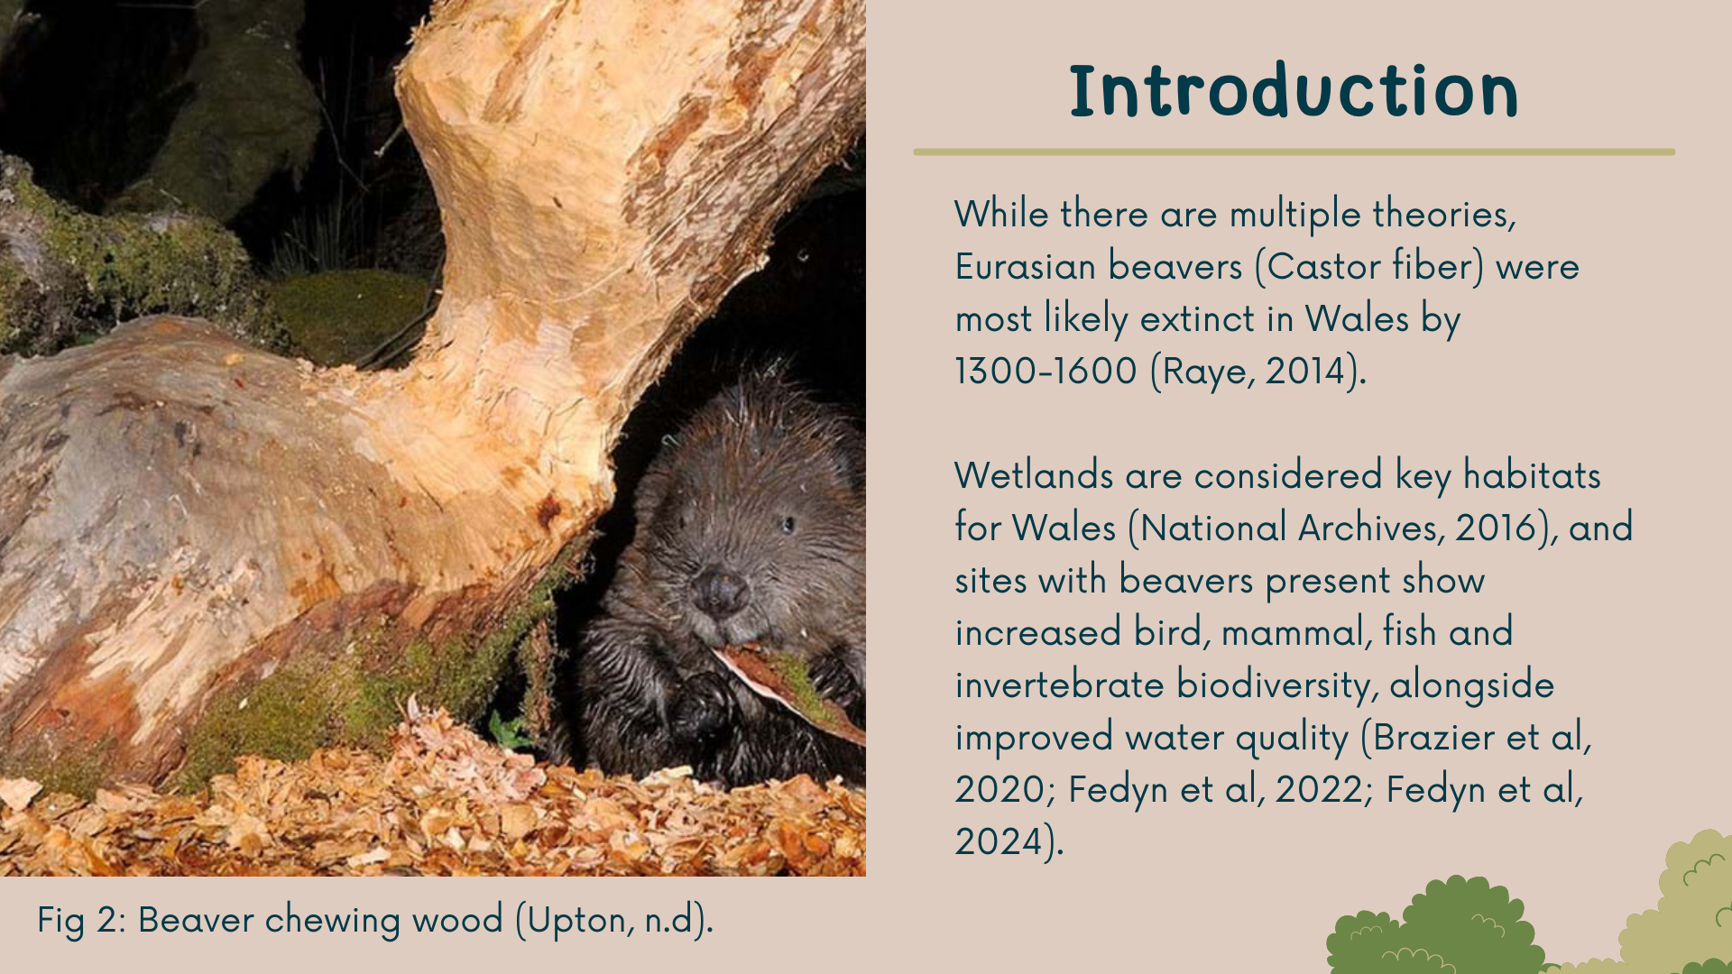
Notes:
Widespread in Eurasia. Earlier in Wales and South England, and later in Scotland and North England. Hunted for fur, meat and castoreum.
Environment (Wales) Act 2016, section 7 of priority habitats - lowland fen.
Increased biodiversity because of how they shape the habitat around them - damming and burrowing activities create ponds, wetland, and disturbed areas. also reduces flooding and drought.

Slide 3
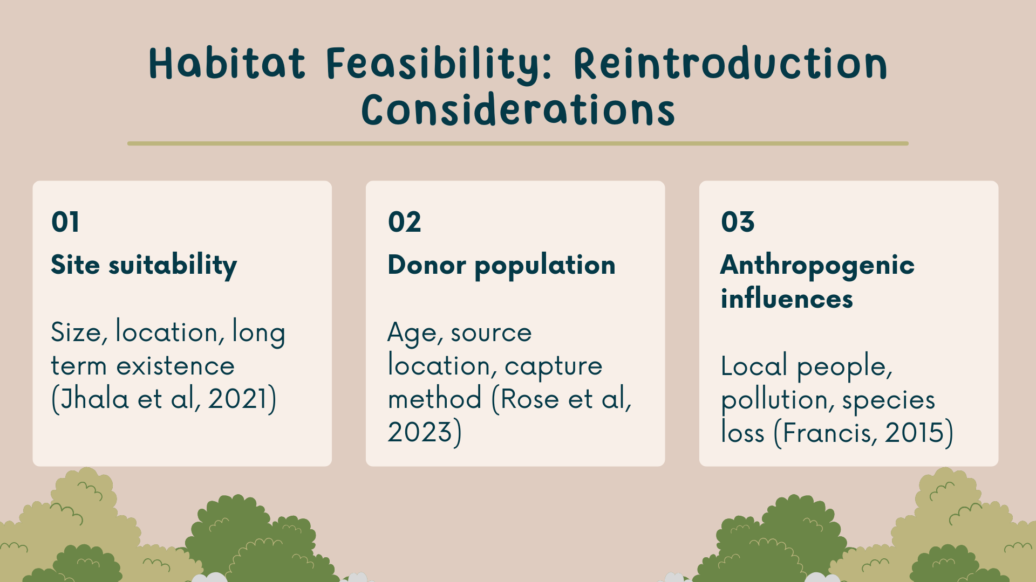

Slide 4
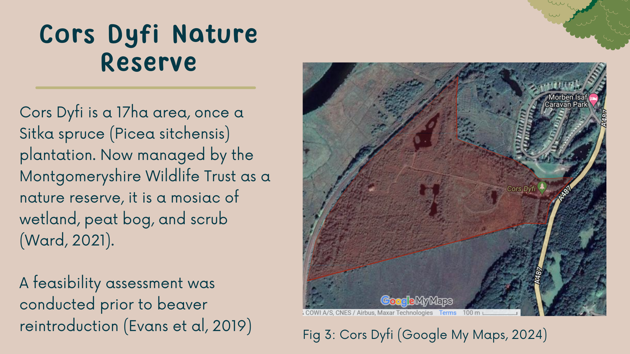
Notes:
Cors Dyfi = 17 hectare site, sitka spruce plantation post WWII.
Surrounded by railway line, road, and caravan park, in Powys, above Aberystwyth.
Welsh Beaver Project has been looking to reintro beavers since about 2005 - they looked at the Rheidol catchment, which the Dyfi is part of.

Slide 5
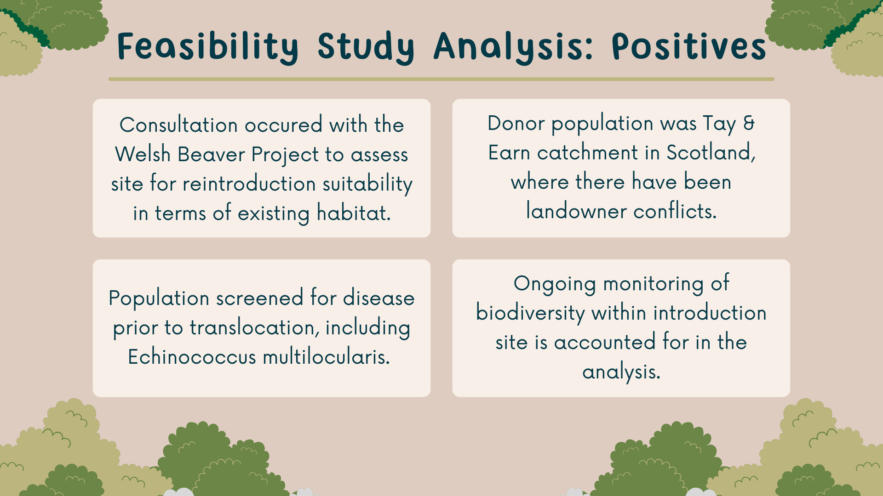
Notes:
Lethal control licences issued in Tay and Earn catchment in Scotland - individuals trapped and removed from there so they wouldn't be killed.
Echinococcus multilocularis - tapeworm species that has small mammals such as foxes and beavers as its hosts in Europe.

Slide 6
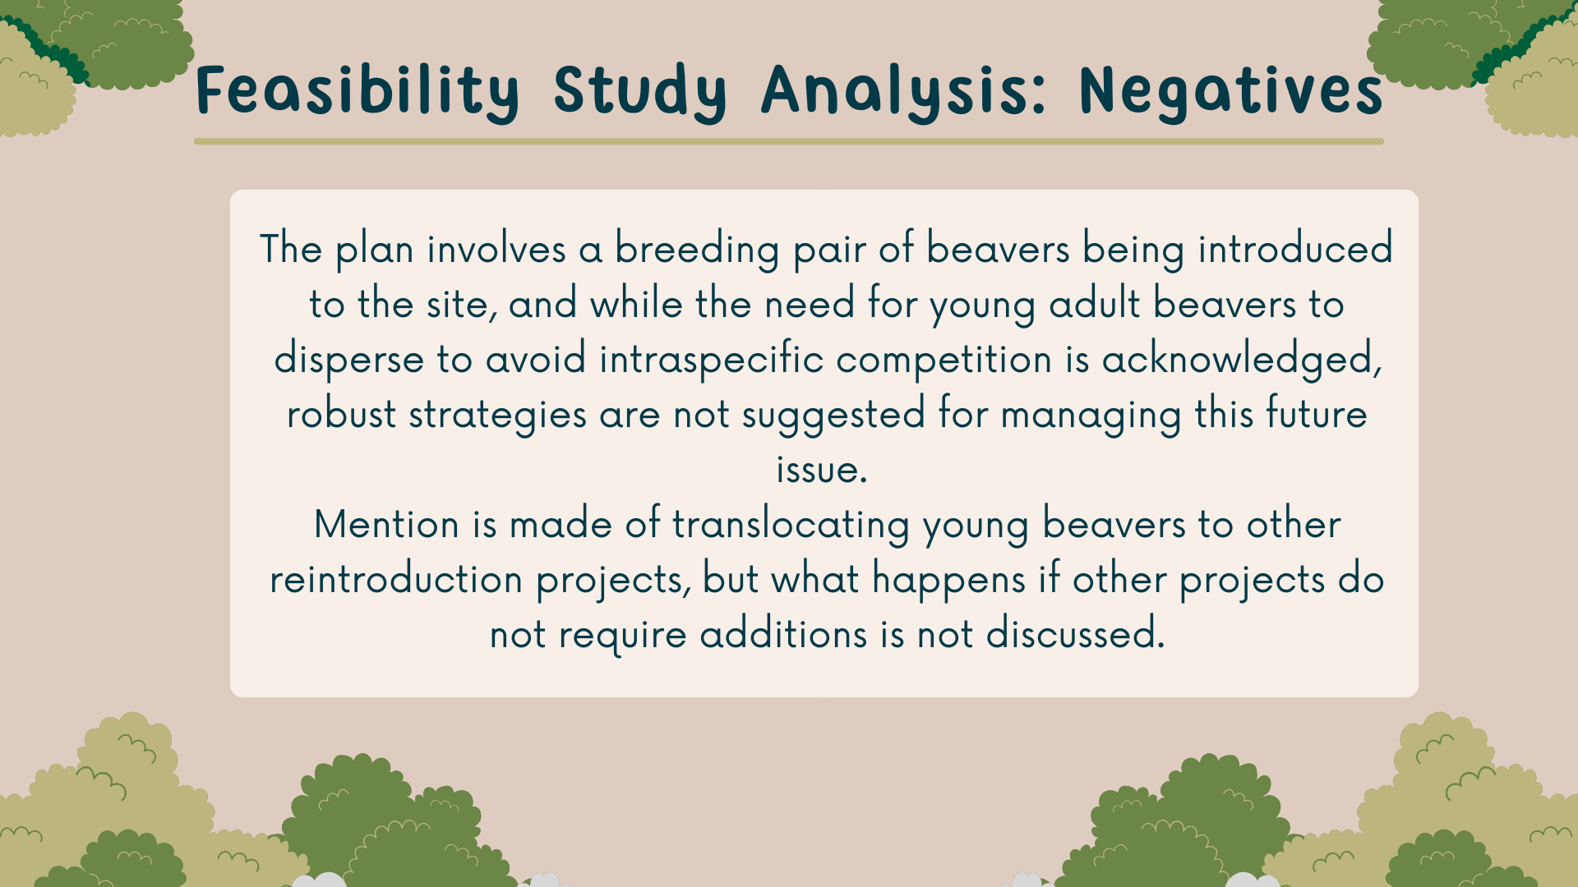

Slide 7
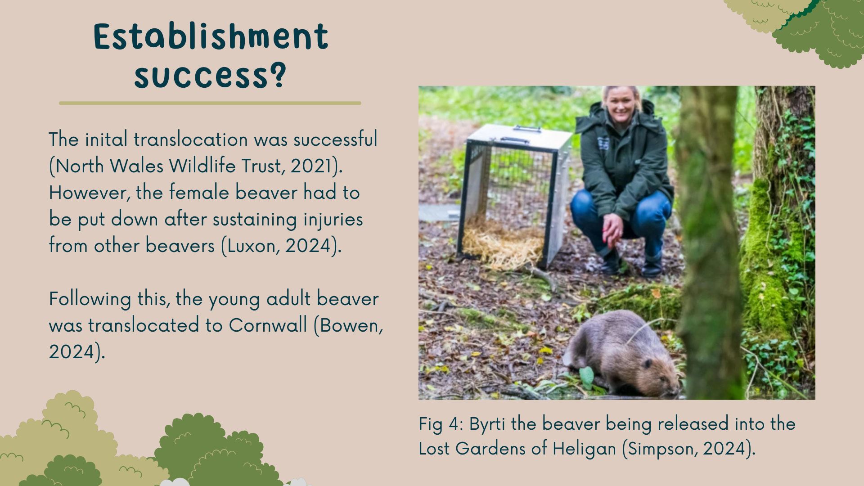
Notes:
Spring 2024, 3 years after initial reintro. Female had to be put down, injuries were determined to be from the other beavers - by this time there were 4 in total.
Unsure of the future of this project, but Wildlife Trusts overall are now advocating for full release and reintro, rather than into enclosures

Slide 8
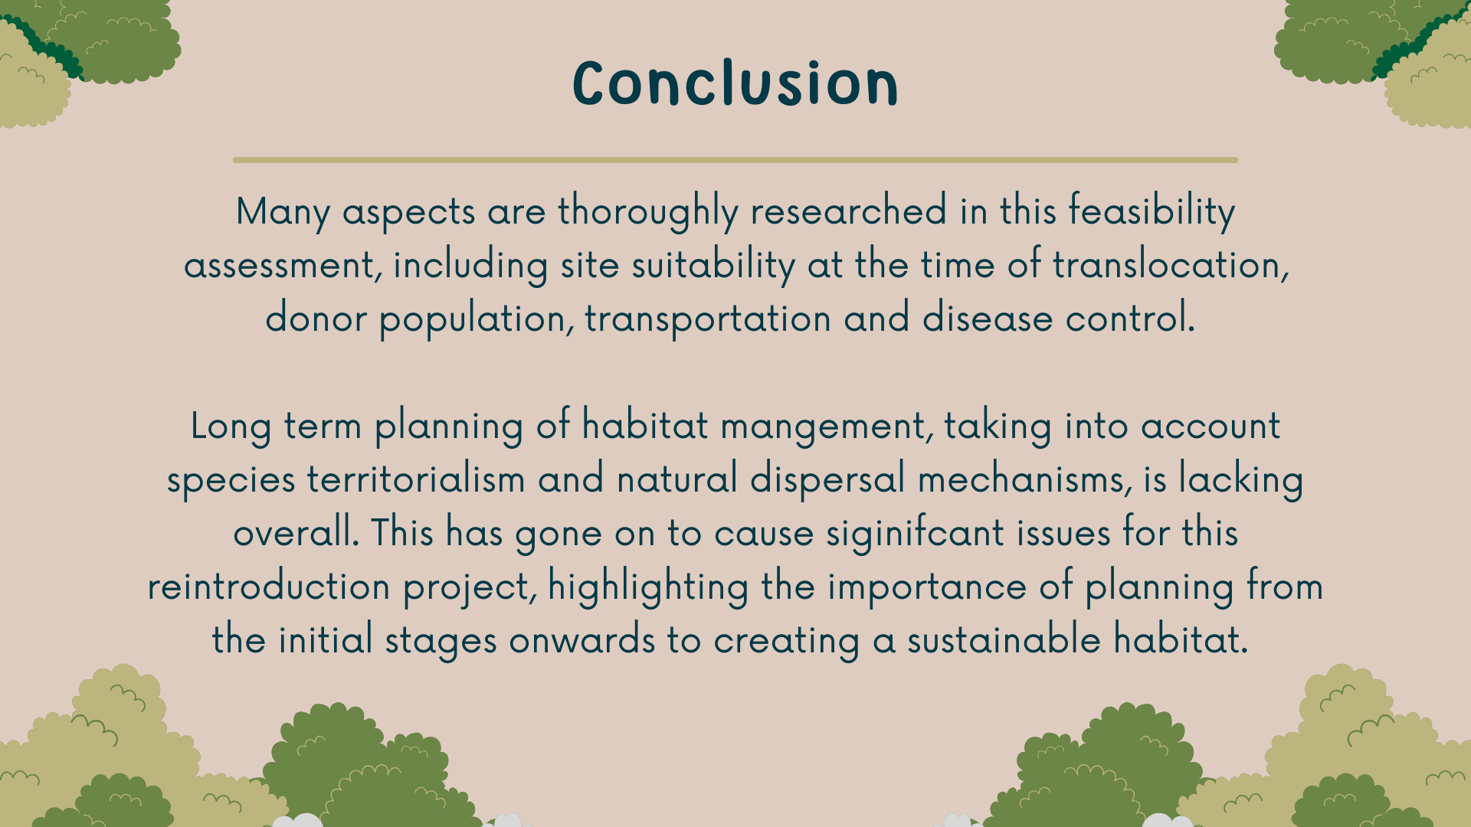

Slide 9
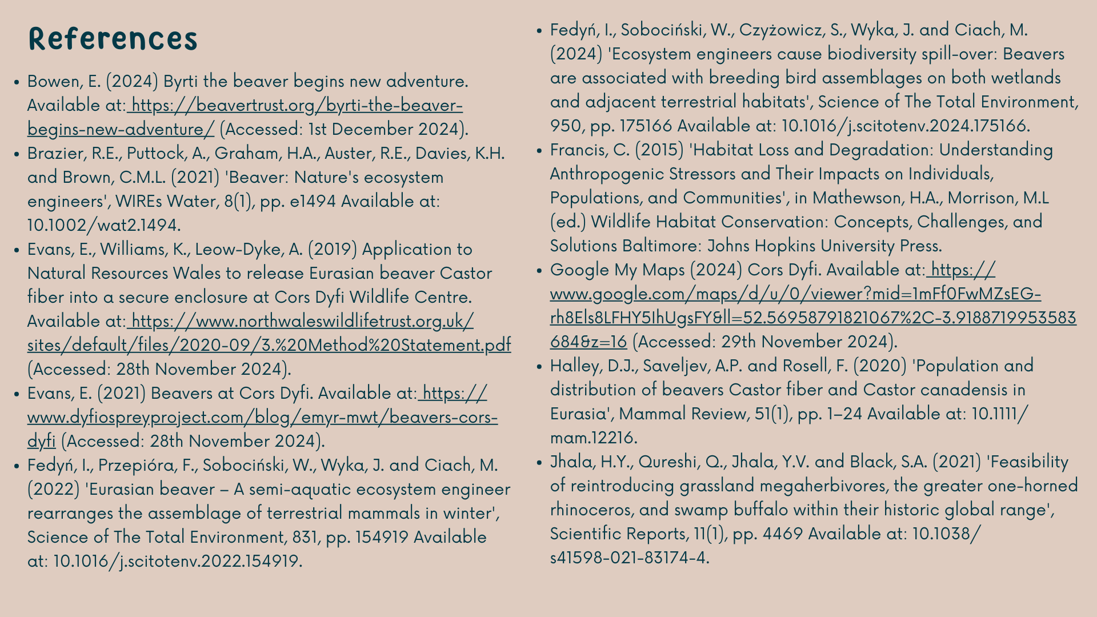

Slide 10
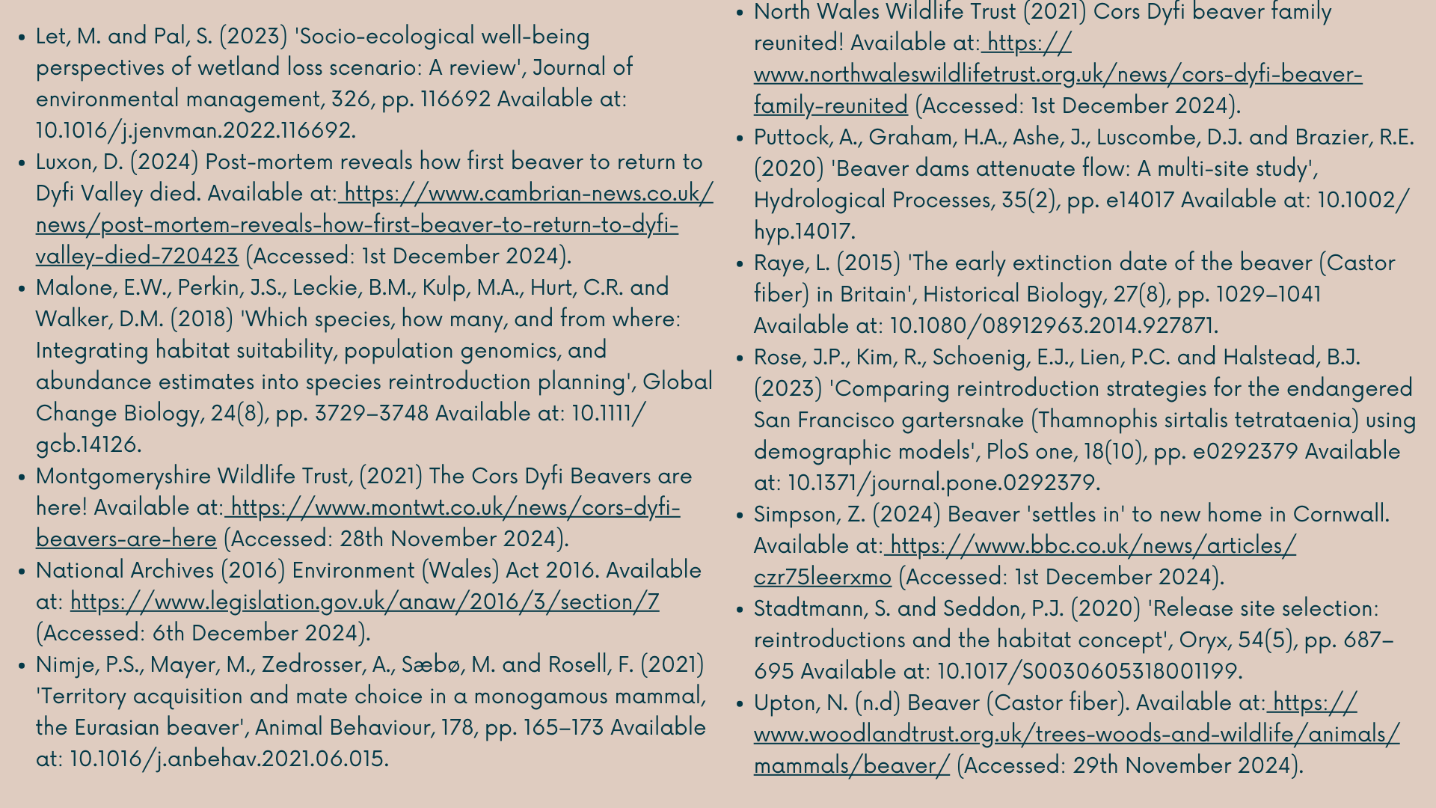

Slide 11


