Slide 1
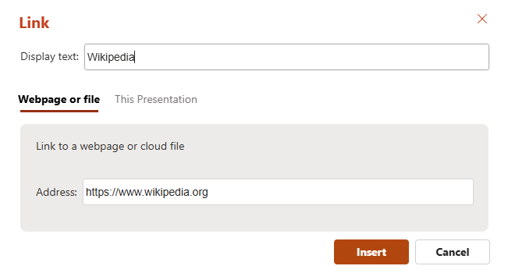
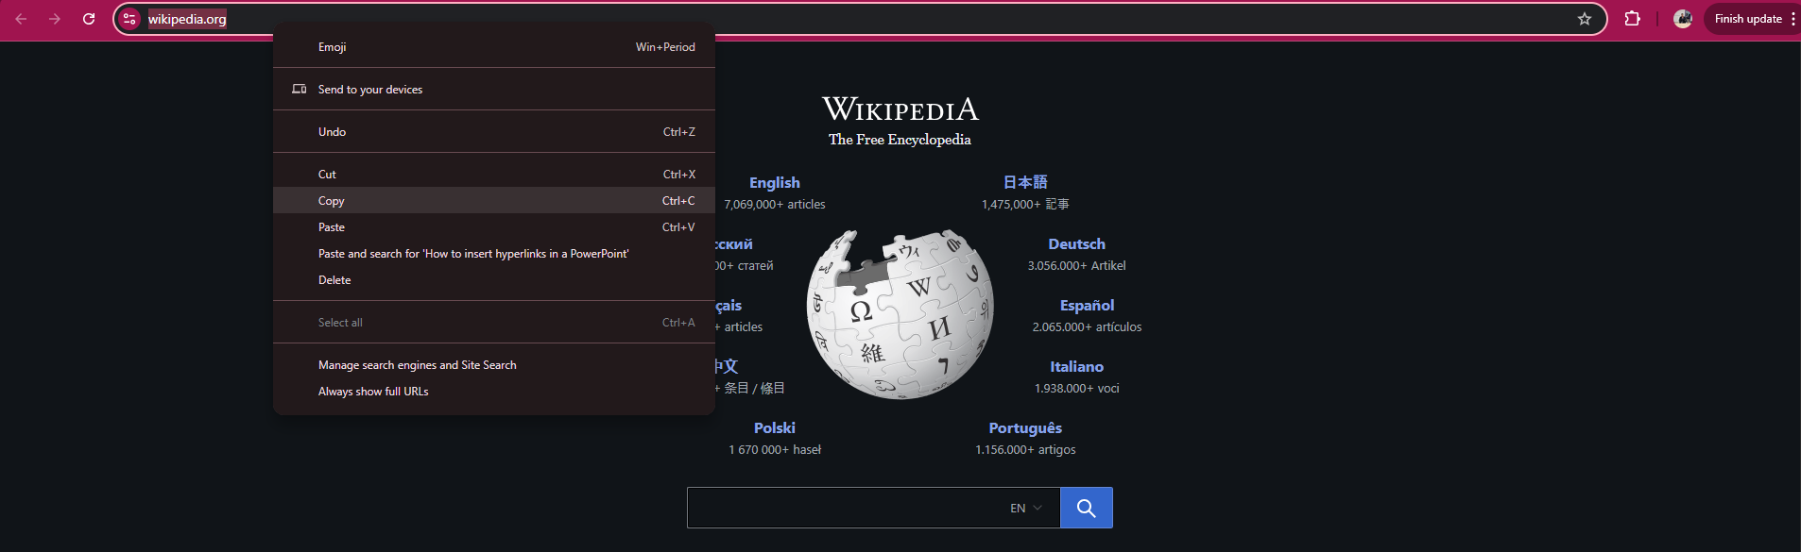
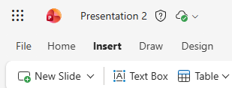






How to insert hyperlinks in a PowerPoint
First Step Forth Step
Choose the website and copy-paste the link
From the text box
Second Step
Open PowerPoint then go to Inserts
In the [Display text] gap you need to choose how the hyperlink will be shown.
In the [Address] gap, you should paste the link you copied in the first step.
After that you will have to press on Insert and there you have your hyperlink.
Third Step
Go to the Link icon Wikipedia

