Slide 1


Business Model Canvas Workshop
A comprehensive guide to understanding and applying the Business Model Canvas in various industries. Learn to create effective business models and strategies.

Slide 2

Introduction to Business Model Canvas
1
Strategic Tool
2
Nine Components
Visual mapping of key business model elements on one page.
Covers customer segments, value propositions, channels, and more.
3
Versatile Application
Suitable for businesses of any size and industry.

Slide 3




Customer Segments
Target Audience
Define specific groups the business serves.
Customer Personas
Consider different types of customers, like budget or business travelers.
Demographics
Identify key characteristics of your target market.

Slide 4

Value Propositions
Unique Benefits
Problem Solving
Identify the unique value your business offers to customers.
Define how your product or service addresses customer needs.
Differentiation
Highlight what sets your offering apart from competitors.

Slide 5




Channels
Distribution
Identify how products or services reach customers.
Communication
Determine methods for interacting with customers.
Digital Presence
Consider online platforms like websites and mobile apps.

Slide 6
Customer Relationships
Trust Building
Engagement
Loyalty Programs
Implement systems like reviews and responsive customer service.
Develop strategies for ongoing customer interaction and support.
Consider implementing rewards to encourage repeat business.

Slide 7
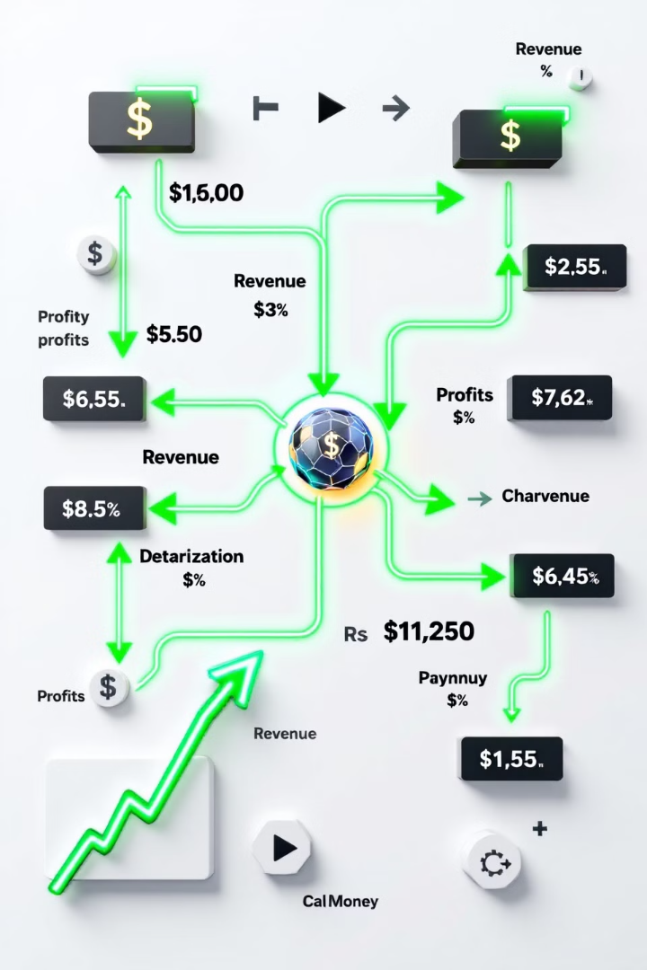
Revenue Streams
1
Transaction Fees
Earn revenue through booking fees or percentages from transactions.
2
Subscriptions
Implement recurring payment models for ongoing services.
3
One-Time Sales
Generate income through single product or service purchases.

Slide 8





Key Resources
Technology
Brand
Identify crucial digital platforms and software.
Recognize the value of your company's reputation.
Data
Talent
Utilize customer information and market insights.
Acknowledge the importance of skilled personnel.

Slide 9

Key Activities
1
Platform Maintenance
2
Marketing
Ensure digital infrastructure remains functional and up-to-date.
Promote products or services to target audiences.
3
Customer Support
4
Product Development
Provide assistance and resolve issues for clients.
Continuously improve and innovate offerings.

Slide 10



Key Partnerships
Strategic Alliances
Collaboration Network
Legal Compliance
Partner with legal entities to ensure regulatory adherence.
Form partnerships with complementary businesses or suppliers.
Build a network of partners to enhance value creation.

Slide 11

Cost Structure
Fixed Costs
Variable Costs
Platform maintenance
Marketing expenses
Salaries
Transaction fees
Office rent
Customer support

Slide 12

Industry-Specific Adaptations
Tech Startups
Retail Business
Focus on key partnerships and intellectual property resources.
Emphasize customer relationships and multi-channel strategies.
Service-Based
Prioritize personalized customer relationships and flexible revenue streams.

Slide 13

Group Exercise: Creating a BMC
1
Form Groups
Divide into small teams and assign business ideas.
2
Fill Template
Complete each section of the Business Model Canvas.
3
Present
Share completed BMCs, highlighting key points of the business model.

Slide 14





Applying BMC to Your Business
Identify Customers
Define your target market and their needs.
Craft Value Proposition
Develop a unique offering that solves customer problems.
Determine Resources
List key assets and activities needed for success.
Analyze Finances
Outline revenue streams and cost structure.

Slide 15

Conclusion and Next Steps
1
Review Key Points
2
Encourage Application
Summarize the nine components of the Business Model Canvas.
Motivate students to apply BMC to their own business ideas.
3
Continuous Iteration
Emphasize the importance of regularly updating the canvas.

