Slide 1

ECOWASH
Name: Songul Kisa
Student ID: 2513589
Module code: LCLM4006
Module Title: Enterprise & Entrepreneurship
Lecturer: Mustakkima Afrin

Slide 2
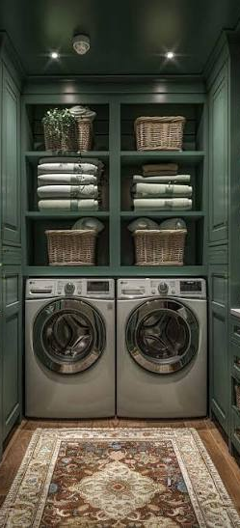

Content
Introduction
Overview of the Business Idea
Legal Format and Management Structure
PESTEL Analysis
Marketing Strategies
Funding Requirements and Allocation
Financial Plan

Slide 3

Introduction
EcoWash London Ltd
Sustainable Laundry Collection & Delivery Service
EcoWash London Ltd is a London-based laundry collection and delivery business.
The business provides convenient, reliable, and eco-friendly laundry services.
Customers include busy families, students, Airbnb hosts, and small businesses.
The company partners with existing local laundrettes to reduce startup costs.
Long-term goal: establish an independent eco-friendly laundrette within two years.

Slide 4
Overview of the Business Idea
Services | Target Customers | Unique Selling Points (USP)
Laundry collection | Busy working families | Door-to-door service
Washing & drying | University students | Affordable pricing
Ironing & folding | Airbnb Hosts | Eco-friendly detergents
Doorstep delivery | Small businesses | Online Booking

Slide 5
Legal Format and Management Structure
Legal Format | Founder & Managing Director | Future Employees
Private Limited Company (Ltd) | Songül Kısa | Operations Assistant
Limited liability protection | Finance | Delivery Staff
Suitable for future business growth | Marketing | Local Laundrette Partners

Slide 6
PESTEL Analysis
Factor | Impact on EcoWash
Political | Environmental regulations encourage sustainable businesses.
Economic | Rising living costs increase demand for affordable services.
Social | Busy lifestyles increase demand for convenient laundry services.
Technological | Online booking and digital payments improve customer experience.
Environmental | Eco-friendly detergents and efficient delivery routes reduce pollution.
Legal | Must comply with employment, health & safety, and consumer protection laws.

Slide 7
Marketing Strategies
Target Market | Promotion | Competitive Advantage
Working families | Social media marketing | Eco-friendly service
Students | Business website | Flexible collection & delivery
Airbnb Hosts | Online booking system | Competitive prices
Small Businesses | Customer referral programme | Personalised customer service

Slide 8
Funding Requirements and Allocation
Purpose | Amount
Website Development | £2,000
Marketing & Advertising | £2,500
Transport & Delivery Equipment | 3500
Eco-friendly Supplies | £1,000
Working Capital | £1,000

Slide 9
Financial Plan
First Year Financial Plan
Startup investment: £10,000
Average order value: £20–£25
Revenue will increase through repeat customers and local partnerships.
Costs are reduced by partnering with existing laundrettes instead of purchasing equipment.
Business aims to reach the break-even point when monthly revenue covers all operating costs.
Financial Objectives
Build a stable customer base
Increase monthly sales
Achieve profitability
Prepare for future expansion

Slide 10
Thankyou
EcoWash London Ltd
"Making laundry easier while protecting the environment."
Any Questions?

