Slide 1

Marketing Fundamentals
BMBM4005
Today’s Session
BUYER BEHAVIOUR

Slide 2

What is the difference between a customer and consumer?

Slide 3
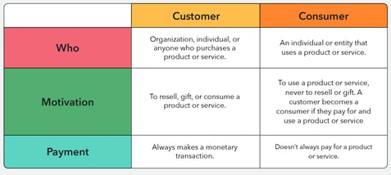
Customers and consumers – key differences

Slide 4
Why do we need to know?
Customers are the people who purchase your product or service. Consumers are the end users who use or “consume” your product. Sometimes, they are the same person, but not always.
Understanding if you have a customer that is different than your consumer will enable a marketer to develop effective marketing strategies.
Once marketers find out if they have customers who are different from their consumers, creating a customer profile for each should be a priority. They will need to find out what is most important to each group in order to craft the most effective marketing message.

Slide 5
Task
Think of some examples where the consumer is different to the purchaser
How do you think this would affect the marketing of the products?

Slide 6
Buyer behaviour
Who
is important?
How
do they buy?
What are
their choice
criteria?
Buyer Behaviour refers to the decisions and acts people (customers) undertake to buy products or services for individual or group use.
Customers
Where
do they buy?
When
do they buy?

Slide 7
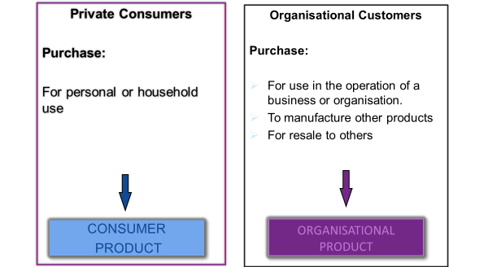
Customer types
There are two broad customer types:
  Private Consumers - B2C (business to consumer)
  Organisational Customers - B2B (business to business)

Slide 8
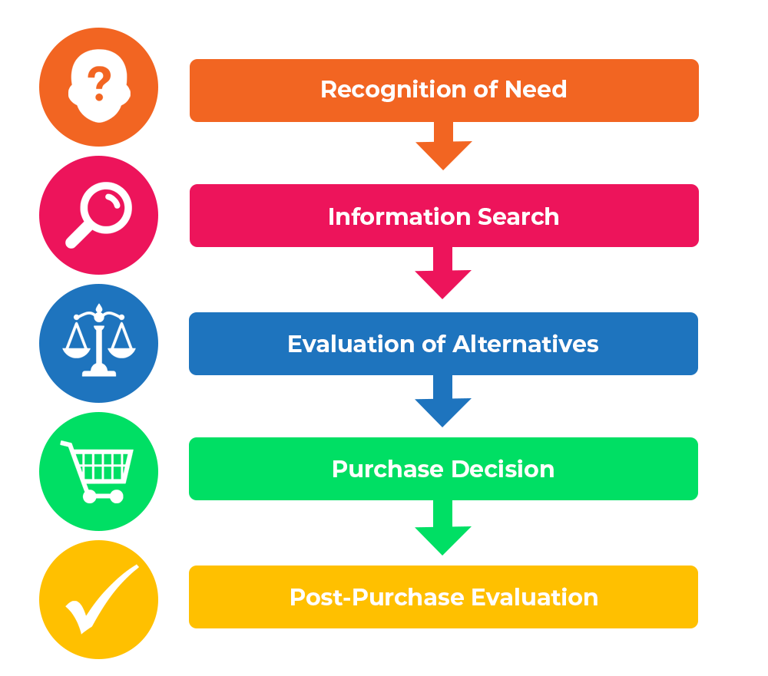
Consumers’ decision-making process
This model outlines the steps taken throughout purchasing process
It is rooted in cognitive psychology; hence, it deals with problem-solving, decision-making, motivation etc. (Fahy and Jobber 2022)

Slide 9
Decision making in practice
I’m hungry
What’s available?
Cakes or chocolate?
Problem recognition
Information search
Information evaluation
Mars Bar
I should have had cake ☹
Decision
Post purchase evaluation

Slide 10
Task
Working in pairs, think of a recent purchase you have made.
Discuss what happened at each stage of the buying process.
What influenced you at each stage?

Slide 11
Step 1: problem recognition
In the first stage, a consumer acknowledges that they have a need for a product or service. The awareness of need can arise from either an internal or an external stimulus.
An example of an internal stimulus might be hunger informing a consumer's pursuit of something to eat.
An external stimulus could be an advertisement that appeals directly to a particular consumer.

Slide 12

Step 2: information search
Once the customer has identified a need, they will search for information.
Purpose: to build up enough knowledge to feel secure in making a reasoned decision.
First: internal information search whereby the customer attempts to make a decision based on their existing knowledge.
Then: external information search, including talking to friends or experts, reading relevant sales material, or searching the internet for reviews.
Varies considerably for different product categories.

Slide 13

Step 3: evaluation of alternatives
The customer compares alternatives based on criteria derived from their needs and product knowledge.
  This is a very personal choice and different people will evaluate against different criteria.
  For example - features or benefits sought, budget etc
Marketers try to help customers evaluate alternatives effectively to encourage them to move to the purchase stage.
If a customer is not happy with the options, they may delay purchase or return to the information search stage,

Slide 14

Step 4: purchase decision
Purchase Stage
  Involves the trade of money for a product or service
  Shoppers in bricks and mortar stores rarely abandon their carts
  Abandonment of virtual shopping carts is quite common and provides marketers with real challenges.

Slide 15

Step 5: post-purchase evaluation
After the Purchase, customers may experience ‘cognitive dissonance’
  Cognitive Dissonance is the feelings of uncertainty as to whether they made the right decision.
  It is common for customers to seek reassurance from friends, family, people who have made the same purchase decision
  It is important that customers feel happy with their decision as this leads to word-of-mouth marketing and potential long-term customer relationships.

Slide 16

Overcoming cognitive dissonance
What can businesses do to avoid cognitive dissonance or to help customers to overcome it?
  Ensuring that pre-purchase expectations are realistic (e.g., making reviews from other customers visible)
  Offering post-purchase service (e.g. extended warranties)

Slide 17

Consumer Buying Situations
Routine response behaviour
  When buying frequently purchased, low-cost items.
Limited decision making behaviour
  When purchasing products only bought occasionally and for which a moderate amount of information and deliberation is required
Extensive decision making behaviour
  When buying unfamiliar, expensive or infrequently purchased items. Time ,maybe spent comparing, seeking out extensive information.
Notes:
Give me examples

Slide 18
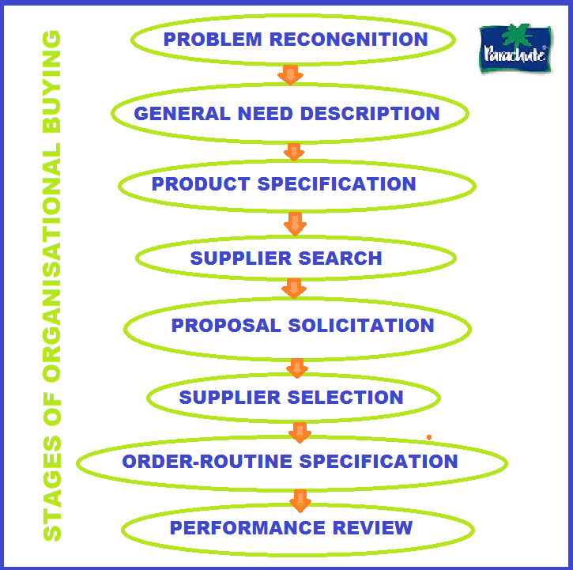
Organisational decision-making process
B2B

Slide 19
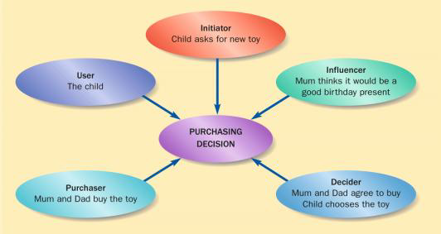
Decision-Making Unit (DMU)
Brassington & Pettitt (2006)
Notes:
The buying roles
Roles
Initiator – A person who first suggests the idea of buying the particular product or service
Influencer - A person whose view or advice influences the decision
Decider - A person who decides on any component of a buying decision; whether to buy, what to buy, how to buy, or where to buy
Buyer - The person who makes the actual purchase
User - A person who consumes or uses the product or service.
Wife and husband
Parent and child, etc.

Slide 20
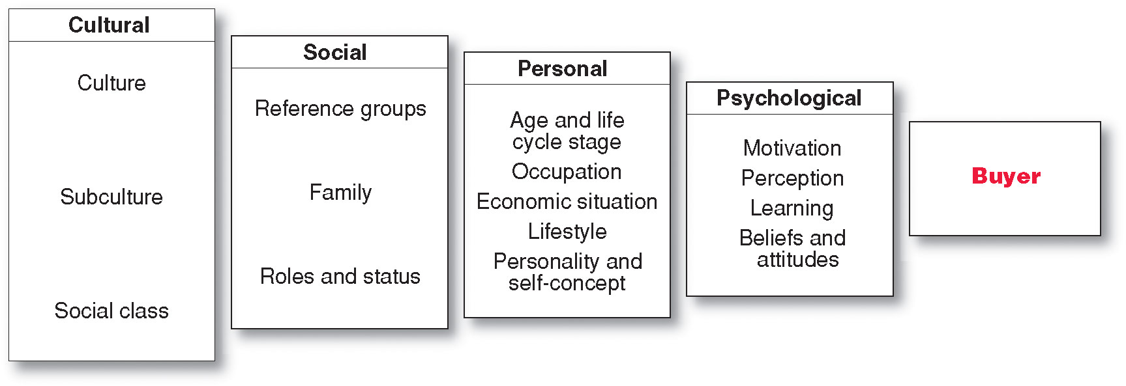
Characteristics Affecting Consumer Behavior
Factors Influencing Consumer Behavior
Copyright Pearson Education
Notes:
Consumer purchases are influenced strongly by cultural, social, personal, and psychological characteristics, as shown here. This is the individual.
For the most part, marketers cannot control such factors, but they must take them into account.

Slide 21
Factors influencing consumer behaviour cultural factors
Culture – set of basic values, perceptions, wants and behaviours learned by a member of society from family and other important institutions
Subculture – A group of people with shared value systems based on common life experiences and situations
Notes:
Global v local is an important factor in marketing planning and one which is affected by cultural influences. These can include language, religion, beliefs & social norms.

Slide 22
Example of localised advertising for different cultural markets
McDonalds golden arches UK VS Arabia
How McDonald's executed on producing the same ad for different markets... | localizing ads | TikTok

Slide 23


Slide 24


Slide 25


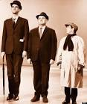
Factors Influencing Consumer Behaviour social factors
Social Factors
Small Groups
Family
Social Roles & Status – Class

Slide 26
Factors Influencing Consumer Behaviour personal factors
Age and life cycle
Economic Situation
Personality and self concept
Lifestyle

Slide 27
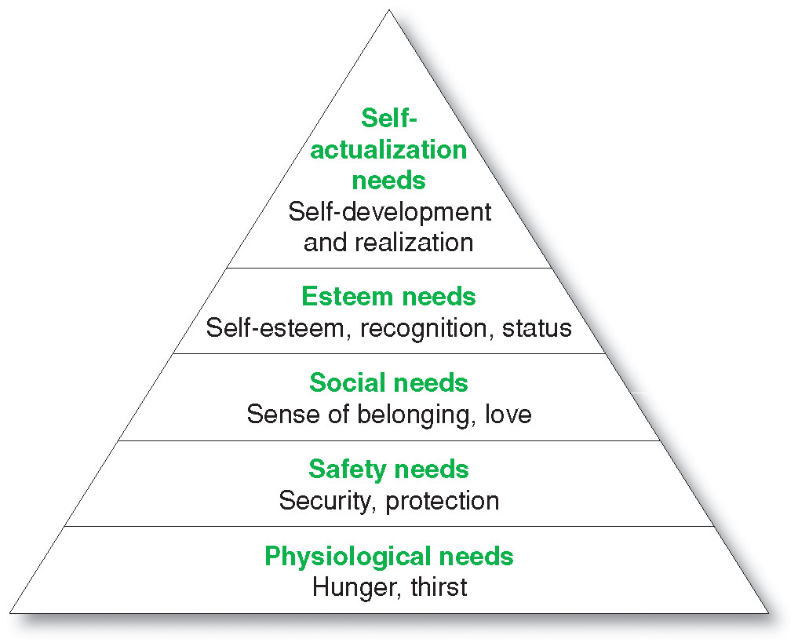
Factors Influencing
Consumer Behavior - Psychological
Maslow’s
Hierarchy of Needs
A motive (or drive) is a need that is sufficiently pressing to direct the person to seek satisfaction of the need
Copyright ©2014 by Pearson Education
Notes:
Maslow sought to explain why people are driven by particular needs at particular times. Why does one person spend a lot of time and energy on personal safety and another on gaining the esteem of others? Maslow’s answer is that human needs are arranged in a hierarchy, as shown in Figure 5.4, from the most pressing at the bottom to the least pressing at the top. They include physiological needs, safety needs, social needs, esteem needs, and self-actualization needs.
A person tries to satisfy the most important need first. When that need is satisfied, it will stop being a motivator, and the person will then try to satisfy the next most important need. For example, starving people (physiological need) will not take an interest in the latest happenings in the art world (self-actualization needs) nor in how they are seen or esteemed by others (social or esteem needs) nor even in whether they are breathing clean air (safety needs). But as each important need is satisfied, the next most important need will come into play.

Slide 28
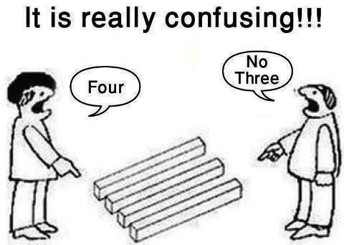
Factors Influencing
Consumer Behavior – Perception
Perception is a process by which people select, organise and interpret information to form a meaningful picture of the world

Slide 29
Factors Influencing
Consumer Behavior – Beliefs and Attitude
Belief: an acceptance that something exists or is true, especially one without proof.
Attitude: a settled way of thinking or feeling about something.

Slide 30
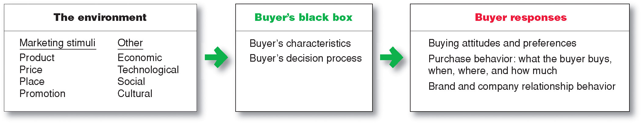
Models of buyer behaviour
-The Stimulus-response model
Source: Kotler & Armstrong Principles of Marketing pg. 159

Slide 31

Any Questions?

