Slide 1
MODULE NAME:ENTERPRISE AND ENTERPRENUERSHIP.
MODULE CODE: LCLM4006
STUDENT NAME: TASFIA AMIR
ID:2426107
LECTURER: SHENFENG MEI
TITLE: BUSINESS PLAN

Slide 2
OVERVIEW
Introduction
Business concept & company background
Environmental analysis (PESTLE)
Marketing strategy (STP & promotional methods)
Funding requirements & start-up cost breakdown
Conclusion
References
Management structure

Slide 3
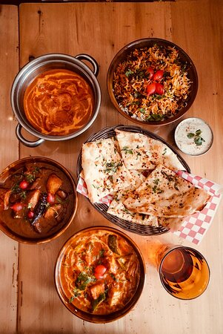
INTRODUCTION
My name is Tasfia, and in this presentation, I will present my business plan idea for a new Indian restaurant that’s offering Halal, vegan, vegetarian, and allergy-friendly dishes.
The restaurant will provide an inclusive, modern dining experience designed for families, students, and professional workers.
This plan outlines the business concept, marketing strategy, environmental analysis, funding that needed, and financial forecast required to launch and grow a restaurant successfully

Slide 4
Modern Indian restaurant that’s offering Halal, vegan, and allergy-friendly dishes.
Targets families, students, and professionals seeking safe and cultural food options.
Focuses on authentic flavours in a clean, friendly, and inclusive dining environment.
Will provide dine-in, takeaway, and delivery services through different delivery platforms .
Aims to be a trusted community restaurant known for its quality and service.
The restaurant legal format will be a Limited Liability Company.
Business Concept & Background

Slide 5
Management structure
owner
Managing director
Restaurant
Manager
Head
chef
Marketing and admin assistant
Front house supervisor
Waiting
staff
Sous chef
Tandoori
chef
Social
Media

Slide 6
PESTEL ANALYSIS
Political
Must follow the food safety and hygiene regulations. (Food Standards Agency, 2023).
Policies supporting small businesses and local restaurants, for example, loan (Gov.uk, 2023).
Economic
Rising food prices may affect ingredient costs and customer visit.
Local employment opportunities will help support the community.
Social
Increasing demand for Halal, vegan, and allergy-friendly food options.
Growing interest in Indian cuisine among families, students, and professionals.

Slide 7
Technological
Use of online ordering platforms and delivery apps will boost profit .
Social media marketing helps attracting more customers.
Legal
Must follow the food allergy labelling laws and health inspections.
Employment laws for hiring staff (contracts, minimum wage, training). (gov.uk,2023)
Environmental
Waste reduction and recycling expectations in the food industry.
Sourcing environment friendly packaging for takeaway and delivery.

Slide 8
Marketing strategy (STP & promotional methods)
Segmentation:
Muslim customers wanting Halal meals and customers with allergies
Vegans and vegetarians. Families
Families. Students and professionals
Targeting:
Value-conscious customers who want authentic halal and Indian food
People seeking convenient dine-in, takeaway, and delivery options
Positioning:
An inclusive, modern Indian restaurant that offers Halal, vegan, vegetarian, and allergy-friendly dishes

Slide 9
Marketing Methods
Social Media Marketing: Instagram, TikTok, Facebook, Google.
Digital Advertising: Paid ads targeting local customers. .
Delivery Platforms: Collaborations with UberEats, Just Eat, and Deliveroo.
Local Marketing: opening-day discounts, student deals.
Customer Loyalty Scheme: Digital loyalty app or membership discounts for the customers.
Branding: Uniforms, strong logo, and consistent visual identity.

Slide 10
Funding requirements & start-up cost breakdown
Interior décor and renovation | £15,000
Kitchen equipment | £20,000
Furniture | £6,000
License and insurance | £2,000
Epos and website | £3,000
Marketing and advertising | £3,000
Utility cost | £2,000
Emergency fund | £6,000
Total estimated | £57,000

Slide 11
Fixed cost
Rent | £2,000
Utilities | £1,000
Insurance | £200
Staff salaries | £5,000
Internet | £100
Loan repayment | £500
Total | £7,800

Slide 12
Variable cost (changes deepening on the sales)
Variable cost | Jan | Feb | Mar | Apr | May | Jun
Ingredients | £1,000 | £1,100 | £1,200 | £1,300 | £1,400 | £1,500
Delivery package | £200 | £220 | £240 | £260 | £280 | £300
Marketing, advertising | £100 | £110 | £120 | £130 | £140 | £150
Total | £1,300 | £1,430 | £1,560 | £1,730 | £1,820 | £1,950

Slide 13
Financial forecast for the first six months
Months | Fixed cost | Variable cost | Total cost | Project revenue | Profit/loss
Jan | £7,800 | £1,300 | £9,100 | £6,000 | -£3,100
Feb | £7,800 | £1,430 | £9,230 | £7,000 | -£2,230
Mar | £7,800 | £1,560 | £9,360 | £8,000 | -£1.360
Apr | £7,800 | £1,730 | £9,530 | £10,000 | £470
May | £7,800 | £1,820 | £9,620 | £11,000 | £1,380
Jun | £7,800 | £1,950 | £9,750 | £12,000 | £2,250
The restaurant faces loss for the first three month however more customers start visiting from April and we start making some profit and gradually it keeps increasing

Slide 14
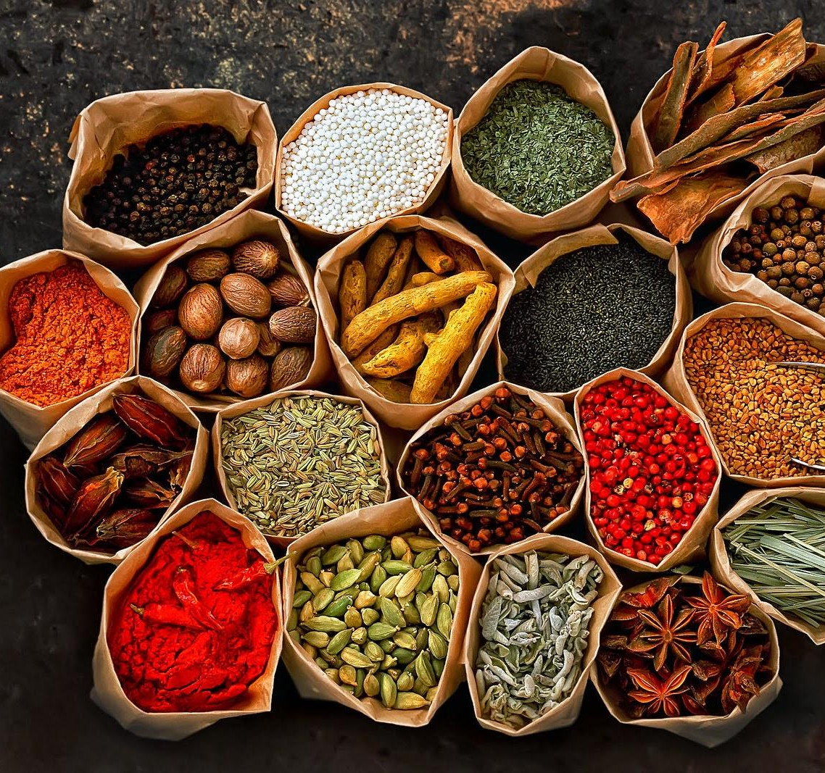
CONCLUSION
The restaurant has strong potential to succeed in the diverse market.
Offers authentic Indian flavours with a modern, welcoming dining experience.
Meets the demand for Halal, vegan, vegetarian, and allergy-friendly meals.
The marketing and PESTLE analysis will support a clear growth strategy for the restaurant .
Strong planning and quality service will help the business for long-term success.

Slide 15
REFERENCE
Food Standards Agency (FSA) (2023) Food Hygiene Rating Scheme. Available at: https://www.food.gov.uk(Accessed: 5 December 2025).
UK Government (2021) Natasha’s Law: Allergen Labelling Requirements. Available at: https://www.gov.uk/food-labelling-and-packaging (Accessed: 5 December 2025).
UK Government (2023) Employment Rights and Regulations. Available at: https://www.gov.uk/employment-rights (Accessed: 5 December 2025).
Statista (2023) Indian Restaurants and Food Trends in the UK. Available at: https://www.statista.com (Accessed: 5 December 2025).
Leela Indian Food Bar – Dundas West (2025) Leela Indian Food Bar – Dundas West, Toronto, Ontario. TripAdvisor. Available at: https://www.tripadvisor.co.uk/Restaurant_Review-g155019-d12105414-Reviews-Leela_Indian_Food_Bar_Dundas_West-Toronto_Ontario.html (Accessed: 5 December 2025).
Jalpur Millers (n.d.) Buy Indian flours and spices online: the paleo diet, Jalpur Millers Online, (accessed: 5 December 2025)

