Slide 1

HUMAN RESOURCE MANAGEMENT
(LCMB7000)
S.NO | NAME | STUDENT ID
1 | ROMEO MAKIADI | 1906720
2 | AKRAM QURESHI MOHAMMED | 2223912
3 | RELIN REJI BABY | 2228653
4 | SATHWIK RAMADUGU | 2223934
5 | NIRANJAN KONDAPALLY | 2226891

Slide 2
Staffing: Recruitment and Availability of Skilled and Local LaboUr
NATIONAL HEALTH SERVICE (NHS)

Slide 3
Table of Contents
1 Introduction
2 Factors Influencing Availability of Skilled Labor In the NHS
3 Current State of Skilled Labour in the NHS
4 Recruitment Strategies for Organizations to Overcome Challenges
5 Recruiting & Staffing in NHS
6 Placement and Orientation
7 Promotion and Transfer
8 What is Internal Source of Staffing?
9 Benefits of Internal Sources of Staffing
10 Demerits of External Recruitments
11 Sources and methods of Internal Recruitment
12 Internal Staffing and its effectiveness
13 SWOT ANALYSIS OF NHS
14 Conclusion
15 References

Slide 4

Introduction
Staffing could be defined as the procedure of hiring eligible and apt individuals to fill up specific positions in an organization. This process takes into consideration the skills and attributes of candidates to ensure the best person for the job. Hence, the presentation ahead is related to recruitment and availability of skilled local labour within the United Kingdom. It would be inclusive of factors influencing the availability of skilled labour, and the current condition of the same within the UK specifically in NHS, alongside steps that Hospitals and recruiters could take to ensure effective recruitment.

Slide 5
Factors Influencing Availability of Skilled Labour In the NHS
Several factors within the country influence the availability of skilled labour in the NHS United Kingdom. Some of these factors are discussed below:
Country Demographics
The Covid-19 Pandemic
Compensation
Notes:
1. UK’s Immigration Policy:
The immigration policy of the United Kingdom has changed after the events of Brexit. Hence, the same has made it harder for EU citizens to work in the nation. Hence, the same has reduced the availability of skilled personnel in sectors that heavily relied upon EU workers (Åhlberg and Granada, 2022).
2. The Covid-19 Pandemic:
There has been a substantial shift in the trend of online or remote working since the Covid-19 pandemic. Moreover, there are ample job opportunities available online for individuals that look for convenient-based jobs. Hence, the overall workforce within the country has now become more diverse and distributed.
3. Country Demographics:
The United Kingdom comprises an ageing population, indicating that a substantial share of the skilled population is approaching the age of retirement. Hence, this highlights the risk of a skills gap within the United Kingdom as the replacement of these workers might be quite tough for some sectors (UK Parliament, 2023).

Slide 6

Current State of Skilled Labour in the NHS
Currently, the nursing staff of the United Kingdom has been facing certain difficulties in its labour market conditions. This has led to major inconveniences for industries to recruit local skilled individuals into their organizations. Hence, below is an assessment of the current state of skilled labour in the country:
1. Recruitment Challenges:
There has been an active shortage of practicing medical student in Hospital all over the country. For example, sectors like respiratory and musculoskeletal experienced major challenges in recruiting skilled and required individuals for their vacancies.
Notes:
Recruitment Challenges:
The reasons for these vacancies have been the rise of demand and low supply of labour post-pandemic due to economic inactivity. Moreover, Brexit has also caused inefficiencies in the supply of labour within the countries (House of Commons, 2023). Additionally, there has been a substantial rise in working inactivity lately within the country, where people in huge groups are leaving their jobs altogether. This enhances the challenge for companies to recruit more individuals to fill up their job vacancies (Partington, 2023).

Slide 7
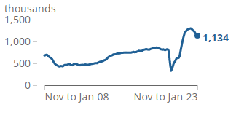
Cont…
2. High Number of Vacancies:
As per the data from the Office of National Statistics (2022), in September-November 2022, there have been more than 1.19 million vacancies within the country.
Job Vacancies Rate from November-January 2008 to November-January 2023
(Source: Office of National Statistics, 2023)
Notes:
2. High Number of Vacancies:
In terms of sectors, social work and human health have reported the highest number of vacancies. Furthermore, accommodation and food also reported a substantial rise in job vacancies in the UK.

Slide 8
Recruitment Strategies for Organizations to Overcome These Challenges
Certain ways in which organizations can help overcome these challenges and recruit apt people for their jobs are explored further:
Internships and Apprenticeships
Diversity and Inclusion
Recruitment Strategies
Technological Interventions
Promotion of Positive Employment Culture
Notes:
1. Internships and Apprenticeships:
An essential approach that companies in the UK must adopt for improving the state of a labour shortage is to provide internships, as well as apprenticeships to skills individuals. In this way, it would help in the training and development of young individuals (Wonthey, 2019). In addition, through this, the firms would also be providing them with the required work experience to build an appropriate career for themselves in future.
2. Diversity and Inclusion:
Organizations could expand the efforts of their recruitment processes and ensure focus on better diversity and inclusion efforts. The firms could do so by actively engaging in recruiting candidates from diverse backgrounds, such as from various under-represented groups. In this manner, companies would give a platform for these people to showcase their abilities and in turn, the organizations would be getting better talents and improvements at the workplace.
3. Technological Interventions:
Another tactic that firms could implement is that they could utilize various technological solutions and transit towards automation. This would help the firms in enhancing efficiencies, as well as free up the workers and employees to emphasize higher-level operations requiring specialized skill sets (Wilburn and Wilburn, 2018).
4. Promotion of Positive Employment Culture:
With the current state of inflation within the country, as well as economic inactivity, it is imperative that organizations collectively help in maintaining the balance in the level of skill enhancements and remunerations provided to individuals (Tamunomiebi and Worgu, 2020). The agenda behind this strategy must be to retain top talents and improve and develop young employees. Along with this, the firms must also focus on providing their workforce with benefits, competitive salaries, work-life balance and so forth that would keep them motivated.

Slide 9

Internal Source of Staffing

Slide 10

What is Internal Source of Staffing?
It means hiring people from within or inside the organization.
Seeking applicants for the job positions from those who are currently employed within the firm and no outsiders are permitted in the internal sources.(accountlearning.com)
Vacancies at higher maybe filled up by promoting persons from lower levels also depending upon their job standards and responsibilities.
Notes:
Internal staffing means hiring people from within organisation. They are already an employee belonging to the organization.So the plan goes of hiring people from within organisation no outsiders are allowed,Vacancies are filled according to the availability and sources depending upon the job.

Slide 11
Benefits of Internal Sources of Staffing
It is the most practical and affordable way to fill open roles in an organization.
It ought to be the ideal strategy for inspiring current workers.
Enhance overall responsibility and demonstrate workers' finest work.
Additionally, because they are obtaining job rotations in their working lives, it allows the employees readily train for better jobs.(bika,n.,resources.workable..com)
Demerits of External Recruitments
Frustration among present employees because when a new member is added the existing employees who aspire for promotion fail to get the same and naturally takes time to get adjusted with nature and system of the organization.
Also are expensive method where the costs are incurred in advertising job vacancies, holding tests and interviews.
A time consuming process.
Notes:
One of the most important benefits is that it is most economical and easiest way of filling positions in an organizationAlso becomes a best way to motivate employees to work more and responsibly to achieve their higher careers..This help in increasing the job standard of the employee .. get well trained and motivated towards their goals.
Demerits....Also causes frustrating and pressure for employees because they have to get well trained and existing feel it more pressure

Slide 12
Sources and methods of Internal Recruitment
Transfer : Employees are transferred when they go from one employment position to another while maintaining the same degree of responsibility and status.
Promotion: This is when a person moves from one position to another with more responsibility.
Employee Referrals: With this approach, a current employee can recommend a member of their family or a person they know personally for open positions inside the company. The best example is the NHS, where nurses are free to change hospitals as they see fit, depending on their preferences for locations or departments, as long as there are openings.
Former Employees: Hiring retired individuals or individuals with extensive expertise in the role they had can also be referred to as internal sources of recruiting. The crucial element is the knowledge and experience about their past working life. They can work part-time or full depending upon the availability and requirement of the organization.
Notes:
One of the method is transfer where employees are transferred in same. Level of working to fill up the positions but there is no big change in rank or responsibility
Promotion... Shifting employees to next level and higher responsibility

Slide 13
Internal Staffing and its effectiveness
The simplest way internal applicants can be motivated and promoted is internal recruitment. Through this the managers can identify the most qualified candidates; formal techniques also ensure that employees have an equal opportunities to find out about openings and apply for them a job posting system.(fica,T 2018)
Management finds this method most cost effective than running ads or engaging in external recruiting.(humaans.io.2021)
So when there are vacancies available for certain positions in an organization, the management decides whether the priority should be given to internal staffing or external. If an appropriate candidate is found suitable and eligible for the required post, the management takes necessary steps by providing a way to accomplish the plan.
Because the existing employee is already used to the company systems and procedures, and policies, also well trained so this makes the task simpler and in other hand also motivates employees to more responsible and suit for best positions.
Notes:
This source of staffing motivates employees.. a big chance will be opened for employees to work and get to their desired position in future
This must be one of the most cost effective method and depending upon the vacancies open the right candidate can be place don right position.

Slide 14
Recruiting & Staffing in NHS
NHS’s recruitment process focuses equally on hiring local and international employees and there are particular roles like clinical support workers for which the establishment only goes for local recruitment (UK Parliament, 2022).
They also attempt at increasing apprenticeships and this ranges from entry level jobs to senior positions in scientific, clinical, and managerial roles.
This provides the establishment with opportunity to create high variety of roles in the healthcare settings while offering various opportunities to individual for earning and gaining valuable work experience in this field (NHS England, 2020).
Notes:
They are also focused on expanding the workforce in primary care, which is supported by ICSs and systems. Under the Additional Role Reimbursement Scheme, they aim to recruit 26,000 more employees by 2023-24 (NHS England, 2020). Considering staffing crisis in recent years due to the pandemic, this scheme would help them to address the issue at large.

Slide 15
Recruiting & Staffing in NHS
For international recruitment, a new ‘Health and Care Visa’ was introduced in 2020.
This allows the NHS to rapidly recruit registered healthcare workers from overseas (NHS England, 2020).
Considering the high standards in their staffing, they equally prioritise co-ordinating with labours from the international markets and offer training in English language.
Notes:
Under their international recruitment nursing programme they are also building local hubs, driving incentive trusts for developing system-level models of overseas staffing (NHS England, 2020).

Slide 16
Placement and Orientation
NHS believes in assessing skills and capabilities of individual candidates for determining their placements.
Observational placement is practiced by the establishment as it allows them to assign candidates with GPs so that they can learn more about their roles, responsibilities, and work in the NHS (NHS choices, 2023).
This also enables the applicants to recognise the opportunities and day-to-day duties practiced by the GPs on a regular basis.
Notes:
Generally, the orientation process was designed to support managers and trainees for planning an effective and valuable orientation experience for the newly recruits. Their orientation programme is about allowing the applicants to understand the experience from patient’s perspectives. 20 working days are allotted for completing orientation exclusive from education dates (NHS Leadership Academy, 2021).

Slide 17


Promotion and Transfer
Their transfer scheme allows for transferring nurses internally by allowing them to develop skills and knowledge.
Promotional opportunities are carried out in a usual manner, which starts from the first incremental point (NHS Employers, 2023).
Notes:
This combines a number of factors such as increasing the basic pay, improving the payments for unsocial hours, and determining their positions under the long-term employee recruitment and retention programme. The internal promotions are carried out with the intent of improving employee and knowledge retention (NHS Employers, 2022).

Slide 18



Identifying the need for training and development.
This can be done by determining the precise training standards for the medical staff.
Performance reviews
Comments from patients or co-workers
Research into market trends and the best techniques.
All these methods can be used to achieve this. Prioritiesing the training programs that will help the individual in majority of the areas where they need to develop more than any other.
Notes:
To verify that doctors and nurses are putting their newly acquired knowledge learnt into practice on a continuous basis, offering them ongoing assistance and coaching and mentorship roles. This can also incorporate feedback evaluation, and follow-up meetings.

Slide 19
Identifying the training strategies for development.
The best training strategies depending on the unique requirements of the doctors and nurses.
eLearning
seminars,
meetings,
simulations,
practical learning scenarios
These are a few efficient training techniques for medical practitioners (Armstrong,2014)
Notes:
To verify that doctors and nurses are putting their newly acquired knowledge learnt into practice on a continuous basis, offering them ongoing assistance and coaching and mentorship roles. This can also incorporate feedback evaluation, and follow-up meetings.

Slide 20

The procedure may differ slightly regarding merging training for nurses and doctors. further considerations to consider while including training for each group.
1.Ensure the training course corresponds to their specific areas of competence or desire (Armstrong,2014)
2.To inform all doctors of the` most recent medical developments, implementing medical magazines, studies that have been peer-reviewed, and conferences.
3.Incorporate training on effective communication skills with patients and nurses including, other healthcare professionals and incorporating emotional intelligence newsletters weekly.
Notes:
Periodical evaluations of the development program's success need to be completed. This data could be obtained via Survey results, recommendations from health care professionals, and performance data analysis.

Slide 21
The procedure may differ slightly regarding merging training for nurses and doctors. further considerations to consider while including training for each group.
Nurses
Emphasize on
Emphasize on efficiency, which will require practical guidance to aid in the development of their clinical competencies.
Include
Include cooperation, leadership, and compassionate treatment training.
Provide
Provide possibilities for job progression, such as degree programmes or specialist nursing credentials.
Notes:
Periodical evaluations of the development program's success need to be completed. This data could be obtained via Survey results, recommendations from health care professionals, and performance data analysis.

Slide 22
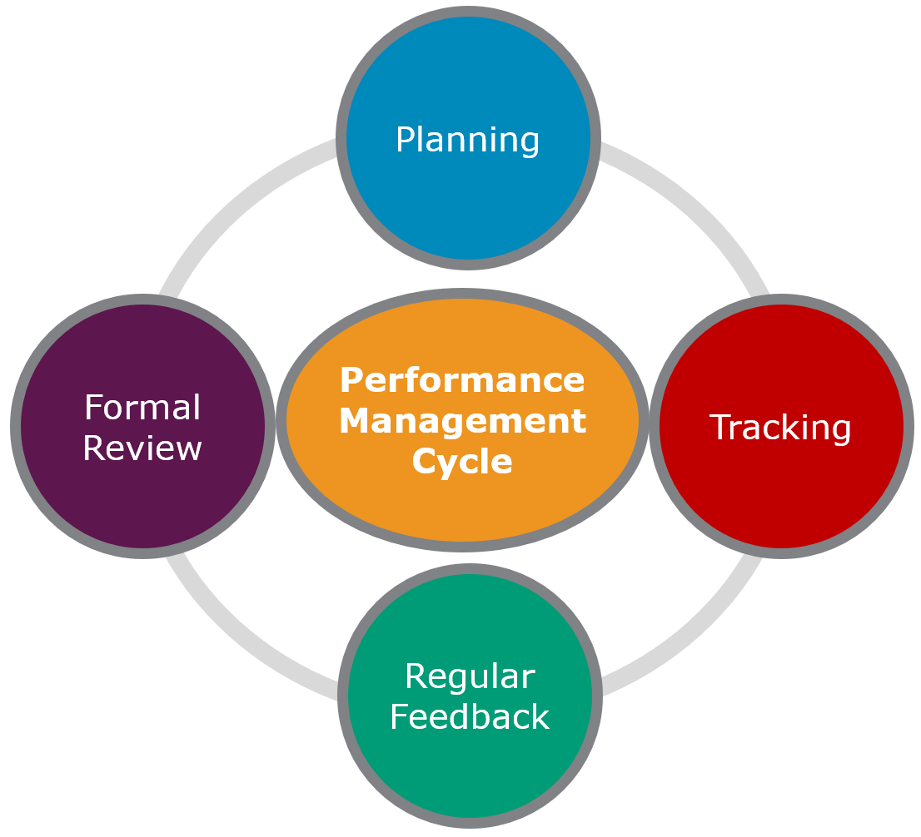
Reward Management and Incentives
A staff member puts out specific quantities of mental and physical exertion and complies with others, in exchange for an appropriate amount of compensation or incentive. (DavidsonMorris, 2021)
Notes:
Performance management cycle (Armstrong, 2014) (Hague, 2022)

Slide 23
Objectives of the reward system
Salarys, pension schemes, bonuses , holiday and sick pay, merit payment, skill-based -pay (SBP), occupation perks/Benefits (Cole,2000).
tying awards to specified indicators of performance, encouraging a work environment that embraces creativity and constant development, and praising and rewarding those that go further than expected to meet organisational goals (Armstrong,2014).
Promoting from within the organisation, Analyse the pay equity, Provide flexible scheduling, Implement programmes for diversity and equality, Establish equal opportunity for chances for advancement​
Utilising the reward system as a performance gauge. The organisation can evaluate occupation roles and determine if they are being overachieved resulting in a promotion and new fixed wage with new targets or vice versa and requirements for support in this role can identified(Armstrong,2014)
1.Retainment and enticing additional professional's
2.Make advocacies for the organisation's strategies
3.Ensure equity both internally as well as externally.
4.Maintain the organization's financial resources.
Notes:
International scenarios and a country's inflation or political stability are all factors that effect labour productivity and quality of service within employees and organisations. However an assessment of reward vs cost would be fundamental in the decision process of adequately dispensing rewards.
Three decisions must be made-1.how much to pay, 2.Individual or collective basis of reward payments, 3. How much focus should applied to incentives.

Slide 24
Advantages and Disadvantages.
Individual incentives enable rewards to be tailored to employee preferences and make it simple to assess each person on their own merits. Promoting performance and results.
Disadvantages Many professions lack concrete outputs, making it challenging to control individual performance. Data storage obligations and constraints, perpetuate negative behaviour
Group incentives aid the notion of team co-operation, require less supervision can be developed with less difficulty than individually incentive based.
Disadvantages include the potential of employees doing others work, disagreements , discount others individual output, and lessen potential productivity and effort due to less responsibility.
(In class reference, Chapter summary fundamentals of human resources )

Slide 25
Contracts and Interns
Employment Relationship contracts
Traditional – formal with clear a exchange of terms and obligations between employee and employer with financial agreements and including performance necessities.
Rational – informal ,broad expectations and open clauses as the performance requirements are abstract.
Phycological contracts – commitment, passion ,experience , personality , transparency from both parties, overall emotional Wellbeing (unwritten expectations)
Employment relationship contracts are strongly influenced by reward systems, Career developments and performance reviews regarding promotion(Armstrong,2014)
Notes:
Zero hour contracts , short term contracts , fixed .dual term contracts , rolling contracts for executives , treated with terms of fairness

Slide 26
Contracts and Interns
Internships
Cons-They won't be able to support the company as consistently as a skilled full-time employee can. You might need to consider taking into consideration probable misconceptions or early errors in their work because they are missing this experience. Personnel might loose productivity and time if an intern needs special training while learning their duties (Murphey, 2023).
Pros-They are young and recently graduated from university or higher education, thus they have a wide range of transferrable abilities. An intern's enthusiasm is one of a company's most important assets. More inclined to continue around and support your company for longer, rewarding you with their loyalty (Murphey, 2023).
Notes:
Using a shift scheduler, so the student assistant is not taking up excessive amounts of an employee's time.

Slide 27
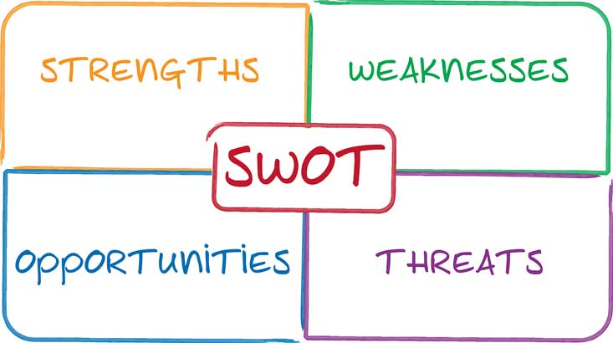
SWOT ANALYSIS OF NHS
STRENGTHS
ENANCHED PATIENT CARE:
Doctors can make better decisions regarding the care of their patients with the help of patient records, which are readily accessible. This eliminates errors and helps them make informed decisions for NHS. (Goldberg et al., 2002)
FUNCTIONAL REGULATION IS HIGH:
The use of information technology in NHS has greatly improved their efficiency. It has also eliminated various manual activities and duplicated information. (Conger and Chiavetta, 2006)
FUNDING FOR IT PROJECTS:
The NHS utilizes IT to operate its clinical and administrative systems, which include its billing and patient data. The hospital's investment in such projects ensures that it can continue improving the quality of patient care. (Cohen, 2005).

Slide 28
SWOT ANALYSIS OF NHS
WEAKNESS
NO STRUCTURAL INCORPORATION:
The treatment of a patient involves using various systems within a hospital. Unfortunately, the lack of integration of these components has a negative impact on the decision-making process and efficiency of the facility in NHS. (Cohen, 2005).
IT ACQISITION IS MODERATE:
The high cost of implementing new technology and the lack of competition are some of the factors that have caused hospitals to slow down in adopting new systems. (Hough, Chen, & Lin, 2005)
FINAL CUSTOMER WITHSTAND:
The other main reasons why end-users are reluctant to adopt new systems are the lack of familiarity with them and the threat of job loss.

Slide 29
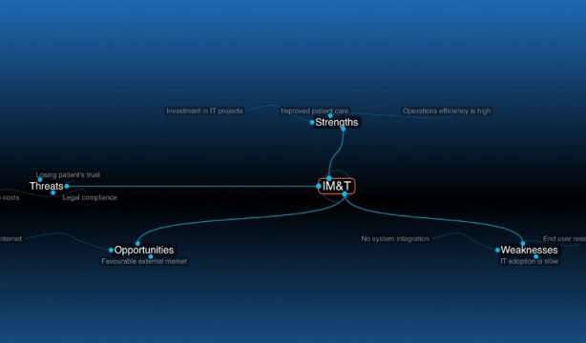
SWOT ANALYSIS OF NHS
OPPURTUNITIES
APPROVING THE EXTERNAL RETAILERS:
The government's funding and grants for technology upgrades are an excellent way to speed up the adoption of new systems (NHS Accelerator, 2017).
ONLINE PLATFORM:
The internet has opened new communication channels between patients, healthcare professionals, and the general public. It has also improved the efficiency of web-based applications and created awareness regarding the various services that a hospital provides. (DeShazo et al., 2005).

Slide 30
SWOT ANALYSIS OF NHS
THREATS
FEAR OF LACKING THE CUSTOMERS CONFIDENCE:
In order to maintain the trust of its patients, a hospital must utilize all available resources to minimize errors and ensure that records are obtainable at the appropriate time. The accuracy and availability of data are vital factors that hospitals must consider in order to maintain their patient's trust. (Kohn et al., 1999).
Lawful assent:
The information technology (IT) operations of a hospital are constantly under threat due to the various regulations that affect their operations. To ensure that the confidentiality of patient data is maintained, the hospital must regularly update its policies and procedures.
Heavy price:
The high cost of implementing new technology and the complexity of the system are some of the factors that prevent hospitals from adopting the latest innovations in the industry(Lopes, 2007).

Slide 31
Conclusion
Hence, the presentation determined that the state of recruitment and availability of professional doctors in the United Kingdom is quite difficult lately. Factors like Brexit, as well as the Covid-19 pandemic, harmed the supply and demand of labour. Furthermore, while the state of remote doctors, online recruitment and job opportunities has enhanced, the state of surgeon in sectors like gastroenterologists, orthopaedic surgeons, oncologists, pulmonologists, neurologists, and psychiatrists has decreased in recent years. Hence, companies must implement recruitment techniques like apprenticeships and internship programs, diversity and inclusion, alongside aspects like a technological intervention to help overcome the current state of labour conditions in the country.

Slide 32
References
Accountlearning. (n.d.). staffing. accountlearning.com. management studies.
Åhlberg, M. and Granada, L., 2022. The making of irregular migration: post-brexit immigration policy and risk of labour exploitation. Journal of Poverty and Social Justice, 30(2), pp.120-140.Armstrong, M., 2014. Absenteeism. In: 13, ed. Armstrong’s Handbook of Human resources Management . London: Konan Page, p. 659.
Armstrong, M., 2014. HRM defined . In: 13, ed. Armstrong’s Handbook of Human Resource Management . London: Konan page, p. 5.
Armstrong, M., 2014. Performance and Reward . In: 13, ed. Armstrong’s handbook of human resource management . London : Konan Page , p. 331.
Available at: https://www.davidsonmorris.com/reward-management/#:~:text=Reward%20management%20is%20a%20strategic%20approach%20to%20incentivising,to%20a%20strong%2C%20positive%20company%20culture%20More%20items
[Accessed 21 April 2023].
Armstrong, M., 2014. Performance Management Cycle . In: 13, ed. Armstrong handbook of Human resource Management . London: Konan Page, pp. 337-338.
Armstrong, M., 2014. performance Assessment. In: 13, ed. Armstrong Handbook of Human resource management . London: Konan Page , pp. 339-342.

Slide 33
Armstrong, M., 2014. The Meaning of Performance. In: 13, ed. Armstrong Handbook of human resource management. London: Konan Page, pp. 334-335.
Armstrong, M., 2014. The Psychological Contract. In: 13, ed. Armstrong Handbook of Human resource Management . London: Konan Page , pp. 419-421.
Bika, N. (n.d.). Resources for employers. Retrieved from resouces.workable.com: resources.workable.com/stories-and-insights/advantages-disadvantages-of-internal-recruitment
Conger, T. and Chiavetta, D. (2006) ‘The pulse of industry’, Industrial Engineer, 38(1), pp. 30–35.
DavidsonMorris, 2021. Reward Management Best Practise Guide. [Online]
DeShazo, C., Fessenden, R. and Schock, P. (2005) ‘Rnalizing IT’s Potential’, Physician Executive, 31(4), pp. 26-29.
fica, t. (2018, Aug 28). bamboohr. Retrieved from bamboohr
blog: https://www.bamboohr.com/blog/benefits-of-internal-recruiting
Goldberg, R.M., Kuhn, G., Andrew, L.B. & Thomas, H. A (2002) ‘Coping with medical mistakes and errors in judgment’, Annals of Emergency Medicine – An International Journal, 39(3), pp. 287-292.
Hague, W., 2022. CIPD profession map. [Online]
Available at: https://peopleprofession.cipd.org/profession-map
[Accessed 22 April 2023].
Helms, M. et al. (2008) ‘Information Technology (IT) and the Healthcare Industry: A SWOT Analysis’, International Journal of Healthcare Information Systems and Informatics (IJHISI), 3(1), pp. 75-92.
Helms, M. et al. (2008) ‘Information Technology (IT) and the Healthcare Industry: A SWOT Analysis’, International Journal of Healthcare Information Systems and Informatics (IJHISI), 3(1), pp. 75-92.

Slide 34
Hough, C., Chen, J. and Lin, B. (2005) ‘Virtual health/electronic medical record: Current status and perspective, International Journal of Healthcare Technology and Management, 6(3), pp. 257.
humaans.io. (2021, June 03). Retrieved from humaans: https://humaans.io/blog/the-advantages-and-disadvantages-of-internal-recruitment
Murphey, D., 2023. THE 3 PROS AND CONS OF HIRING AN INTERN. [Online]
Available at: https://www.classycareergirl.com/intern-hiring-business-3-pros-cons/
[Accessed 14 April 2023].
NHS Employers, 2023. NHS terms and conditions of Service Handbook, NHS Employers. Available at: https://www.nhsemployers.org/publications/tchandbook (Accessed: April 14, 2023).
NHS England, 2020. NHS choices. NHS. Available at: https://www.england.nhs.uk/ournhspeople/online-version/growing-for-the-future/focus-on-recruitment/ (Accessed: April 14, 2023).
NHS Leadership Academy, 2021. Orientation guidance and frequently asked questions. Available at: https://se.leadershipacademy.nhs.uk/wp-content/uploads/sites/5/2021/01/Orientation-Guidance-and-FAQs-March-2021-V1-Final.pdf (Accessed: April 14, 2023).
NHS Leadership Academy, 2021. Orientation guidance and frequently asked questions. Available at: https://se.leadershipacademy.nhs.uk/wp-content/uploads/sites/5/2021/01/Orientation-Guidance-and-FAQs-March-2021-V1-Final.pdf (Accessed: April 14, 2023).
Tamunomiebi, M.D. and Worgu, V.O., 2020. Talent management and organizational effectiveness. Journal of Contemporary Research in Social Sciences, 2(2), pp.35-45.

Slide 35
UK Parliament, 2022. Recruiting and retaining NHS staff - early day motions - UK parliament. Available at: https://edm.parliament.uk/early-day-motion/59903/recruiting-and-retaining-nhs-staff (Accessed: April 14, 2023).
Wilburn, K.M. and Wilburn, H.R., 2018. The impact of technology on business and society. Global Journal of Business Research, 12(1), pp.23-39.
Wonthey, W., 2019. The Critical Role of Apprenticeship Programs. State Education Standard, 19(3), pp.30-46.

Slide 36
THANK YOU

