Slide 1



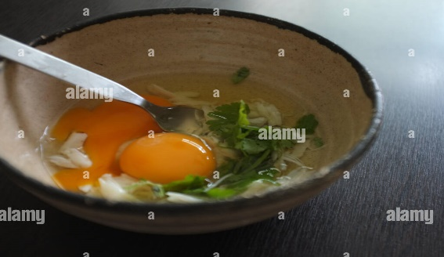
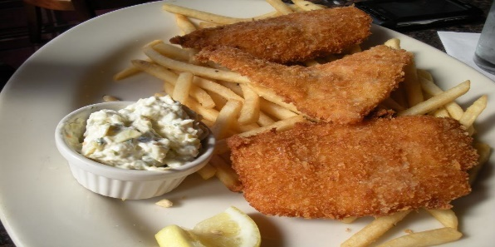



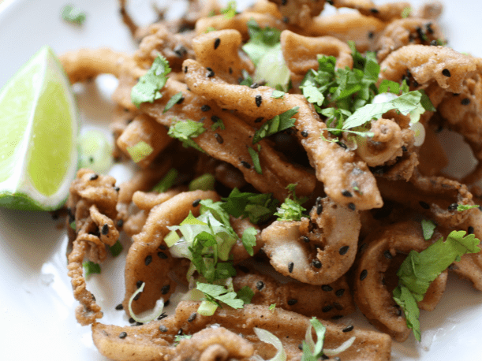

Fish and Cheaps with Clairet
Trinity Omlet
The best in Town
Price: Only £5.50
Calories: 355
Allergens: Startar Sauce, lemon, mustard powder.
Availability: 1:00pm to 03:00 pm
Order by: +44 0915 123456/Delivero/Uber Eats
Payment by
Price: Only £3.5
Calories: 154
Allergens: omlet.
Availability: 11:00am to 01:00 pm
Order by: +44 0915 123456/Delivero/Uber Eats
Payment by
Chicken Parmigiana
Seasame Coated Calamari
Price: Only £15.99
Calories: 218
Allergens: calamari tubes, spice powder, peanut oil.
Availability: 1:00pm to 03:00 pm
Order by: +44 0915 123456/Delivero/Uber Eats
Payment by
Price: Only £4.29
Calories: 340
Allergens: boneless, skinless chicken breasts, slat.
Availability: 11:00am to 01:00 pm
Order by: +44 0915 123456/Delivero/Uber Eats
Payment by
Notes:
Mansour Ghazi, K. (2016). Hotel Maintenance Management Practices. Journal of Hotel & Business Management, 5(1). doi:10.4172/2169-0286.1000136.

