Slide 1
Lighting
By
Andrew Thorn

Slide 2
Introduction
Artificial illumination for both functional and decorative purposes is a major consumer of primary energy, and developed countries have become used to very high levels of illumination
The use of daylight is encouraged in order to reduce fuel consumption for lighting but this occurs at the expense of heating and cooling energy consumption at the building outer envelope

Slide 3
Natural Illumination
By penetration of direct solar and diffuse sky visible radiation requires correctly designed passive architecture
Large glazed areas may provide sufficient day lighting at some distance into the building, but can also cause glare, overheating and high heating and cooling energy costs

Slide 4
Artificial Illumination
Is lighting provided to supplement daylight on a temporary or permanent basis
Local control of light by manual and/or automatic switches aids economy in electricity consumption
The colours rendered by objects on the working plane should match the colours under daylight
The working plane may be a desk, drawing area or assembly point

Slide 5
Natural and artificial illumination
Illumination intensity – illuminance measured in lux- on the working plane is determined by the size of detail to be discerned, the contrast of the detail with its background, the accuracy and speed with which the task must be performed and the length of time continuously spent on the task
The working plane is the surface being illuminated and other areas are lit by overspill from it and by reflections from other room surfaces

Slide 6
Typical Values of illuminance
Application illuminance (lx)
Emergency lighting 0.2
Suburban street lighting 5
Dwelling 50 - 150
Corridors 100
Rough tasks with large detail 200
Storerooms
General offices, retail shops 400
Drawing office 600
Prolonged task with fine detail 900

Slide 7
Natural and Artificial illumination
Higher levels of illuminance may be provided for particularly fine detail tasks at the area of use by local, or task illumination: for example, up to 3000 Lx for inspection of small electronic components and 50,000 Lx on a hospital operating table
Bright sunlight provides up to 100,000 Lx

Slide 8
Natural and Artificial illumination
The penetration of daylight into a building can be enhanced with north-facing roof lights, skylights have motorised louvres which are adjusted to suit the sun’s position and weather conditions, or mirrored reflectors which direct light rays horizontally into the building

Slide 9
Use of daylight reflectors
Window
Reflector
Mirrored
reflector
Daylight
penetration
Window

Slide 10
Terminology used in lighting
Contrast: - the difference in the light and dark appearance of two parts of the visual field seen simultaneously
Daylight factor: - the ratio of the natural illumination on a horizontal plane within the building to that present simultaneously from an unobstructed sky, discounting direct sunlight

Slide 11
Terminology used in lighting
Efficacy: - luminous efficacy is the lamp light output in lumens per watt of electrical power consumption
Glare : - the discomfort or impairment of vision due to excessive brightness
Illuminance: - the luminous flux density at a surface in lumens per square metre (l/m2 lux). The surface is

Slide 12
Terminology used in lighting
Illumination: - process of lighting an object or surface
Lumen, Lm: - SI unit of luminous flux. It is the quantity of light emitted from a source or received by a surface
Lux, Lx: - SI unit of illuminance, 1 Lx = 1 Lm/m2

Slide 13
Terminology used in lighting
Light loss factor: - the overall loss of light from the dirtiness of the lamp (0.8), luminaire (0.95). Preferred to maintenance factor
Luminaire: - the complete apparatus that contains the lamp, the light emitter and the electrical controls
Utilisation factor: - the ratio of the luminous flux received at the working plane to the installed flux.

Slide 14
Maintenance
Cleaning Schedule
Windows and skylights
Luminaires
Sensors

Slide 15
Maintenance
Check sensors
Make sure the sensors are operating properly. One simple check is to obscure daylight sensors- this should bring the lights on
Check times on lights are showing the correct time and that the settings meet business requirements
Make sure these are altered when the clocks change during the year

Slide 16
Establish a maintenance programme
Maintenance can reduce costs by up to 15% as well as improving light output and appearance
List equipment that should be maintained with notes on frequency of actions
Keep an ongoing schedule of maintenance activity to ensure nothing is inadvertently missed
Without regular maintenance light levels can fall by at least 50% in 2 – 3 years

Slide 17
Replace failing lights
Maintenance is an excellent time to change for efficiency. Failing lamps and dirty fittings reduce the quantity (and sometimes the quality) of light that enters the room
As well as costing in terms of energy, this can lead to unnecessary use of task lighting, and even have safety implications
During any maintenance, consider if there are more efficient alternatives available

Slide 18
Replace failing lights
A maintenance schedule can be adapted to accommodate individual circumstances. For example, industrial premises may have many lights mounted at height (high bay). Replacing all of them at the same time ensures that all lights in an area are the same age and reduces the risk of failure
It can be cheaper to operate this way, especially if equipment is required to reach the lamps

Slide 19
Maintenance
Always replace or remove fluorescent tubes that are not working. The ballast uses around 25% of the energy of a lamp and fitting for mains frequency lighting, and around 10% for high frequency lighting
Significant amounts of energy will still be consumed even when the failed tube is not lit, so removing it is important

Slide 20
Utilisation factor
The utilisation factor is provided by the manufacturer and takes into account the pattern of light-distribution from the whole fitting, its light-distributing efficiency, the shape and size of the room for which it is being designed and the reflectivity of the ceiling and walls
Values vary from 0.03, where purely in direct distribution is employed, the room has poorly reflecting surfaces and all the light is upwards onto the ceiling or walls, to 0.75 for the most energy-efficient designs

Slide 21
Luminance factors for painted surfaces
Surface Typical colour Luminance factor range(%)
Ceiling White, cream 70 - 80
Ceiling Sky blue 50 - 60
Ceiling Light brown 20 - 30
Walls Light stone 50 - 60
Walls Dark grey 20 - 30
Walls Black 10
Floor 10

Slide 22
Utilisation factors
Luminance factors Room Index
Ceiling Walls 0.75 1 1.25 1.5 2 2.5 3 4 5
70 50 48 53 59 64 71 75 79 83 86
70 30 40 46 51 57 64 69 73 78 82
70 10 35 40 46 51 59 64 68 74 78
50 50 43 48 52 57 63 67 70 74 76
50 30 37 41 46 51 57 62 65 70 73
50 10 33 37 42 46 53 58 61 67 70
30 50 39 42 46 50 55 59 61 65 67
30 30 34 37 42 46 51 55 58 62 65
30 10 30 33 38 42 48 52 55 59 62

Slide 23
Utilisation factors
The configuration of the room is found from the room index:
Room index = lw
H (l + w)
Where l is the room length (m), w is the room width (m) and H is the height of the light fitting above the working plane (m)

Slide 24
Glare and reflections
Disability glare is when a bright light source prevents the subject from seeing the necessary detail of the task
Veiling reflections can be formed on windows and visual display unit screens from nearby lamps
A limiting glare index is recommended for each application, for example, general office 16, and this can be calculated

Slide 25
Glare and reflections
To maximise contrast on the working plane, luminaires should be placed in rows parallel to the direction of view
The rows should be widely spaced to form work areas between them
The zone of the ceiling that would cause glare or veiling reflections can be viewed with a mirror on the working plane from the normal angle of work
A luminaire or direct sunlight should not appear in the mirror

Slide 26
Lumen design method
The number of light fittings is found from the total lumens needed at the working plane and the illumination provided by each fitting using the formula
No of = lux X working plane area m2
Fittings LDL x UF x MF

Slide 27
Lumen design method
Where
LDL = lighting design lumens
MF = maintenance factor
UF = utilisation factor

Slide 28
Lumen design method
New streamlite luminaire with two colour fluorescent lamps, 1500mm long, emits 5,100 lumens measured at 200hrs of use. This is known as its lighting design lumens (LDL)

Slide 29
Example 1
A drawing office 16m x 11m and 3m high has a white ceiling and light-coloured walls. The working plane is 0.85m above the floor. New streamlite double-lamp luminaires are to be used and their normal spacing-to-height ratio SHR is 1.75. Calculate the number of luminaires needed and draw their layout arrangement. Find the electrical power consumption of the lighting system assuming each luminaire consumes 140W of power

Slide 30
Example 1
Using table of luminance factors, are 70 for the ceiling and 50 for the walls. A high standard of maintenance will be assumed, giving a maintenance factor of 0.9. The lighting design lumens is taken as 5100 lumens for the whole light fitting. The illuminance required is 600 lm/m2

Slide 31
Example
The height H of fittings above the working plane is
H = (3.0 – 0.85) m = 2.15m
Room Index = l W___ = 16 x 11
H (l + w) 2.15 (16 + 11)
Room Index = 3.03

Slide 32
Example
Using table for utilisation factors for a room index of 3
Utilisation factor = 79% = 0.79

Slide 33
Example
No of = 600 x (16 x 11)
Fittings 5,100 x 0.79 x 0.9
= 29.12 or 30 luminaires

Slide 34
Example
The ratio of spacing S between rows to the height H above the working plane is
SHR = S = 1.75
H
Therefore
S = 1.75 H
= 1.75 x 2.15
= 3.76

Slide 35
Example
16.0m
1.74m
3.76m
11m
3.76m
1.74m

Slide 36
Example
Power consumption
= 30 fittings x 140w
= 4, 200w

Slide 37
Lighting Systems
Made up of three basic components
Lamp
Luminaire
Controls

Slide 38
Lighting Systems
The lamp is central to any lighting system and choosing the right one is vital for maximising savings
The light from each type of lamp can be defined in terms of colour, brightness and warmth
Lamps can also be compared by their efficiency and life

Slide 39
Lighting Systems
Qualities of systems and components
Efficacy: - the amount of light provided relative to the amount of energy used, measured in lumens per watt once the lamp has reached full brightness. The higher the value the more light is gained for the same energy
Lamp life: - how long the lamp should last in operating hours
Warm up: - the time it takes for a lamp to reach 80% of maximum output from cold

Slide 40
Lighting Systems
Qualities of systems and components
Re-strike: - time taken for a warm discharge lamp to reach 80% of maximum light output when power is interrupted
When considering lamp types choose the most efficient (highest efficacy) to meet but not exceed general lighting needs (such as brightness or colour) and regulations (such as health and safety)

Slide 41
Categories of lamp
There are three main categories of lamp which create light differently
Filament lamps
Discharge lamps
Light emitting diodes (LEDs)

Slide 42
Filament Lamps
Light is produced when the filament gets so hot it glows. This is a fundamentally inefficient method, producing more heat than light
This is the way all ‘traditional’ tungsten light bulbs work
A variant of this is the tungsten halogen, which also employs a filament, but in a bulb containing halogen gas

Slide 43
Filament lamps
Are very common, although their poor efficacy means that they are increasingly being replaced with more efficient alternatives such as compact fluorescent lamps (CLS)

Slide 44
Discharge Lamps
Electricity creates a charge which, when applied to a gas filled lamp at the correct voltage causes the gas to emit energy as light
To obtain and maintain the correct voltage, additional control gear called ballast is needed
This is how most non-tungsten lights work including fluorescent, sodium metal halide and mercury

Slide 45
Light Emitting Diodes
LEDs can be very efficient relying on a pure semi-conductor to emit light (but not heat or noise) as a response to an electric current
At the moment common business applications include illuminated signs, such as emergency lighting, for which they are excellent

Slide 46
Luminaires
As part of considering which lamps to use, check which fittings are required and how they will influence the light quality and efficiency
Some lamps will require particular kinds of luminaire, and many lamps can be greatly enhanced by efficient luminaires

Slide 47
Luminaires
A luminaire’s efficiency is measured by its light output ratio (LOR)
This is the ratio of the luminaire’s light output to the light output of the bare lamp, or lamps
Generally, LOR is expressed as a percentage
For most situations a luminaire with an LOR of at least 0.5 (or 50%) or greater is regarded as efficient, but to some extent this will depend on the light output distribution required

Slide 48
Luminaires
Just because a luminaire has a good ratio, it does not mean that the right amount of light will be falling into a space
This is because many luminaires also affect the direction of the light.
Consider this when planning a lighting scheme
Remember that in most cases, light fittings reduce the amount of light provided by the lamp and therefore reduce the overall efficiency of the lighting system

Slide 49
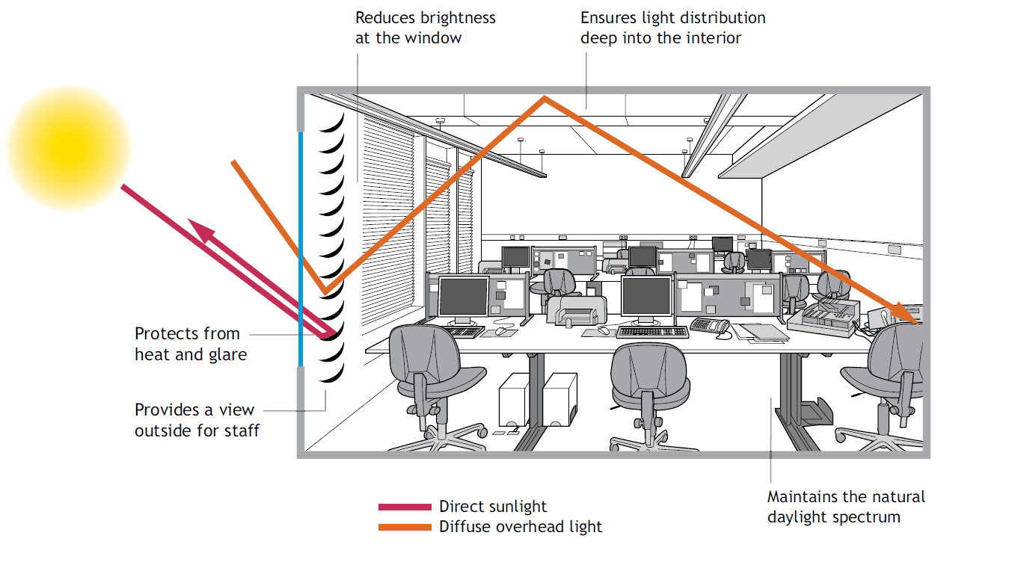

Slide 50
Reduce the Need
Reducing lighting levels and maximising the use of natural, free daylight can help save substantial sums of money and give building occupants better control over their environment
Working in areas with very high lighting levels for extended periods is difficult due to excess glare
Provide task lighting for those areas that require it

Slide 51
Make use of Natural Lighting
Keep lights off where there is sufficient daylight
Ensure windows and roof lights are not obstructed and that they are regularly cleaned
Angle blinds where possible to reflect more light onto the ceiling or into the work
Decorate walls and ceilings in light colours will help reflect light more deeply into the building

Slide 52
Reduce the number of lights
Consider removing some lamps from their fittings in non-critical areas
Make sure there is still sufficient light to satisfy health and safety requirements

Slide 53
Staff Involvement
Request feedback on problems, particularly on poorly maintained lights and areas where lighting is causing discomfort or disagreement
Find out what staff need
Involve staff in awareness campaigns
Run training in best practice and controls so that they can achieve comfortable and efficient conditions for themselves

Slide 54
Zoning Lighting
Larger work spaces have areas that require different levels of lighting
A solution to this is to create ‘zones’ wherein separate lighting controls are installed
This allows lighting to be switched off in certain areas independently
Zoning provides closer, more efficient lighting control which can improve local conditions and save on costs

Slide 55
Zoning Lighting
Should consider
Different occupancy patterns
Different lighting requirements depending on the task being carried out
Different levels of daylight provision within a building

Slide 56
Zoning Lighting
Can utilised to switch lights off that are close to windows whilst dimming those further in to provide adequate light levels
This enables occupants to make the most of natural daylight without leaving those spaces further away from windows in shadow
As a result, less lighting is used which reduces energy consumption and additional heat generated by the lights and, therefore, less cooling is required

Slide 57
Switching in Parallel
One way to arrange lighting zones is to wire switches to control lights that are parallel to windows
This enables occupants to make the most of natural daylight without leaving those spaces further away from windows in shadow

Slide 58
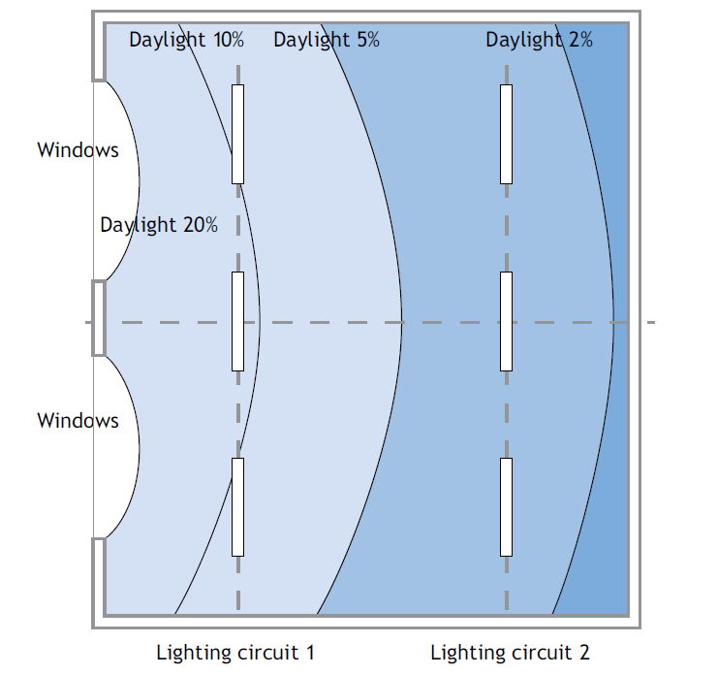
Switching in Parallel

Slide 59
Time Delay
Time delay switches installed in storerooms and cupboard spaces that are not continually occupied will prevent lights being left on accidentally. For larger spaces, it is better to install a manual switch with presence sensors to ensure the lights only go off after a set period of time in which no movement has been detected

Slide 60
Occupancy Control
Occupancy sensors help to ensure lights only operate when there is somebody there to require them
Sensors can achieve savings of up to 30% on lighting costs
They are often used in external security lighting to switch them on when a presence is detected

Slide 61
Occupancy Control
Occupancy sensors can also be used in conjunction with a manual switch to turn off lights after a set time period, again where no movement is detected
However, this option is not always suitable for areas where occupants are still for significant periods, such as offices, examination rooms

Slide 62
Photo-Electric Cells
Light sensors or ‘photocells’ can be used to switch off artificial lighting when there is sufficient natural daylight
As daylight hours vary throughout the year, sensors help to provide closer control and thus, substantial savings
They can be particularly useful for external lighting and can payback their costs in less than a year
Photo-electric controls can also enable dimming of fluorescent lamps. This application is only possible for newer lighting installations that are switched in parallel to windows and have high frequency fittings

Slide 63
Install CFLs
Compact fluorescent lamps (CFLs) will last up to eight times longer than their tungsten comparators, meaning there is less time spent replacing them
For a similar light output to tungsten bulbs, they use only 20 – 25% of the energy
Instant start-up is now available and many new light fittings are being produced that can accommodate larger lamps. Dimming is possible if high frequency control gear is specified

Slide 64
Triphosphor Coating
Specify this coating on all new fluorescent tubes
These provide a more natural, brighter light for the whole life of the tube

Slide 65
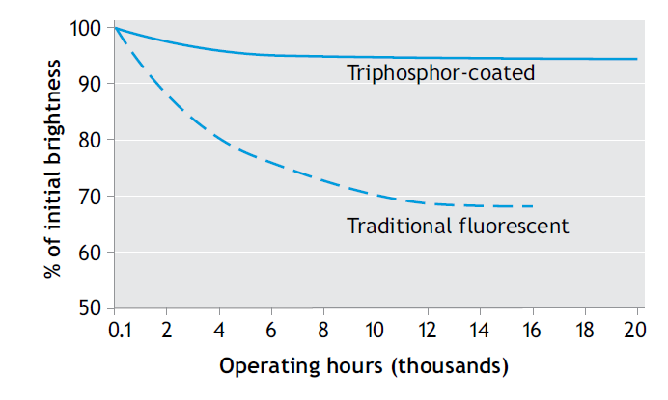
Brightness over time of Fluorescent Tubes

Slide 66
Fit Mirror Reflectors
Fluorescent lights usually sit within one of two types of fittings: either within a plastic case designed to reduce glare (a diffuser) or one with mirrors within the fitting to reflect the tube light
Reflectors increase the light falling into an area for no electricity usage and therefore lower wattage tubes or fewer tubes can be used to obtain the same light output

Slide 67
Specify High-Frequency Fittings
High-frequency fittings reduce energy use and heat output, eliminate flicker and hum, extend lamp life and can allow dimming- all of which can make a building more comfortable for staff and customers
Take care to ensure the fitting still provides the user with protection from glare

Slide 68
Issues to Consider when Designing Lighting Installation
The safety of the occupants
How lighting can help building occupants to carry out their tasks effectively
In what ways lighting can create the right atmosphere for the business
The building’s architecture
How the use of daylight can be maximised

Slide 69
Issues to Consider when Designing Lighting Installation
How lighting will dim with age
The costs of installing and operating the system
The most energy efficient design possible

Slide 70
Health & Safety Implications when Designing Lighting Installation
A safe and well-lit exit in the event of an emergency
Elimination of any deep shadows that may hide obstructions
Reduction or elimination of glare from a light source or reflection
Rotating machinery can be operated safely
A safe and well lit environment if potentially dangerous tasks are to be carried out

Slide 71
Lighting Action Checklist
Reduce the need
Good housekeeping and people
Maintain existing systems
Understanding and using controls
Upgrading and refurbishment

Slide 72
Reduce the need
Reduce lighting in over lit areas
Seek opportunities to use daylight
Decorate walls and ceilings in light colours to reflect light
Remove redundant lights that are no longer required
Where appropriate remove fluorescent tubes from multiple fittings

Slide 73
Good Housekeeping and People
Make switching off lights an official policy
Label light switches
Set controls appropriately in line with time and location of lighting requirement
Train staff to use blinds to maximise daylight

Slide 74
Maintain Existing Systems
Establish a cleaning schedule
Check sensors and timers on lights making sure they are altered when clocks change
Replace failing lamps and yellowing diffusers immediately considering if there are more efficient alternatives available
Replace all lamps that are difficult to reach at the same time reduce the time spent on maintenance overall

Slide 75
Understanding and Using Controls
Create ‘zones’ in a building where separate lighting controls are installed for individual areas
Wire switches to control lights that are parallel to windows
Install seven-day timers to switch off lights when building is unoccupied
Install occupancy sensors to ensure lights only operate when the building is occupied
Install photo electric cells to switch off lights when there is sufficient natural daylight

Slide 76
Upgrading and Refurbishment
Replace traditional tungsten bulbs with energy efficient compact fluorescent lamps (CFLs)
Replace any T12 fluorescent tubes with slimmer T8 tubes
Specify triphosphor coating on all new fluorescent tubes
Select luminaires with reflectors allowing greater amounts of light into an area
Install high frequency fluorescent lighting to eliminate hum and flicker, increase lamp brightness and reduce energy use

Slide 77
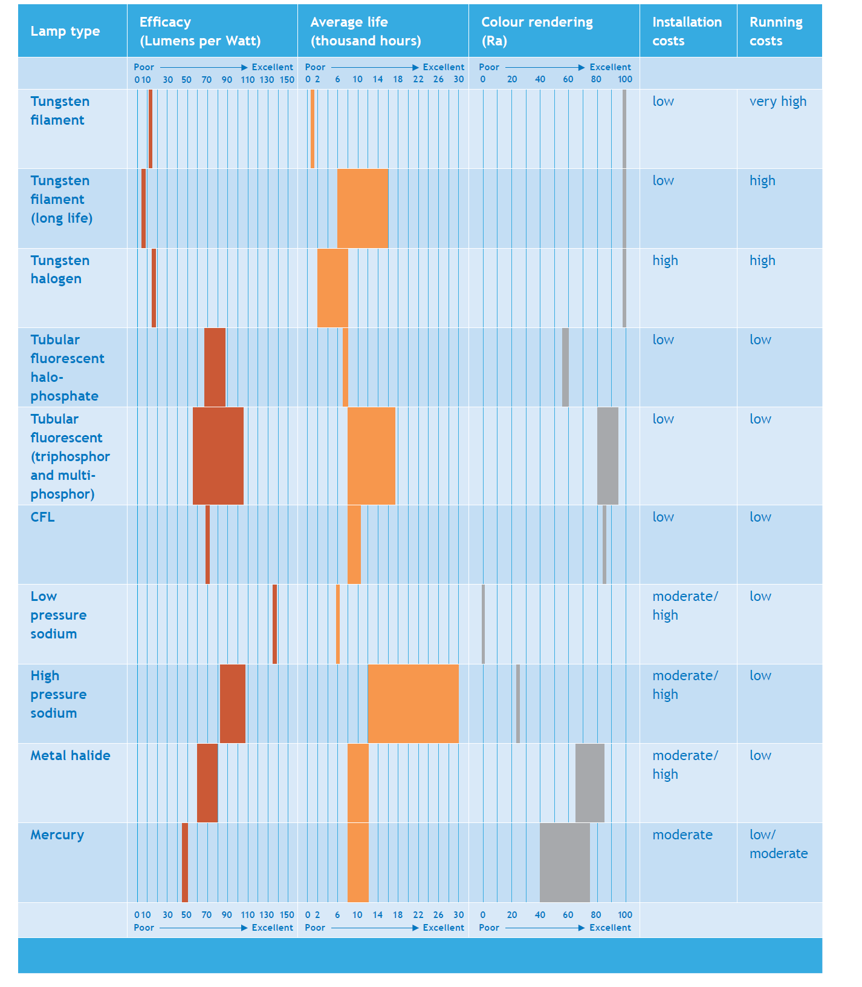

Slide 78
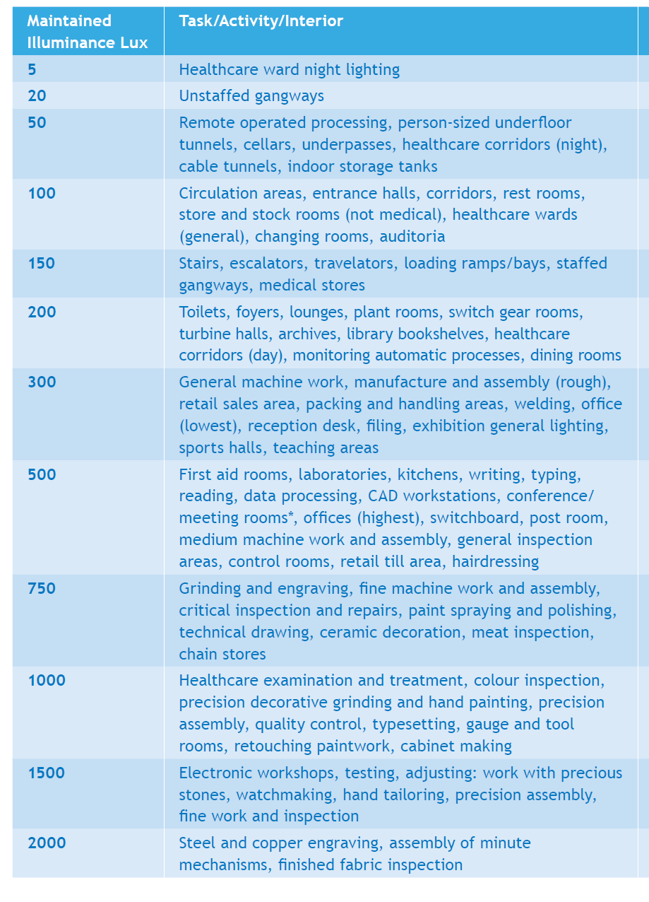

Slide 79


