Slide 1


DIGITAL COMPETENCE
CYMHWYSEDD DIGIDOL
Cwestiwn syml… beth yw ef?
Simple question…. What is it?
ECAD6012

Slide 2
Meddyliwch / Think
Ydy Cymhwysedd Digidol yn TGCh?
Ydy Cymhwysedd Digidol yn pwnc craiddd?
Ydy e’n rhan o MDPh?
Is Digital Competence ICT?
Is Digital Competence a Core subject?
Is it part of an AOLE?

Slide 3
Why is it important?
Donaldson
Curriculum
ESTYN , ERW, EAS, GWE, CSC
Industry and the economy – Jobs and Careers
STEM – SCIENCE TECHNOLOGY ENIGEERING & MATHEMATICS
PISA

Slide 4
Hanes / History
Adroddiad grŵp lliwio TGCh / ICT steering group report
2013
Adroddiad Donaldson / Donaldson Report
2015
Ysgolion Arloesi ac Arbenigwyr /
Pioneer Schools and experts
2015
2016
Fframwaith Cymhwysedd Digidol/
Digital Competence Framework
Datblygiad y datganiadau dilyniant/
Development of the progression statements
2018
Adroddiad – CAMAU - Reports
https://beta.gov.wales/science-and-technology-aole-what-matters-update

Slide 5




https://padlet.com/mathewreesjones/CD2018

Slide 6
Future Skills…
What learners need in the future?
What are the priorities for education systems across the world?
http://www.oecd.org/education/wales-should-continue-reforms-to-boost-quality-and-equity-of-school-system.htm

Slide 7
TASG - TASK 1
What learners need in the future?
What are the priorities for education systems across the world?

Slide 8


https://www.youtube.com/watch?v=7g8OpiWR83Y

Slide 9
https://www.youtube.com/watch?v=6p0VM-yUpGk

Slide 10
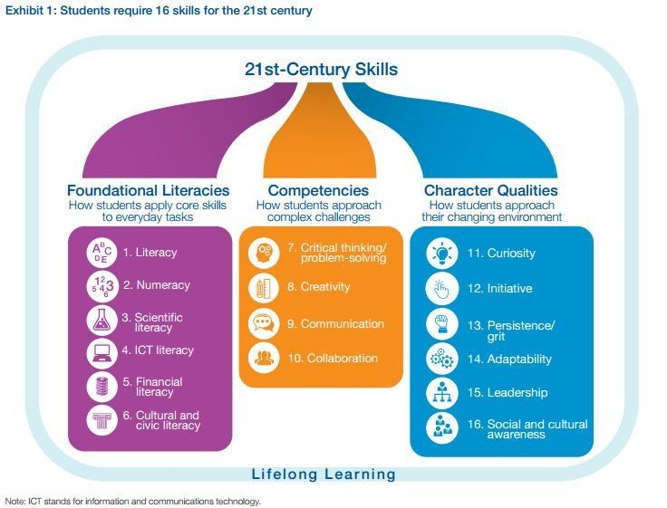
https://www.weforum.org/agenda/2016/03/21st-century-skills-future-jobs-students

Slide 11
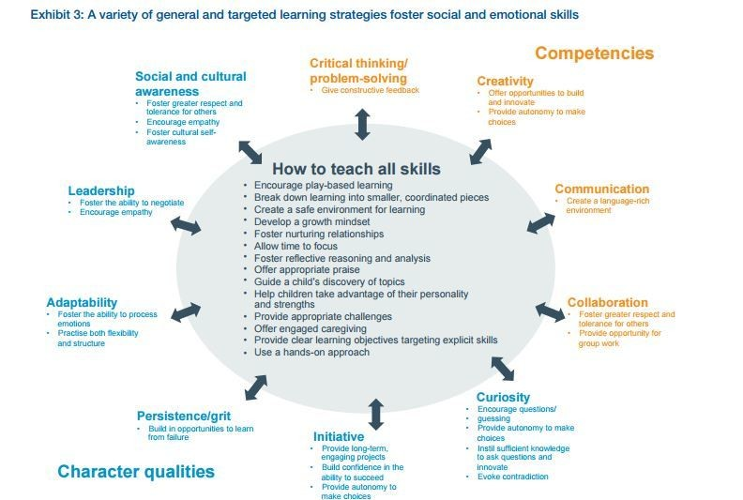

Slide 12
Industry and the Economy
“At the same time 50 percent of the jobs what we’ll have in 2025 don’t exist yet, according to a CBRE/Genesis report. [14] Perhaps the most jarring estimate from the report is that 65 percent of today’s primary school children will find themselves in jobs that don’t exist yet. [15]”

Slide 13
Industry and the Economy
“According to a 2016 report by the World Economic Forum, "By one popular estimate, 65% of children entering primary school today will ultimately end up working in completely new job types that don't yet exist." Even "old" jobs will look radically different in workplaces transformed by technology, changing demographics, and globalization. So how do we prepare students for jobs and workplaces that don't exist yet? Here are a few thoughts gathered from teachers at Connections Academy®—supported schools. After all, they are pioneers in online education, a field that itself didn't exist 20 years ago”

Slide 14




STEM
SCIENCE TECHNOLOGY ENGINEERING MATHEMATICS
“STEM is a curriculum based on the idea of educating students in four specific disciplines — science, technology, engineering and mathematics — in an interdisciplinary and applied approach. Rather than teach the four disciplines as separate and discrete subjects, STEM integrates them into a cohesive learning paradigm based on real-world”
http://www.nationalstemcentre.org.uk/
http://www.stemcymru.org.uk/en/index.php
http://www.stemclubs.net

Slide 15
TASK - TASG 2

Slide 16

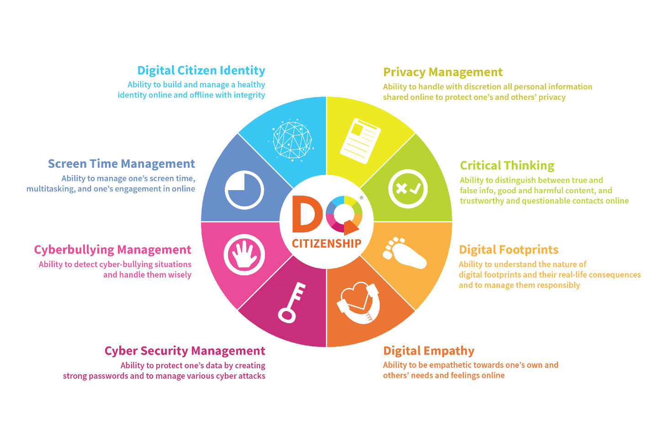
8 digital life skills all children need – and a plan for teaching them
Darllen - Read
https://www.weforum.org/agenda/2016/09/8-digital-life-skills-all-children-need-and-a-plan-for-teaching-them

Slide 17
TASK - TASG 3

Slide 18
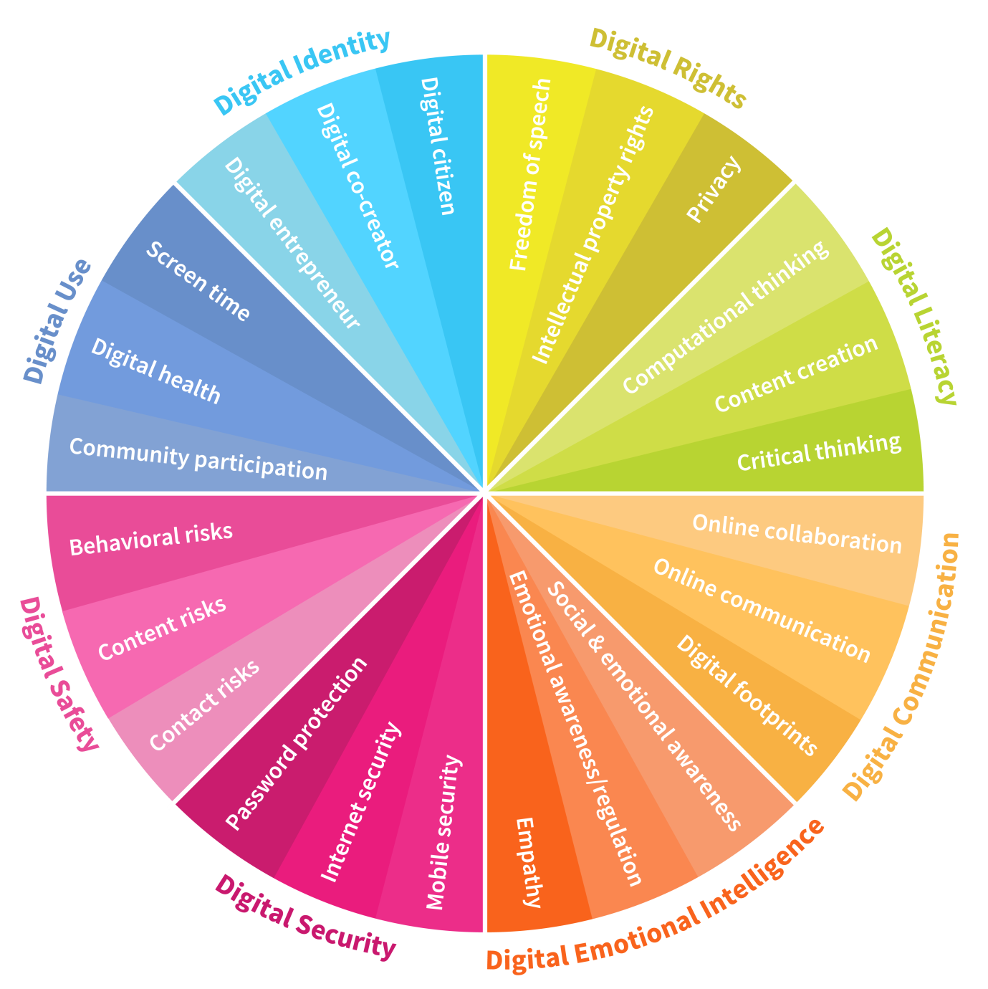
https://www.weforum.org/agenda/2016/06/8-digital-skills-we-must-teach-our-children/

Slide 19
Y Fframwaith / The Framework
Dinasyddiaeth.
Rhyngweithio a chydweithio.
Cynhyrchu.
Data a meddwl cyfri adurol.
Citizenship.
Interacting and collaborating.
Producing.
Data and
Computational
thinking.

Slide 20
Dinasyddiaeth Citizenship | Rhyngweithio a chydweithio Interacting and collaborating | Cynhyrchu Producing | Data a meddwl cyfri adurol Data and computational thinking
1) Hunaniaeth, delwedd ac enw da / Identity, image and reputation 2) Iechyd a lles / Health and well-being 3) Hawliau digidol, trwyddedu a pherchnogaeth / Digital rights licensing and ownership 4) Ymddygiad ar-lein a Seiberfwlio / Online behaviour and cyberbullying | 1) Cyfathrebu / Communication 2) Cydweithio / Collaboration 3) Storio a rhannu / Storing and sharing | 1) Cynllunio, cyrchu a chwilio / Planning, sourcing and searching 2) Creu / Creating 3) Gwerthuso a gwella / Evaluating and improving | 1) Datrys problemau a modelu / Problem solving and modelling 2) Llythrennedd gwybodaeth a data / Data and information literacy

Slide 21
Things to consider when thinking about Digital Competence
Define competence digital / digital literacy
The ways to develop it; cross-curricular, topic on their own, or as a key skill - is it the same as numeracy and literacy?
Discussion about the cross-curricular method
Possible models - Barnes / Savage / Hayes or something else?
Challenges for the development of digital competence

Slide 22

National Digital Learning Council (NDLC)
Cyngor Dysgu Digidol Cenedlaethol (CDDC)

Slide 23
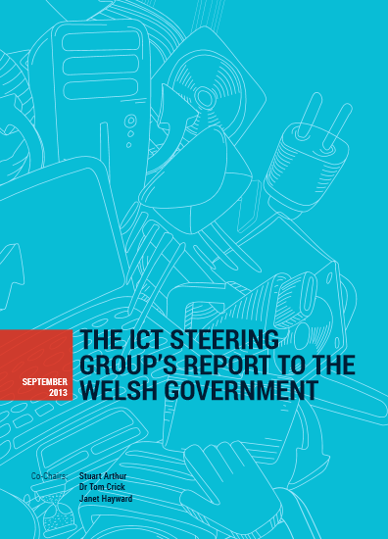
ICT Steering Group
‘As the ICT steering group identified for the report, competences ‘should not primarily be predicated on rapidly changing technologies, but should focus on pedagogy, deeper skill development, transferability, and understanding, as well as potential application of these competencies’ ( Arthur, et al. 2013)

Slide 24
Possible debates…
Discuss how to develop the 3 aspects in a cross-curricular approach - through models - note the challenges of such models – how do they relate to Numeracy / Literacy / Digital Competence
Form your own model
Critique current initiatives by the government - formation LNF and DCF - eg Looking at the structure of ERW for DCF- suggestions

Slide 25
What is Donaldson’s opinion?

Slide 26
What about the Consortia?

Slide 27
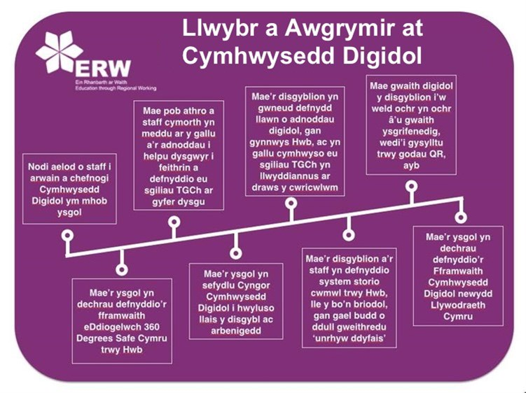

Slide 28
Beth am y gweddill?
Gwe, EAS, CSC …
Beth sy’n digwydd yn Lloegr? Yr Alban Gogledd Iwerddon?
Datblygu dadl…

Slide 29
PISA?

Slide 30
Safbwyntiau am y dull Trawscwricwlaidd
Barnes
Savage
Hayes
Hague a Payton

Slide 31
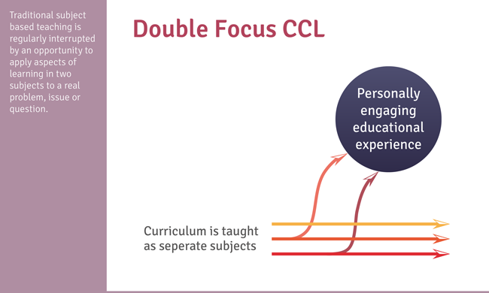
Barnes’ ModEl

Slide 32
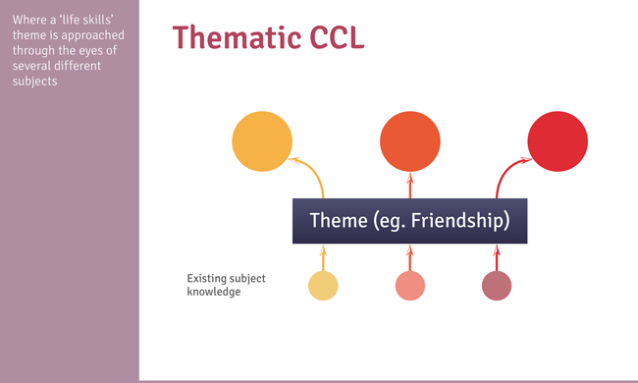
Barnes’ ModEl

Slide 33
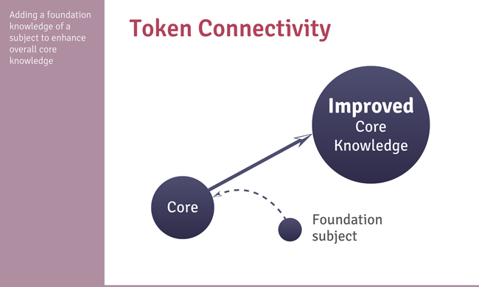
Barnes’ ModEl

Slide 34
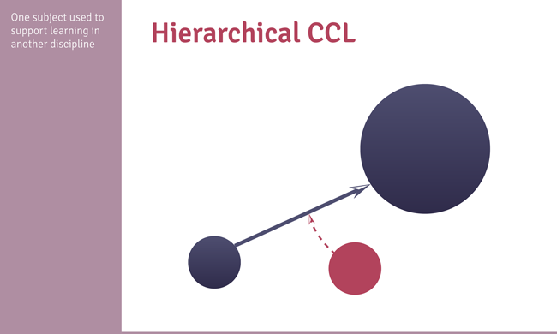
Barnes’ ModEl

Slide 35
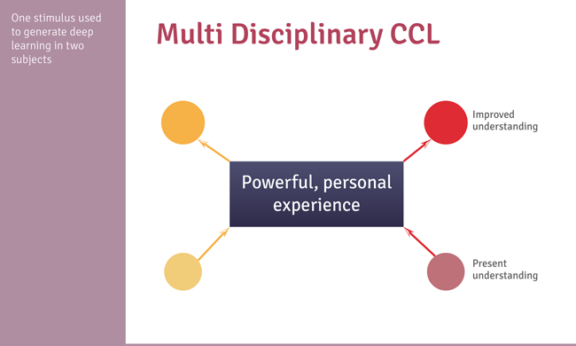
Barnes’ ModEl

Slide 36
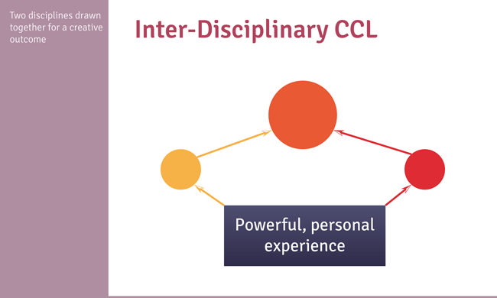
Barnes’ ModEl

Slide 37
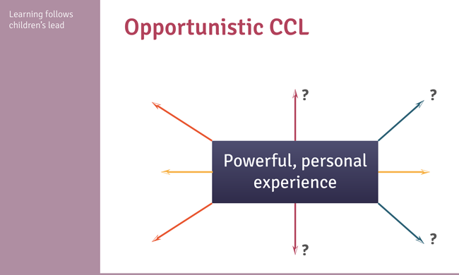
Barnes’ ModEl

Slide 38
Savage states …
“ A cross-curricular approach to teaching is characterised by sensitivity towards, and a synthesis of, knowledge, skills and understandings from various subject areas. These inform an enriched pedagogy that promotes an approach to learning which embraces and explores this wider sensitivity through various methods” 2010

Slide 39
Read the article by Hayes
“The seductive charm of a cross-curricular approach”
How does this relate to digital competence?

Slide 40
What do Hague a Payton suggest about how to develop digital competence in a cross-curricular way?

Slide 41
So are there obstacles for the development of Digital Competence?
Is there value to the initiative?
Does Digital Competence differ from numeracy or literacy?
Are there any who are against the cross-curricular approach?

Slide 42
Challenges

Slide 43
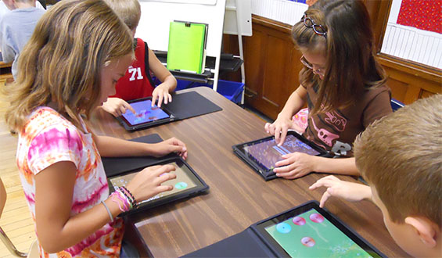
Key Concepts - Cysyniadau Allweddol
User, Consumer v Competency & Creation
Early adopter, early discarder
Digital natives, digital immigrants
Competency is not about coding
Impossibility of 100% competence with digital technology

Slide 44
Users, Consumer v Competency and Creation
The widespread use of technology in our working lives and in education mean that we all have become users of technology. It is important to consider that being a proficient technology user does not mean that you are completely digitally competent. Digital competence has more aspects to it that just using technology.

Slide 45
Advocates of computer science and computing, particularly those in industry are concerned with an under-skilled work force in areas such as programming and computer coding. They have indicated that more could be done in schools to develop these skills.
Work by Nesta points to a new digital divide: showing that for every child learning to make things using digital technology, over 60 are being left behind. Young Digital Makers Nesta

Slide 46
Digital Competence is also concerned with how to use technology for more creative purposes. It also important to consider that digital competence is also being able to adapt and engage with new or unfamiliar systems and technology and to have an awareness of how or where to find out how to use technology when you do not know.

Slide 47
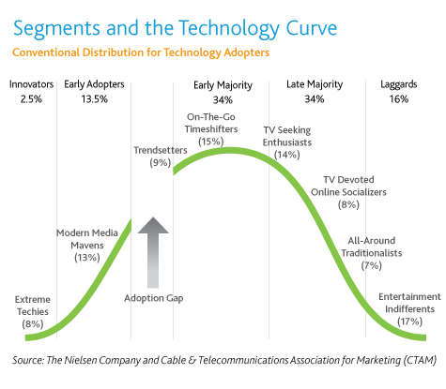
Early adopter, early discarder
The difficulty with early adopters is the initial cost of cutting edge technology that may not become mainstream in the long run and if does become a mainstream adoption it can become cheaper for others despite the initial premium that was paid by the early adopters i.e wasting budget initially.

Slide 48
Early adopter, early discarder
You will notice the adoption gap in the model. For some technologies, this gap represents the end of the road. The technology never gains mainstream acceptance, either because it is ill-suited to the mainstream or because another technology supersedes it (for example “Laser disc” and “Blu-Ray”, 3D interactive White boards ).

Slide 49
Early adopter, early discarder

Slide 50
Early adopters
These graphs help answer the early adopters when they come calling. Early acceptance of a new technology does not guarantee its popularity with the mainstream. It also means that being sector leading in technology in terms of an education setting is also a potential gamble.

Slide 51
Early Discarders
Those who may very well be early adopters of technologies may also be those who discard the very same technology in order to try and adopt another, almost following an evaluation model. This may mean that after a certain time scale it maybe decided that there are alternatives or better technologies available for the same or similar purposes.

Slide 52

Digital natives and digital immigrants
It is clear that the learners that we are now dealing with are considerably more aware and familiar with our technologically advanced world. Prensky ( 2001) refers to them as “Digital Natives”. Learners today are all “native speakers” of the digital language of computers, video games and the Internet.
These are the learners we have in schools and with our trainee teachers. According to Prensky that would make those of who were not born into the digital world but have, at some later point in our lives, become fascinated by and adopted many or most aspects of the new technology are, and always will be compared to them, Digital Immigrants.

Slide 53
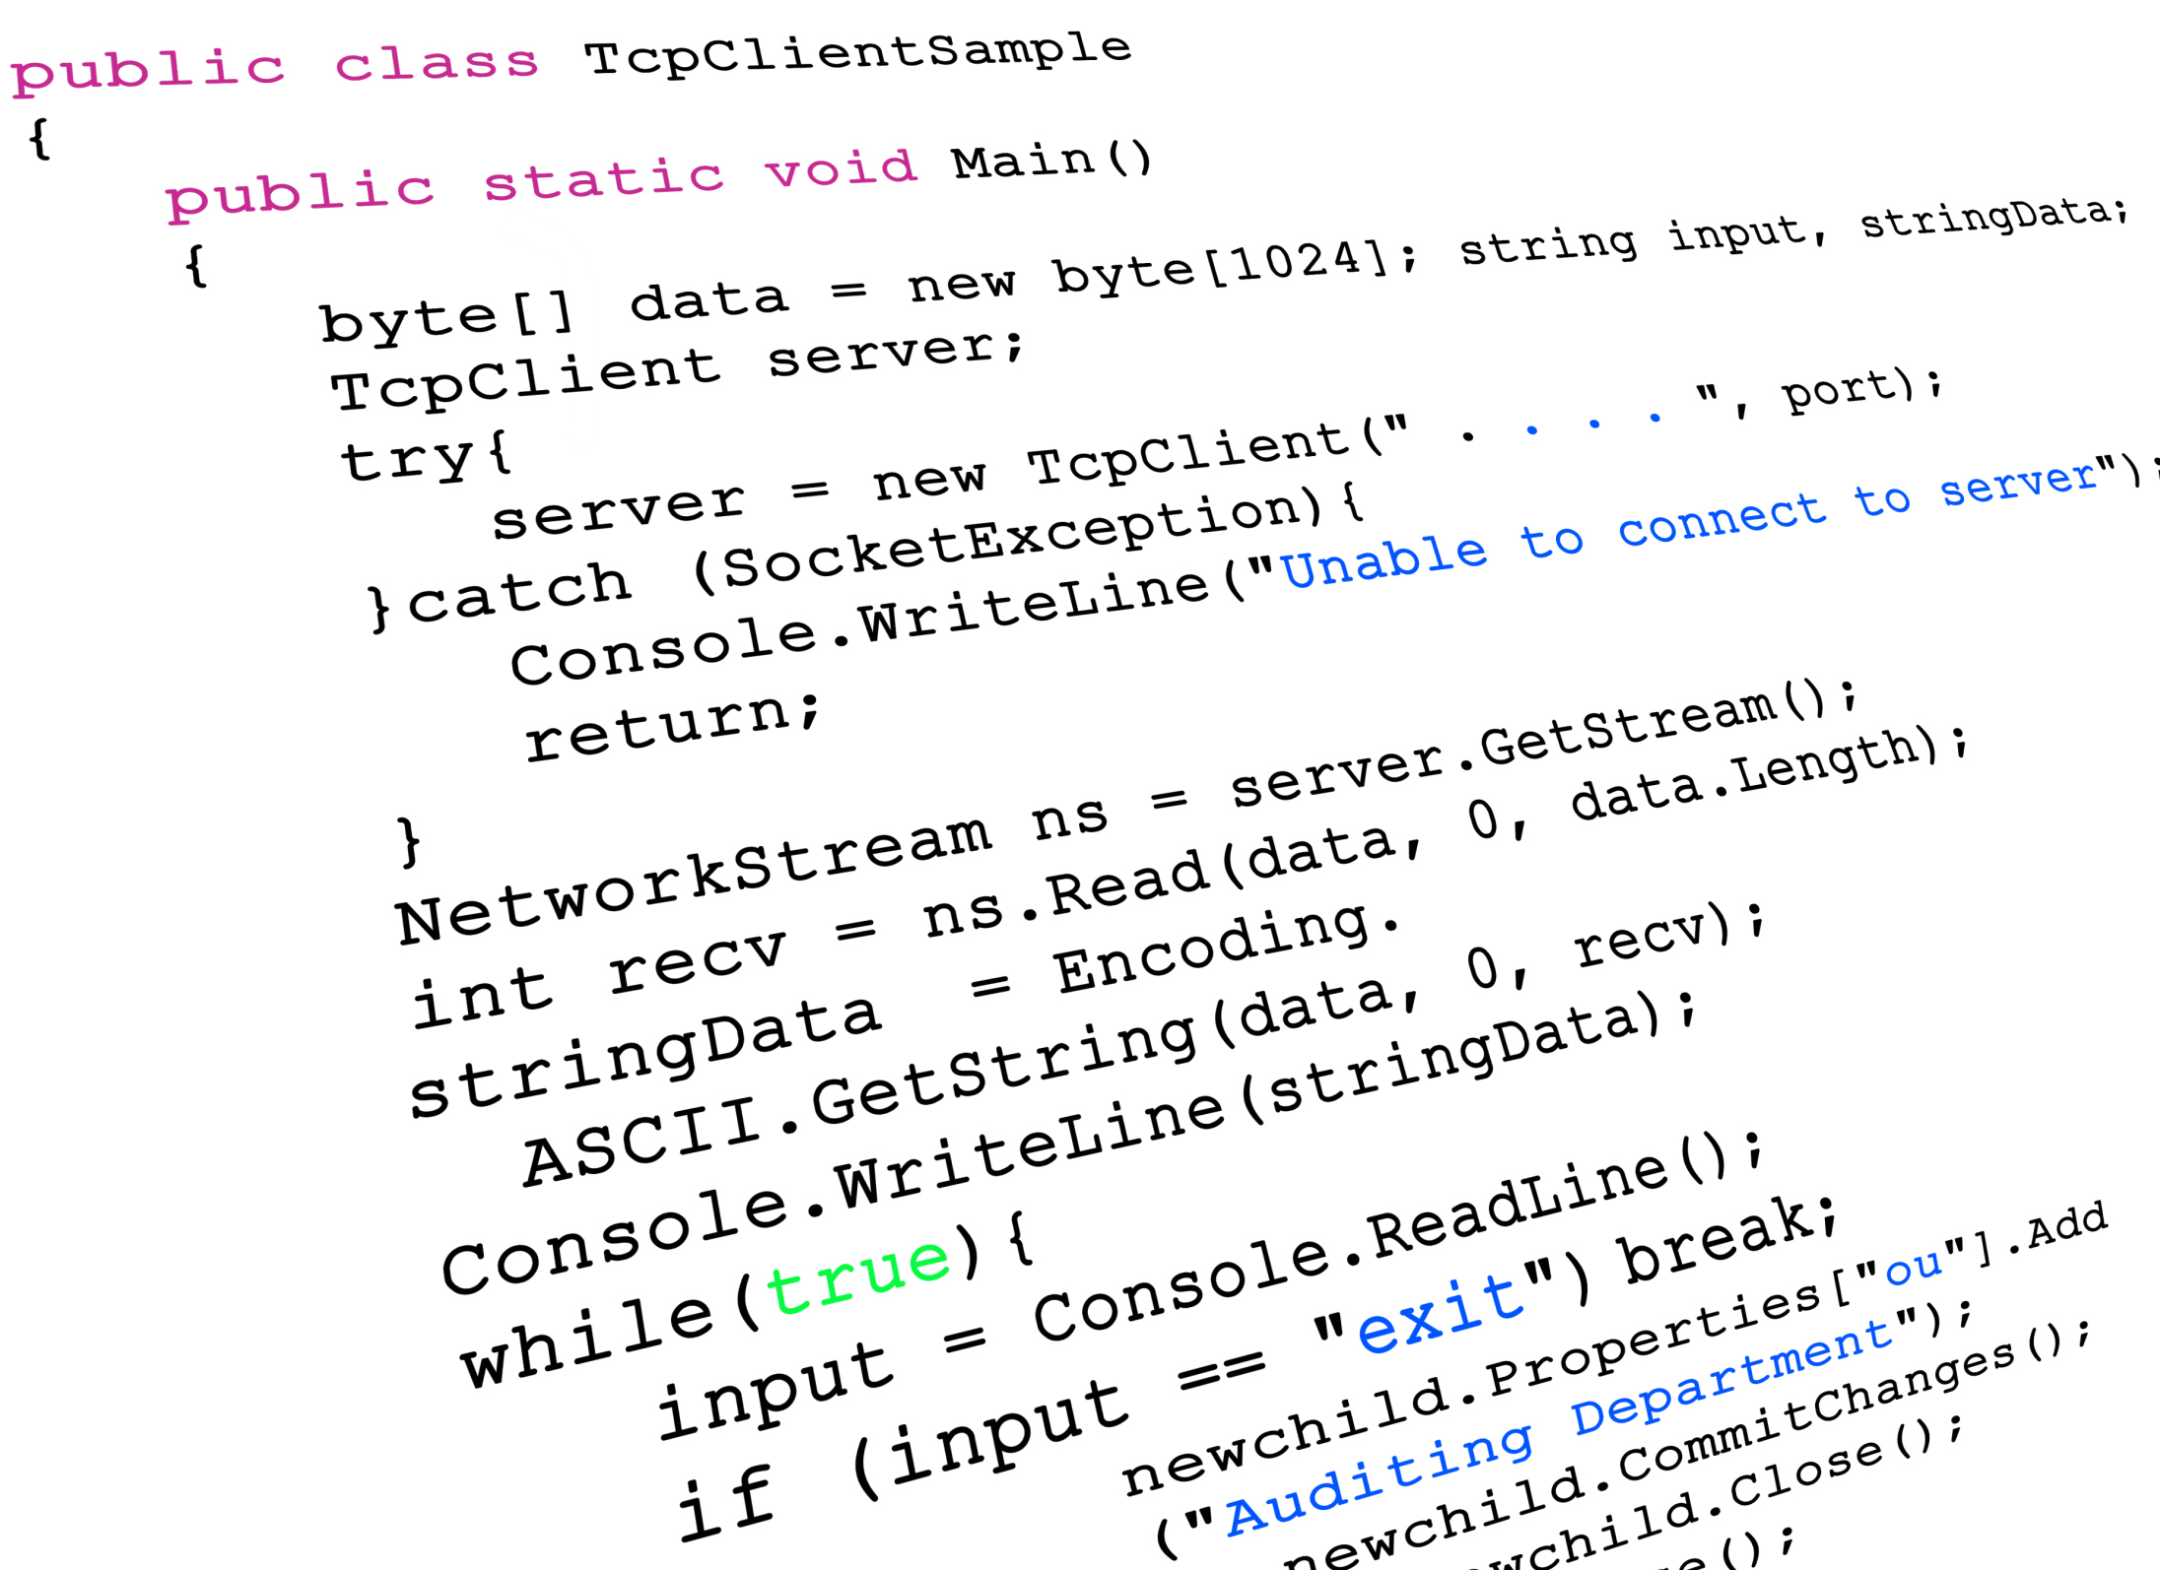
Competency is not about coding
It is important not to consider digital competency as having to be an expert in every aspect of technology, from computer programming, to video editing, to blogging and repairing a computer. That would be an impossibility

Slide 54
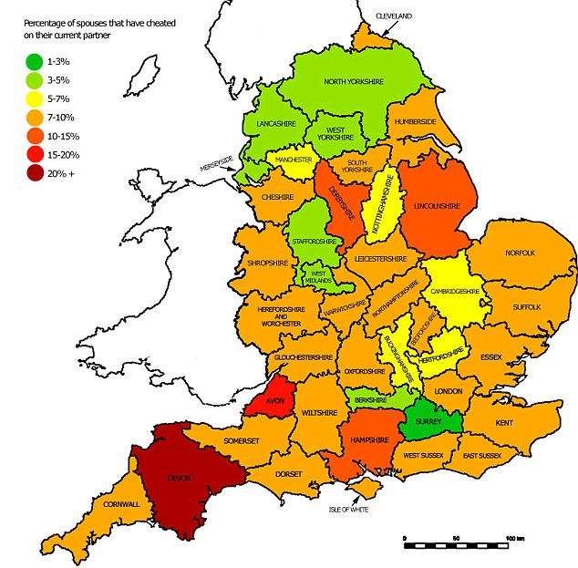

However, given the increased profile of aspects considered as computer science, and in particular coding skills, in the National Curriculum in England, it is fair to say that many educational practitioners have found themselves despairingly considering how on earth they are going to teach programming and computer coding.

Slide 55
Digital competency does not mean coding. Awareness of the potential of coding and how to develop it in certain areas of the curriculum is certainly advantageous, but direct coding programming skills would more likely be part of a revised ICT or Computer Science style curriculum area. Digital competence is something that is meant to be developed in lessons where possible according to Donaldson, not how to develop coding in every lesson.

Slide 56
Impossibility of 100% competence with digital technology
Given the diverse nature of technology and the digital world and its ever changing and development it would be impossible to develop complete expertise in all aspects of for example how to use the latest version of Microsoft Office or latest ipad.
Changes and developments in technology both in hardware and software mean that 100% competence would be fleeting if not impossible. The competency required is the ability to adapt, learn and adapt to these changes.

Slide 57
https://padlet.com/mathewreesjones/CD2018

Slide 58
Possible Links
- Alexander, R. (ed.) (2010) Children, their World, their Education: Final Report and Recommendations of the Cambridge Primary Review. London: Routledge.
-Alexander, R.J., Rose, A.J. and Woodhead, C. (1992) Curriculum Organisation and Classroom Practice in Primary Schools: A Discussion Paper. London: Department of Education and Science.
-Barnes, J. (2011) Cross-Curricular Learning 3–14. Second edition. London: Sage.
- Blair, E and Francis, L (2011) Was it right to abandon the creative curriculum? NFER practical research for education. 44 : 26-32.
-Central Advisory Council for Education (CACE) (1967) Children and their Primary Schools (The Plowden Report). London: HMSO.
-Department for Education (DfE) (2012) Statutory Framework for the Early Years Foundation Stage. London: DfE.
-Department for Education (DFE) (2013) The national curriculum in England framework document. London: DFE.
- Dewey, J. in J. McDermott (ed) (1981) The philosophy of John Dewey. Chicago IL: University of Chicago Press.
- Doherty, J. and Hughes, M. (2009) Child Development Theory and Practice 0-11. Essex: Pearson Education.
-Early Education (2012) Development Matters in the Early Years Foundation Stage (EYFS). London: Early Education.
-Hadow, L (1931) Hadow Report of the Consultative Committee on the Primary School [online]. London: HM stationary office. [Accessed 15 February 2015]
-Kelly, L & Stead, D. (2013) Enhancing primary science: developing effective cross curricular link. Berkshire: open University Press.
- Kenner, C and Ruby, M (2011) Enriching cross-curricular work by involving complementary schools. NALDIC Quarterly. 8 (3) : 4-9.
- Ofsted (2002) The curriculum in successful primary schools. Available from: http://www.robinalexander.org.uk/wp-content/uploads/2014/05/Ofsted-2002.pdf (accessed 10/02/15)
-Ofsted (2010) Learning: creative approaches that raise standards. Manchester: Ofsted.
-Ofsted (2013) Maintaining curiosity: A survey into science education in schools. Manchester: Ofsted
-Rose, J. (2009) Independent Review of the Primary Curriculum. London: DCSF.
-Savage, J. (2011) Cross-curricular Teaching and Learning in the Secondary School. Oxon: Routledge.
- Taylor, A. (2006) A Critical Evaluation of "Mantle of the Expert" as a teaching and learning Approach, based on pupil and practitoner opinion. Available from: http://www.mantleoftheexpert.com/community/research/ accessed 09/02/2015

