Slide 1
BA Management Skills for the Workplace
BMSK5004
Managing Projects in the Organisation
Online Session 4

Slide 2
Session 4
Work Breakdown Structure
Gantt Chart
Structure Flow Diagrams

Slide 3
Work Breakdown Structure
A deliverable orientated Hierarchical structure that shows break down of the work that needs to be ‘executed’ by the team to achieve the project objectives and produce the deliverables.
An organising tool by defining the Scope and identifying the KEY DELIVERABLES and noting tasks that need to be done to achieve them

Slide 4
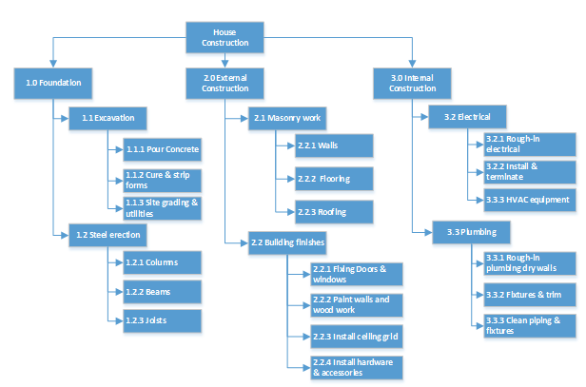

Slide 5
Phase 1: Research on capabilities of current systems
Phase 2: Prototype of Visual tool simulation
Phase 3: Prototype to connect visual tool to aircraft engine via satellite
Showcase prototype tool in Air Tattoo exhibition
Integration of Visual Tool with current engine monitoring tools
WP16: Integrate prototype with engine monitoring tools
WP1: Market research
WP2: Research on 3D graphics systems
WP3: Research on communication systems
WP4: Research on GUI
WP5: Trade-off analysis
WP6: Architectural Design
WP7: Visual tool prototype
WP8: Test prototype tool
WP9: Simulate integration of prototype tool with the live system
WP10: Develope communication module
WP11: Test communication module prototype
Wp12: Integrate communication tool with the visualisation tool
WP13: Prepare prototype for exhibition
WP14: Trade-off analysis of exhibition customer feedback
WP15: Implement key customer feedback
WP17: Live test of final integrated system
WP18: Prepare and pack for customer delivery

Slide 6
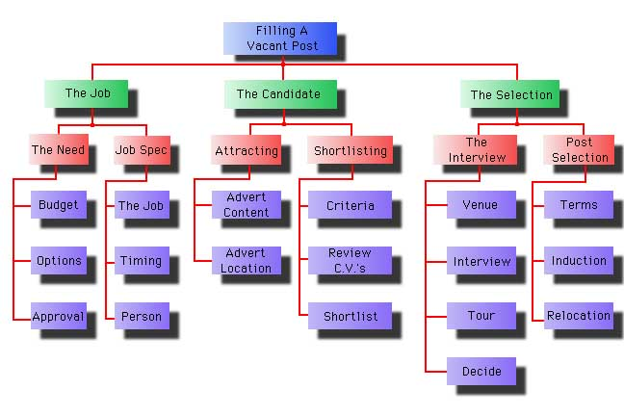
Notes:
WBS example

Slide 7
Creating a Work Breakdown Structure
5 steps to creating a work breakdown structure : a bird’s-eye view, which eventually gets down to the most basic level by looking at the main parts of what is needed to construct a thorough WBS.
Project Scope- objectives and who is participating in the project—determine what it is and describe it.
Project Phases: breaks larger project statement of intent into series of phases taking it from conception to completion.
Deliverables: List them all and note what is necessary for those deliverables to be completed successfully.
Deliverables from above broken them into individual tasks required to deliver them, listed by tasks.
Assign: assign tasks to team. Provide team members the tools, resources and authority they need to get the job done.

Slide 8
Work Breakdown Structure – 100% Rule
The WBS includes 100% of the work defined by the project scope and captures all deliverables – internal, external, interim – in terms of the work to be completed, including project management.
General Rules:
No Gaps: All work for a given task must be encompassed in its sub-tasks
No Overlaps: The same work should not be included in more than one sub-task.

Slide 9
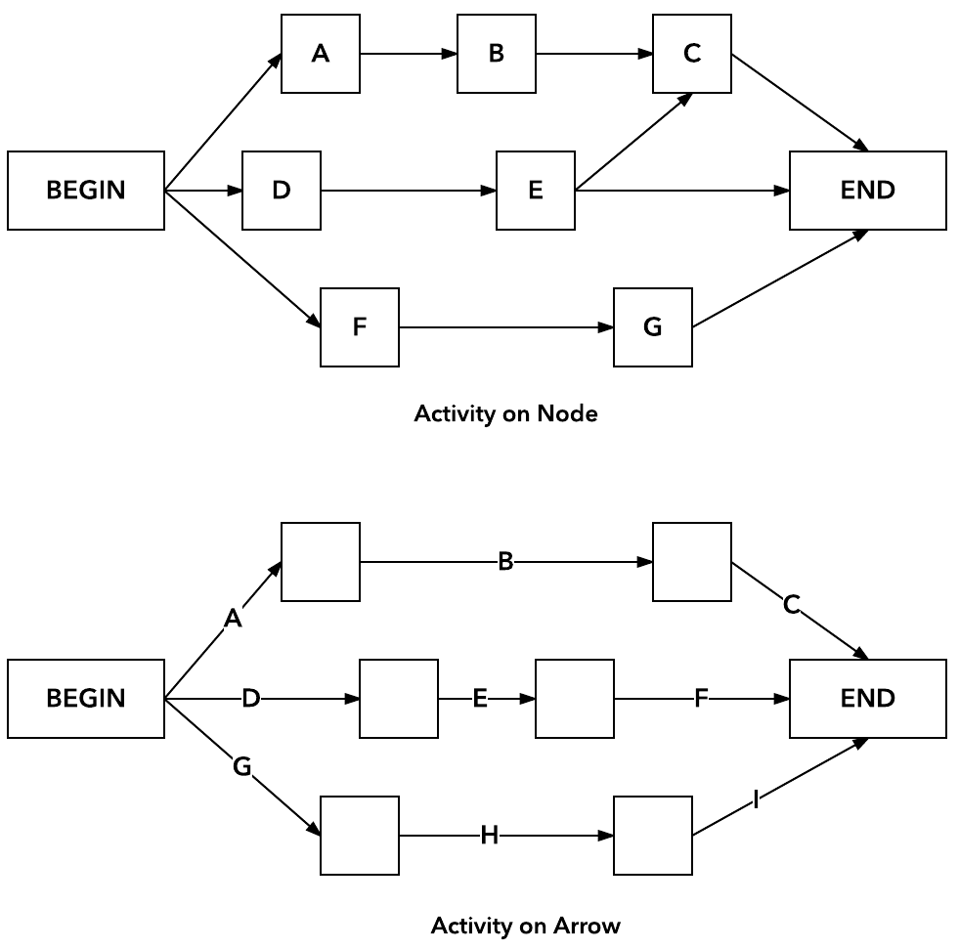
Network Diagram
Because project network diagrams show chronology, PMs always draw them left to right.
The first format, Event or activity (task to be completed) on either side of node, shows an event/ activity as a box. Arrows connect them together to show sequence.
The second format, Event/ activity (on either side), shows the arrows that connect nodes.

Slide 10
2 Rules of Network Diagrams
Rule 1
After you finish an activity or reach an event you can proceed to the next activity or event as indicated by the arrow(s) leaving that activity or event.
Rule 2
To be able to start an activity or reach an event you must complete all activities and reach all events from which arrows entering that activity or event emanate.
Notes:
Network diagrams are vital for project management. They allow us to change one of the variables and see what affect it has on the whole project

Slide 11
Network Diagrams
Activity 1
t₁ = 5
Activity 2
t₂ = 1
END
START
Activity 3
t₃ = 1
Activity 4
t₄ = 3
Activity 5
t₅ = 2
All inputs to an activity box must have been completed before it can begin.
E.g. Activity 1 and 4 must be completed before 5 can commence. Total minimum time is 7

Slide 12
Calculating Span Time
Must take account of actual working hours and practice
Example
Activity taking 24 hours will have a span time of 3 working days if an 9.5 hour day is worked. (1 hour lunch break & 15 minute break morning & afternoon with the assumption that people do nothing else other than work on the project.)
Or
A span time of 6 working days if the working day is 4 hours with no breaks.

Slide 13
Span Time Example
An activity
  Time T=5
An Event
  Time T= 0
(Remember, events take no time)
An Activity and an event
  Time T= 5
Write report
Finished report
approved
Hand in
finished report

Slide 14
Critical Path Analysis
Critical Path – a sequence of activities in your project that takes the longest time to complete.
Activity 1
T = 5
Activity 2
T = 1
END
T=7
START
T=0
Critical Path is red.
Time T is in weeks
Activity 3
T = 1
Activity 4
T = 3
Activity 5
T = 2

Slide 15
Critical Path Analysis
Making a cup of tea…
Re-Boil
10s
START
Fill
Kettle
Switch
Kettle On
Boil Water
(Initial)
Scold Pot
Put
Tea-bag In
Pour
Water
Place Pot
On Tray
10s
3s
180s
10s
5s
15s
5s
Put Milk
In Jug
Put Sugar
In Bowl
Get Tray
Put Milk, Sugar,
Cup & Saucer on Tray
Draw &
Serve
END.
TEA
SERVED
15s
15s
10s
10s
180s
Critical Path
TOTAL TIME = TIME ON CRITICAL PATH = 413 secs!!
Notes:
The duration of each activity is listed above each node in the diagram.
For each path, add the duration of each node to determine it's total duration. The critical path is the one with the longest duration.

Slide 16
CPA – Resource Change (New Technology)
Re-Boil
1s
START
Fill
Kettle
Switch
Kettle On
Boil Water
(Initial)
Scold Pot
Put
Tea-bag In
Pour
Water
Place Pot
On Tray
10s
3s
10s
10s
5s
15s
5s
Put Milk
In Jug
Put Sugar
In Bowl
Get Tray
Put Milk, Sugar,
Cup & Saucer on Tray
Draw &
Serve
END
TEA
SERVED
15s
15s
10s
10s
180s
Resource Change
TOTAL TIME = TIME ON CRITICAL PATH = 243 secs
Strictly speaking this would not work with a single person due to the overlap in activities
Critical Path
Notes:
Cost benefit?
Bought a super fast boil kettle
The time saved is 170 seconds
However, the new super-kettle set you back a princely £200
Is the investment worth it to improve on changes in time constraint?
If those 170 seconds saved represented an early finish bonus worth £300 then the investment would be worth it.
And once you have bought it it can be used over and over again.

Slide 17
Path Durations
Consider this network
B, 12d
D, 5d
A,7d
F, 4d
C, 10d
E, 3d
It consists of the following paths
ABDF = 28 days (7+12+5+4)
ABEF = 26 days (7+12+3+4)
ACEF = 24 days (7+10+3+4)
Notes:
The critical path is ABDF which has a duration of 28 days
The other path durations are shorter and have some ‘free time’
ABEF 28-26 = 2 days
ACEF 28-24 = 4 days
But what does this mean?
Could we delay the whole path ABEF by up to 2 days?
No, only some of the activities on the path can be delayed (the non-critical activities).
The critical path is the longest path in the network; therefore it represents the minimum time needed to finish the project.
The near critical path which finishes slightly sooner than the critical path is: ABEF
ACEF
This is non-critical path, because you have 4 days floating time. I.e., C and E can be delayed by as much as 4 days without affecting the total duration of the project.
Critical Path Terms
Early Start (ES): earliest time an activity can begin
Without interfering with the completion of preceding activities
Early Finish (EF): earliest time an activity can finish
Early start + activity duration
Late Finish (LF): latest time an activity can finish
Without delaying the completion of the project
Late Start (LS): latest time an activity can start
Late finish – activity duration
Float (aka Slack)
Total Float: The time by which an activity can be delayed without impacting the project end date
LF-EF or LS-LS can be used to derive total float
Free Float: The time by which an activity can be delayed without impacting the start time of any successor activity
Float is the standard UK term, Slack is the standard US term.

Slide 18
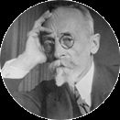
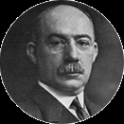
Gantt Charts
Used for planning projects of all sizes. A useful way of showing what work is scheduled to be completed on a specific day.
Simplified graphical presentation:
Project start date
Project finish date
Project tasks (start/finish dates)
Task duration
Who is working on each task
How tasks group together, overlap and link with each other
Karol Adamiecki
Henry Gantt

Slide 20
Simple Gantt Chart
Notes:
Gantt Chart
https://www.teamgantt.com/free-gantt-chart-excel-template
Useful free gantt chart software tool for assignment

Slide 21
PEST
Political
Ecological / environmental issues
Current legislation – home market
Future legislation
European / international legislation
Government policies
Trading policies
Funding, grants and initiatives
Pressure groups – home and abroad
Wars and conflict
Economic
Home economy situation
Home economy trends
Overseas economies and trends
General taxation issues
Taxation – specific to the product / services
Seasonality / weather issues
Market and trade cycles
Specific industry factors
Market routes and distribution trends
Customer / end-user drivers
Interest / exchange rates
International trade / monetary issues

Slide 22
PEST
Social
Lifestyle trends
Demographics
Consumer attitudes and opinions
Media views
Law changes affecting social factors
Brand, company, technology image
Consumer buying patterns
Fashion and role models
Major events and influences
Technological
Competing technology development
Research funding
Associated / dependant technologies
Replacement technology / solutions
Maturity of technology
Manufacturing maturity and capacity
Information and communications
Consumer buying mechanisms / technology
Technology legislation
Buying access and trends
Ethnic / religious factors
Advertising and publicity
Ethical issues
Innovation potential
Technology access, licensing patents
Intellectual property issues
Global communications

Slide 23
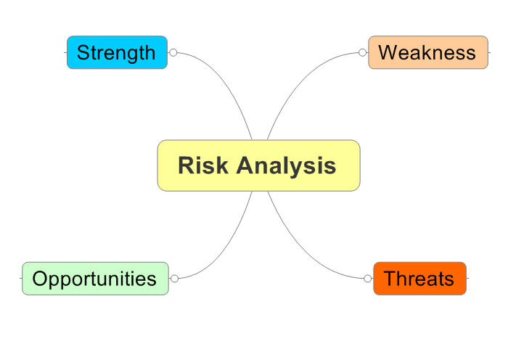
SWOT - revision
Notes:
SWOT can be captured easily with mind maps. This way, you also take advantages of all the benefits of mind maps and brainstorming. It logically structures your new inputs in each category and helps you to come up with more which is exactly what you want in a SWOT analysis.
Clearly the SWOT can be adapted for other categories that Risk analysis – look to implement and develop SWOT

Slide 24
Managing Projects in the Organisation
Questions?
Notes:
So today we studied definitions of project management and Projects
We considered features of success and failure
We explored some examples

Slide 25

Homework
Complete a Gantt chart for your project
Complete WBS/Network Diagram for your project
Undertake simple PEST analysis for your project.
Use a SWOT to analyse 1 criteria from each of the PEST analysis.
25

Slide 26
References
Assets.publishing.service.gov.uk. 2010. How To Organise, Plan And Control Projects. [online] Available at: <https://assets.publishing.service.gov.uk/government/uploads/system/uploads/attachment_data/file/31979/10-1257-guidelines-for-managing-projects.pdf> [Accessed 16 July 2020].
Smith, L. W. (2000). Stakeholder analysis: a pivotal practice of successful projects. Paper presented at Project Management Institute Annual Seminars & Symposium, Houston, TX. Newtown Square, PA: Project Management Institute.

