Slide 1
Student Name: Shagufta Bi
Student ID: 2324572
Module: Psychopathological Classifications and Provisions
Module Code: BMHP6029
Assignment Title: Component 1 – Poster Presentation
Lecturer: Kennedy Obohwemu

Slide 2
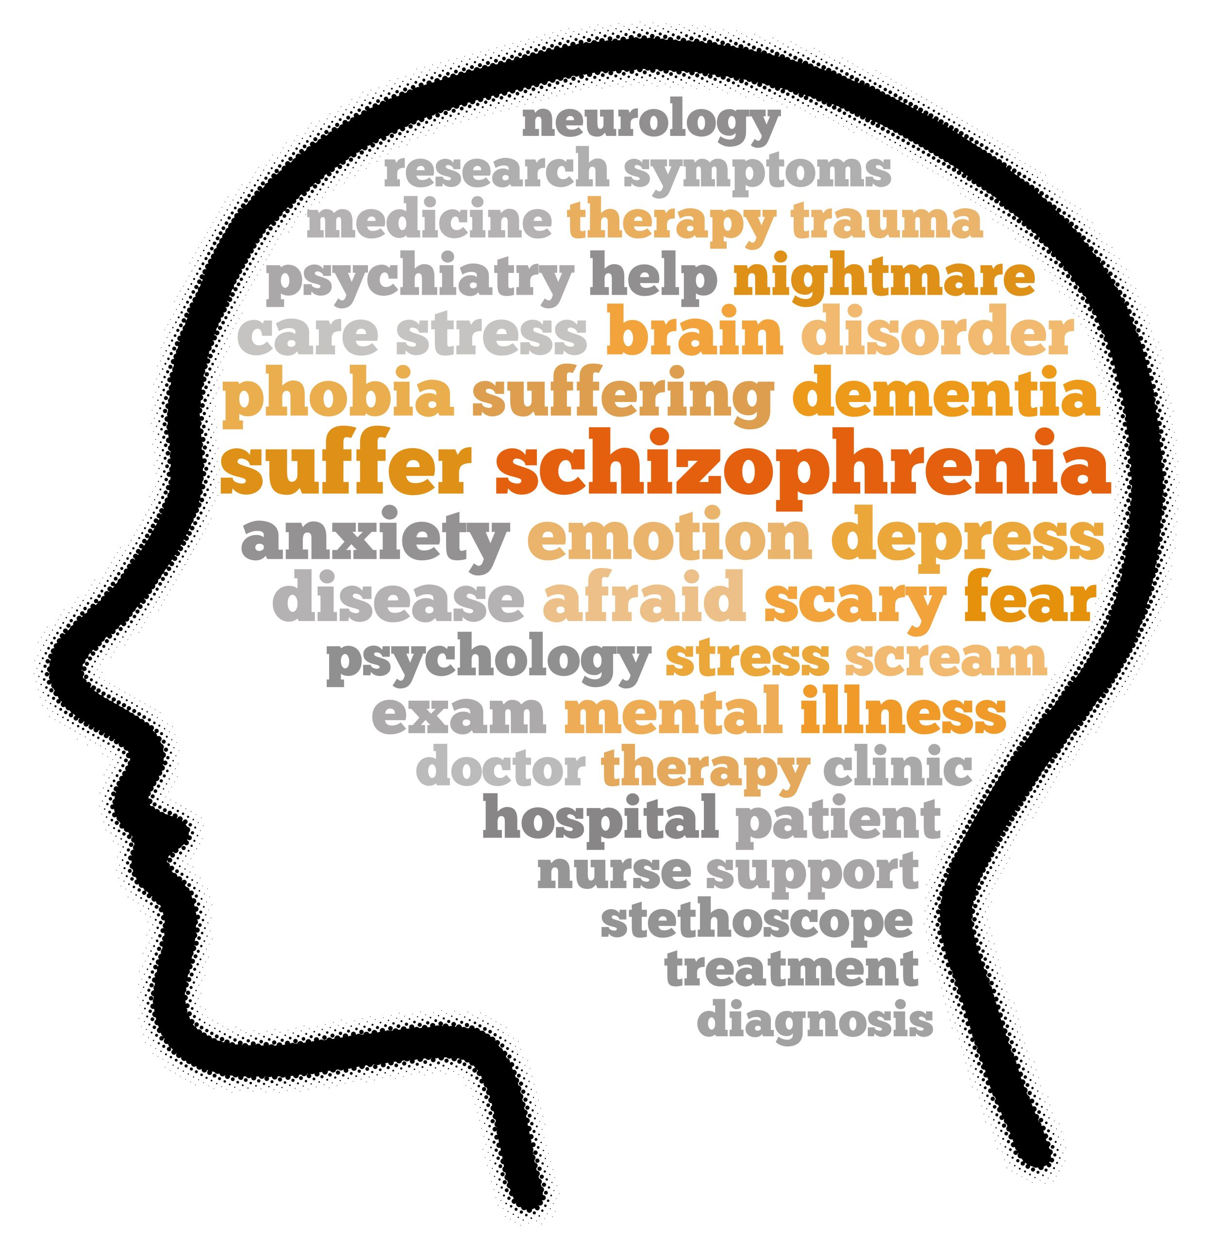
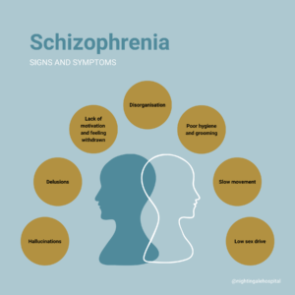
Schizophrenia
Introduction
Stigma and Social Inequality
Disturbances in perception, thoughts, emotions, and behaviour are hallmarks of schizophrenia, a serious mental illness. Hallucinations, delusions and disordered thought patterns are common in people with schizophrenia and can have a substantial impact on day-to-day functioning and quality of life (World Health Organization, 2025).
ICD – 11 Classification
Schizophrenia is classified as "Schizophrenia and Other Primary Psychotic Disorders" in the International Classification of Diseases (ICD-11) (World Health Organization, 2022).
Poor reality testing and behavioural abnormalities, such as persistent hallucinations, delusions and disorganised thinking, are characteristics of these diseases. According to the World Health Organization (2022), symptoms must be severe enough to significantly limit social, professional, or personal functioning and cannot be better explained by substance abuse or another medical disease.
To prevent misinterpreting culturally accepted experiences as mental illness, ICD-11 underlines that medical professionals must take cultural beliefs and practices into account when evaluating psychotic symptoms (World Health Organization, 2022).
Some researchers suggest that psychotic experiences exist on a continuum rather than within strict diagnostic categories (Van Os and Kapur, 2009).
Symptom Domains
Schizophrenia patients may face discrimination and stigma. According to Thornicroft et al., (2022), negative stereotypes that depict people as violent or unreliable might lead to housing problems, unemployment and social exclusion.
According to Kruse and Dodell-Feder (2025), stigma can also arise inside healthcare systems and have an impact on the quality-of-care people receive or deter them from seeking treatment.
Several symptom domains linked to schizophrenia are identified by ICD-11 (World Health Organization, 2022).
Positive Symptoms
Hallucinations
Delusions
Disorganised behaviour and speech
Negative Symptoms
Reduced emotional expression
Social disengagement
Lack of motivation
Cognitive Symptoms
Memory impairment
Decreased focus
The significance of comprehensive treatment and rehabilitation procedures is highlighted by the fact that negative and cognitive symptoms are frequently linked to worse long-term functioning than positive symptoms (McCutcheon, Marques and Howes, 2020).
Historical Treatment Approaches
In the past, people with schizophrenia were often treated in sizable mental hospitals where the main goal of treatment was containment rather than healing. Biological therapies like insulin coma therapy, electroconvulsive therapy and psychosurgery were introduced in the early twentieth century.
While some treatments were ineffective, others raised ethical questions about patient safety and consent.
A significant turning point in the treatment of schizophrenia was the invention of antipsychotic drugs in the 1950s, which also aided in the deinstitutionalisation movement and the growth of community mental health facilities (Owen, Sawa and Mortensen, 2016).
Recommendations
Increasing the availability of early intervention services
Increasing community mental health care accessibility
When treating schizophrenia, a mix of medication, psychological therapy, and family interventions (NICE, 2014).
Encouraging culturally sensitive and recovery-focused care
Putting public education programs into action to lessen stigma
Legal Framework in the UK
Mental health care in the United Kingdom is guided by legislation designed to protect individuals while ensuring access to appropriate treatment. The Mental Health Act 1983 (amended 2007) allows individuals with severe mental disorders to be detained in hospital for assessment or treatment if they pose a risk to themselves or others (Department of Health, 2015). The Mental Capacity Act 2005 provides a framework for assessing decision-making capacity and emphasises that individuals should be supported to make their own decisions whenever possible (Mental Capacity Act, 2005). These legal frameworks aim to balance patient autonomy with the need to ensure safety and access to treatment.
Conclusion
A complicated mental illness that profoundly impacts people's life is schizophrenia. The illness is now more understood and managed thanks to advancements in treatment and classification systems like ICD-11.
But there are still issues, especially regarding stigma, societal injustices and getting the right care. Improving results and promoting rehabilitation require a comprehensive strategy that incorporates medical care, psychological assistance and social initiatives.

Slide 3
References
Department of Health (2015) Mental Health Act 1983: Code of Practice. London: Department of Health. Available at:https://www.gov.uk/government/publications/code-of-practice-mental-health-act-1983 (Accessed: 05 March 2026)
McCutcheon, R.A., Marques, T.R. and Howes, O.D. (2020) ‘Schizophrenia - An overview’, JAMA Psychiatry, 77(2), pp. 201-210. Available at: https://doi.org/10.1001/jamapsychiatry.2019.3360 (Accessed: 05 March 2026)
Mental Capacity Act (2005) Mental Capacity Act 2005. London: UK Government. Available at: https://www.gov.uk/government/collections/mental-capacity-act-making-decisions (Accessed: 05 March 2026)
National Institute for Health and Care Excellence (NICE) (2014) Psychosis and Schizophrenia in Adults: Prevention and Management (CG178). Available at: https://www.nice.org.uk/guidance/cg178 (Accessed: 06 March 2026)
Owen, M.J., Sawa, A. and Mortensen, P.B. (2016) ‘Schizophrenia’, The Lancet, 388(10039), pp. 86 - 97. Available at: https://doi.org/10.1016/S0140-6736(15)01121-6 (Accessed: 06 March 2026)
Thornicroft, G. et al. (2022) ‘The Lancet Commission on Ending Stigma and Discrimination in Mental Health’, The Lancet, 400(10361), pp. 1438 - 1480. Available at: https://doi.org/10.1016/S0140-6736(22)01470-2 (Accessed: 06 March 2026)
van Os, J. and Kapur, S. (2009) ‘Schizophrenia’, The Lancet, 374(9690), pp. 635 - 645. Available at: https://doi.org/10.1016/S0140-6736(09)60995-8 (Accessed: 06bMarcg 2026)
World Health Organization (2022) ICD-11 Clinical Descriptions and Diagnostic Requirements for Mental, Behavioural and Neurodevelopmental Disorders. Geneva: World Health Organization. Available at: https://icd.who.int/en/ (Accessed: 06 March 2026)
World Health Organization (2025) Schizophrenia Fact Sheet. Available at: https://www.who.int/news-room/fact-sheets/detail/schizophrenia (Accessed: 06 March 2026)
Kruse, E.A and Dodell-Feder, G (2025) ‘Schizophrenia Spectrum Stigma in Healthcare: A Systematic Review’, Frontiers in Psychiatry, 16, Article 1648957. Available at: https://www.frontiersin.org/journals/psychiatry/articles/10.3389/fpsyt.2025.1648957/full (Accessed: 05 March 2026)

