Slide 1
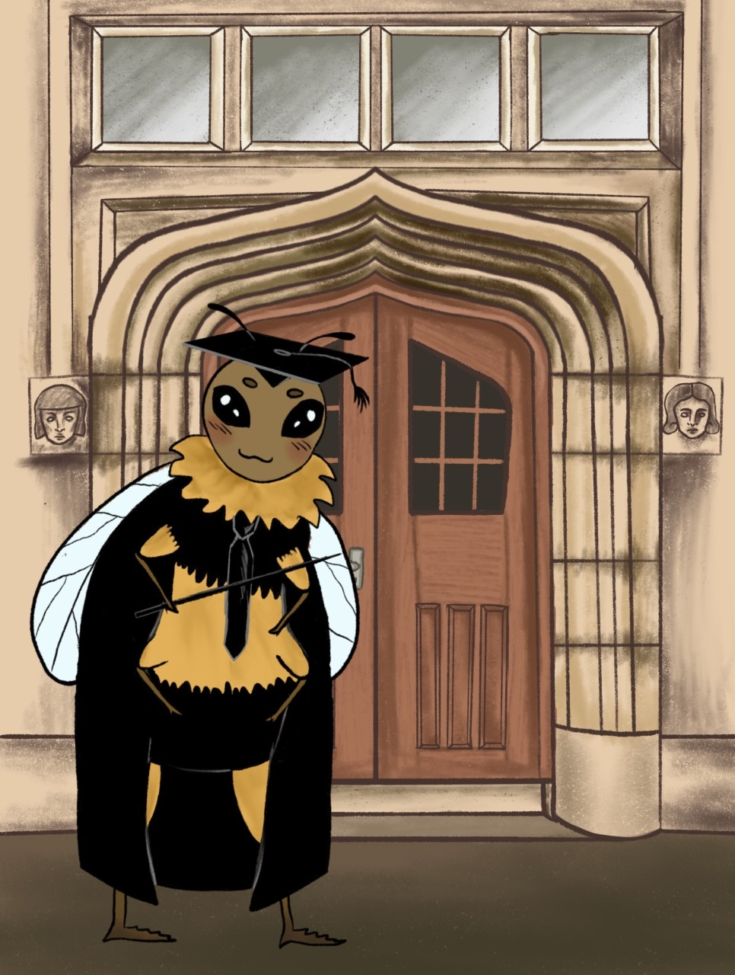
CVs and PDP
Bethan Jenkins
b.Jenkins@uwtsd.ac.uk
Careers Adviser Carmarthen

Slide 2

Career Luck is what happens
when preparation meets opportunity
- Seneca (with apologies)

Slide 3
700 words – PDP coursework – suggested structure
Word count
Introduction 50 words
Paragraph topic - Skills
discuss top 10 skills from skills audit & 200 words
multiple intelligences quiz
Paragraph topic - Interests – Princeton review results 100 words
Paragraph topic -Motivations and values
– answer the question: what is important to you? 100 words
Opportunities your profile suggests are suited to you? 100 words
Discuss pathways to access those opportunities 100 words
Conclusion 50 words

Slide 4
Sample Education CV
NAME / CONTACT DETAILS
PERSONAL PROFILE – Career focus
EDUCATION
WORK HISTORY / VOLUNTEERING
SKILLS / ACHIEVEMENTS - Educational
INTERESTS / HOBBIES
REFERENCES AVAILABLE ON REQUEST

Slide 5
What does a great CV look like?
Example:
UWTSD Career Focus section –
Final year student at Trinity St David’s University studying the BA Education, predicted to graduate with a 1st class degree.
With 10 years experience in teaching support in schools I have organised and led forest Schools Projects, designing lessons on environmental and well being activities.
I can establish excellent rapport with pupils and have a hands-on, friendly community focused approach that enables and empowers people to get involved.
I am now seeking a position within the education and voluntary sectors which will allow me to combine my management skills, mentoring and supportive skills in a position as a graduate education officer/trainer.
2 sides of A4 max
Reverse chronological order
Needs a ‘Career Focus’ section and an ‘Educational Skills’ sections
Should tell an employer what you can do, and what additional talents you can bring to the organisation.

Slide 6
Where to look for vacancies?
Charity and 3rd sector jobs
Recruit3
https://www.recruit3.org.uk/jobs/
Charity Jobs
https://www.charityjob.co.uk/jobs?location=swansea&radius=40
Education/teaching agencies
Eteach.com
https://www.eteach.com/jobs/support-non-teaching/swansea-uk/?oo=ca-lc&pt=51.62144,-3.94364600000000&dis=40
CV-Library
https://www.cv-library.co.uk/register
Reed Education
https://www.reed.co.uk/jobs/reed-education/p1307
Indeed Education Wales
https://www.indeed.co.uk/Education-jobs-in-Wales

Slide 7
You Need a systematic way to Job Hunt!
You know where vacancies are but do you know HOW to job hunt ?
Use job descriptions to help you
Detailed information about the employer’s ideal worker is provided in the job description and person specification.
This is CRUCIAL information that must be used by you when writing your application forms and C.V.s

Slide 8
Job Descriptions
Job description
A job description is a summary of the main duties and responsibilities associated with the post. It should detail any responsibilities attached to the post and who line manages the post.
TIP – look up the line manager on linkedin and check their experience and interests!

Slide 9
Person Specifications
Person Specification
The person specification is a description of the essential and desirable skills, qualifications and qualities that the job holder needs to be able to perform that job successfully.
Interview questions should be related to this!

Slide 10

Writing CVs – A systematic way to do it
Analysing the job description
Reading a job description isn’t as straight forward as you might think!
You will need to do some detective work, reading between the lines, to find out exactly what skills and qualities the employer really wants.
Blue Text = Organisation & people skills
Green Text = Education related Knowledge & experience
Purple Text = Personal skills needed

Slide 11
Education Project officer: ‘CAN DO’ Job description
Key Responsibilities include:
Support the programme to achieve positive outcomes for young people with additional needs in line with agreed project pathways and plans
Recruit participants to agreed targets each year and deliver the three pathways: One off or taster activities; Building Communities programme of 16 hours; and social enterprise Steering Group
Build partnerships with local schools, colleges, disability groups and services, to promote the project and recruit groups of participants
Design and develop sessions, community activities and skills development workshops to meet the programme’s outcomes
Support participants to complete relevant paperwork, including photographic and written evidence of achievements
Organise and present at promotional and networking events
Follow Can Do Theories of Change, Quality Management and Evaluation Frameworks
Support the development of community volunteering at your location
Assist the Programme Manager in coordination of the national Can Do programme
Undertake any other reasonable duties as requested

Slide 12
Education Project officer: ‘CAN DO’ Job description
Key Experience needed:
Experience of working with young people is essential
Experience of organising and delivering projects/events and building community links is essential
Experience of working with disabled people is desirable
Working knowledge of Swansea and surrounding area is essential
Good standard of education and IT literate
An engaging manner with the ability to build rapport with young people
Passion, enthusiasm and a real commitment to make a difference to people’s lives
Good communication, interpersonal and team working skills
Be able to work unsupervised and on your own initiative, as well as part of a team
Own vehicle (essential) and a satisfactory disclosure check (DBS) is required for this position

Slide 13
Match it up to your experience
You need to show the employer that you understand what skills are necessary to be able to fulfil the duties on the job description.
You then need to think about examples from your experiences in work or your personal life that demonstrate you have these skills or qualities.

Slide 14
How to structure your examples
Explain your answers using –
C A R E or S T A R
Context - Describe the where/when/ Situation of your example?
Activities – What were your specific Tasks duties/actions ?
Results – What was the outcome? Give specifics / quantities and/or say what you learnt from this.
Explain – Link this example back to the job description, explain how it shows you can fulfil XXX element of the job.

Slide 15
Example Skill Paragraph – using STAR/CARE technique
At the Art club at Dyfatty Primary, the most successful activity was the advent calendar. This involved me in preparing the art materials and templates for pupils to use to create their calendars. The activity was a great success because the pupils all seemed to have fun and enjoyed it. It was fun and rewarding working with the pupils, while providing them the opportunity for experiential learning; I have developed my communication, time keeping, planning and organisational skills from this experience.
Context - At the Art club at Dyfatty Primary
Actions - Advent Calendar activity – preparing art materials and templates.
Result - This was a success because the pupils all seemed to have fun and enjoyed it.
Explain - I developed my communication, planning and organisational skills from this.

Slide 16
Get help writing
CV & Applications from your Careers Service!
No questions are too silly or simple to ask a careers adviser!
Book an appointment with your careers adviser -
Bethan Jenkins – b.Jenkins@uwtsd.ac.uk
Mon - Weds

Slide 17
Personal Development Planning
Career/Future Life Planning
Knowing your - Skills, Interests, Motivation and Values
Knowing what opportunities are out there and available
Matching the two together ( With the help of a great careers adviser!)
Voluntary work (if necessary) then Job hunting!

Slide 18
Mindset
Analyse your skills & strengths….
What are your “Super-Powers”?
Can you explain difficult ideas easily ?
Are you uber-organised ?
Can you inspire people and engage them?
Can you analyse Data, interpret it and write
Reports that everyone can understand?
Personal Attributes
Confidence
Positivity
Resilience
Organised
Team work
Hard working
Can meet deadlines
Multi-task…..etc

Slide 19
Knowing your Skills
Multiple Intelligences (Gardner, H)
Free online quiz
https://www.idrlabs.com/multiple-intelligences/test.php

Slide 20
Career interests
Princeton review
This Quiz is about your INTERESTS not your skills!
You must answer the paired sets of questions purely on whether you fancy or are interested in that job, regardless of whether it is a realistic job for your skill set.
https://www.princetonreview.com/quiz/career-quiz
Holland code
This quiz matches you to career sectors based on your answers
https://www.roguecc.edu/Counseling/HollandCodes/test.asp
( based on reputable psychology but American jobs!)

Slide 21
DIOLCH AM WRANDO A PHOB LWC!
THANKS FOR LISTENING AND BEST OF LUCK!

