Slide 2
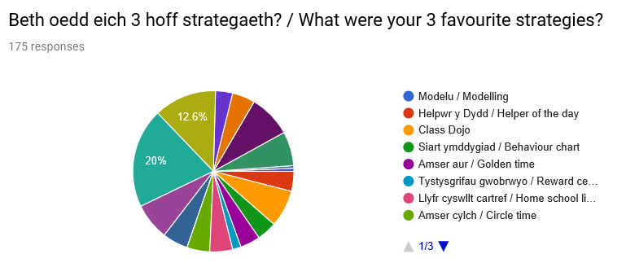
Adborth o sesiwn Y Farchnad
Feedback from the Marketplace session
Notes:
1af = Ffyn lollipop / Lollipop sticks (20%)
2il = Chwarae rol / Role play (12.6%)
3ydd = Goleuadau traffig / Traffic lights (8.6%)

Slide 3
Rhai rhesymau a rhoddwyd
Some reasons given
Ffordd dda o gael plant sydd ddim yn hyderus i ddod yn fwy hyderus
It included all children and encourages them to answer questions
It was Interesting to know that it’s more than just lollipop sticks
Notes:
Trafodaeth fer am fanteision ac anfanteision y math yma o strategaethau a’u heffaith yn yr ystafell ddosbarth, e.e. gorddibynnu ar un strategaeth yn broblem, angen gofalu bod polisi ysgol yn cael ei ddilyn, nid yw pob strategaeth yn siwto dulliau dysgu ac addygsu yr athro/disgyblion.

Slide 4
Tri phrif arsylwad
Three main observations
Erbyn hyn, rydych wedi derbyn y mewnbwn canlynol am reolaeth dosbarth effeithiol:
Arsylwi gwers
Sesiwn/darlith ar reolaeth dosbarth
Darllen pennod 12 Grigg.
Beth yw eich 3 phrif arsylwad am reolaeth dosbarth effeithiol?
By now, you’ve received the following input concerning effective classroom management:
Lesson observation
Session/lecture on classroom management
Reading Grigg chapter 12
What are your 3 main observations about effective classroom management?
Notes:
Trafodaeth fer am ganfyddiadau’r myfyrwyr.

Slide 5
Paratoi at eich meicroaddysgu
Preparing for your microteach

Slide 6
What is micro-teaching?
Beth yw meicro-addysgu?
Micro-teaching: noun
a scaled-down teaching procedure with a few peers/students under controlled conditions, often videotaped/observed in order to analyse teaching techniques and develop new teaching skills and to develop an initial sense of themselves as teachers
Micro-lesson: noun
a shorter lesson time intended to teach 1 or 2 specific targets in an intense way – often used as an interview procedure for teaching. The pace of a micro-lesson is brisker than a typical lesson; the children are not prepared, prior knowledge cannot be assumed and there is less time to spend getting to know the class. Common errors include not modelling or explaining clearly what is needed in each section of the lesson.
Meicro-addysgu: enw
gweithdrefn addysgu wedi'i lleihau yn gymesur, gyda nifer fechan o gyfoedion/myfyrwyr mewn cyflyrau rheoledig, yn aml wedi ei thapio ar fideo /ei harsylwi er mwyn dadansoddi technegau addysgu a datblygu sgiliau addysgu newydd a datblygu ymdeimlad cychwynnol o'u hunain fel athrawon.
Meicro-wers: enw
amser gwers byrrach gyda'r nod o addysgu 1 neu 2 darged penodol mewn ffordd ddwys – defnyddir yn aml fel trefn gyfweld ar gyfer addysgu. Mae cyflymdra micro-wers yn fwy bywiog na gwers nodweddiadol: nid yw'r plant wedi cael eu paratoi, ni ellir tybio bod ganddynt wybodaeth flaenorol, a threulir llai o amser yn dod i adnabod y dosbarth. Mae'r gwallau cyffredin yn cynnwys peidio â modelu neu esbonio'n glir beth sydd ei angen ym mhob rhan o'r wers

Slide 7
Nodau’r meicroaddysgu
Microteaching aims
I ddechrau dod yn gyfarwydd gyda thempledi cynllunio’r Birfysgol.
I ddechrau meddwl sut mae gweithgareddau addysgu yn cysylltu gyda nodau’r wers.
I gael tro ar addysgu plant.
To begin familiarising yourselves with the University’s planning templates.
To begin thinking how learning activities link to the lesson’s learning objectives.
To have a go at teaching children.

Slide 8
The microteach task
You will be teaching as a group of up to 4 students.
Organise your roles effectively – consider where you will work, with whom, and how you will ‘divide’ the teaching and supporting roles.
Ensure that your plans indicate these roles clearly.

Slide 9
Y Model class set-up
Topic – Bonfire Night
4 activities – creative, outdoors, numeracy, literacy
Focus task

Slide 10
Details of teaching requirements
Topic: Bonfire Night
Age group: FP Year 2
Resources available: IWB, general resources
Classroom layout: 2 classes – Mrs Hawkings & Mrs Thomas, 4 mixed ability groups of children in each class
Structure: 30 minute focus task (class teacher will provide introduction and plenary)

Slide 11
Planning for micro-teaching
Use University form 2d
Include appropriate curriculum references (Foundation Phase Framework)
Consider your learning objectives – link these to the curriculum documents, focusing on the topic, the age of the pupils and the time available.
Plan an appropriate learning activity
Details of appropriate resources

Slide 12
Learning Objectives
Must focus on LEARNING not DOING.
Should begin with a verb such as understand, appreciate, identify…
Should be SPECIFIC – the more focused the better.
Don’t try to cover too much in one activity!

Slide 13
Your microteach learning objective
By the end of the lesson/session, pupils will have learnt…
How and why we celebrate Bonfire Night

Slide 14
Presenting your plans
Each group of 4 students is required to present a session plan (including explanations of resources you will prepare) on the relevant form.

