Slide 1
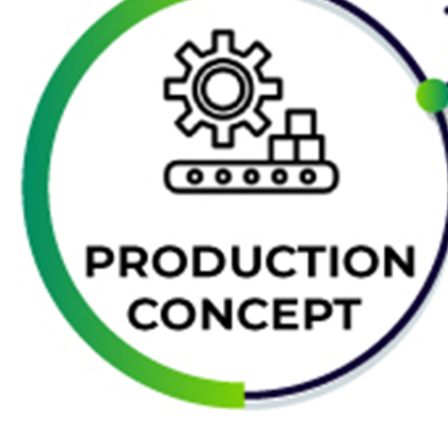
The most efficient concept for business in 2025
Somerda Iancu

Slide 2
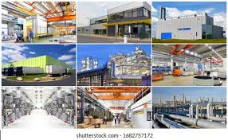
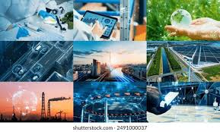
Introduction
The production concept emphasises efficiency and affordability (Kotler & Amstrong, 2015).
It emerged during industrialisation but remains highly relevant today.
2025 businesses use data and automation to enhance production (Darmawan, 2021).

Slide 3
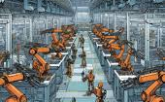

Core Principles
Operations and processes are more efficient (Kotler & Amstrong, 2015).
Economies of scale reduce costs and increase output.
Quality control creates trust and loyalty with customers.

Slide 4
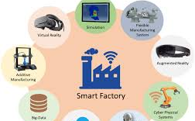
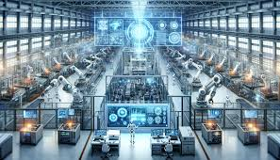
Modern application
AI and Robotics reduce human errors and increase precision Cheng, Jian & Lieu, 2022).
Sustainable options reduce waste (Thakkar, 2021).
With digital twins and IoT the ability to improve efficiency exists.

Slide 5
Conclusion: Why the Production Concept Is Best for Business in 2025
Confronts significant modern issues: expense management, sustainability, and technological disruptions (Kotler & Amstrong, 2015).
Activates efficiency providing companies with a distinct competitive advantage.
Motivates efficiency, productivity, and an overall low-cost operation for any business through automation, AI, and data analytics.
Enables eco-efficient practices minimising environmental impacts.
Delivers low-cost, high-quality product choices to the global consumer.
Meets the needs of both price-sensitive consumers as well as conscious sustainable consumers.
Balances potential profit with social and environmental responsibilities.
Assures long-term, continuing resilience and relevancy in the marketplace by 2025 (Sekine, 2024).

Slide 6
References
Chen, L., Jiang, M., Jia, F., & Liu, G. (2022). Artificial intelligence adoption in business-to-business marketing: toward a conceptual framework. Journal of Business & Industrial Marketing, 37(5), 1025-1044.
Darmawan, D., & Grenier, E. (2021). Competitive advantage and service marketing mix. Journal of Social Science Studies (JOS3), 1(2), 75-80.
Kotler, P., Burton, S., Deans, K., Brown, L., & Armstrong, G. (2015). Marketing. Pearson Higher Education AU.
Martynenko, M., Demchenko, H., & Osypenko, N. (2023). Developing and implementing digital marketing strategies of the future: Toward improving product quality and competitiveness.
Sekine, K. (2024). One-piece flow: cell design for transforming the production process. CRC Press.
Thakkar, R. (2021). Green marketing and sustainable development challenges and opportunities. International Journal of Management, Public Policy and Research, 1(1), 15-23.
https://bbanote.org/production-concept/
https://testbook.com/key-differences/difference-between-product-and-production-concept
https://www.mbaskool.com/business-concepts/marketing-and-strategy-terms/3235-production-concept.html

