Slide 1

Strategic and Agile Business ManagementBMMB7027
Competitive Strategy
Daniela Hellyer
May 2026

Slide 2
This week we will focus on…
Topics:
  Welcome
  Introduction to strategy and strategic management
  Strategic analysis
  Competitive strategy

Slide 3
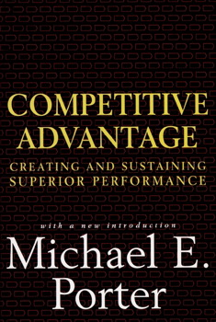
competitive advantage
Competitive Advantage
  Competitive advantage grows fundamentally out of value an organisation is able to create for its buyers that exceeds the organisation's cost of creating it.
  Value is what buyers are willing to pay, and superior value stems from offering lower prices than competitors for equivalent benefits or providing unique benefits that more than offset a higher price.
  There are two basic types of competitive advantage: cost leadership and differentiation.

Slide 4
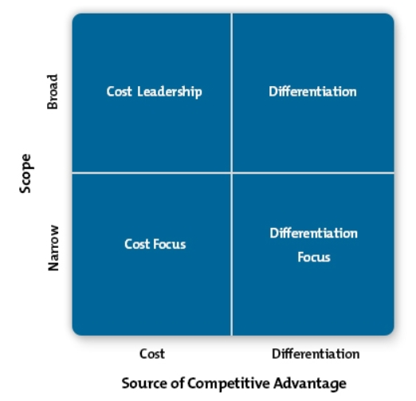
Porter's Generic Competitive Strategies
There are two basic types of competitive advantage:
cost leadership and differentiation
Key question: How is the organisation positioned in competitive environment?
These choices of ‘generic strategy’ are at the broadest level
Organisation chooses the type and scope of its operations and market appeal
The relative position in the industry is determined by:
  Choice of competitive advantage: cost leadership vs. differentiation
  Choice of competitive scope: broad vs. narrow

Slide 5
cost leadership strategies
Cost Leadership
  A price-driven strategy based on basic products/services offered to a broad market
  Leader in cost in industry or market
  Achieved by:
    Increasing profits by reducing costs while charging industry-average prices
    Increasing market share through charging lower prices, while still making reasonable profit due to cost reduction
  Risk:
    Cost reduction sources are not unique to your company and competitors can copy cost reduction strategies

Slide 6
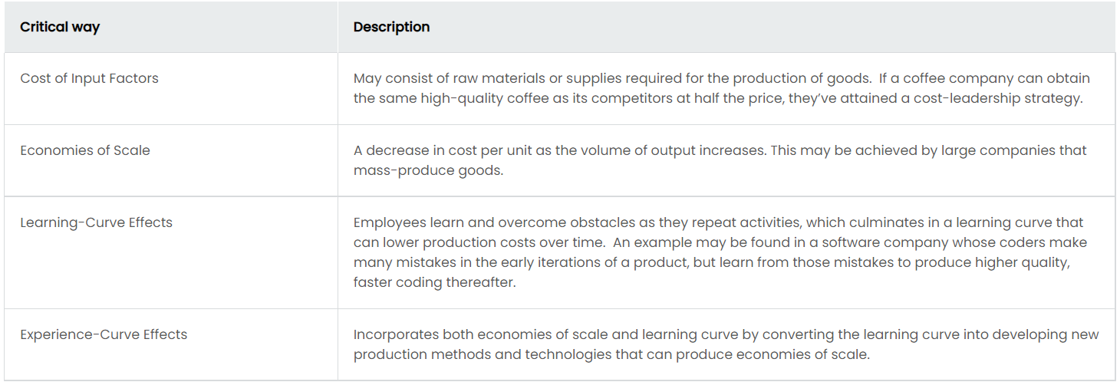
cost leadership
Cost Drivers:
  Four critical ways of cost reduction for product/service

Slide 7
Differentiation strategies
Differentiation
  Products/services are different and more attractive than competitors’, e.g. through features, functionality, durability etc.
  Requires:
    Great Research & Development and innovation
    Ability to deliver high quality products/services
    Effective sales and marketing functions
    Agile approach
    Understanding core value drivers of a given product/service

Slide 8
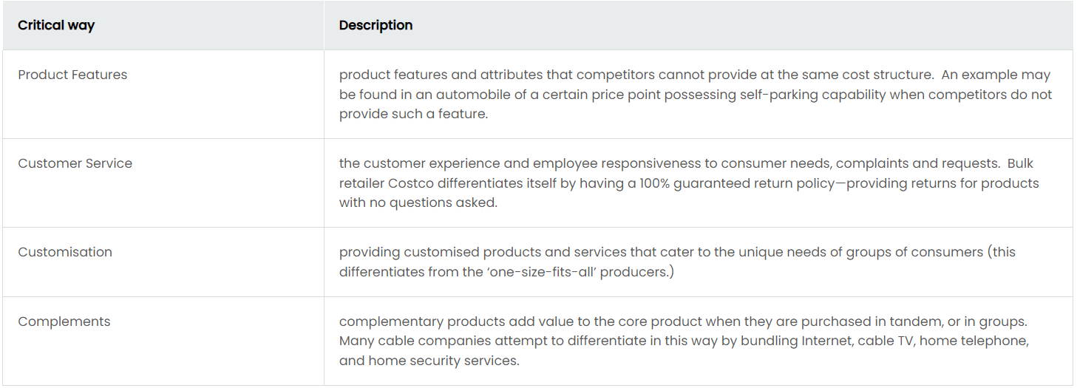
differentiation
Value Drivers:
  Four critical ways for an organisation to increase the perceived value of their product/service and achieve differentiation

Slide 9
Focus strategies
Focus Strategies
  Focus on niche markets and their unique needs of customers
  Develop unique low-cost or well-specified products
  Result in strong brand loyalty
  Less attractive to competitors
Note: Focus Strategies are not successful on their own:
  Company needs to decide on Cost Leadership vs. Differentiation first
  Must add something ‘extra’ to serve only that niche
  This ‘extra’ can:
    Reduce costs (e.g. through your knowledge of specialist suppliers) or
    Increase differentiation (e.g. through your deep understanding of customers’ needs or design edge)

Slide 10
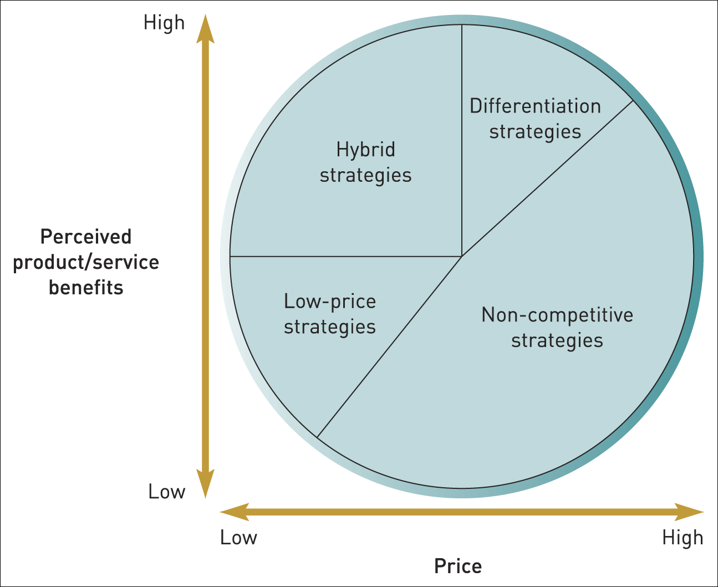
Bowman’s strategic clock
Builds on Porter’s Generic Competitive Strategies:
Cost Leadership vs. Differentiation
A strategic framework developed by Bowman and Faulkner
Focuses on market strategy: prices/sacrifice vs. perceived service/product benefits
Customers’ perceived value of a product/service

Slide 11
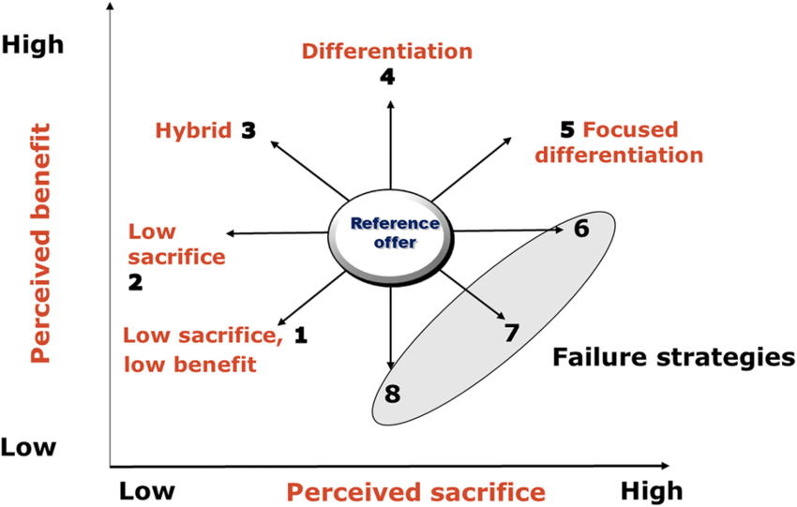







Bowman’s strategic clock
Consists of eight positions across the clock – indicating a different market strategy
Risky High Margins
Fitness Centres
Monopoly Pricing
Loss of
Market Share
Note: Perceived sacrifice = price

Slide 12



competitive role strategies
Competitive Role Strategies:
  An organisation must decide how to best position itself in a strategic context:
    Will they be a Leader, Follower, Challenger or a Specialist / Niche Player?
  They must consider their position relative to all competitors and their market share
There are four Competitive Role Strategies:
Leader | Challenge: constantly defending business, protecting market share Benefits: securing share, first choice of customers, high market credibility, seen as dominant player
Follower | Capitalises on competitor's errors, sometimes not willing/able to innovate Watch problems arise and then tackle them with own offering Enjoys lower costs, and R&D expense, lower cost to serve customers Seen as unwilling to take major risks
Challenger | Capitalises on mistakes of Market Leaders Allows R&D cost reduction and therefor often faster go-to-market lead times
Specialist / niche | Able to concentrate on select number of target segments Suitable for high-end products or where premium price strategy can be exploited Aiming to gain competitive advantage through effectiveness rather than efficiency
Independent Premium Restaurants

Slide 13
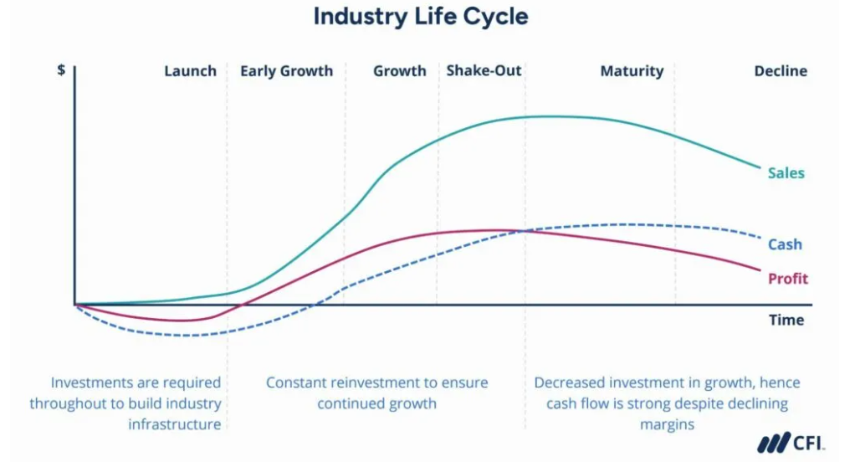
The industry life cycle
Question: Can you think of examples of markets for each stage?
Notes:
Figure 3.4 The industry life cycle

Slide 14
This is the end of our session ☺

