Slide 1

Change and Stability Management
TWITTER 2.0
By Dawid Walczak
07th June 2023
Tutor: marie pitson

Slide 2
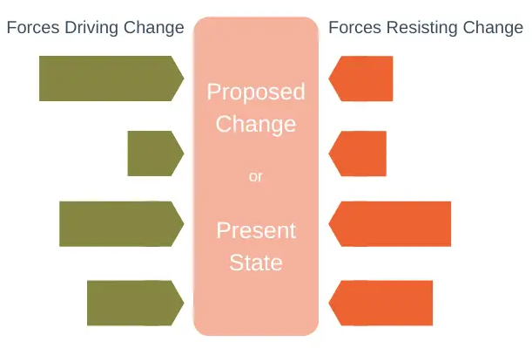
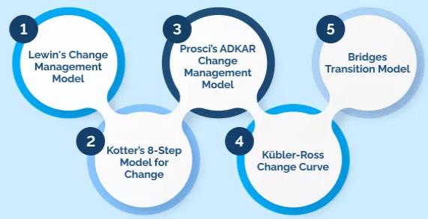
What is the change management?
“…moving from the current to a future state using a coordinated and structured approach” (Stobierski, 2020).
Force Field Analysis & Kurt Lewin (Connelly,2023)
Notes:
*Force Field – created in 1940 by Kurt Lewin
*Kurt Lewin was a German-American psychologist who was born in 1890 and died 1947.
*originally used in social psychology but now used for to see if change is good or bad for an organisation

Slide 3

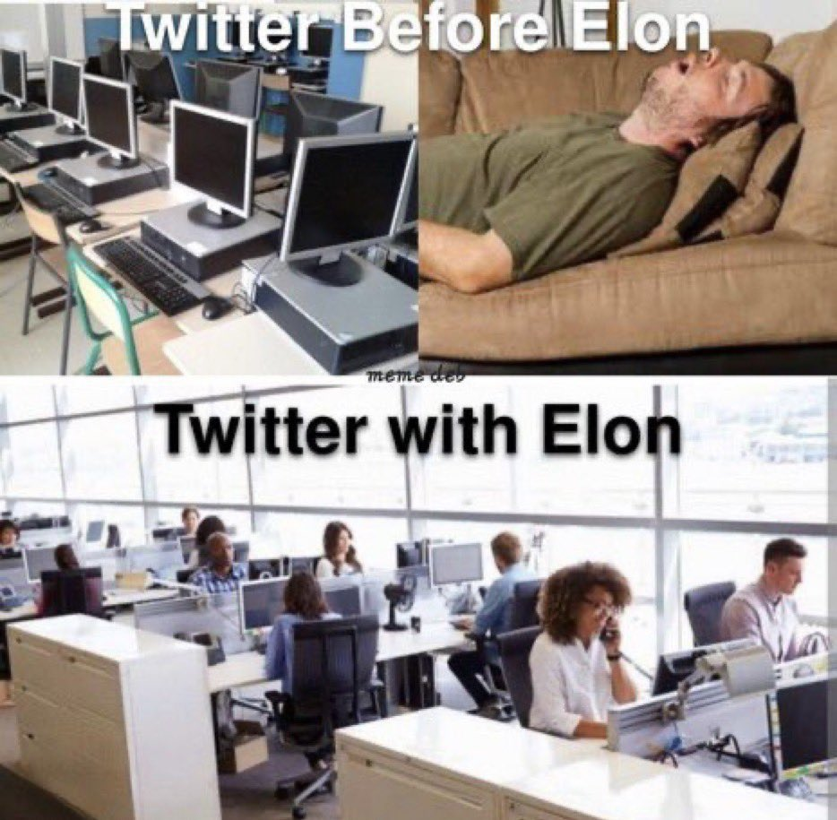
Twitter
Type of change
Founded in 2006 (Awa,2022)
Emergent – out of nowhere
~370m users (Iqbal,2023)
Transformational – complete reshape
Elon Musk and enormous money (Daniel, 2022)
Organisational Level
Massive Lay-offs (Baine, 2022)
Strategically/Operational
Being a ‘hardcore’ (Schiffer,2023)
Unhappy former workers (Duffy,2023)
Notes:
Founded originally by Jack Dorsey, Noah Glass, Biz Stone and Evan Williams
-Since 2006 -2013 Twitter seen a lot of growth
-In 2014 there was a slow user growth and increase in news litter
-Used in politics – Donald Trump
-Fake news during precidency campaigns and Covid-19

Slide 4
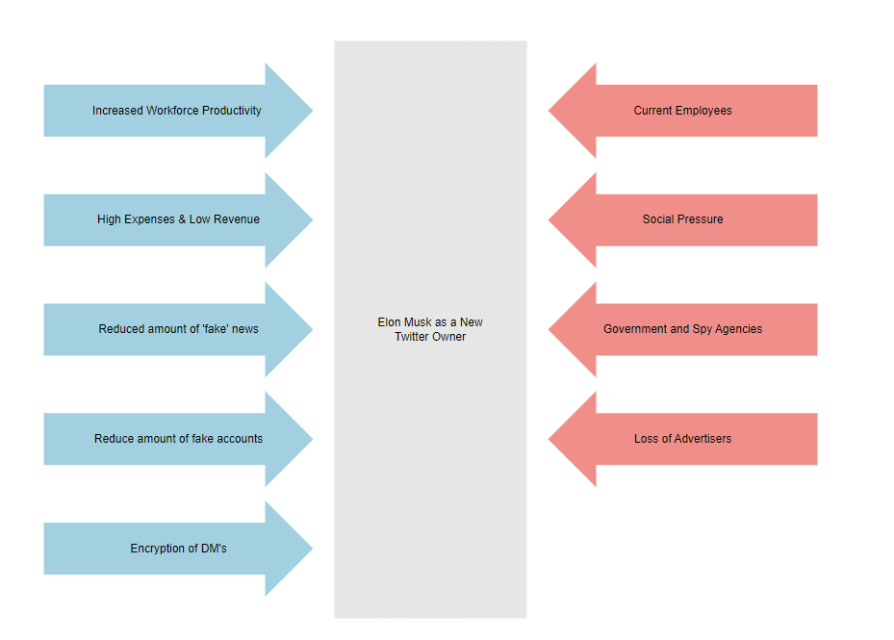
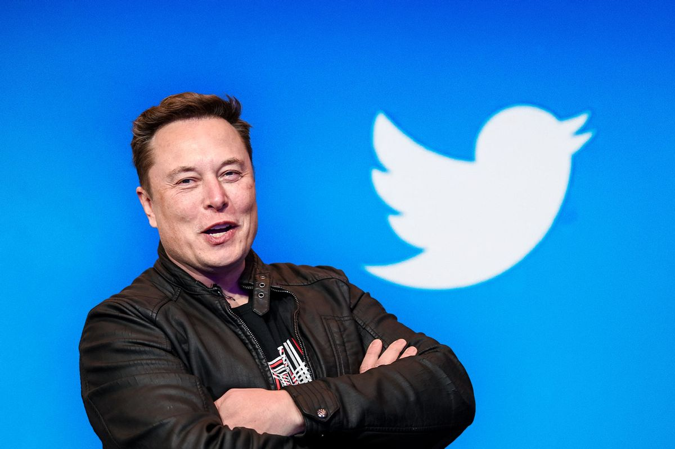
Force Field Analysis & Twitter
Notes:
Increased productivity – Less people equals more work done
Social Pressure – Famous celebrities have deleted their account (Le Bron, Elton John, Whoopie Goldberg)
Current Employees – Legal Action against Musk
*during covid Twitter emloyees could work from home forever, Musk came in and brought everyone back

Slide 5
Was the change for better?
Increase in DAU (Daily Active Users) by 1.3m users each month in US (Ingram, 2022)
Main advertisers did not come back (Warrington,2023)
Employees overworked due to long hours (Grace,2022)
Increased communication between teams due to reduced staff (Schiffer, 2023)

Slide 6


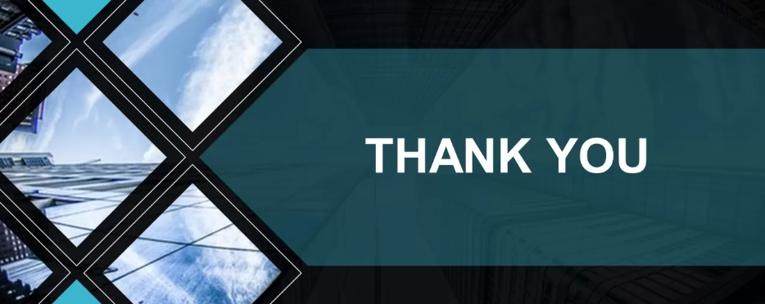




Any Questions?

Slide 7
References
Awa, J. (2022). Who Owns Twitter? A Brief History of the Company. [online] MUO. Available at: https://www.makeuseof.com/who-owns-twitter-company-history/.
Baine, D. (2022). Elon Musk Moves Quickly On Twitter Restructuring : Huge Layoffs On Saturday? [online] Forbes. Available at: https://www.forbes.com/sites/derekbaine/2022/10/29/elon-musk-moves-quickly-on-twitter-restructuring--huge-layoffs-on-saturday.
Connelly, M. (2023). Lewin’s Force Field Analysis Explained. [online] Available at: https://www.change-management-coach.com/force-field-analysis.html
Daniel, W. (2022). Elon Musk’s $44 billion Twitter purchase is ‘one of the most overpaid tech acquisitions in history,’ Wedbush’s Dan Ives says. [online] Available at: https://fortune.com/2022/10/27/elon-musk-twitter-purchase-most-overpaid-tech-history-dan-ives-wedbush/
Duffy, C. (2023). Elon Musk’s Twitter accused of unlawful staff firings in the UK | CNN Business. [online] CNN. Available at: https://edition.cnn.com/2023/01/11/tech/twitter-uk-layoffs-employee-claims/index.html.
Grace, K. (2022). Elon Musk takes away ‘days of rest’ at Twitter in another major shift from Jack Dorsey’s leadership style. [online] Business Insider. Available at: https://www.businessinsider.com/elon-musk-takes-away-twitter-workers-days-of-rest.
Ingram, D. (2022). New data confirms Musk’s claim that Twitter activity is up. [online] Available at: https://www.nbcnews.com/tech/social-media/elon-musk-twitter-us-data-growth-tweet-bankruptcy-shutting-down

Slide 8
References
Iqbal, M. (2023). Twitter Revenue and Usage Statistics (2023). [online] Business of Apps. Available at: https://www.businessofapps.com/data/twitter-statistics/.
Mier, T. (2022). All the Celebrities Who’ve Quit Twitter Because of Elon Musk. [online] Rolling Stone. Available at: https://www.rollingstone.com/culture/culture-lists/elon-musk-twitter-celebrities-quit. ‌
Schiffer,A. (2023). Inside Elon’s ‘extremely hardcore’ Twitter. [online] The Verge. Available at: https://www.theverge.com/23551060/elon-musk-twitter-takeover-layoffs-workplace-salute-emoji.
Stobierski, T. (2020). What Is Organizational Change Management? | HBS Online. [online] Harvard Business School Online. Available at: https://online.hbs.edu/blog/post/organizational-change-management.
Warrington, J. (2023). Twitter no longer ‘high risk’ after Musk replaced, says leading advertising agency. The Telegraph. [online] 19 May. Available at: https://www.telegraph.co.uk/business/2023/05/19/twitter-no-longer-high-risk-musk-replaced
YouTube Video (2023). Tesla CEO Elon Musk: I’ll say what I want to say, and if we lose money, so be it. [online] Available at: https://www.youtube.com/watch?v=6sUwRiIncKU

