Slide 1
Authentic Leadership

Slide 2
Definition
Authentic leadership brings together the concept of authenticity with positive psychology. Luthans and Avolio (2003) defined authentic leadership as "a process that draws from both positive psychological capacities and a highly developed organizational context, which results in both greater self-awareness and self-regulated positive behaviours on the part of leaders and associates, fostering positive self-development" (p. 243). This definition, and the theory of authentic leadership were developed to define components (Walumbwa et al., 2008).
Internalised moral perspective: self-regulation that is based on internalised moral values (as opposed to those imposed by a group organisation or society) this is expressed in ethical decision making and ethical behaviour.
Balanced processing: objective evaluation of information before deciding, including encouraging others to question or challenge ones values
Relational transparency: being true to one’s values and expressing this to others, this involves the open sharing of information about one’s thoughts and feelings.
Authentic Leadership was set to inspire individuals to pull together, work hard and most importantly communicate with others in a group environment, but leading in the authentic way is hard to answer as authenticity can mean many different things and can involve a wide range of skills, actions and behaviours. Authentic leadership is about behaving with integrity and being consistent.

Slide 3
Research
The concepts have been around for years but the model was popularised in business first in:
Beddoes-Jones 2015
Bill George – “Authentic Leadership: Rediscovering the Secrets to Creating Lasting Value” 2003
He identifies five qualities that authentic leaders demonstrate

Slide 4
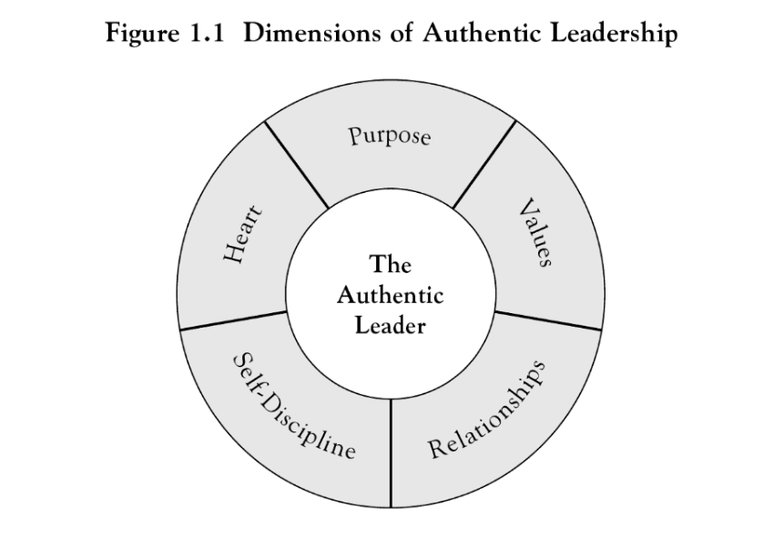
Reference: “Authentic Leadership: Rediscovering the Secrets to Creating Lasting Value” 2003

Slide 5
1. Purpose
“If you lack purpose and direction in leadership, why would anyone want to follow you?”
“There is no way you can adopt someone else’s purpose and still be an authentic leader
Understand yourself, your passions, and your underlying motivations

Slide 6
2. Values
Moral compass
Can’t necessarily be taught
INTEGRITY is required in every authentic leader
If people don’t trust you why would they follow you?

Slide 7
3. Relationships

Slide 8
4. Self - discipline

Slide 9
5. Heart

Slide 10
21st Century
Authentic leadership has to adapt to meet changing needs of this 21st century if it is to remain relevant. The 21st century world has changed from that of the previous century with the global financial crisis marking a point of inflection in this change (Walker, 2011).
Business leadership became an elite profession, dominated by managers who ruled their enterprises from the top down. A new generation of leaders is reshaping the best-led global companies. Authentic leaders focused on customers are replacing hierarchical leaders that focus on serving short-term shareholders. In the 21st century the most successful leaders will focus on sustaining superior performance by aligning people around mission and values and empowering leaders at all levels, while concentrating on serving customers and collaborating throughout the organization (George, 2010).
In the largest leadership development study ever undertaken, Harvard professor and former Medtronic chief executive Bill George concluded that you might drive short-term outcomes without being authentic, but authentic leadership is the only way to create long-term results (Masterson, 2018)
Lloyd-Walker, Beverley & Walker, Derek. (2011). Authentic leadership for 21st century project delivery. International Journal of Project Management. 29. 383-395. 10.1016/j.ijproman.2011.02.004.
George, B. (2010). Harvard Business Review. The New 21st Century Leaders, 1.
Masterson, A. (2018). What it takes to be a great leader in the 21st century. The Irish Times, 1.

