Slide 1
EAEE6008/C
Arweinyddiaeth ar gyfer systemau o ansawdd
Leadership for systems of quality
Darlith/Lecture 3

Slide 2
Overview
Research-informed knowledge about effective early years practice
‘Measuring’ quality: Using environment rating scales
The SSTEW scale

Slide 3
Beth yw ansawdd?
What is quality?
‘‘quality’ was a choice, not a necessity’
‘Quality is something everyone wants to have and everyone wants to offer, while ‘quality’ itself is taken for granted, as ‘some thing – objective, real, knowable … waiting “out there” to be discovered and measured by experts’ (Dahlberg et al., 2013: 5–6).’
(Moss, 2016, p. 8-9)

Slide 4
Beth yw ansawdd?
What is quality?

Slide 5
Research-informed knowledge about effective early years practice
EPPE
EPPSE
REPEY

Slide 6
EPPE/ EPPSE project
http://www.ioe.ac.uk/research/153.html
The first major study in the UK to focus specifically on the effectiveness of early years education.
Large-scale, longitudinal study of the progress and development of children from pre-school to post-compulsory education.
Aspects of pre-school provision which have a positive impact on children's attainment, progress and development.
More than 3,000 children were assessed at the start of pre-school around the age of 3 and their development was monitored until they entered school around the age of 5. They were assessed again at key points until the end of Key Stage 3 in secondary school and then tracked through their final year of compulsory schooling and on to their post 16 educational, training and employment choices.
Six participating Local Authorities in England.

Slide 7
Prosiect EPPE/ EPPSE
http://www.ioe.ac.uk/research/153.html
Yr astudiaeth sylweddol gyntaf yn y D.U. i ganolbwyntio’n benodol ar effeithiolrwydd addysg blynyddoedd cynnar.
Astudiaeth arhydol ar raddfa fawr o gynnydd a datblygiad plant cyn ysgol hyd at addysg ôl-orfodol.
Agweddau o ddarpariaeth cyn ysgol sy’n cael effaith gadarnhaol ar gyrhaeddiad, cynnydd a datblygiad plant.
Cafodd dros 3,000 o blant eu hasesu ar ddechrau’r blynyddoedd cyn ysgol pan oeddent tua 3 blwydd oed a chafodd eu datblygiad ei fonitro tan iddynt ddechrau yn yr ysgol pan oeddent tua 5 mlwydd oed. Cawsant eu hasesu eto wrth iddynt gyrraedd pwyntiau allweddol hyd at ddiwedd Cyfnod Allweddol 3 yn yr ysgol uwchradd, ac yna, cawsant eu dilyn drwy gydol eu blwyddyn ddiwethaf o addysg orfodol tan iddynt wneud eu dewisiadau addysgol ôl-16 a’u dewisiadau hyfforddiant a gwaith. Gwnaeth chwe Awdurdod Lleol yn Lloegr gymryd rhan.

Slide 8
Key messages
There is an enduring effect of pre-school.
Attendance, quality and duration at pre-school all show long term effects on students’ academic outcomes
The quality of pre-school predicted both total GCSE scores and English and maths grades.
High quality was also linked to better self-regulation, pro-social behaviour and lower levels of hyperactivity.
The quality of pre-school was especially important for children whose parents had low qualifications.

Slide 9
Negeseuon allweddol
Mae gan flynyddoedd cyn ysgol effaith hir dymor
Mae presenoldeb, ansawdd a hyd eu hamser mewn lleoliad cyn ysgol yn dangos effeithiau tymor hir ar ddeilliannau academaidd myfyrwyr.
Gwnaeth ansawdd y cyfnod cyn ysgol ragfynegi cyfanswm y sgoriau TGAU a’r graddau Saesneg a Mathemateg a enillwyd.
Roedd ansawdd uchel hefyd yn gysylltiedig â gwell hunanreolaeth ac ymddygiad cymdeithasol, a lefelau is o orfywiogrwydd.
Roedd ansawdd y cyfnod cyn ysgol yn enwedig o bwysig i blant a oedd ganddynt rieni â chymwysterau isel.

Slide 10
REPEY project
Researching Effective Pedagogy in the Early Years
Asked the question
    ‘What does high quality look like?’
  how is it differentiated from ‘good’ quality?
12 case studies of pre-school provision where outcomes were highest (after accounting for social, economic variables)

Slide 11
Key messages
More ‘sustained shared thinking’ was observed in settings where children made the most progress.
‘Sustained shared thinking’ occurs when two or more individuals ‘work together’ in an intellectual way to solve a problem, clarify a concept, evaluate an activity, extend a narrative etc. Both parties must contribute to the thinking and it must develop and extend the understanding. It was more likely to occur when children were interacting 1:1 with an adult or with a single peer partner and during focussed group work.
The quality of adult-child verbal interaction matters.
http://eppe.ioe.ac.uk/eppe/eppepdfs/RBTec1223sept0412.pdf

Slide 12
Prosiect REPEY
Ymchwilio i Addysgeg Effeithiol yn y Blynyddoedd Cynnar
Gofynnwyd y cwestiwn sut mae ansawdd uchel yn edrych?
  Sut y gellir ei wahaniaethu oddi wrth ansawdd ‘da’?
12 astudiaeth achos o ddarpariaeth cyn ysgol lle gwelwyd y deilliannau uchaf (ar ôl ystyried newidynnau cymdeithasol, economaidd)

Slide 13
Effective pedagogy
Involvement of adult and child in co-construction of knowledge
Adults engaging in intentional pedagogic strategies such as:
  Demonstration
  Modelling
  Questioning
  Explaining
This is more than ‘facilitation’

Slide 14
Addysgeg Effeithiol
Cyfranogiad oedolyn a phlentyn yn y broses o adeiladu gwybodaeth ar y cyd
Oedolion yn cymryd rhan mewn strategaethau addysgol bwriadol, megis:
  Arddangos
  Modelu ymddygiad
  Holi
  Esbonio
Mae hyn yn fwy na ‘hwyluso’

Slide 15
Sut ydyn ni'n Mesur Ansawdd?
How do we Measure Quality?

Slide 16
Graddegau Mesur yr Amgylchedd a’r Raddfa Meddwl Cyson a Rennir a Lles Emosiynol
Environment Ratings Scales and the Sustained Shared Thinking and Emotional Wellbeing Scale

Slide 17
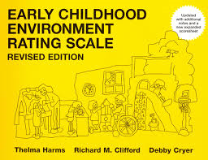
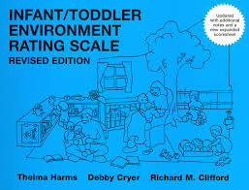
Graddegau mesur yr amgylchedd Environment rating scales

Slide 18
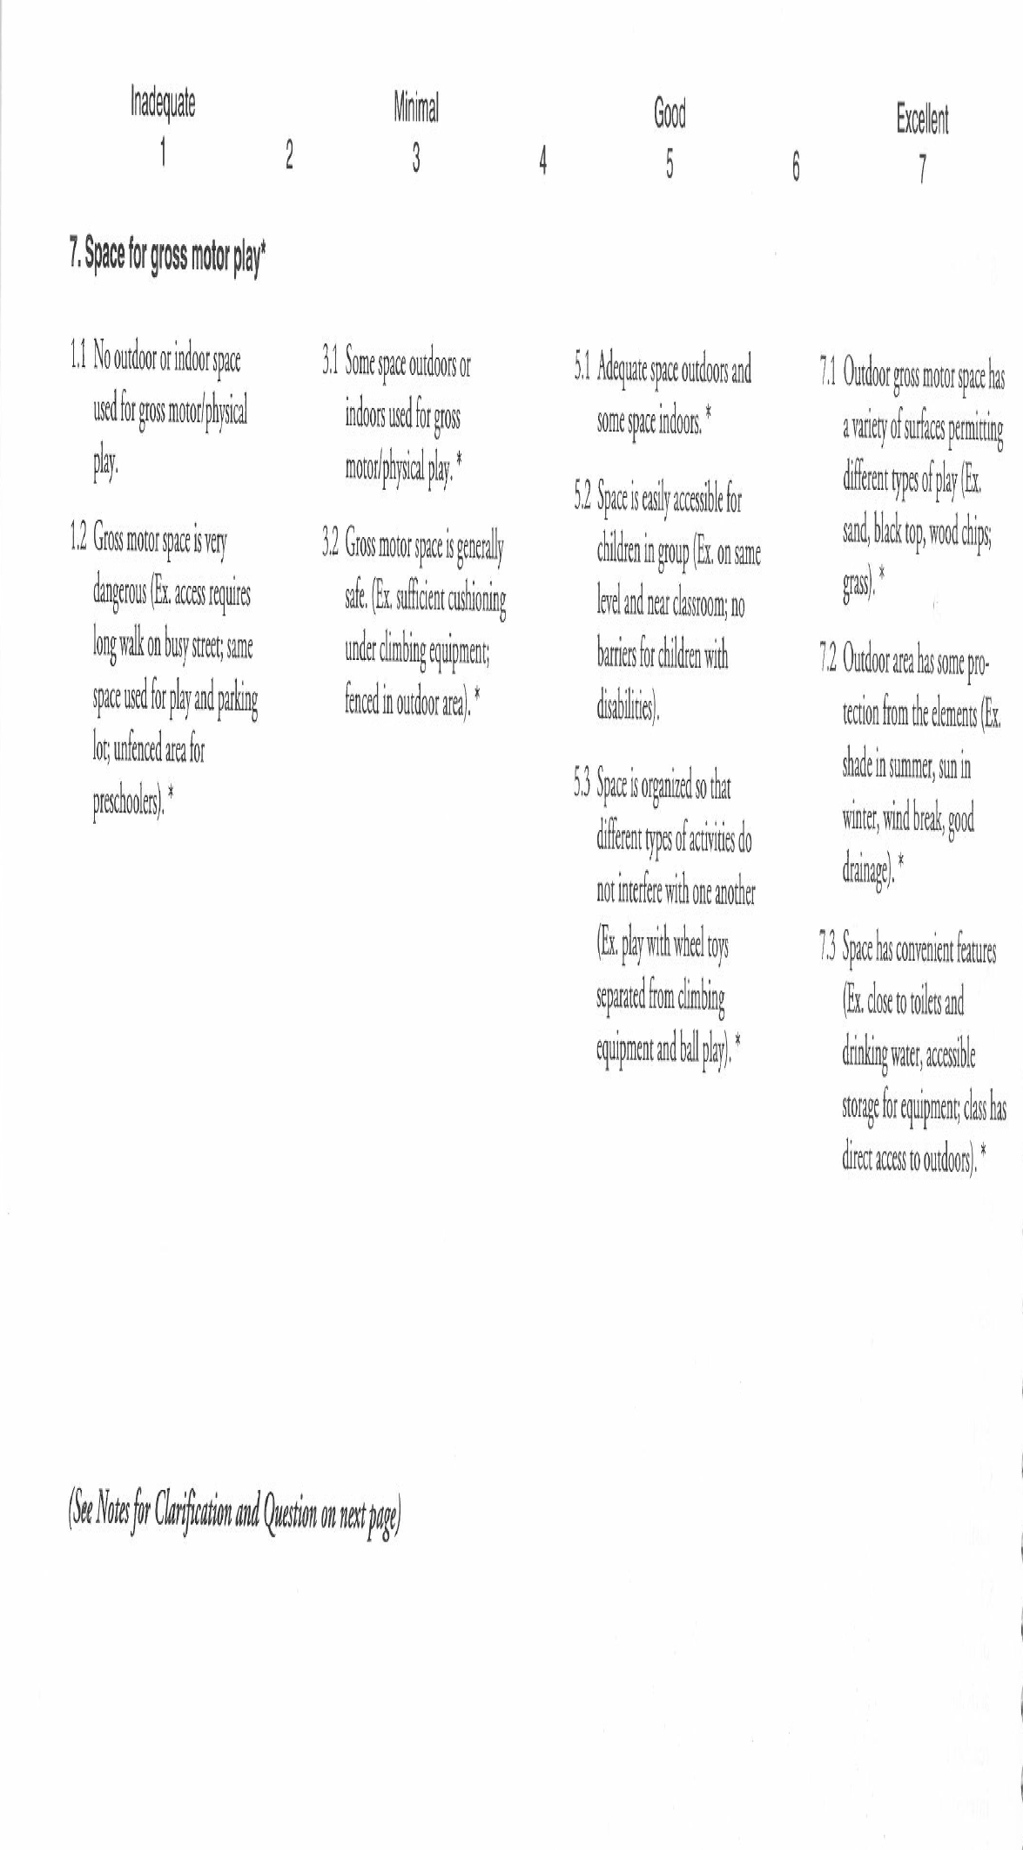
ECERS-R

Slide 19
Clip Fideo ECERS Video clip
https://www.youtube.com/watch?v=0OHFTGADcnI

Slide 20
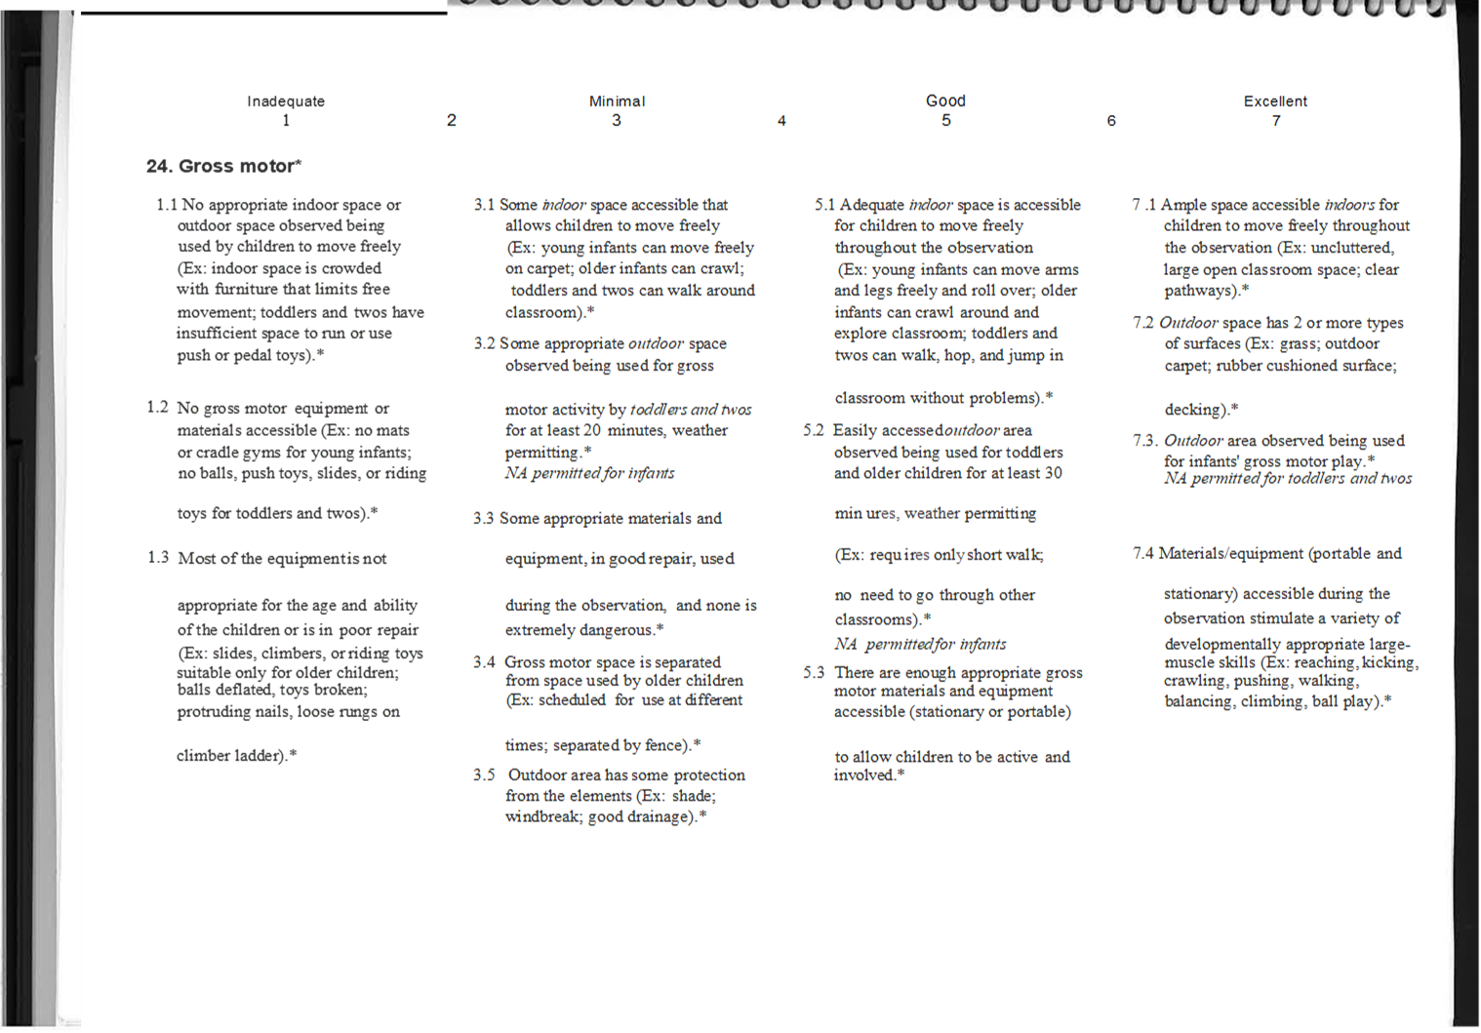
ITERS-3

Slide 21
Clip Fideo ITERS-3 Video clip
https://www.youtube.com/watch?v=0OHFTGADcnI

Slide 22
Sut mae rhyngweithio effeithiol mewn ysgol/lleoliad blynyddoedd cynnar yn edrych?
Gwrando
Rhannu diddordeb
Dau neu fwy o bobl
Gweithio gyda’i gilydd
Datrys problemau
Gwerthuso gweithgareddau
Ysgogir gan y plentyn
Egluro cysyniadau
Ymestyn y naratif
Datblygu ac ymestyn y meddwl
Modelu
Cwestiynau penagored
Meddwl cyson a rennir

Slide 23
What does effective interaction in early years school/settings look like?
Listening
Shared interest
Two or more people
Working together
Problem solving
Evaluating activities
Child-initiated
Clarifying concepts
Extending narrative
Develop and extend thinking
Modelling
Open ended questions
Sustained shared thinking

Slide 24


Slide 25
Is-raddfeydd SSTEW
Subscale | Item
Building trust and confidence | Self regulation and social development
 | Encouraging choices and independent play
 | Planning for small group and individual interactions/ adult deployment
Social and emotional well-being | Supporting socio-emotional well-being
Supporting and extending language and communication | Encouraging children to talk with others
 | Staff actively listen to children and encourage children to listen
 | Staff support children’s language use
 | Sensitive responsiveness
Supporting learning and critical thinking | Supporting curiosity and problem solving
 | Encouraging sustained, shared thinking through storytelling, sharing books, singing and rhymes
 | Encourage sustained shared thinking in investigation and exploration
 | Supporting concept development and higher order thinking
Assessing learning and language | Using assessment to support and extend language and critical thinking
 | Assessing language development

Slide 26
SSTEW subscales
Subscale | Item
Building trust and confidence | Self regulation and social development
 | Encouraging choices and independent play
 | Planning for small group and individual interactions/ adult deployment
Social and emotional well-being | Supporting socio-emotional well-being
Supporting and extending language and communication | Encouraging children to talk with others
 | Staff actively listen to children and encourage children to listen
 | Staff support children’s language use
 | Sensitive responsiveness
Supporting learning and critical thinking | Supporting curiosity and problem solving
 | Encouraging sustained, shared thinking through storytelling, sharing books, singing and rhymes
 | Encourage sustained shared thinking in investigation and exploration
 | Supporting concept development and higher order thinking
Assessing learning and language | Using assessment to support and extend language and critical thinking
 | Assessing language development

Slide 27
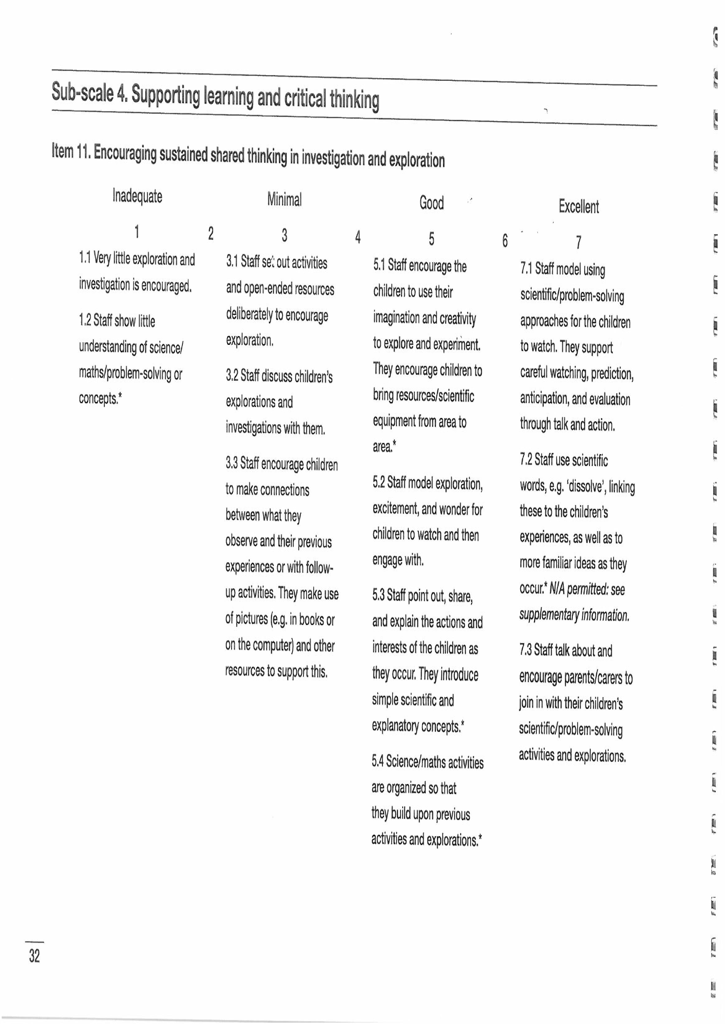
Using the SSTEW scale

Slide 28
Iâ Ice
https://www.youtube.com/watch?v=AehOYZENvzg

Slide 29
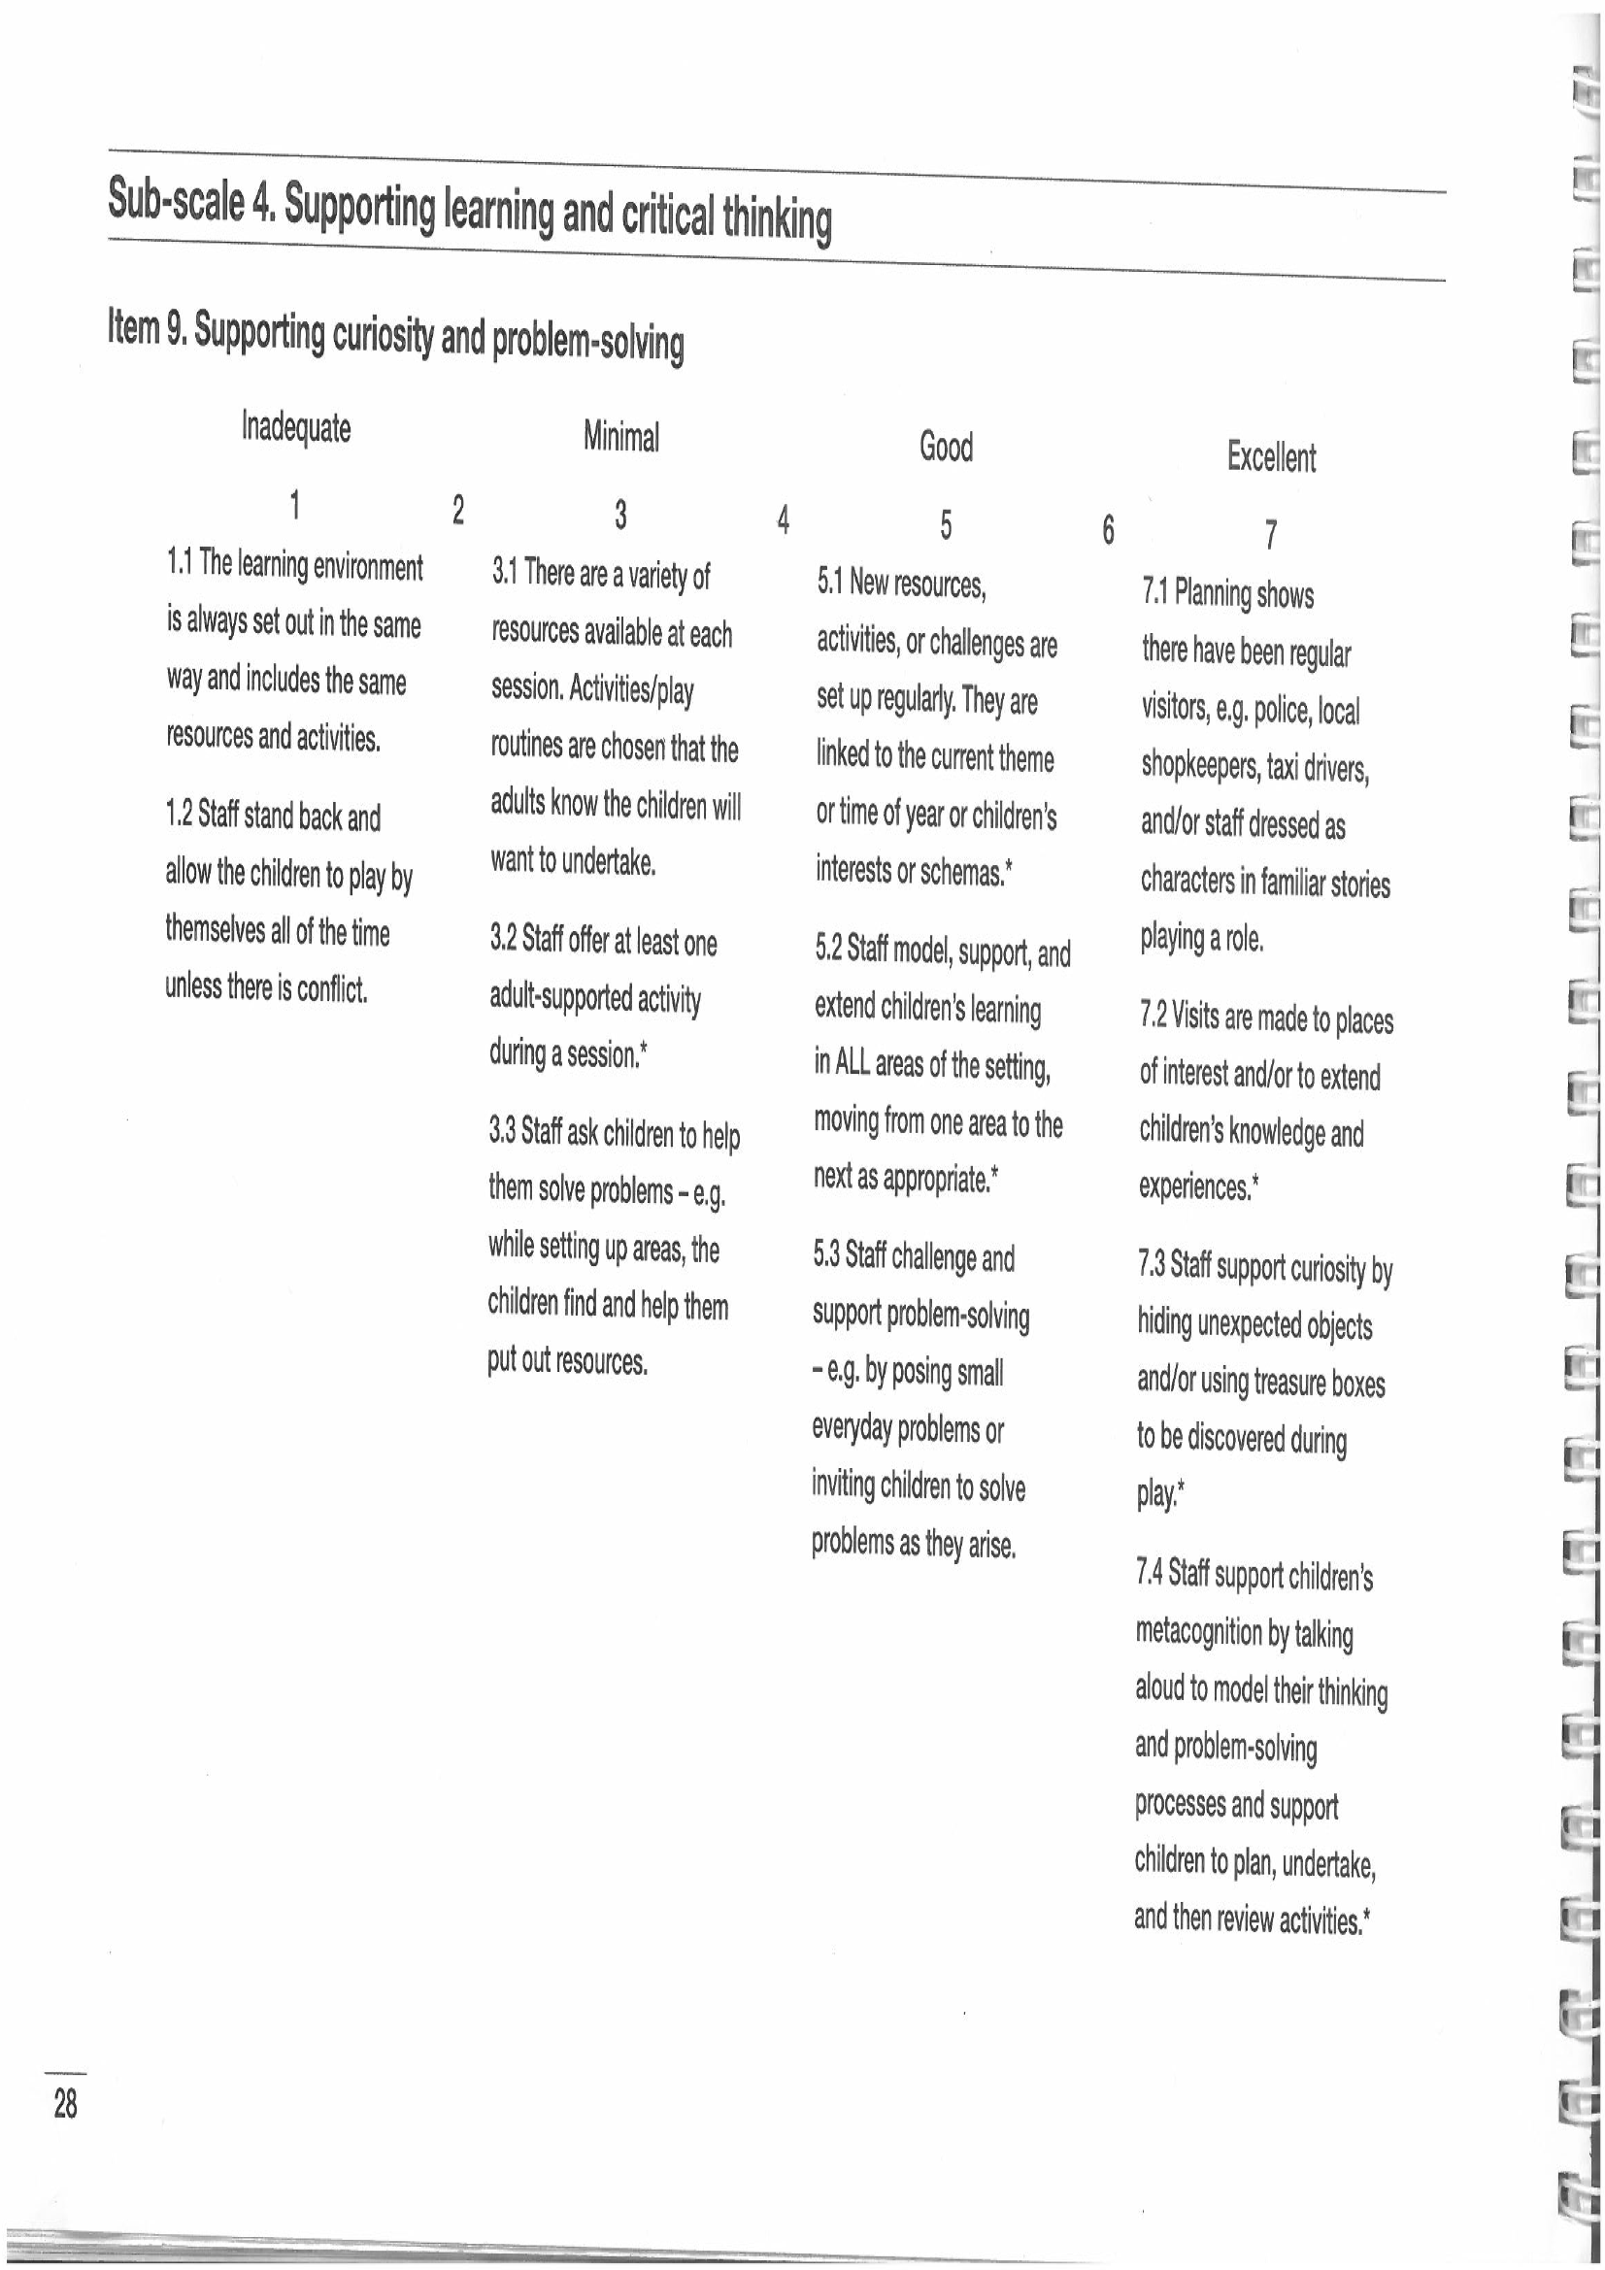

Slide 30
Pwli Pulley
https://www.youtube.com/watch?v=bylL-3W7pAI

Slide 31
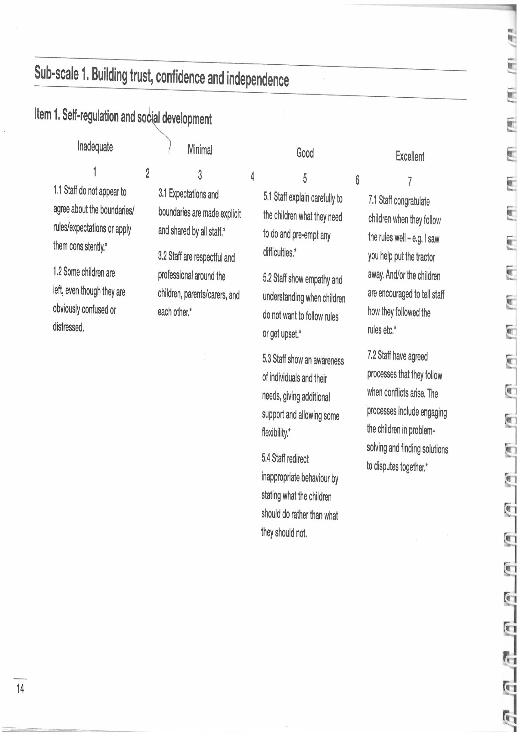

Slide 32
Arferol Routine
https://www.youtube.com/watch?v=GzCbYCOEveE

Slide 33
Syniadau? Thoughts?
Beth yw eich barn am STEW ac ECERS/ITERS fel arf Sicrhau Ansawdd?
Trafod
What do you think of SSTEW and ECERS/ITERS as a Quality Assurance tool?
Discuss

Slide 34
EEL and BEEL

Slide 35
Cyfeiriadau References
Abrahamson, L. (2015) The early years teacher’s book. London: Sage.
Bolton, G. (2014) Reflective practice: writing and professional development. London: Sage.
Boud D, Keogh R & Walker D (1985) Reflection: turning experience into learning. London: Kogan Page.
Gill, R. and Whitehouse, A. ‘Reflecting on work-based learning’. In C. Hayes, D. Daly, M. Duncan, R. Gill, and A. Whitehouse, Developing as a reflective early years professional: a thematic approach. (2nd ed) St Albans: Critical Publishing. pp61-98.
Hallett, E. (2013) The reflective early years practitioner. London: Sage.

Slide 36
Cyfeiriadau References
Hayes, C. (2017) ‘Reflection informed by observation and assessment’. In C. Hayes, D. Daly, M. Duncan, R. Gill, and A. Whitehouse, Developing as a reflective early years professional: a thematic approach. (2nd ed) St Albans: Critical Publishing. Pp98-124.
Hayes, C., Daly, D., Duncan, M., Gill, R. and Whitehouse, A. (2017) Developing as a reflective early years professional: a thematic approach. (2nd ed) St Albans: Critical Publishing.
Lindon, J. (2012) Reflective practice and early years professionalism. (2nd ed) Great Brittain: Hodder Education
Moss, P. (2016) Why can’t we get beyond quality? Contemporary Issues in Early Childhood. Vol. 17 (1) pp. 8-15.
Paige-Smith, A. and Craft, A. (eds) (2011) Developing Reflective Practice in the Early Years. (2nd ed) Maidenhead: Open University Press.
Siraj, I. et al. (2015) Assessing quality in early childhood education and care : sustained shared thinking and emotional well-being (SSTEW) scale for 2-5-year-olds provision. London, England: IOE Press.

