Slide 1



Analysis of a CURRICULUM: a comparison
South Korea & wales
Lynda Westhead
P151589

Slide 2
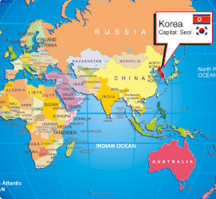
South korea
Population of 51 million
12th largest economy in world
Similar geographical size to England
Life expectancy = 82 years (Worldlifexpetancy, 2018)
English is the second language and Korean the first.
Literacy rate was 22% 1945
In 2013 literacy rate was ?
(Unicef, 2013)
(Mapsnworld, 2018)

Slide 3
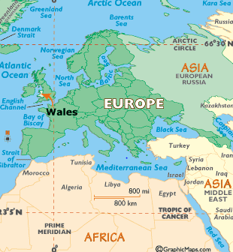
Wales
Population of 3.1 million
Life expectancy of 81 years
19% speak Welsh
Literacy rate 88%
(Welsh Government, 2011)
World Atlas (2018)

Slide 4
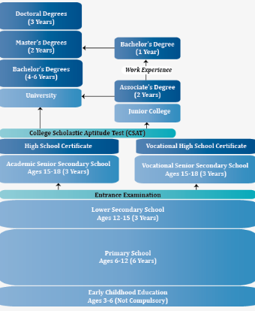
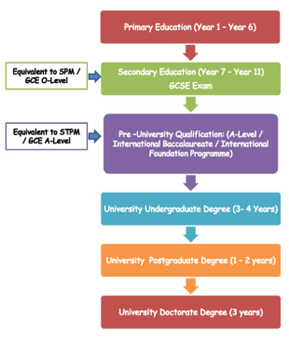
Curriculum structures, Concepts, theories
South korea
wales
(NCEE, 2018).
(ASA, 2018)

Slide 5


Subjects
Primary
Middle& Secondary

Slide 6
Testing, testing.
South Korea
wales
CSAT – College Scholastic Ability test.
Training for this test since primary school.
NAEA (National Assessment of Educational Achievement) years 9-11
Throughout Middle school tests used to take place each term. Now the government has made it policy that 1 term is test-free.
National literacy & numeracy tests (ages 7-14)
Grading tests (sets)
GCSE’s
A-levels
(ncee, 2018)

Slide 7
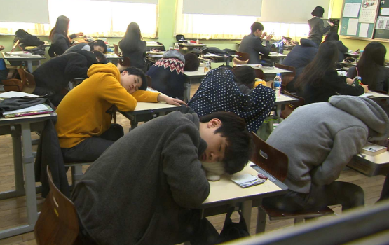
Typical day
Hagwons close earlier now thanks to government intervention – 10pm.
School libraries – midnight
Mental health effects are detrimental .
(Carney, 2015)
(ABC, 2018)

Slide 8
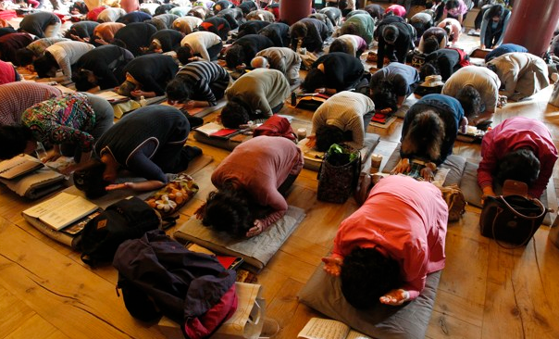
Pressure cooker assessments – Extreme measures
In 2017, suicide was recorded as the number 1 cause of death in 9-24 year olds (Yonhap, 2018)
The Korea Herald (2018) reported on the OECD’s (Organisation for Economic Cooperation and Development Countries) survey results which showed that South Korean students are some of the unhappiest in the OECD country range.
Air traffic halted, traffic halted..
Atlantic/Reuters (2016)

Slide 9
Are Welsh pupils happier?
Pisa has reported that the United Kingdom have some of the most unhappy pupils in the world! 38/48 (TES, 2017).
Ward (2017) reports that testing was recorded as being the main reason for unhappiness and anxiety in pupils.
So all the play and child centred learning still results in testing, which results in unhappiness..so are Wales and South Korea really that different?

Slide 10

“Suicide is the number one cause of death for young people aged 5-19 in England and Wales, new data released today reveals. The ONS research found that 'suicide and injury/poisoning of undetermined intent' accounted for 15.2% of deaths among males and 9.6% of deaths among females in this age bracket in 2016”.
(Long, 2017)

Slide 11
School Swap: South Korean style!
The South Korean’s demonstrated how easy the Welsh students had it when it came to examinations, with a class completing a 60 minute WJEC GCSE Maths paper in 15 minutes!!!! (BBC, 2016).
https://www.bbc.co.uk/news/av/uk-wales-38115296/south-korean-students-finish-welsh-gcse-maths-paper-in-15-minutes

Slide 12
Analysis of new curriculum: a comparison
South Korea
wales
Devised 2015
Fully implemented by 2020
Creative and imaginative learner
Integrating subjects
Six key competencies - “self-management,” “knowledge and information processing,” “creative thinking,” “aesthetic sensibility,” “communication skills,” and “civic competency.” (Cho, 2017).
Devised 2015
Hopes to be implemented by 2022
Ambitious, capable, enterprising creative contributors, healthy, confident, ethical citizens,
6 areas of learning
(Welsh Government, 2018)

Slide 13
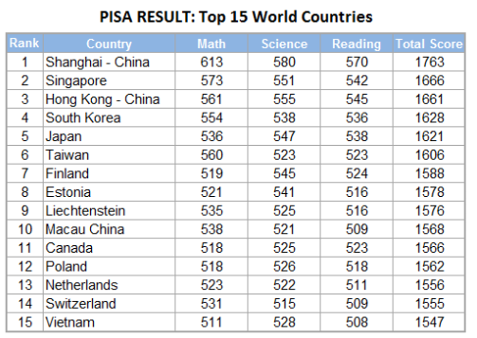
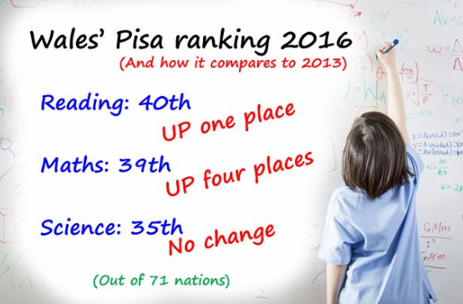
PISA RESULTS 2015
South korea
wales
(WALES ONLINE, 2016)

Slide 14

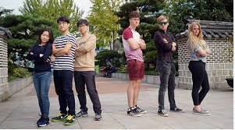
CONCLUDING THOUGHTS AND RECOMMENDATIONS

Slide 15
Reference List
ASA (2018) United Kingdom: Fast facts http://www.asa-edu.com/abroad-uk1.php (Accessed: 20 November 2018).
Carney, M. (2015) South Korean Education Success has its costs in unhappiness and suicide rates http://www.abc.net.au/am/content/2015/s4255647.htm (Accessed: 25 November 2018).
Cho,J. (2017) New Education Policies and Practices in South Korea. https://bangkok.unesco.org/content/new-education-policies-and-practices-south-korea (Accessed: 22 November 2018).
Diamond, A. (2016) South Koreas Testing Fixation https://www.theatlantic.com/education/archive/2016/11/south-korean-seniors-have-been-preparing-for-today-since-kindergarten/508031/ (Accessed: 20 November 2018).
Gangwonepik (2008) Proclamation of the Ministry of Education, Science and Technology The School Curriculum of the Republic of Korea http://gangwonepik.weebly.com/uploads/1/3/8/5/13851570/national_school_curriculum-english2008.pdf (Accessed: 22 November 2018).
https://wales.com/language (Accessed: 24 November 2018).
https://www.studycountry.com/guide/KR-language.htm
https://www.tes.com/news/uk-pupils-among-worlds-unhappiest (Accessed: 24 November 2018).
Korea Herald (2017) http://www.koreaherald.com/view.php?ud=20170502000772 (Accessed: 20 November 2018).
Long, M (2017) Suicide is the biggest killer of 5 – 19 year olds in England and Wales. https://uk.news.yahoo.com/suicide-biggest-killer-5-19-year-olds-uk-101120768.html (Accessed: 21 November 2018).
Mapsnworld (2018) World maps and information. http://www.mapsnworld.com/korea/where-is-korea.html (Accessed: 19 November 2018).
National Center on Education and Economy (2018) South Korea: Learning Systems http://ncee.org/what-we-do/center-on-international-education-benchmarking/top-performing-countries/south-korea-overview/south-korea-instructional-systems/ (Accessed: 20 November 2018).

Slide 16
Schiro, M.S (2013) Curriculum theory. 2nd edn. London: SAGE.
School Swap: Korea Style (2016) BBC, 29 November.
Tanner, D. and Tanner, S. (2007) Curriculum Development Theory into Practice. 4th edn. New Jersey: Pearson Education.
Unicef (2013) At a glance: Korea, Democratic People’s Republic of https://www.unicef.org/infobycountry/korea_statistics.html (Accessed: 20 November 2018).
Ward, H. (2017) Uk pupils among the world’s unhappiest
https://www.tes.com/news/uk-pupils-among-worlds-unhappiest (Accessed: 24 November 2018).
Welsh Government (2011) National survey of adult skills in Wales https://gov.wales/statistics-and-research/national-survey-adult-skills-wales/?lang=en (Accessed: 21 November 2018).
Welsh Government (2018) Life expectancy by gender and year https://statswales.gov.wales/Catalogue/Health-and-Social-Care/Life-Expectancy/LifeExpectancy-by-Gender-Year (Accessed: 24 November 2018).
Welsh Government (2018) Mid year estimates of the population https://gov.wales/statistics-and-research/mid-year-estimates-population/?lang=en (Accessed: 24 November 2018).
Welsh Government Beta (2018) Successful Futures: Looking at the curriculum arrangements in Wales ; https://beta.gov.wales/sites/default/files/publications/2018-03/succesful-futures-a-summary-of-professor-graham-donaldsons-report.pdf (Accessed: 24 November 2018).
Wightwick, A. (2016) Full Pisa results 2016 show Wales’ schools are still adrift of the rest of the UK https://www.walesonline.co.uk/news/education/full-pisa-results-2016-show-12278551 (Accessed: 22 November 2018).
World Atlas (2018) United Kingdom. https://www.worldatlas.com/webimage/countrys/europe/ukw.html (Accessed: 19 November 2018).
World Life Expectancy ( 2018) South Korea: Life expectancy https://www.worldlifeexpectancy.com/south-korea-life-expectancy (Accessed: 19 November 2018).
Worldometers (2018) South Korea Population
www.worldometers.info/world-population/south-korea-population/ (Accessed: 20 November 2018).
Yonhap (2018) The Korea Herald Suicide no.1 cause of death for S.Korean teens, youths http://www.koreaherald.com/view.php?ud=20180426000581 (Accessed: 24 November 2018).

