Slide 1
Alternative Revenue Streams

Slide 2
Schedule
12.00pm Affiliates Landscape
12.05pm Amazon, ClickBank, Affiliatly, Tradedoubler
12.30pm Exercise: Evaluate The Music Affiliate Programs here https://onemorecupof-coffee.com/music-affiliate-programs/
1.00pm Lunch
2.00pm Print on Demand Merchandising Videos
2.05pm Printful, Etsy, Amazon Merch
2.15pm Exercise: Create a Printful Account, Create and Etsy Account . Connect your Printful account to Etsy as per the video.
2.45pm Break
3.00pm Random Content Ideas Video https://www.tiktok.com/@amiefinlayson/video/6775006421823130886
3.05pm Create An Ebook - Designrr
3.10pm Amazon Kindle Direct Publishing
3.20 Exercise: Try to Publish a Kindle book. Familiarise yourself with information Kindle Direct Program is asking for.

Slide 3
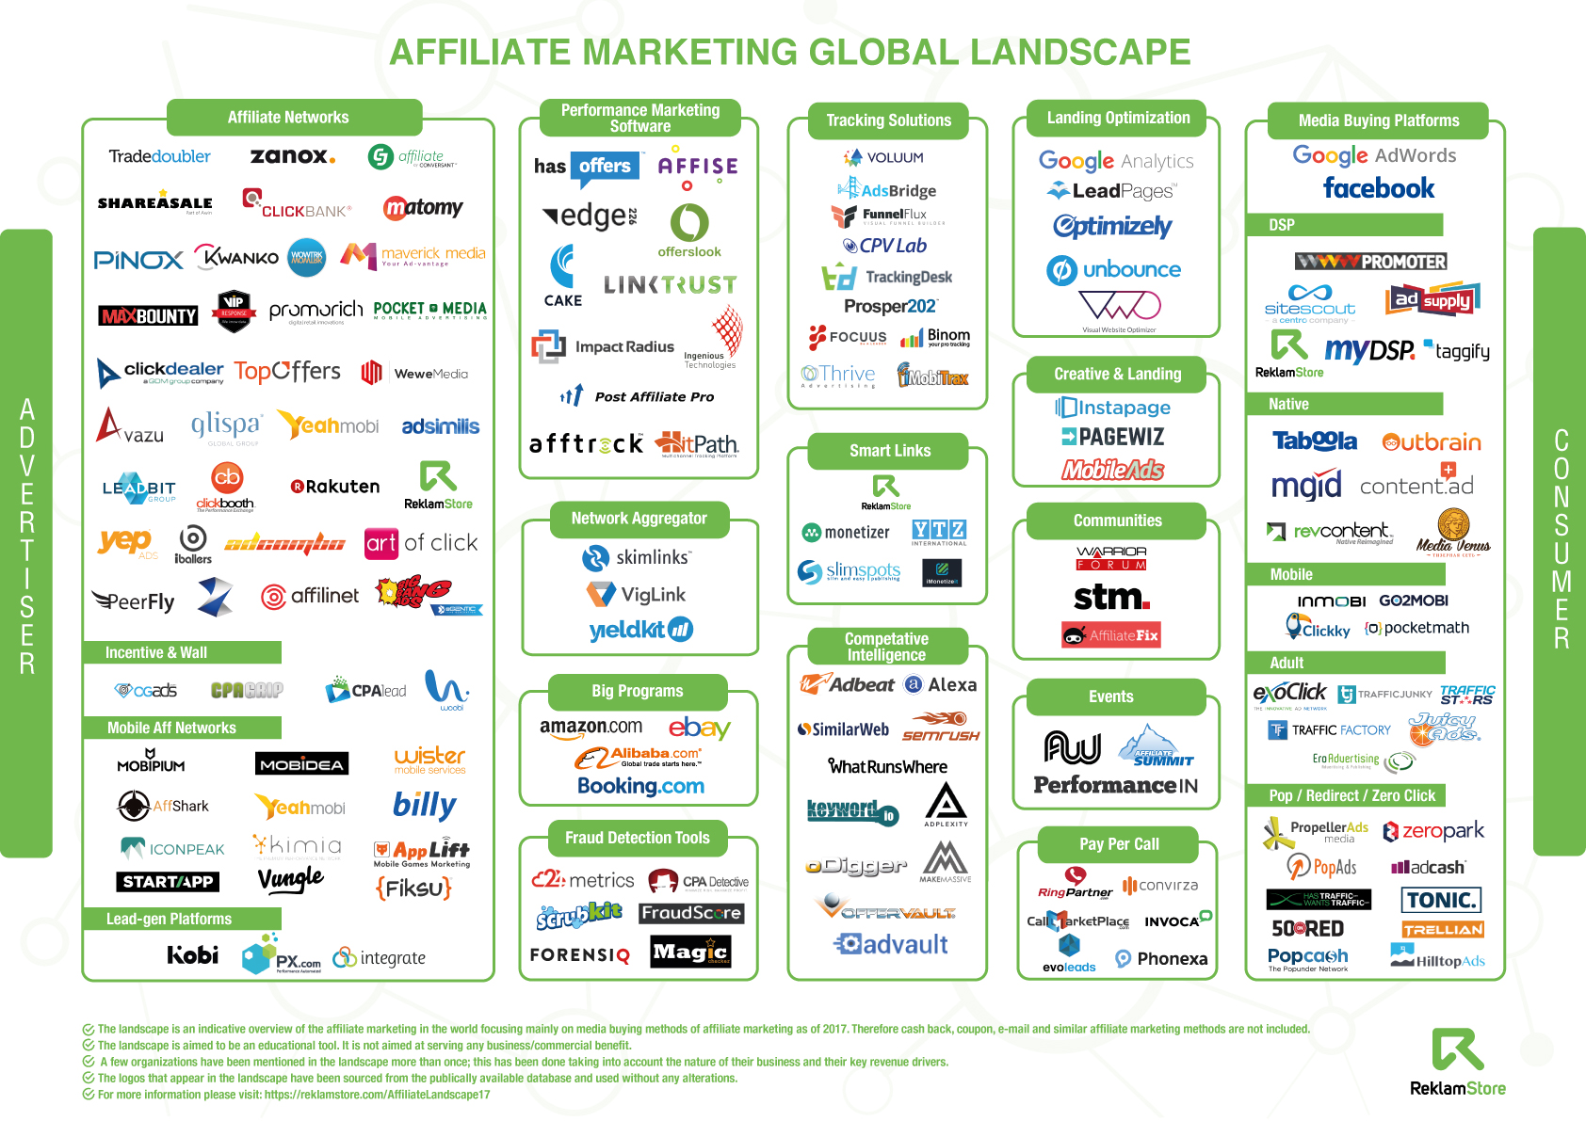
Affiliates Landscape

Slide 4
Affiliate Marketing & Merchandising
Amazon Affiliates
Clickbank
Affiliatly
Tradedoubler
Sell other people’s stuff on your site, social media
Set your affiliate network with one of the major networks so people can earn commission selling YOUR stuff
Set up a completely white label affiliate program of your own so other people can earn commission to sell YOUR stuff

Slide 5
Exercise- Evaluate the Music Affiliate Programs
Exercise: Evaluate The Music Affiliate Programs here https://onemorecupof-coffee.com/music-affiliate-programs/

Slide 6
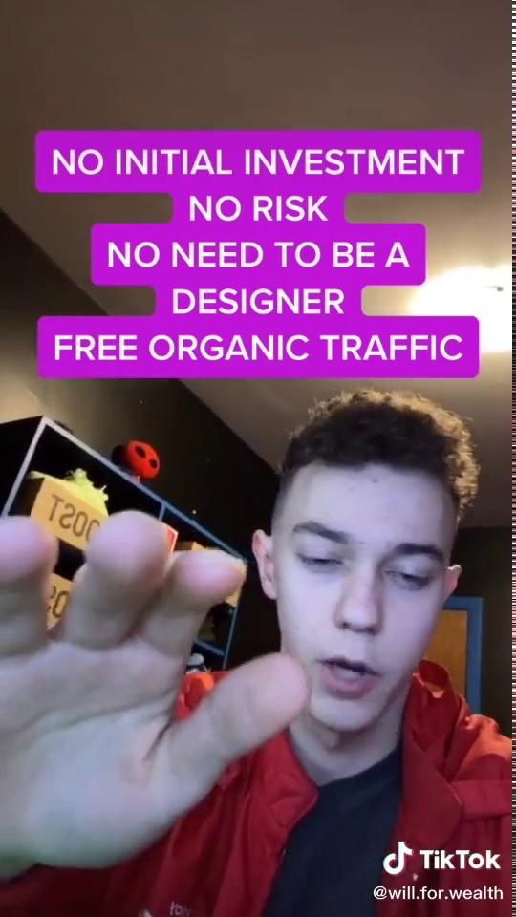
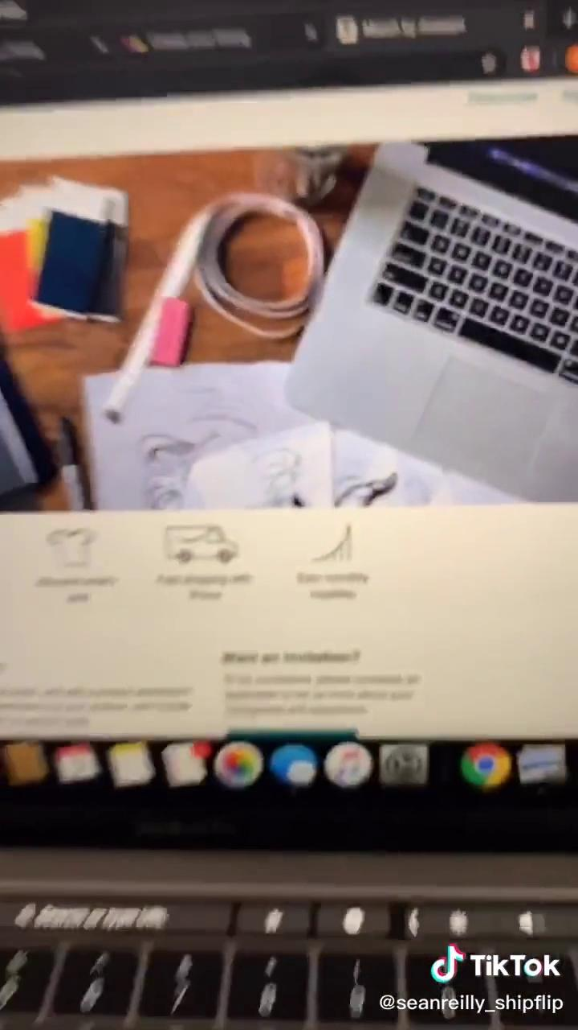
Print on Demand Merchandising

Slide 7
Exercise: Connect a Printful Account to Etsy
Create a Printful Account
Create an Etsy Account
Connect Printful to Etsy as per the video on slide 7
Printful and Etsy
Amazon Merch on Demand

Slide 8
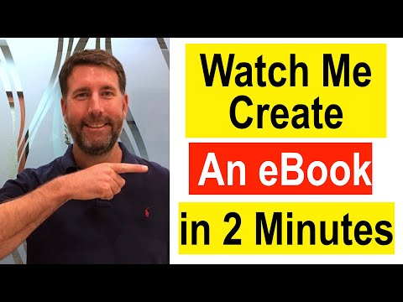
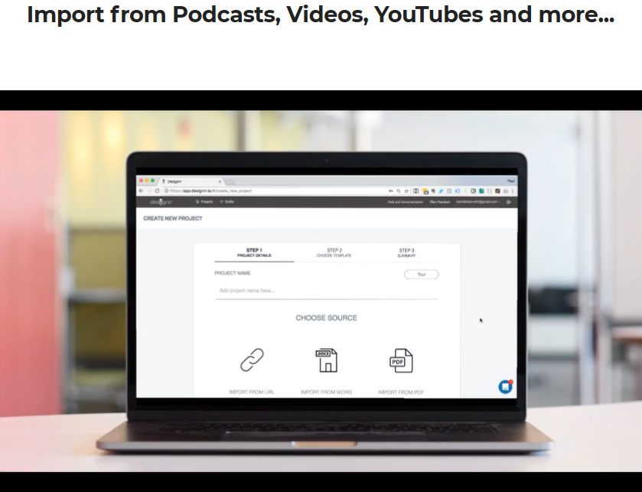
Create an eBook - Designrr
Designrr YouTube Channel
Play on Designrr https://designrr.io/

Slide 9
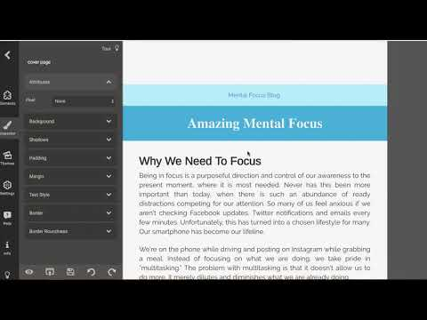
Exporting for Kindle and ePub Readers -Publish on Amazon Kindle Direct Publishing

Slide 10
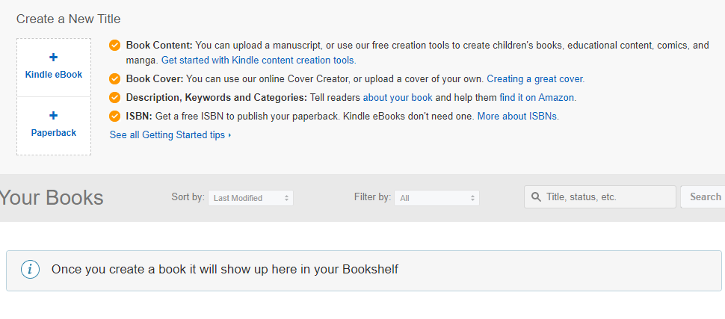
Exercise - Publish an eBook
Create an account on Kindle Direct https://kdp.amazon.com/en_US/
Download this Sample Kindle Ebook https://drive.google.com/file/d/1SpBEf7kZot7OMM19fladHqP1z5-p7mQu/view?usp=sharing
Try to publish the sample ebook on Kindle Direct. Click + Kindle eBook.
Fill out the form, familirise yourself with the information it asks you for. Its a lot!
Pro-Tip The system can recognise if the work has already been published by another author.

