Slide 1
Accounting Fundamentals
(LCBB4001BIRM)
Week 1 - Introduction to the module, and
the basic accounting principles
Dr. Ernest Ovia

Slide 2
Learning outcomes
Review the basic principles of accounting, including the use of appropriate software
Prepare financial statements from initial data, dealing with both routine and non-routine transactions, and analyse financial statements
Explain the nature, behaviour, and purpose of cost accounting, and apply cost accounting
© McGraw-Hill Education 2015

Slide 3
Indicative content - 1
• Accounting as a means of communication.
• Fundamental concepts of accounting.
• Accounting information systems.
• Introduction to double entry bookkeeping and the trial balance.
• The main financial statements – balance sheet, profit and loss account.
• Accounting for VAT, stocks, depreciation, disposals of fixed assets, accruals, and prepayments.
© McGraw-Hill Education 2015

Slide 4
Indicative content - 2
The nature and purpose of cost accounting. Cost centres and cost units
Relationship between cost accounting and financial accounting.
Cost classification, behaviour, and purpose. Elements of production and non-production costs.
The nature of costs: fixed and variable; direct and indirect.
Cost accounting techniques. Accounting for materials, labour, and overheads.
Marginal and absorption costing. The concept of contribution. Break-even point, margin of safety
Inventory valuation and profit determination
© McGraw-Hill Education 2015

Slide 5
Assessment
Assignment one is a three-part assessment of 2,500 words based on the material delivered during the first five weeks of the course. It is worth 50% of the total marks for the module. The pass mark is 40%
Assignment two takes the form of a two-hour, closed book, multiple-choice examination that is based on the material covered in the whole module, with approximately 40% of the questions relating to financial accounting and 60% to management accounting. The pass mark is 40%
© McGraw-Hill Education 2015

Slide 6
Financial Accounting
The process of designing and operating an information system for collecting, measuring and recording an enterprise’s transactions, and summarising and communicating the results of these transactions to users to facilitate making financial and economic decisions.
The process of identifying, measuring and communicating economic information to permit informed judgements and decisions by users of that information (Wood and Sangster, 2012)
© McGraw-Hill Education 2015

Slide 7
Objectives of an appropriate accounting system
To record and control business transactions
To maintain accuracy in recording
To present final financial statements to the owners of the business
To present other financial reports and analyses
To facilitate the efficient allocation of resources
© McGraw-Hill Education 2015

Slide 8
Branches of accounting - 1
Financial accounting
Tax accounting
Audit
Public sector accounting
Project accounting
Fund accounting
Management accounting
Cost accounting
Forensic accounting
Fiduciary accounting
International accounting
Accounting information systems

Slide 9
Branches of accounting - 2
Branches in accounting
  Mainly two branches; Financial Accounting and Management Accounting.
Financial Accounting
  Preparation of Financial Reports for external users
  Reports used to assess stewardship of entity’s management and for making economic decisions
Management Accounting
  Is the presentation of financial and non-financial data to management in such a form to facilitate planning, control and decision making

Slide 10
Accounting principles - 1
Business entity
Financial statements are prepared based on transactions affecting the business only and not the owners. (We came across this idea when dealing with different types of business entities). The business has an identity and existence that is separate from the owners.
Going concern concept
The financial statements are prepared on the assumption that the entity is expected to operate for the foreseeable future (at least for the next 12 months) and not with the intention to curtail its activities materially or anticipate immediate liquidation. The’ framework document’ of the IASB considers this as an underlying assumption.

Slide 11
Accounting principles - 2
Accrual
Essentially, what accrual accounting means is that the date on which cash is paid or received is not treated as the date on which the transaction took place. The date is that on which the transaction took place. Although the definition might seem a little impenetrable at first reading, this is essentially a simple idea.
Historical cost
There is no definition of double entry in the conceptual Framework – although it is probably fair to say that this is the most fundamental underpinning principle in accounting. In the absence of a formal definition, it is probably best to start by noting that double entry arises from the fact that every transaction has a dual aspect (sometimes referred to as ‘duality’). The dual aspect means that each party in a transaction is affected in two ways by the transaction, hence: every transaction gives rise to both a debit entry and a credit entry.
Notes:
Accrual accounting example: If Andrea agrees to buy goods from Brian on 25 January and Brian agrees that Andrea can wait until 25 March to pay for the goods, accrual accounting requires that the transaction is recorded. Thus, the transaction is recorded on 25 January when it occurred, regardless of when the payment is made.

Slide 12
Accounting principles - 3
Materiality – relevant or significant
Information is material if omitting it or misleading it could influence decisions that users make on the basis of financial information about a specific reporting entity.
Consistency- uniform accounting practice
Entities when preparing financial statements should adopt a consistent approach in terms of using the same methods for similar items from period to period, so that results can be compared. Explanation should be provided for any changes. E.g. Calculating depreciation.

Slide 13
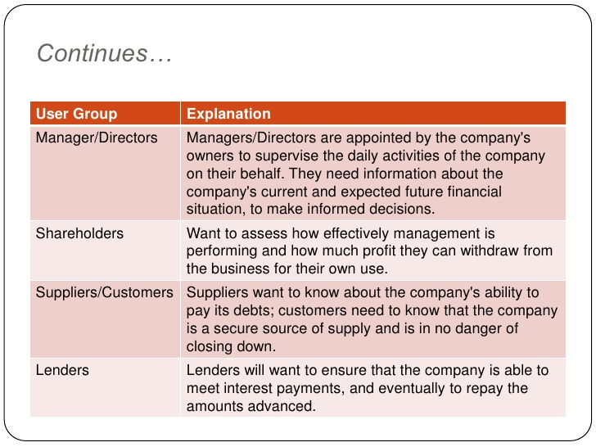
Users of Accounting Statements

Slide 14
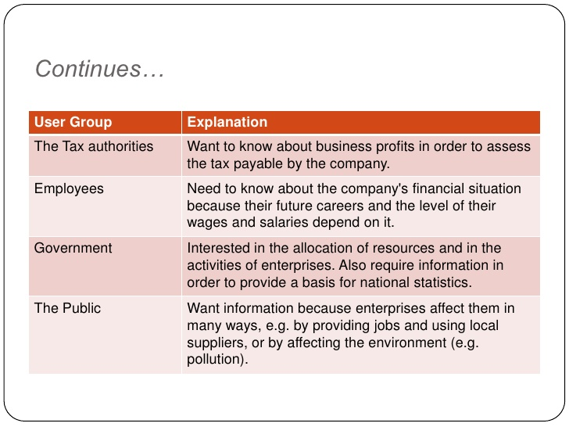
Users of Accounting Statements

Slide 15
Terminologies - 1
Revenue is income earned in the period from normal trading activities called operations.
When an entity has income from activities that are not its core business, such as receiving interest, then this is disclosed separately, as ‘other income’.
Expenses are yearly running costs. They are used up in the period being reported on. For example, electricity used to generate heat and light, or rent for the period.
Profit or loss is the total income made by the entity in the period less the total expenses incurred by the entity in the period.
© McGraw-Hill Education 2015

Slide 16
Terminologies
Assets
  Items of value that the business owns/has control of, such as goods for resale (inventory), vehicles or machinery, trade receivables cash and money at the bank. An asset is an item of value held by an entity that is going to generate income in the future.
Capital
  The amount of money or similar resource invested in the business by its owner(s).
Liabilities
  Money that has been borrowed by the business and trade payables. Liabilities represent obligations that the entity has to meet in the future.
© McGraw-Hill Education 2015

Slide 17
Terminologies - 3
An asset is a tangible or intangible resource that is owned or controlled by an accounting entity, and which is expected to generate future economic benefits (e.g. plant & machinery, cash).
A liability is a legal obligation to transfer assets, or provide services to another entity which arises from some past transaction or event (e.g. loans).

Slide 18
The central accounting equation
Assets = Capital + Liabilities
(A = C + L)

Slide 19
Pearls of wisdom – 1
 | Increase | Increase
Purchases | Debit
Expenses | Debit
Assets | Debit
Revenues |  | Credit
Liabilities |  | Credit
Source of funds (Capital) |  | Credit

Slide 20
Pearls of wisdom – 2
Examples…
Owner invests £5,000 in the business by cheque
Assets increase (debit bank account)
Capital account (a source of funds) increases (credit capital account)
Business buys goods for resale on credit
Purchases increase (debit purchases account)
Payables/Creditors (liabilities) increase (credit payables account)
Business sells goods on credit
Revenues (sales) increase (credit sales account)
Receivables/Debtors (asset) increase (debit receivables account)

Slide 21
The basic principles of double entry bookkeeping
Double-entry bookkeeping is a systematic method of recording an enterprise’s transactions in a book called the (general) ledger.
Each page of the ledger is split into two halves, the left half called the debit side, and the right half called the credit side.
The ledger is divided into sections called accounts, each of which usually starts on a new page.
The money value of every transaction is entered twice, once on each side of the ledger in different accounts.
Notes:
You would soon understand that by recording each item twice in the books of account, the integrity of the accounting equation is maintained.

Slide 22
Method for recording transactions in the ledger ‘T’ accounts
Posting is the term used to describe updating the accounting records (or T accounts) with transactions.
4 steps:
Determine the 2 accounts affected by the transaction you want to record.
Consider the flow of value (determine the account(s) increasing value and/or the account(s) reducing value)
Classify the accounts in step 1 as either assets, liabilities, income, expenses or capital.
Post the transactions to the T accounts using the posting rules set out in the previous slide.
Notes:
Note: As you would experience in many cases, one account would increase value while the other decreases value. However, in certain cases, a transaction may actually lead to an increase / decrease in the value of both accounts affected. In every case, a debit and corresponding credit entry is required in line with the double entry rules in slide 19.

Slide 23
Worked example - 1
On January the 10th Jane bought office machinery for £1,200 cash. Post this transaction to the accounts following the four steps in the previous slide.
The accounts affected are office machinery and bank
Cash was paid and a new machine has been brought to the office, so office machinery account is increasing and bank is decreasing.
Both cash and office machinery are classified as assets so the double-entry rules would be applied accordingly.
Debit (receive) the Office machinery account and credit (give) the bank account

Slide 24
Worked example - 1
Cash account
Debit (receiving side) |  |  | Credit (giving side)
Date | Description | Amount (£) | Date | Description | Amount (£)
 |  |  | Jan 10 | Office machinery | 1,200
Office machinery account
Debit (receiving side) |  |  | Credit (giving side)
Date | Description | Amount (£) | Date | Description | Amount
Jan 10 | Cash | 1,200

Slide 25
Worked example - 2
Jane sold goods worth £100 cash on 3 Feb.
The two affected accounts are the sales account and the bank account
The value increases cash a/c and also increases sales a/c.
Sales is a revenue account while cash is an asset account.

Slide 26
Worked example - 2
Cash account
Debit (receiving side) |  |  | Credit (giving side)
Date | Description | Amount (£) | Date | Description | Amount (£)
Feb 3rd | Sales | 100
Sales
Debit (receiving side) |  |  | Credit (giving side)
Date | Description | Amount (£) | Date | Description | Amount
 |  |  | Feb 3rd | Cash | 100

Slide 27
Summary
Financial accounting emerged from demand for quality financial information about an entity’s financial performance and financial position by stakeholders who are external to the entity.
Regulation provides rules and guidance on content. Regulatory sources are legislation, the profession and stock exchanges.
© McGraw-Hill Education 2015

