Slide 1
Effective TeamWork and Communication
Assessment 2-Group presentation
Nicoleta buzatu 2029862
Sonia Dehelean 2029858
Yeliz Koncak 2028995
Ana Maria dehelean 2030030
Silviu Tanasa 2028900
Notes:
Me and my team are going to present the effective teamwork and communication presentation.
Nicoleta will present the benefits of team working
Sonia will present the stages of team development
Yeliz will present team roles
Ana will present managing conflict
Silviu/me will present successful team development and conclusion

Slide 2
Benefits of team working
Team working and comunication
Team working have many benefits such as :
increased problem solving
Improved outcomes
greater risk taking
Faster resolutions.

Slide 3
Increased problem solving
A team will be able to find more solutions to the same problem.
The team can identify the best solution by working together.
Individual working will result in a limited input and results.
Douglas B. Reeves “ states that Collaboration, it turns out, is not a gift from the gods but a skill that requires effort and practice.”

Slide 4
Improved outcomes
Team working generates Better end results.
When teams work effectively, they obtain More quality performances.
Higher Target can be attained by Many participants working and thinking together.
Patrick Lencioni states that “Great teams do not hold back with one another. They are unafraid to air their dirty laundry. They admit their mistakes, their weaknesses, and their concerns without fear of reprisal.”

Slide 5
Greater risk taking
Individuals that are part of a team More probably with take risks .
The guide and reassurance they receive from the team offers them mental freedom to think large and take extra risks.
This results in more creative Solutions.
Michael Joling states that”Even the strongest, most well-built team will, at times, be met with adversity. What makes us great is not that we should anticipate less adversity the stronger that we become, but rather that in anticipation of adversity we become stronger.”

Slide 6
Faster resolutions
By producing more than one solutions in a short period of time and thru the fine allocation of human resources, teams can whole duties and resolve problems greater shortly than individuals.
Bill Bradleystates that”Respect your fellow human being, treat them fairly, disagree with them honestly, enjoy their friendship, explore your thoughts about one another candidly, work together for a common goal and help one another achieve it”

Slide 7

Stages of team development
Sonia dehelean

Slide 8
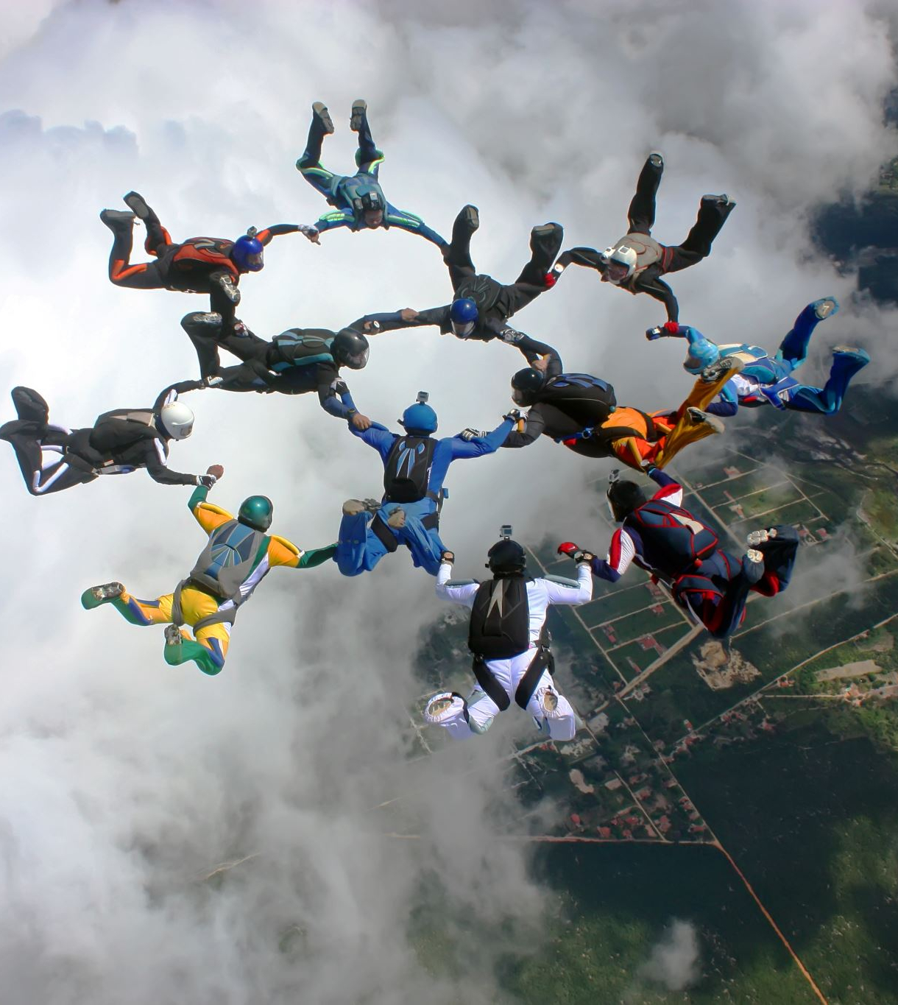
What is a team?
A group of individuals that join forces to complete a task, job, or a project.
Teams are a typical arrangement in the present business climate.

Slide 9
The initial four phases of team development were first evolved by Bruce Wayne Tuckman and distributed in 1965.
In 1977, Tuckman, mutually with Mary Ann Jensen, added a fifth stage to the 4 phases: "Adjourning."
It is believed that these stages are viable to all groups regardless of the group individuals, purpose, goals, culture and so on.

Slide 10
The five stages are:
Stage 1: Forming
Stage 2: Storming
Stage 3: Norming
Stage 4: Performing
Stage 5: Adjourning

Slide 11

Forming
-many interactions are rather social as individuals get to know one another
-members are vulnerable and searching for initiative and authority

Slide 12
Storming
-members might form subgroups due to dealing with tensions
-conflict and competition might arise

Slide 13
Norming
-the group comes to an agreement on who the leader or leaders will be
-relationships start to settle
-if any conflict arises the group can slide back into Storming

Slide 14
Performing
-at this stage the teams become very productive together
-everyone knows his place in the team and the main focus is on the tasks and achievements

Slide 15
Adjourning
-large portion of groups objectives have been refines
-wrapping up final task and reporting the work and results
-at this stage team break up might also be called Mourning or Deforming

Slide 16
Team roles
Yeliz koncak 2028995

Slide 17
Some essential team roles and responsibilities
Collaboration
Cooperation
High-quality outcome
Notes:
In an organisation, effective business communication is a must because effective communication makes everything easy and goal oriented. In addition, team working plays the most effective role in achieving business goals and objectives. An effective team working has some essential roles and responsibilities such as:
Collaboration: Collaboration of different activities within a team drives the organisation towards goals and objectives. In that case, team working plays the most significant role (Nemeth and Cobb, 2020).
Cooperation: Cooperative working environment is very essential to organisational goals and objectives. Team members should be cooperative with each other which is enhance productivity and performance of the team.
High-quality outcome: Collaboration and cooperation within team working helps to produce high quality results. In that case, it should be ensured that team members are collaborative and cooperative (Nemeth and Cobb, 2020).

Slide 18
Belbin’s nine team roles
Shaper: Team provides a clear direction towards organisational goals and objectives. Accordingly, it drives team members and get things done within time.
Implementer: Team finds different alternatives to do the task done and also generate practical working activity (GARCIA-RAMIREZ, 2021).
Completer-Finisher: Team focuses on the completion of the tasks. Besides, all other tasks do organise towards completion.
Coordinator: An effective team manages the teams or group of people though they are dynamics entity. In addition, effective team roles seem leadership role (GARCIA-RAMIREZ, 2021).
Notes:
Belbin’s has identified some roles of team working. Belbin’s nine team roles are:
Shaper: Team provides a clear direction towards organisational goals and objectives. Accordingly, it drives team members and get things done within time.
Implementer: Team finds different alternatives to do the task done and also generate practical working activity (GARCIA-RAMIREZ, 2021).
Completer-Finisher: Team focuses on the completion of the tasks. Besides, all other tasks do organise towards completion.
Coordinator: An effective team manages the teams or group of people though they are dynamics entity. In addition, effective team roles seem leadership role (GARCIA-RAMIREZ, 2021).

Slide 19
Contd.
Team-worker: In a team, personal relationship plays vital role to work effectively and efficiently. Team focuses on maintaining good relationship among the team members.
Resource Investigator: Team gathers external resources and information to help the team and move the team towards organisational goals (GARCIA-RAMIREZ, 2021).
Plant: Team generate different creative ideas and also generates different effective solutions of different existing and new problems. However, all the solutions may not practical but effective for the team (Fisher, W.D. and Semple, 2001).
Monitor Evaluator: Team working is good at critically assessing ideas and proposals, and at making decisions so that a team can reach an effective solution for particular problems.
Specialist: In a teamwork, experts provide their knowledge in their respective areas which enhances team performance and productivity. Most of the team functions properly with the help of experts in the team.
Notes:
Team-worker: In a team, personal relationship plays vital role to work effectively and efficiently. Team focuses on maintaining good relationship among the team members.
Resource Investigator: Team gathers external resources and information to help the team and move the team towards organisational goals (GARCIA-RAMIREZ, 2021).
Plant: Team generate different creative ideas and also generates different effective solutions of different existing and new problems. However, all the solutions may not practical but effective for the team (Fisher, W.D. and Semple, 2001).
Monitor Evaluator: Team working is good at critically assessing ideas and proposals, and at making decisions so that a team can reach an effective solution for particular problems.
Specialist: In a team work, experts provide their knowledge in their respective areas which enhances team performance and productivity. Most of the team functions properly with the help of experts in the team.

Slide 20
Key focused team skills
Planning Skill
Decision making Skill
Problem solving skill
Notes:
Key focused team skills: Team work plays vital roles in developing skills and knowledge of the team members in the organisation so that the whole team can perform effectively and efficiently. Some key focused skills are:
Planning Skill: A team plan for different crucial aspects of business for instance, new product development plan (Nwokorie et al., 2012).
Decision making Skill: It is one of the most significant skills for a team member. A team focuses in developing of decision making skill for the betterment of the individual and team as well (Nwokorie et al., 2012).
Problem solving skill: Organisation always seeks for innovative and creative employees who will able to solve different problems in the organisation.

Slide 21
Contd.
Communication skill
Persuasion and Influencing Skills
Feedback Skills
Notes:
Communication skill: Effective communication enhance performance and productivity of an individual and organisation as well. It is very essential skill in effective team working.
Persuasion and Influencing Skills: A team member or a leader has to this skill to persuade or influence other.
Feedback Skills: Giving and receiving feedback well is essential in any team-working situation. That’s why it is important in effective team working (Nwokorie et al., 2012).

Slide 22

Managing conflict
Ana maria dehelean

Slide 23

The Conflict in teams can be characterized as a battle or challenge between individuals with contradicting needs, thoughts, convictions, values or objectives.

Slide 24

The Thomas-Kilmann Conflict Mode Instrument (TKI) surveys a person's conduct in conflict circumstances and depicts it along two aspects: assertiveness and collaboration

Slide 25

The Model has 5 conflict Modes
Competing
Avoiding
Accommodating
Compromising
Collaborating
Let's discuss about the effectiveness of each Mode!

Slide 26

Competing
-when quick actions are required
-on important issues where unpopular courses of actions need enforcing
-on matters important for the group well-being, when you know you have a point
-to keep yourself safe from people that may pray on non-competitive behaviour

Slide 27
Accommodating
-to build up future relationships
-to put an end to ineffective and destructive competition
-when altruism is vital

Slide 28
Avoiding
when stress is reduced within the team to a certain productive level and perspective is back on track
when absorbing more information is more important than the benefits of an immediate decision

Slide 29

Compromising
-to quickly achieve a convenient solution
-when both parties have equal power and commitment to the same goals

Slide 30
Collaborating
-when it is vital that both parties are unified
-when you want to comprehend others’ points of view
-to manage hard feelings that have meddled with interpersonal relationships

Slide 31

Basic Skills for Conflict Resolution
Listen actively
Avoid suppositions
Do not criticize
Anger management
Negotiate

Slide 32
Successful team development
Communication
Divide the work
Notes:
Milestones of a successful team are
1) First of all, communication within the team. Is the start on the path to success. When a team communicate well, adapt and socialise, the members get to know each other, know what are their strengths and weaknesses and they can plan and (2)split the work effectively. Transparency and clear communication lead to a clear definition of the roles and responsibilities each member has. In this way, everybody is aware of their role and work harmoniously. Dividing the work is the whole point of working in teams. Is doing small bits towards a bigger goal and linking each part. Most importantly, if the parts are divided correctly, is much easier to achieve the bigger goal by everybody doing only the bit that is good at. There is strength in numbers.

Slide 33
Cont.
Proactive with feedback
Acknowledge and reward
Celebrate success
Notes:
3) Proactive feedback. After the roles are defined and the work has started, each member changes ideas and opinions, the team will receive some feedback from outside also. This is the point where the transparency has to continue, to understand and acknowledge the mistakes and put in practice solutions. Critical thinking is the key in the team and I am going to develop this later on in the presentation. In simple words, the feedback, even the negative one should bring value to the team and towards the work. The negative feedback is even better because you can understand where you have to improve.
4) Acknowledge and reward is where the leader plays his role. At this point, the leader acknowledges where are the areas to improve or give credit where the feedback is good. Reassuring the team, making them feel they do good and they make a difference is a key to building loyalty and fuelling the team to work more efficient and effective.
5) Celebrating success is the part where everybody stops, make a step back and just enjoy the harvest. This brings a positive impact on the motivation within the team.

Slide 34
Critical thinking in group
Analise
Evaluate
Reflect
Notes:
Critical thinking is important during almost all stages mentioned earlier and has many approaches however some are vital in working as a team. Critical thinking is the process of analysing, evaluating, being aware and open about what surrounds you.
Good decisions can be taken by analysing and evaluating the members and the work, and judging everything unbiased, based on facts, feedback and the plan.
It is important that the leader to be a good critical thinker and keep a clear mind. The leader should ensure that the team covers the eight Belbin Team roles and is merging all the roles together, everybody working as one, like one efficient machine.

Slide 35
Characteristics of a successful team
Goal-oriented mindset
Commitment to their roles
Open to learning
Diverse perspective and experiences
Shared culture
Responsibility and accountability
Clear communication
An effective leader
Notes:
However the process, here are some characteristics of a successful team.

Slide 36
Conclusion
Working in a team can lead to a greater success than working alone if is done correctly and transparently.
If exist a good communication and everybody knows their role and play it well, the outcome is improved.
There exist higher risks to get in conflict but with an open mind and loyalty everything can be overcome.
The key is the communication out of all other steps mentioned above.

Slide 37
Reference list-Nicoleta Buzatu
Goodman, Paul. (2013) ToughNickel. Available at: https://toughnickel.com/business/15-Advantages-of-teamwork-in-the-workplace (Accessed 12 December 2021)

Slide 38
references Sonia dehelean
Gina Abudi - "The Five Stages of Team Development – Every Team Goes Through Them! (Part I)" - 15th July 2009
https://www.ginaabudi.com/the-five-stages-of-team-development-part-i/
Stages of Team Development. Authored by: John/Lynn Bruton and Lumen Learning. License: CC BY: Attribution
Five Stages of Team Development. Authored by: John/Lynn Bruton and Lumen Learning. License: CC BY: Attribution
Katerina Trajchevska -! Team Traditions, Active Collab, 24th May 2017
https://activecollab.com/blog/collaboration/real-world-examples-of-successful-teamwork
Bonebright, D.A. (2010) 40 years of storming: a historical review of Tuckman’s model of small group development. Human Resource Development International. 13 (1), 111–120.
Tuckman, B.W. (1965) Developmental sequence in small groups. Psychological bulletin. 63 (6), 384.
Tuckman, B.W. & Jensen, M.A.C. (1977) Stages of Small-Group Development Revisited. Group & Organization Studies. [Online] 2 (4), 419–427. Available from: doi:10.1177/105960117700200404.

Slide 39
References Yeliz Koncak
Fisher, S.G., W.D., K. and Semple, J.H. (2001). Control and Belbin’s team roles. Personnel Review, 30(5), pp.578–588.
GARCIA-RAMIREZ, Y.D. (2021). Belbin’s team roles and their performance in road design courses: a study with undergraduate and postgraduates' students. Espacios, 42(01), pp.176–188.
Nemeth, B. and Cobb, J. (2020). Editorial team roles and responsibilities. Interpretation, 8(4), pp.1N2N.
Nwokorie, N., Svoboda, D., Rovito, D.K. and Krugman, S.D. (2012). Effect of focused debriefing on team communication skills. Hospital Pediatrics, [online] 2(4), pp.221–227. Available at: https://www.ncbi.nlm.nih.gov/pubmed/24313029 [Accessed 25 Feb. 2020].

Slide 40

Reference list-Ana Maria Dehelean
PAT, M. (2001). “Thomas-Kilmann Conflict Mode Instrument”, Consulting Psychologists Press (CPP)., Palo Alto, CA:
available on the World Wide Web at http://www.cpp.db.com/products/conflict/index.asp accessed on 30 November 2004
JOHNSON, D.W., and JOHNSON, F.P. (2000) Joining together: group theory and group skills (7th ed.), Boston, Allyn and Bacon.
KATZENBACH, J.R., and SMITH, D.K. (1992) Wisdom of teams, Harvard Business School Press.

Slide 41
Reference list- silviu tanasa
Forbes(2012) 6 ways successful teams are built to last. Available at: https://www.forbes.com/sites/glennllopis/2012/10/01/6-ways-successful-teams-are-built-to-last/?sh=2c8d88432b55 (Accessed at: 10/12/2021)
Deakinco(2020) How Teams Should Approach Critical Thinking. Available at: https://credentials.deakin.edu.au/how-teams-should-approach-critical-thinking/ (Accessed at: 15/12/2021)
Indeed.com (2021) How To Build a Successful Team: a Step-By-Step Guide. Available at: https://www.indeed.com/career-advice/career-development/steps-to-building-a-successful-team (Accessed at : 13/12/2021)

