Slide 1
What is an e-Business Model and what does it signify?
SBUS6004 eBusiness Strategy
Week 4

Slide 2
Objectives
Understand Business Models and value innovation
  Definitions
  Key Elements
  Examples
  Classifications in e-Commerce

Slide 3
Definition of an Business Model
An architecture for product, service, and information flows, including
  a description of various business actors and their roles;
  a description of the potential benefits for the various business actors
  and a description of the source of revenue.
Often cited as a favored definition.
  Timmers (1999)
Notes:
An architecture best thought if as a design.
Timmers was a leader in the EU business research department in the 1980-2000’s and did much research to determine the role e-business would play in the future and to enhance the practical understanding of how traditional forms of business would need to change, and adapt to the changing technical environment.

Slide 4
E-business Logic Triangle
Business
Model
Strategy
Information & Communication Technology (ICT) pressure
Business
Processes
Planning level
Architectural level
e-Business opportunities & change
Implementation
level
e-Business
processes
e-Business Technology layer
Pignuer (2002) et al., HEC Paris/Lausanne
Notes:
As it is illustrated above, a business model is the conceptual and architectural implementation (blueprint) of a business strategy and represents the foundation for the implementation of business processes and information systems. In other words, a business model is the missing link between strategy and business processes. Strategy people position the company, define and formulate objectives and goals whereas business process and information systems designers have to understand and implement this information. This is where a business model comes into play because it assures a clear communication of concepts among the implicated parties. The logic of a “business system” can be described as creating value that lies behind the actual processes. A business model is the conceptual and architectural implementation of a business strategy and the foundation for the implementation of business processes and Information Systems.
Business models have two essential functions. First, they allow managers to talk about possible implementations of strategic objectives and understand the relevant issues.
Secondly, an appropriately formulated business model can help managers easily express what they expect from people on the business process level or from technically oriented people that are in charge of IS implementation.
Business models help to capture, visualize, understand, communicate and share the business logic.
the business model guides day-to-day execution, the strategy should communicate how the change in the business model is intended to take
advantage of shifting markets and new opportunities

Slide 5
What is Value Innovation?
It is at the heart of e-business
New e-business entrants have often been able with limited resources to undermine existing competition in an industry through the use of new business models and this is often referred to by Kim and Mauborgne (1997) as “value innovation”.
Notes:
So value innovation really means that strategy is driven by what is valued by the customer without being constrained by existing industry rules.
Disruptive technology came along first and now we are in the era of disruptive markets.

Slide 6
The Five Challenges of Value Innovation
Industry assumptions – Conventional strategic approaches take the industry conditions as given and set the strategy accordingly; instead value innovators challenge existing industry assumptions an look for quantum leaps in value.
Strategic focus - Conventional strategic approaches set the parameters of their strategic thinking according to their competitors and focus on building advantage. Value innovators monitor competition
Notes:
Strategic focus – value innovators do not use competitors as a benchmark and don’t expend their resources to offer certain products or services just because that is what their rivals are doing.

Slide 7
The Third Challenge of Value Innovation
Customers – Many companies seek growth through retaining and expanding customer bases. This leads to finer segmentation and greater customisation of offering to meet specialised needs.
Value innovators don’t look at the differences among customers , value innovators build on the commonalities in the features that customers value. This enables the companies to capture the core of the market, even if it means that they loose some of their customers.

Slide 8
The Fourth and Fifth Challenge of Value Innovation
Assets and capabilities – Many business view opportunities through the lens of their existing assets and capabilities. In contract, value innovators start from a clean slate. They do not let existing assets constrain their assessment of business opportunities.
Products and service offerings – Conventional competition takes place within established boundaries defined by product and services the industry traditionally offers. Value innovators often cross the boundaries and think in terms of the total solution buyers seek and they try to overcome the chief compromises their industry forces customers to make.

Slide 9
Dell Computers
Dell gained early mover advantage in the 1990’s when it was the first to offer PC’s for sale online.
In 2000, Dell launched a marketplace for discounted goods but closed after four months.
In 2007 launched IdeaStorm encouraging user-participation to suggest new products/services.
  Updates in Action section of the website to report improvements to customers.
A corporate blog – Direct2Dell
Customer experience – StudioDell
A brand channel on YouTube www.youtube.com/dellVLog
Dell community – share and learn with others in an interactive environment – dell.com/conversations
Premier – premier.dell.com a customised procurement portal
Notes:
They were testing possible models.

Slide 10
The Value Curve
The key to new value curves lies in answering four questions
What factors can be
  reduced well below the industry standard?
  raised well above the industry standard?
  eliminated that the industry takes for granted?
  created that the industry has never offered?
Thin Reads website dedicated to reviewing and recommending short-form content from Kindle Singles (Amazon), Quick Reads (Apple’s iBooks Store), and NOOK Snaps (Barnes & Noble)
Reduce
Eliminate
Create
Raise
Kim and Mauborgne (1999)
Notes:
Peer-to-Peer example
With an increase in the use of micropayments this leads to a reduction in processing costs.
A sub model called “Direct operator billing” or “carrier billing,” allows
consumers to use their smartphones to make purchases which are then charged to their phone bill.
e.g. a new app for smartphones, a cross between the online payment platform PayPal and instant messaging apps
like WhatsApp or Line. Users of Mugipay can make small payments to other users from the app itself. A good
example of a blended model, this app falls somewhere in between micropayments and P2P

Slide 11
Value Innovation in the US Car-Retailing Industry
Innovators always need to come up with a new value curve.
Prior to 1993 the Car-Retailing Industry in the USA consisted of two segments: new car retailing (through licenced dealerships) and used car dealing. Within the used car-retailing industry, consumers had a choice of three channels:
Newspaper adverts. (listed process but limited choice)
Local used car dealers. Reasonable choice (poor reliability and unsatisfactory sales process)
Exclusive car dealerships. Reliable quality (limited choice)
CarMax saw an opportunity to create a market space between three strategic groups – low price, variety and reliability, and created a car superstore.
AutoNation then blurred the distinction between the new and used car industry by introducing a complementary value proposition not offered by CarMax, an inter-state service for the cars purchased at AutoNation. Finally, Autobytel took the competition to a new level by electronically linking customers with dealers and manufactures using the Internet. This allowed access to 24-h, 7-day week service , so eliminating barriers to distance and time. www.autobytel.com
Notes:
Creates the market space and takes the benefits of the three groups.
Really good initiative and used by the rent-a-car groups.

Slide 12
Different Definitions of a Business Model
A Business Model is nothing else than a description of
  the value a company offers to one or several segments of customers
  and the architecture of the firm and its network of partners for creating, marketing, and delivering this value and relationship capital, in order to generate profitable and sustainable revenue streams.
Pigneur et al., (2002)

Slide 13
Different Definitions of a Business Model
A summary of how a company will generate revenue, identifying its product offering, value-added services, revenue sources and target customers
Chaffey (2007)

Slide 14
Summary
Based on various definitions of Business Model, have you seen anything in common?
  Product Innovation with value proposition
  Customer
  Infrastructure/Architecture
  Financials/Revenue Source
Notes:
Dubosson-Torbay (2002) argue that an e-business model is divided into four principal components: a) the products and services that a firms offers which represent a substantial value to a target customer (i.e. value proposition); b) the relationship capital that a firm generates and maintains with a customer; c) the infrastructure and the network of partners (the IT and suppliers) necessary to create value; d) the financial aspects pertaining to the three previous components (i.e. cost and revenue structures).

Slide 15
Components of a Business Model
Pigneur et al., (2002 & 2001)
Product Innovation with Value Proposition
  the actual product or service
  the value perceived by customers from the products and services offered by the firm
Customer Relationship
  Who are the target customers
    Market segments or target niches
  How to deliver the customers the Products
    Distribution Channel,
  How to build a strong relationship with customers.
    CRM
Example is the “in-app purchases” or the “in-app” model
Notes:
Whereas other business model approaches focus on products, value creation processes and exchange patterns between different actors, it is worth stressing that ICT offers a new range of opportunities to exploit existing customer relationships by getting a feel for the customers’ desires, serving them and building an enduring relationship with them (i.e. from transactional marketing to relationship marketing).
Examples -
League of Legends and Dota 2, both of which use micropayments,
are two of the most played PC games in the world.
Whether users are offered the chance to purchase virtual objects or whether they need to buy their way into the
next level, this business strategy falls into the category of “in-app purchases” or the “in-app” model for short. The
aim of in-app models is more than to just promote the use of the app and to get as many people as possible to
download it. In these mostly free or reasonably priced apps, accessible content is fragmented. This essentially
means that the first few levels of a game, or the first few fragments, episodes, or chapters for other types of content,
are available for free, like in the freemium model, and users are then offered extra for-a-fee content during
the use of the application.

Slide 16
Components of A Business Model
Infrastructure Management
  How to organize the infrastructure, manage the value chain and processes, build alliances to achieve performance
  How to build a network of partners for creating, marketing, and delivering the value and relationship capital
  How do we collaborate?
    Collaborative commerce and ERP with SCM
  How do we operate and deliver?
    SCM and Logistics
Financials:
  what is our revenue model (transactions, subscription/membership, commission, advertising, licensing)
  Our costing model
Example is the “in-app purchases” or the “in-app” model
Notes:
Shrinking transaction costs make it easier for firms to vertically disintegrate and to re-organise into partner networks (see Malone et al. 1987 –electronic markets & electronic hierarchies).
Financial models:
ICT have had a conspicuous impact on pricing as usually the fixed costs of producing digital goods is very high but marginal costs are almost negligible. This means that if one sets prices equal to marginal costs, then prices should be zero. See Shapiro and Varian (1998) “Information rules”.
SRM= Supplier Relationship Mgmt
PRM= Partner Relationship Mgmt

Slide 17
Financials
What are our revenues?
Our pricing?
What are our costs?
Revenue: Measures the ability of a business to translate the value it offers to its customers into money and therefore generate incoming revenue stream.
Main issues:
  Pricing strategy and mechanism.
    Aligned with the nature of products
    Aim to achieve the highest price that customer is willing to pay for the offered value.
  The right use of ICT opens up good opportunities for delivering premium customer services at lower costs, thereby transferring the saved cost to add more value to customers (such as lower prices, sales offer)
    Most of the low cost Airlines (Such as Easyjet, Ryanair, and many others in the EU)
Notes:
Need to measure all the costs the firms incurs in order to create, market and deliver value to its customers.
Costs include : cost of exhausting resources and assets in activities and processes; and the costs of establishing partner network relationship and exchange.

Slide 18
Financials - Revenue Models
Many possible revenue models:
  Can you provide some examples for these?
  Can you explain how they make their revenue?
        Direct sales revenue
        Selling advertising
        Online Mall
        Online brokers
        Auction commission
        Affiliate referral fees
        Membership subscriptions
        Infomediaries
        Micropayment
        Streaming and on-demand
Notes:
The revenue models describe methods for generating income for an organisation
Direct sales revenue (virtual storefront):
This model is based on an electronic version of traditional “brick-and-mortar” stores. The “click-and-order” electronic store has product displays, shopping carts, checkout stands, etc. It includes wholesalers and retailers of goods and services. It is much more convenient for consumers to shop, cheaper for seller to operate. Must have assortment management, good site content, secure ordering, solid delivery system, and method for driving traffic to your site, such as affiliate programs. It sells physical products directly to consumers or to individual businesses.
Advertising model (selling ads):
E-business model that builds web sites specifically to create traffic and sell advertising. Rooted in traditional media (television, magazines, radio) that sell space and air time. May use permission marketing, which offers consumers incentives to accept advertising and email voluntarily. Asks people what they are interested in, asks permission to send them information, then does it in a creative and entertaining manner. Benefit is a captive audience who has agreed to view ads. Provides content (usually for free) and services (like e-mail, chat, forums) mixed with advertising messages in the form of banner ads.
Online Mall:
Hosts multiple online merchants to gain added exposure from traffic coming to the mall. Customer can register purchase, billing, and shipping information in central account which is used for purchases at all mall stores. Offers numerous customer services such as frequent shopper programs, gift registry, buyers protection, mall search engine, and product recommendations for special occasions.
Online brokers:
Market-makers in which buyers and sellers are brought together to negotiate, and complete transactions. Provides many value-added services such as information resources and financing alternatives, but goes beyond just information provider, helps arrange transactions for B2C, B2B and C2C. May take one of several forms such as:
Buyer Aggregators a unique form of broker that brings groups of buyers together for “power buys”.
Buy/Sell Fulfillment brings individual buyers together with seller
Market Exchanges are trading desks where B2B buyers and sellers come together.
Audvisor is a company that markets 3-minute audio clips through its app in which business experts share their advice
Pildorea, an online training community specializing in audiovisual materials which are geared towards providing immediate, quick, and simple video learning
Auctions may be part of a general auction web site or specialized in particular industries. They are great for unloading surplus goods and getting close to market prices. They offer multiple auction formats: reserve, private. Their main challenges include selecting merchandise suitable for auctions, handling payment, shipping.
Affiliate:
Provides purchase opportunities wherever people may be surfing by offering financial incentives (in the form of a percentage of revenue) to affiliated partner sites. The affiliates provide purchase-point click-through to the merchant and is a pay-for-performance model -- if an affiliate does not generate sales, it represents no cost to the merchant. Well-suited to the web, which explains its popularity. Variations include, banner exchange, pay-per-click, and revenue sharing programs.
Subscription model:
Commonly sites combine free content with "premium" (i.e., subscriber- or member-only) content. Subscription and advertising models are often combined. Longreads made its debut in mid-2009 as a hashtag on Twitter. #longreads was used to indicate that the link was reference-led to content requiring a long, careful, deep read.
Spotify’s subscribers can listen to all the music they want on an unlimited basis for up to six months. After that, they are limited to 10 hours a month.
Freemium users have to listen to ads between songs while premium subscribers can enjoy music ad-free and even download songs, in addition to other advantages. Freemium users
are offered a 48-hour free trial period to experience what it would be like to have a premium account.
ADDITIONALLY, 70% went to copyright holders while the remaining 30% is kept by Spotify. The copyright holders receive between $0.006 and $0.008429 per stream.
A similar platform called Tidal was then created to exclude middlemen so that all of the profit would go directly to the artists themselves, some of whom actually owned the platform, like
Jay-Z and Beyoncé.
Beats Music, belongs to Beats Electronic which was acquired by Apple, also operates a subscription model that closely resembles Spotify’s.
The difference is that Beats Music is a payment-only service and does not have a freemium version that includes advertising.
The utility model (on-demand) is instead based on metering usage, or a the "pay as you go" approach, based on actual usage rates. In some parts of the world, ISPs operate as utilities, charging customers for connection minutes or usage, as opposed to the subscriber model common in the U.S. Example is the “in-app purchases” or the “in-app” model. Also The pay-per-use model has also made its way into the hotel sector and it is now possible to rent hotel rooms by the hour. ByHours (in Spain at the moment) is a platform through which users can book a hotel room by indicating what time they want to
check in and what time they want to check out. The platform also offers fixed-rate packages of 6, 12, 24, and 48 hours. ByHours charges a small fee for matching users to hotels.
Another - Finland’s Consumer Disputes Board has taken this idea to the extreme (ask for part refund e.g. concert ticket . Though not a business model per se, it does reflect how culture is being consumed and the value that is assigned to it at any given moment, similar to consumers’ treatment of pay-per-use.
eBookPie, since rebranded as Slicebooks, was a pioneer in implementing this model in the publishing sector. It began a service called The Chapterizer which allowed publishers to divide up their books so that readers could select from among the fragmented content according to their interests to make their own customized editions of books with the chapters they chose.
Infomediaries:
Information intermediaries: sometimes called aggregators. This model is built around compiling and distributing information, assisting buyers and/or sellers understand a given market. E.g. CoinTent provide the technology that media outlets such as Blendle need to offer their content on a subscription or a micropayment basis
Micropayment model for those who do not want to commit to a subscription and only want to pay for the programs that they are really interested in watching e.g. Game of thrones in the USA TV chaneel network.
London’s Royal Opera House streams several of its performances in high-definition to cinemas. It has also begun using market segmentation to promote its performances. One recent example is the way it promoted the ballet Don Quixote among its Spanish fans through newsletters and social media. Streamed to digital and mobile devices. New York Met and Berlin Philharmonic orchestra were the first to do this successfully.
Also the best-known examples of a flat-rate streamed-content, or video-on-demand (VOD), provider is Netflix. Netflix-style platform called medici.tv, which offers its users musical and
operatic content. And Amazon Prime Video

Slide 19
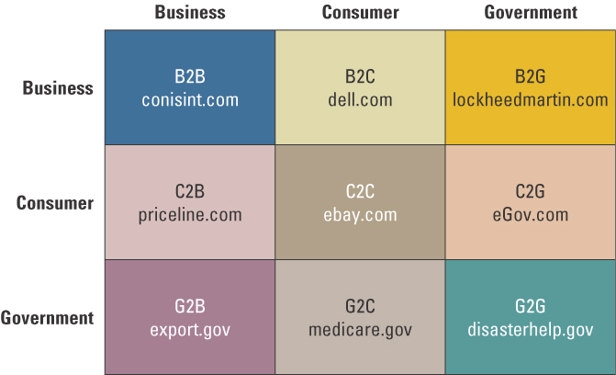
E-commerce Classifications
Notes:
See figure 1.2. on Chaffey (2007: 12) for a more comprehensive representation.

Slide 20
More Classification of e-Commerce by Transactions or Interactions
business-to-business-to-consumer (B2B2C): e-commerce model in which a business provides some product or service to a client business that maintains its own customers
consumer-to-business (C2B):
e-commerce model in which individuals use the Internet to sell products or services to organizations

Slide 21
More Classification of e-Commerce by Transactions or Interactions (cont.)
consumer-to-consumer (C2C):
e-commerce model in which consumers sell directly to other consumers
peer-to-peer (P2P): technology that enables networked peer computers to share data and processing with each other directly; can be used in C2C, B2B, and B2C e-commerce
Notes:
P2P technologies have made inroads in the music industry (P2P file sharing).

Slide 22
More Classification of e-Commerce by Transactions or Interactions (cont.)
collaborative commerce (c-commerce):
e-commerce model in which individuals or groups communicate or collaborate online
e-learning: the online delivery of information for purposes of training or education
exchange (electronic): a public electronic market with many buyers and sellers

Slide 23
Classification of e-Commerce by Transactions or Interactions (cont.)
exchange-to-exchange (E2E): e-commerce model in which electronic exchanges formally connect to one another for the purpose of exchanging information
e-government: e-commerce model in which a government entity buys or provides goods, services, or information to businesses or individual citizens (G2C, G2B)

Slide 24
Summary of transaction alternatives between businesses and consumers
B2C Organisation sites (Dell, Amazon) Consumer marketplaces (Kelkoo.com Shopsmart.com) | C2C Auctions (QXL, EBay) Consumer reviews (Bizrate.com Deja.com)
B2B Organisation sites (Dell) Business marketplaces (CommerceOne VerticalNet) | C2B Customer bids (LetsBuyit.com Priceline.com)
Notes:
B2C – traditionally this is what most people know as e-commerce, i.e. selling products on the web
B2B – DEALS CONDUCTED OVER AN EXTRANET ( 2 intranets connected via the Internet)
C2C – CUSTOMER TO CUSTOMER INTERACTIONS
C2B Customer to business where customers approach the business in their own terms
Barnes & Noble who are one of the largest chain of bookshops in USA and were forced to open a branch on the Internet because it felt the pressure of Amazon

Slide 25
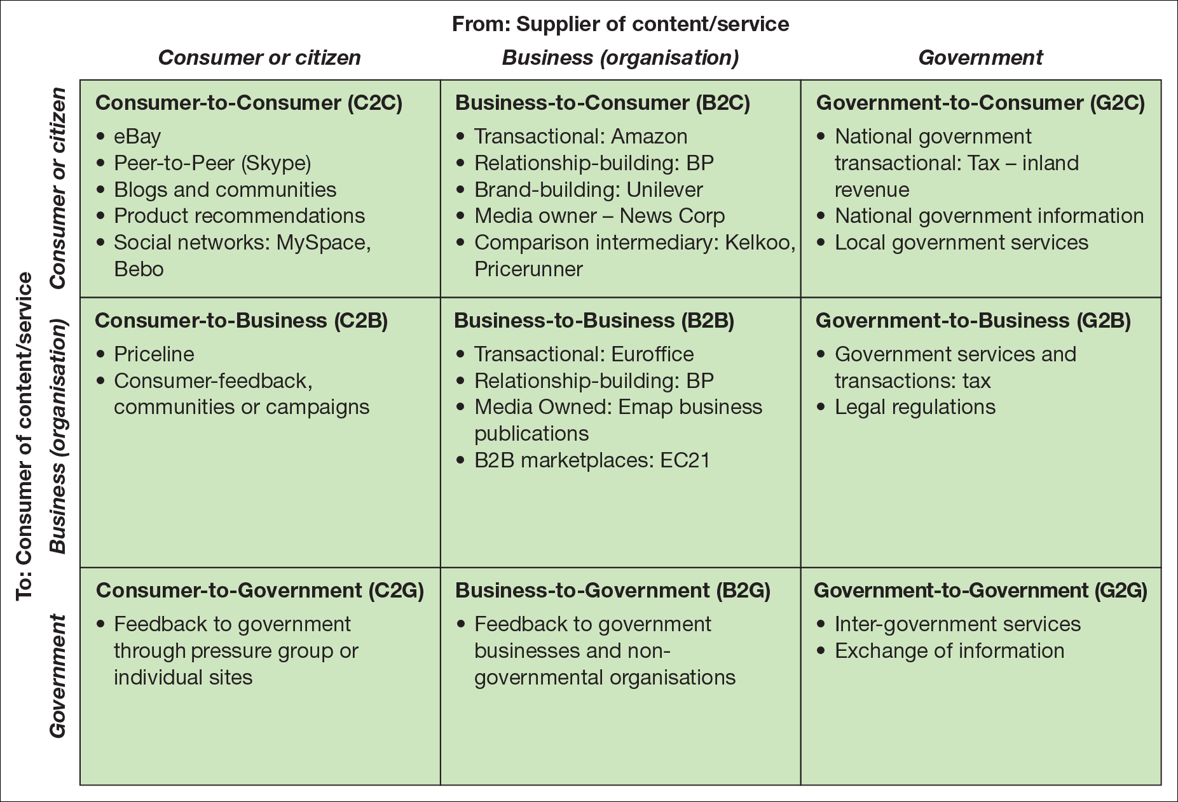
Figure 1.11 Summary and examples of transaction alternatives between businesses, consumers and governmental organisations

Slide 26
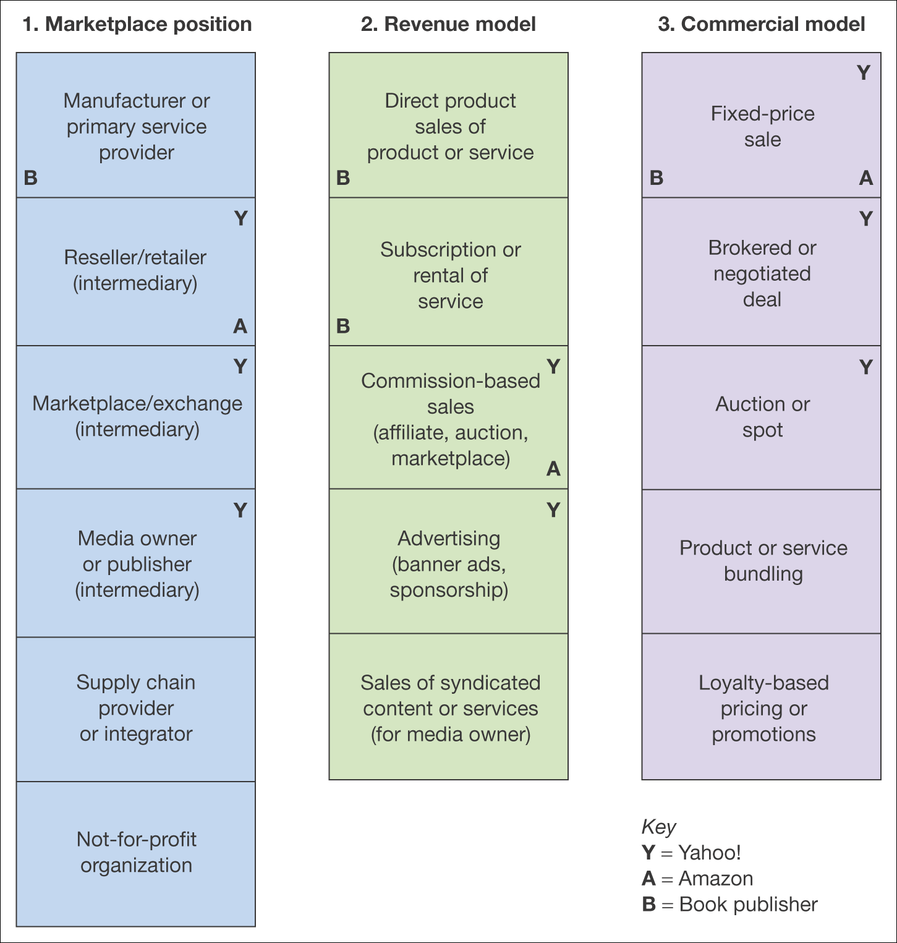
Figure 2.11 Alternative perspectives on business models
Notes:
The revenue is in the centre of core interests such as where the positioned itself and what is its commercial visibility.

Slide 27
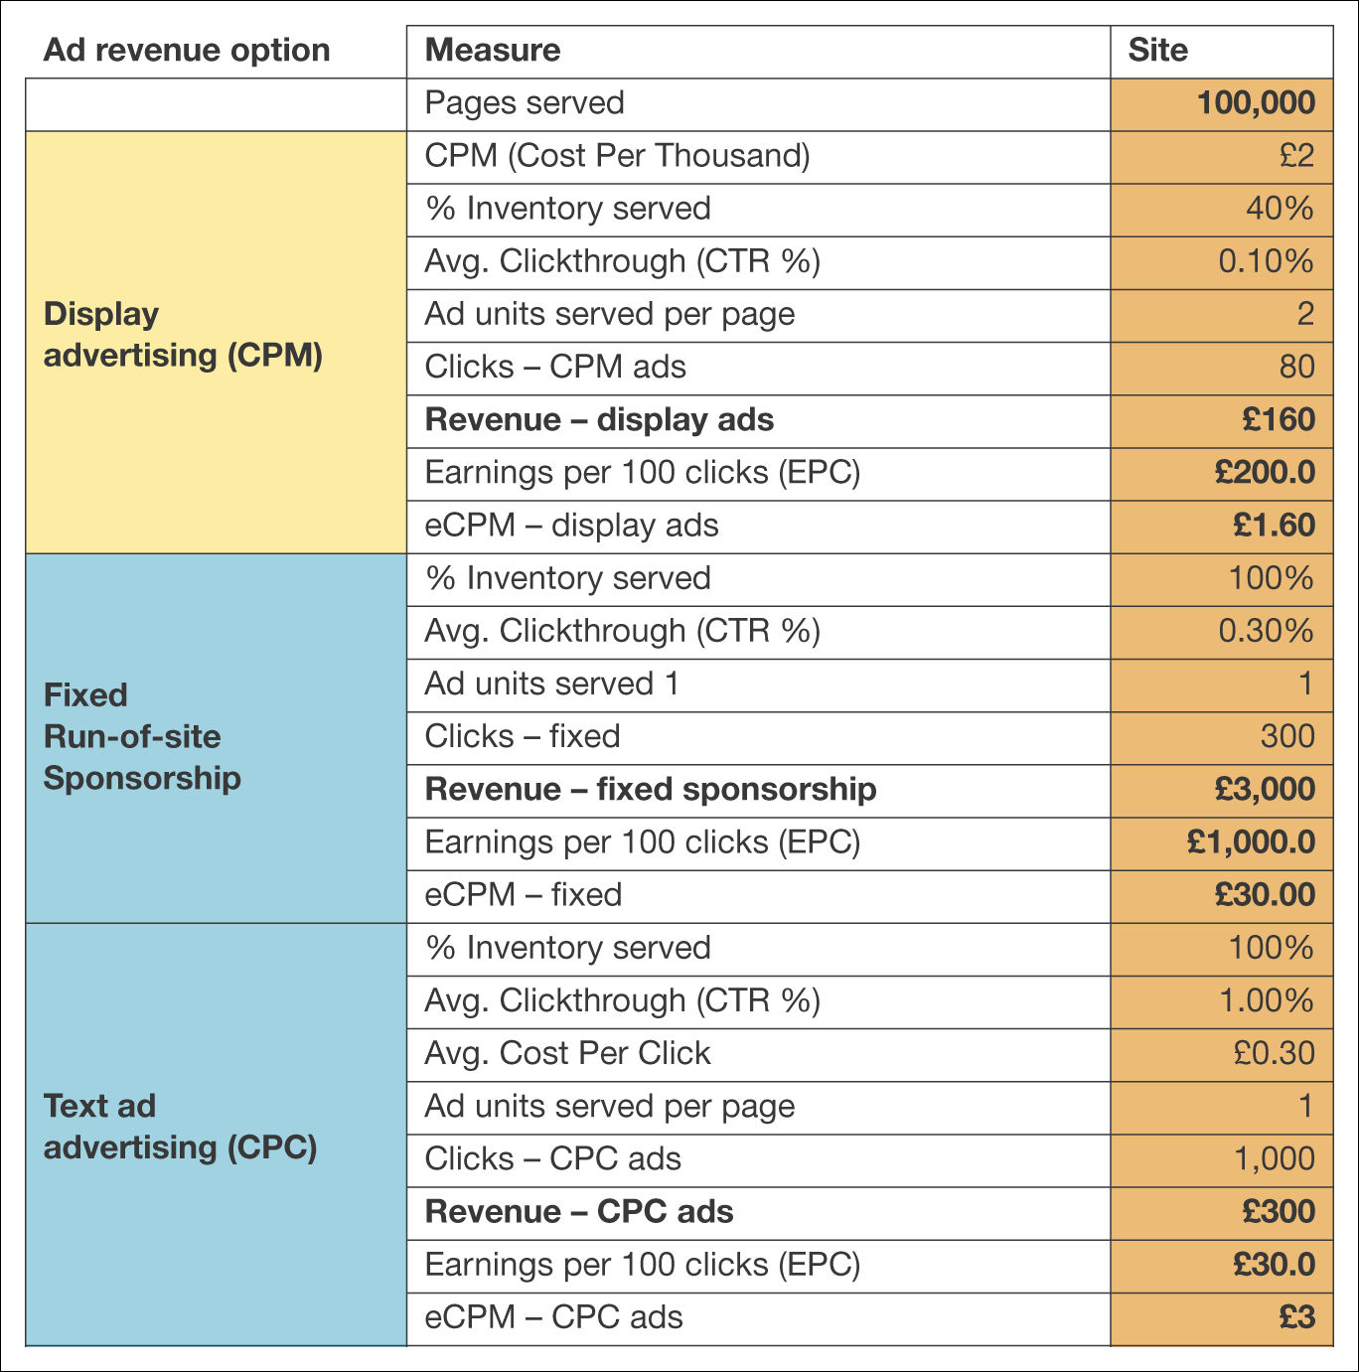
Figure 2.12 Example spreadsheet for calculating a site revenue model
Note: Available for download at www.smartinsights.com/conversion-model-spreadsheets/
Notes:
This is an example of how to calculate the revenue generated form adds on a website, which is triggered by customer visits called traffic.

Slide 28
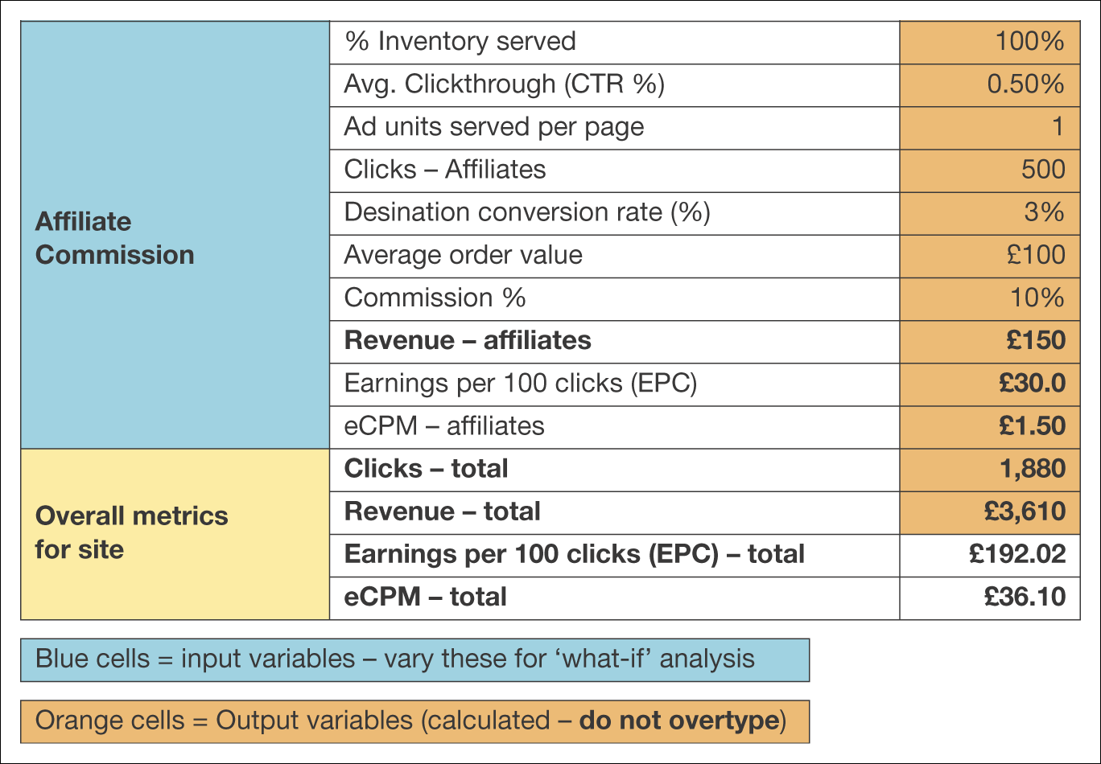
Figure 2.12 Example spreadsheet for calculating a site revenue model (Continued)
Note: Available for download at www.smartinsights.com/conversion-model-spreadsheets/

Slide 29
Revenue Models – Publishing Business Example
Subscription access to content
Pay per view content access
CPM display advertising
CPC advertising on site
Sponsorship of sections, content or widgets
Affiliate revenue (CPA or CPC)
Subscriber data for e-mail marketing
Access to customers for research purposes.
BlablaLivre, a French platform that recommends books in 140 characters or less, like on Twitter. BlablaLivre intends to create a broad community of users who are able to quickly give their opinion on books, especially novels.
Notes:
Another publishing example - MacGuffin is a self-publishing platform for digital mini-stories and short-form audiobooks. Poetry etc
Zinio now distributes local magazines from countries around the world.
With 5,500 titles and 12.5 million registered customers, Zinio is the largest of the digital publishing platforms.
In 2015, Zinio expanded its market to include libraries by creating its mobile lending program app called Zinio for
Libraries.
This initiative was developed to allow members to borrow magazines from their local libraries after having
logged into their library accounts.

