Slide 1

Managing business information presentation
Students name & ID:
Ruth Esther Feliz - 2327588
Ian Moiche Zuniga - 2336866
Slawomir Gora - 2336470
Marinela Vasilie - 1921538
Oliver Petrovski – 2335143
Tamara Sanches - 2336849
Moodle code: LCLM5004
Moodle name: managing business information
Lecture name: Amer Kareem

Slide 2
Table of Content
Introduction of company and information system
Type of information system
Ethical considerations in business information system
AI decision making and bias
Real World Cases
Conclusion
references

Slide 3

Introduction
SHEIN, a global e-commerce retailer,
Founded in 2008 in China
Deliver affordable and trend-driven products (Nikkei Asia, 2024)
Technology, data analytics, and digital marketing
Data-driven production, supply chain management systems, and customer relationship management tools

Slide 4

Introduce Information Systems
Tools used by SHEIN to collect, store, and analyze customer data.
Support daily operations such as orders, stock, and deliveries.
Help SHEIN react quickly to new fashion trends.
Reduce mistakes and improve communication inside the company.
Indeed (n.d.)

Slide 5

Role of Information Systems in SHEIN’s Operations
Manage millions of online orders and deliveries
Track stock levels in real time
Help create fast production based on data
Improve communication across departments
Support quick decision-making on trends
Janelle (n.d.)

Slide 6

Importance of Information Systems for SHEIN
Faster decision-making using customer data
Helps SHEIN react quickly to new fashion trends
Improves customer experience and satisfaction
Gives SHEIN a strong competitive advantage
Helps reduce mistakes and costs
Agrawal, S. (2023)

Slide 7
Types of information systems
Transaction processing systems (TPS)
Customer relationship management systems(CRM)
Supply chain management systems( SCM)
Enterprise resource planning (ERP)

Slide 8

Transaction processing systems (TPS)
Function
Manage orders, payment, conforming shipping etc.
Process of purchase is accurate.
Benefits
Reduce risk while billing and order processing
Reduce delays of orders around the world.
Customers trust
Limitations
Delays and failure due to downtime of the system.
Weak system in high volume of payments
Costly
GeeksforGeeks (2025)

Slide 9

Customer relationship management systems
Function
Track, collect and organised customer data
Provide customer service
Identify customer segmentation
Send notification to customer preferences
Collect feedbacks for future improvements.
Limitations
Have a privacy risk involve
Costly
Difficulty managing huge amount of data
Benefits
Improve customer satisfaction
Get customer loyalty
Used strategy marketing
Prezi (n.d.)

Slide 10
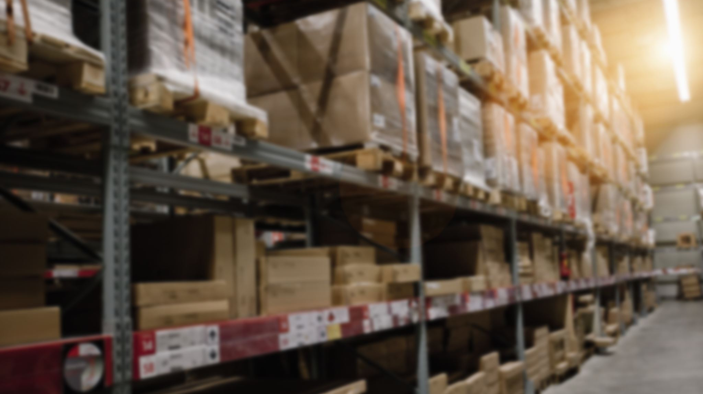
Supply chain management system
Function
Inventory management
Manage of the transportation
Plan production of items
Check items meet quality standards
Suppliers' communication
Limitations
Global operation can give difficulties
Drive overstock or delays due to incorrect demands
Costly
Benefits
Avoid overproduction
Smart decision making
Happier customers
XTransfer (2024)

Slide 11
Enterprise resource planning
Function
Analise what is profitable
Schedule the time of production
Management of human resource
Financially manage
Benefits
Better global manage
Better financing control
Manage growth
Better decision making
Limitations
Costly
Training need to employees
Slow system update
No Name VC (2023),
Investopedia (2025)

Slide 12

Similarities VS differences
Similarities
Use of technology for faster and efficiency
Use of data and storage
Costly
All of them connected
Improve customers satisfaction and better company performance
Differences
Daily operation (payment deliveries etc) TPS
Handle customer behaviour and marketing. CRM
Monitored how the items are delivered ad made .SCM
It connect all the roles regarding the business into one system. ERP

Slide 13

Ethical Considerations in Business Information Systems
Information systems collect and manage sensitive data from customers and employees.
Companies must use data responsibly to protect trust and reputation.
Ethical issues include privacy, security, employee monitoring, and fairness in decision-making.
Organizations should follow laws and ethical standards to avoid negative consequences.
Todorovska, I. (2023)

Slide 14

Data Privacy & Security at SHEIN
Ethical Issue: SHEIN collects and stores large amounts of personal data from customers.
Risk: Miss use of data or cyberattacks could expose sensitive information.
Consequence: Loss of trust and damage to reputation.
Solution: Strong data protection and clear customer consent under GDPR (General Data Protection Regulation) For example Encryption
Deep, A. (2025)
Bahr, C. (2025)

Slide 15
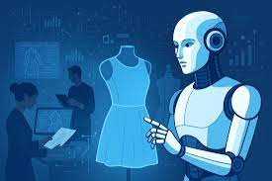
AI Decision-Making & Bias at SHEIN
Ethical issue: AI recommends products and drives production decisions.
Risk: Algorithms may be biased or not transparent.
Consequence: Unfair targeting and reduced customer trust.
Solution: Human oversight, regular bias testing and clear communication.
Rezolve (2025)

Slide 16

Ethical Solutions & Recommendations
Transparency with customers about data usage and AI decisions.
GDPR-compliant consent and data minimization.
Strong cybersecurity (encryption and regular audits).
Human oversight for AI to avoid unfair bias.
Fair treatment and transparency in supply chain monitoring.
Zachariah, T. (2025)

Slide 17
Real-World Case Studie - Zara (Inditex)
Systems used: Supply Chain Management (SCM), Enterprise Resource Planning (ERP), Point-of-Sale (TPS), and data analytics.
Main challenge: Responding quickly to changing fashion trends while avoiding excess inventory.
Solutions: Small production batches, fast restocking based on store data, and centralized planning with strong supplier links.
Ethical issues: Pressure on factory workers and negative environmental effects from fast production.
Impact: Faster trend response, fewer unsold items, and higher profits.
Key takeaway: Using connected systems like TPS, SCM, and ERP gives flexibility and efficiency — but sustainability and fair labour need attention
(Inditex, 2023; IMD, 2023)

Slide 18
Real-World Case Studie - Amazon
Systems used: Transaction Processing Systems (TPS), Customer Relationship Management (CRM), advanced SCM, ERP, and AI.
Main challenge: Managing millions of orders efficiently while keeping delivery fast and data secure.
Solutions: Automated warehouses, smart recommendations, real-time data systems, and strong cybersecurity.
Ethical issues: Data privacy concerns, AI bias, and tough working conditions in warehouses.
Impact: Fast delivery, satisfied customers, and strong revenue growth.
Key takeaway: Technology and automation boost performance — but privacy and employee welfare must be carefully managed.
(Statista, 2024)

Slide 19
Conclusion
How Information systems contribute to business success
SHEIN processes large volumes of data and uses various systems such as Transaction Processing Systems (TPS) and Customer Relationship Management (CRM)
Technology is present in ethical challenges, including data privacy, security risks, and potential AI bias.
SHEIN aims to ensure transparency, strengthen data protection, and implement responsible AI frameworks that promote fairness, accountability, and customer loyalty in the digital environment.

Slide 20
Reference
Indeed (n.d.) ‘What are information systems?’, Indeed Career Advice. Available at: https://uk.indeed.com/career-advice/career-development/what-are-information-systems#:~:text=It%20helps%20convert%20data%20into,money%20to%20instal%20and%20maintain (Accessed: 02 November 2025).
Janelle (n.d.) Management Information Systems SHEIN Case Study. Scribd. Available at: https://www.scribd.com/document/689693217/Management-Information-Systems-Shein-Case-Study#:~:text=and%20digital%20marketing.-,Shein's%20digital%20approach%20allows%20it%20to%20use%20customer%20data%20and,Shein%20respond%20rapidly%20to%20customers (Accessed: 02 November 2025).
Salesforce (n.d.) ‘Benefits of CRM: How Customer Relationship Management Helps Your Business’, Salesforce. Available at: https://www.salesforce.com/crm/benefits-of-crm/#:~:text=The%20primary%20benefits%20of%20using,processes%2C%20and%20better%20data%20insights (Accessed: 02 November 2025).
Salesforce (n.d.) ‘Benefits of CRM: How Customer Relationship Management Helps Your Business’, Salesforce. Available at: https://www.salesforce.com/crm/benefits-of-crm/#:~:text=The%20primary%20benefits%20of%20using,processes%2C%20and%20better%20data%20insights (Accessed: 02 November 2025).
Prezi (n.d.) SHEIN’s CRM Strategy. Available at: https://prezi.com/p/xxhlp36hbwi0/sheins-crm-strategy/ (Accessed on 28/10/2025)
XTransfer (n.d.) how does Shein manage supply chain Available at: https://www.xtransfer.com/archives/669dbd41df89561b92950559?utm_source=seo_archives (Accessed on 28/10/2025)
GeeksforGeeks (2025) ‘Transaction Processing System: Meaning, Types, Benefits and Examples’, GeeksforGeeks. Available at: https://www.geeksforgeeks.org/software-engineering/transaction-processing-system-meaning-types-benefits-and-examples/ (Accessed: 29/10/2025)
No Name VC (n.d.) ‘Look at SHEIN from the perspective’, No Name VC. Available at: https://nonamevc.substack.com/p/look-at-shein-from-the-perspective (Accessed: 02 November 2025).
Todorovska, I. (2023) Ethical issues in information technology — balancing innovation and responsibility, Barrage Blog, 25 August. Available at: https://www.barrage.net/blog/strategy/the-importance-of-ethics-in-technology (Accessed: 26 October 2025).
Bahr, C. (2025) ‘E-commerce and the GDPR: how to keep your business compliant’, Usercentrics Knowledge Hub, 3 October. Available at: https://usercentrics.com/knowledge-hub/gdpr-for-ecommerce/ (Accessed: 26 October 2025).
Deep, A. (2025) ‘Is SHEIN legit? What shoppers should know in 2025’, ExpressVPN Blog, 14 August. Available at: https://www.expressvpn.com/blog/is-shein-safe/ (Accessed: 26 October 2025).
Rezolve (2025) Harnessing the Power of AI in eCommerce: AI Ethics and Bias Mitigation. Available at: https://rezolve.com/blogs/harnessing-the-power-of-ai-in-ecommerce-ai-ethics-and-bias-mitigation/ (Accessed: 26 October 2025).
Zachariah, T. (2025) ‘eCommerce Privacy Compliance: Challenges and Solutions’, WebToffee Blog, 24 October. Available at: https://www.webtoffee.com/blog/ecommerce-and-digital-privacy/ (Accessed: 26 October 2025).
Ria, A. (2023) ‘A Brief History of SHEIN’, Future Startup, 6 November. Available at: https://futurestartup.com/2023/11/06/a-brief-history-of-shein/ (Accessed: 25/10/2025)
Investopedia (n.d.) ‘Enterprise Resource Planning (ERP): Meaning, Components, and Examples’, Investopedia. Available at: https://www.investopedia.com/terms/e/erp.asp (Accessed: 29/10/2025)
Inditex. (2023). Annual Report 2023. Available at: https://www.inditex.com [Accessed 9 Nov 2025].
IMD. (2023). Fast Fashion Case: How Zara Built Its Supply Chain Speed Advantage. IMD Business School.
Statista. (2024). Amazon global revenue 2013–2024. Available at: https://www.statista.com [Accessed 9 Nov 2025].

Slide 21

Thank you
Any questions?

