Slide 1

ECAD5017
Stop the Spread: A Practical STEM Project on Hygiene and Engineering
KHADIZA MOSABBIR
2417359

Slide 2

ACTIVITY SUMMARY-
Activity Summary:
Designed a hands-on STEM project at Cardigan Farm Park focused on disease prevention through proper hand hygiene.
Main Objective:
Teach students about germs and how handwashing prevents illness by designing a functional handwashing device to use at the farm park
Target Age Group:
Children aged 7–11 (Key Stage 2).
Curriculum Links:
Science (microorganisms, health), Design & Technology (mechanical systems), (personal hygiene) aligning with the curriculum for Wales 2022

Slide 3
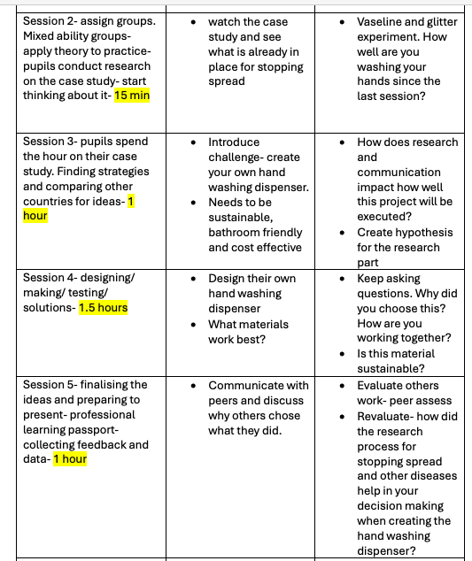
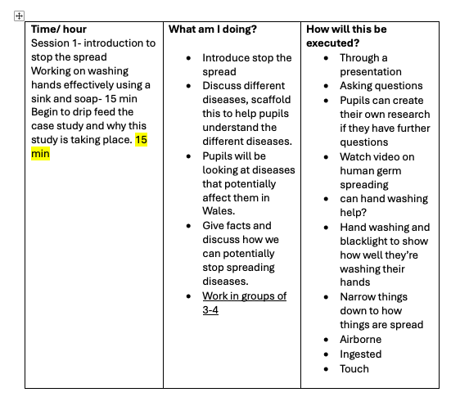
Implementation strategy

Slide 4
Materials used for the experiment
Implementation Strategy – Activity Design (3 minutes)
Materials Used:
  Recycled plastic bottles
  Wooden stands
  String/levers to dispense water (tippy tap concept)
  Soap and water
  Tape/ glue gun
Steps:
  Introduce germs through a visual/interactive demonstration.
  Discuss importance of hand hygiene.
  Design and build handwashing stations in small groups.
  Test, use, and reflect.
Engagement Techniques:
  Inquiry-based questioning
  Hands-on problem solving
  Group collaboration
  Real-world context (farm setting)

Slide 5
Theorists
Compare B
Theoretical Underpinning
Constructivist Learning Theory:
Encourages knowledge building through active experience (Piaget, 1972).
Experiential Learning (Kolb, 1984):
Learn by doing – students constructed meaning through physical creation.
Assessment for Learning:
Embedded questioning and peer feedback to support progress (Black & Wiliam, 1998).
Health Education Framework:
Emphasising real-life relevance increases retention and application (WHO, 2003).

Slide 6
Areas of Learning and Experience (AoLE) Integration
AoLE | How It’s Addressed
Science & Technology (SciTech) | Pupils learn about microorganisms, hygiene, and the mechanics of water dispensing systems.
Health & Wellbeing | Explores physical wellbeing through hygiene. Discusses emotional wellbeing through teamwork and confidence building.
Expressive Arts | Optional: Pupils can design posters, jingles, or diagrams to promote handwashing.
Languages, Literacy & Communication | Pupils use language to explain their ideas, present their project, and document steps. Inquiry and reflection deepen communication skills.
Mathematics & Numeracy | Measuring materials, calculating water flow, estimating use over time—all offer opportunities for real-world maths integration.
Notes:
Slide Addition: “Curriculum for Wales Integration”
This project embodies the Four Purposes of the Curriculum for Wales by developing healthy, ethical, and creative learners.
Areas of Learning and Experience (AoLEs) targeted include:
Science & Technology: Investigating germs and designing hygiene tools.
Health & Wellbeing: Promoting hygiene and teamwork.
Languages & Literacy: Describing and reflecting on their designs and findings.
Learning was pupil-led, inquiry-based, and rooted in real-life problem solving—supporting Curriculum for Wales principles of authentic, meaningful learning.

Slide 7

Critical Analysis & Reflection (3 minutes)
What Worked Well:
  High engagement due to real-world context (farm hygiene)
  Collaboration encouraged social learning
  Creativity in design showed student understanding
Challenges:
  Time constraints limited reflection
  Some children struggled with fine motor skills
Feedback:
  Positive response from teachers and students
  Suggestions for more structured build templates
Improvements:
  Provide differentiated instructions
  Integrate digital reflection tools (e.g. video feedback)

Slide 8
Professional Practice & Future Application (2 minutes)
Preparation for Teaching:
  Gained experience in planning, differentiation, and cross-curricular integration
  Built confidence in classroom management in outdoor settings
Transferable Skills:
  Project-based learning can be applied to topics like sustainability, nutrition, or environmental science
  Encouraged inclusive, hands-on pedagogy aligned with current educational standards (DfE, 2013)

Slide 9


Thank you
References
Black, P. & Wiliam, D. (1998). Assessment and Classroom Learning. Assessment in Education.
Kolb, D. (1984). Experiential Learning: Experience as the Source of Learning and Development.
Piaget, J. (1972). The Psychology of the Child.
WHO. (2003). Skills for Health – Life Skills Training Manual.
DfE. (2013). National Curriculum in England: Framework Document.

