Slide 1


The Intercultural workplace
Reflection Presentation
Laura Davies
1910723

Slide 2

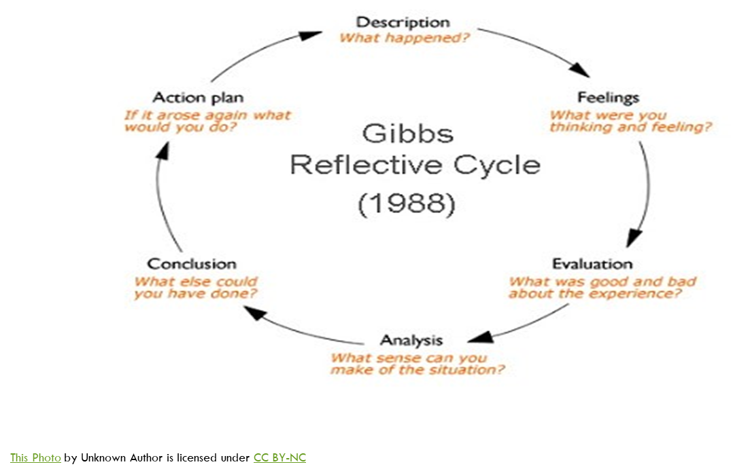
Laura Davies
Critical Reflection
_______________________________
University of Saint David Trinity Carmarthen
Carmarthen Business School
Business & Management Degree
The Intercultural Workplace
Organisational Context
Organisational Culture
Human Resources Management

Slide 3
The Intercultural Workplace
Organisational Context
BACKGROUND
BEGINNING
WHO THEY ARE
WHAT THEY DO
ETHOS
WEALTH
Sinclair, A. (1993
Organisational Culture
THE PEOPLE
CEO’S
MANAGEMENT
TEAMS
GROUND STAFF
THE ENVIRONMENT
DIVERSITY
INDIVIDUAL BACKGROUNDS AND BELIEFS
Handy, C. (2007) & Schein, E. h. (2017).
Human Resources Management
RECRUITMENT
REDUNDANCY
BENEFITS
SUPPORT
P-POLITICAL
E-CONOMICAL
S-SOCIAL
T-TECHNOLOGICAL
L-LEGAL
E-ENVIRONMENTAL
O
SWOT Analysis
Kwamena Nyarku, G. A. (2011).
W
T
PESTLE Analysis
Perera, R. (2017).
S

Slide 4




Step 1: Description
This Photo by Unknown Author is licensed under CC BY-SA

Slide 5


Step 2: Feelings
unsure
Self doubt
confused
This Photo by Unknown Author is licensed under CC BY-SA-NC

Slide 6
Step 3: Evaluation
Teams Meetings
Engaged
Confidence
understanding
Online Activities
No dedication
Struggled to follow
isolation

Slide 7


Step 4: Analysis
What went well?
I grasped concepts on the module topics
What didn’t go so well?
I do not feel I have a complete understanding of the module topics and would like to have had more time and also asked more questions.
This Photo by Unknown Author is licensed under CC BY-SA
This Photo by Unknown Author is licensed under CC BY-ND

Slide 8
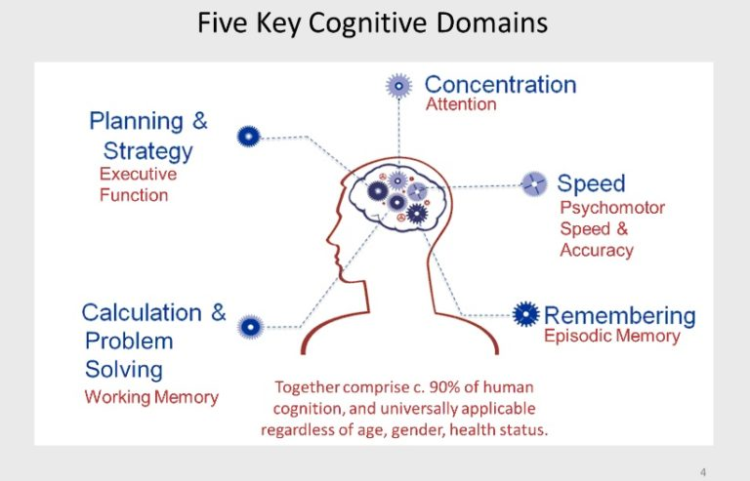
Step 5:Conclusion
Room for improvement
Face to face contact works for me
Basic understanding of the intercultural workplace
This Photo by Unknown Author is licensed under CC BY-NC-ND

Slide 9

Step 6: Action Plan
Check List
Be more vocal
Focus
Utilise time better

Slide 10
Conclusion
The Intercultural Workplace and what it means to me
Gibb’s Reflective cycle allowed for a critical reflection

Slide 11
References
Gibbs G (1988). Learning by Doing: A guide to teaching and learning methods. Further Education Unit. Oxford Polytechnic: Oxford.
Handy, C. (2007). Understanding Orgnizations. Penguin UK.
Kwamena Nyarku, G. A. (2011). Rediscovering SWOT Analysis: The Extended Version. Academic Leadership: The Online Journal, 9.
Perera, R. (2017). The Pestle Analysis. Nerdynaut.
Schein, E. h. (2017). Organizational Culture and Leadership. New Jersey: Hoboken.
Sinclair, A. (1993, January). Approaches to organisational Culture and Ethics. J Bus Ethics 12, 63-73.

