Slide 1
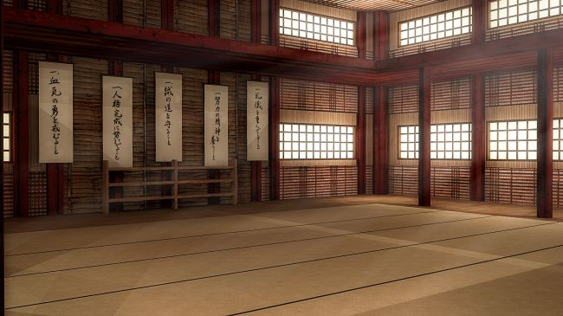
INDEPENDENT PROJECT:
THE FIRST MOVE
Monica Winn Sanchez - 2405896

Slide 2
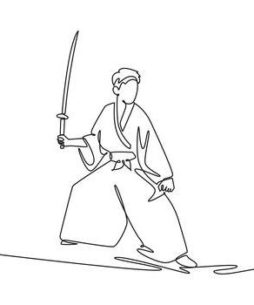
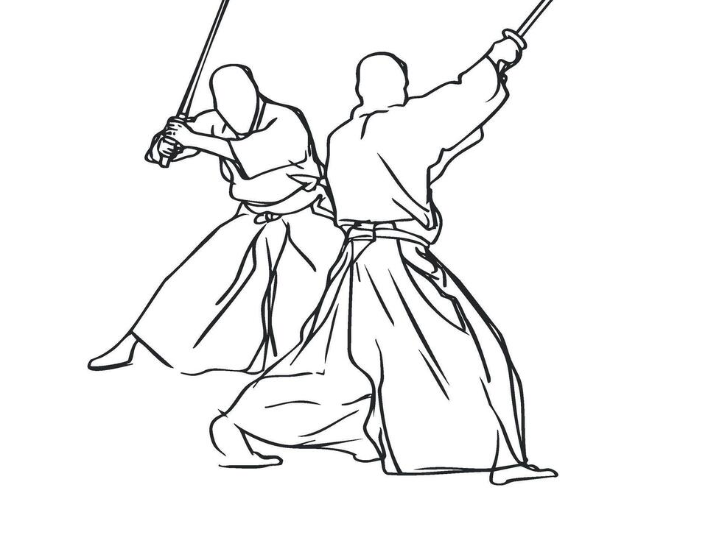
Story Synopsis
A young samurai apprentice prepares to demonstrate his skills to his experienced master. Nervous but eager to impress him, he adopts a fightning stance and attempts his first attack.
However, he loses his balance and nearly falls. Embarrased, he hesitates, unsure whether to continue.
Instead of criticising him, the master calmly gives him another chance. The apprentice takes a breath, regains his focus and prepares to try again.
The story explores courage, perseverance and learning mistakes.
Main themes: Courage, self-confidence and perseverance.

Slide 3
Character permormance & Movement
Nervoussness:
The apprentice notice his master
He tries to look confident
He adjusts his grip on the wooden sword
Preparation:
He positions his feet
He adopts a fighting stance
He takes a deep breath before attacking
Failure:
He makes his first move
He loses his balance and nearly falls
He hesitates, feeling embarrassed
Recovery:
The master gives him another chance
The apprentice regains his focus
He prepares to try again with greater determination

Slide 4
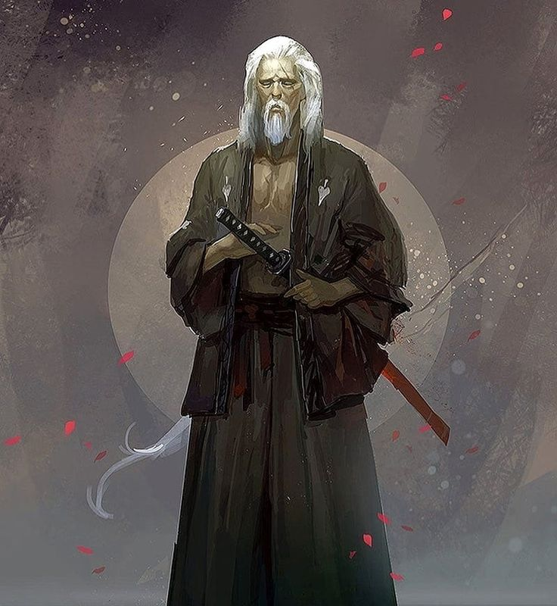
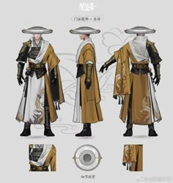
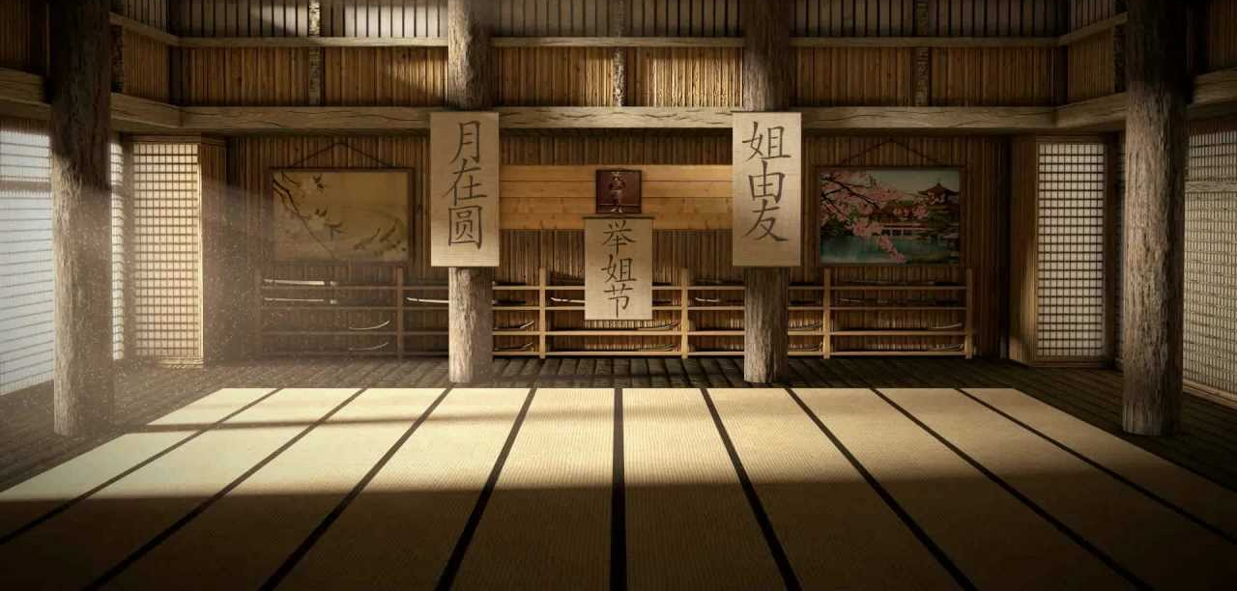
Visual Research & Inspiration
Mi visual research will focus on traditional Japanese architecture, historical clothing and wooden training swords.
I will research historical references to ensure that the characters, props and environment are visualy consistent with the chosen period.

Slide 5
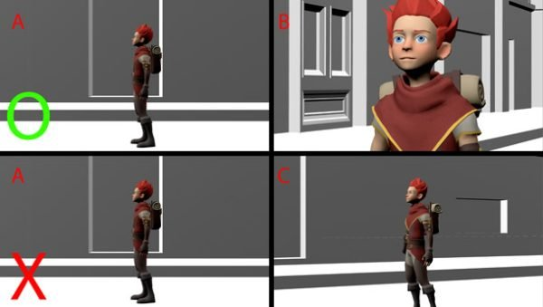
Cinematic
Layout & Composition
SHOT 1 – Establishing shot
A wide shot introduces temple and dojo
Both characters are visible, establishing the distance between them
SHOT 2 – Character performance
A medium shot shows the apprentice preparing to attack.
The framing emphasises his posture and nervous movements
SHOT 3 – The failed move
A wider or medium shot shows the apprentice losing his balance
The audience can clearly read the action
SHOT 4 – The resolution
A medium shot shows the master giving the apprentice another chance
The final composition emphasises the apprentice's renewed determination

Slide 6
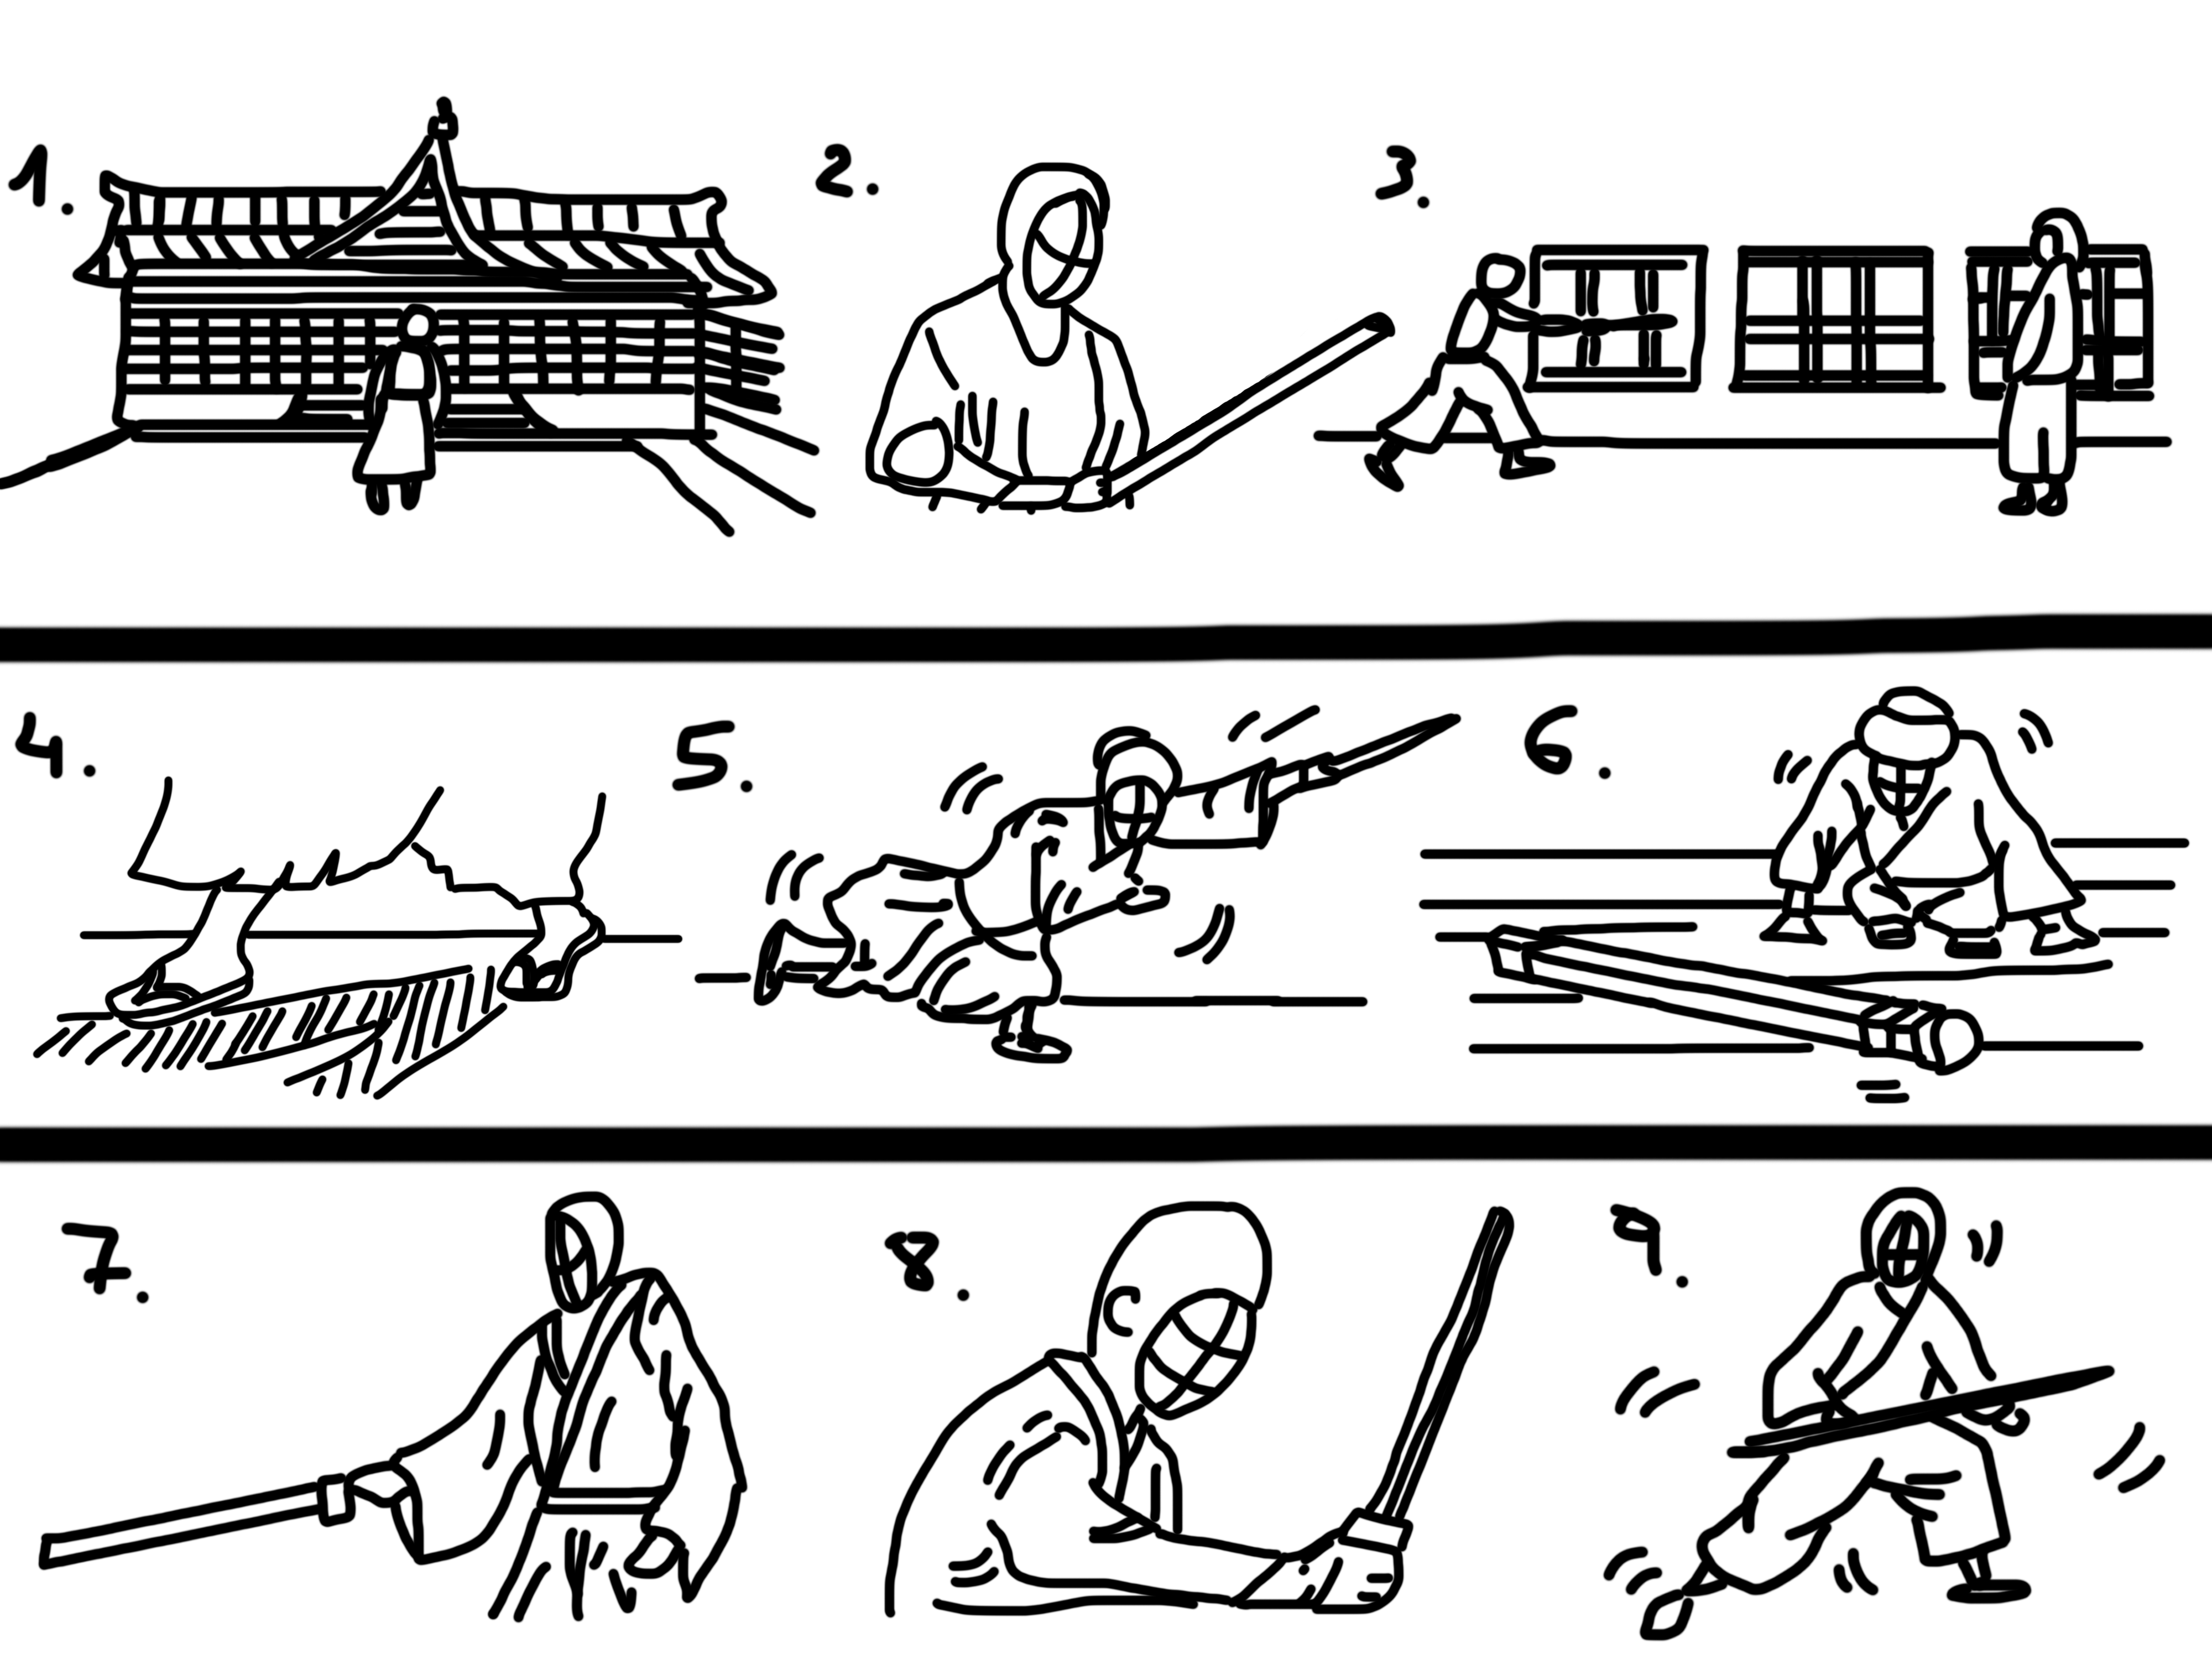

Slide 7
Aims & Objectives
PRODUCTION PLAN
My aim is to create a one-minute 3D animated short film combining character performance with cinematic layout.
I want to improve my skills in body mechanics, timing, posing and physical acting, while experimenting with basic facial animation.
I also main to develop my understanding of composition, camera placement and visual storytelling.
Characters: Two - an apprentice and his master.
Environment: One main location – a temple with traditional dojo.
Props: Wooden training swords.
Animation: Physical acting, anticipation, balance and character interaction.
Visual approach: Cinematic framing and natural lightning.

