Slide 1

Research Methods- BMSW7004
Lecture 1

Slide 2

Contact Details
Badir Miftah
b.miftah@uwtsd.ac.uk

Slide 3

Module Learning Outcomes
Upon the successful completion of this module, the student should be able to:
Critically evaluate the role of theory in shaping and interpreting research;
Critically evaluate approaches to reliability, validity and bias in social research;
Examine fully the ethical considerations in social research and develop research designs that meet a higher standard of ethical practice.
Critique communications and demonstrate a mastery of scholarship by constructing effective modes of communication according to the target audience.

Slide 4
TASK:
Individual presentations – Assignment 1 -13th of June 2023
Research Proposal – Assignment 2 – 21th of July 2023
Part Description | Report Length | Weight
Part1- Presentation | 2,000 words- Presentation 18 min | 40%
Part2- Research Proposal | 3,000 words. | 60%

Slide 5

What is Research?
Lecture 1

Slide 6

Defining Research
“Research is a systematic inquiry to describe, explain, predict, and control the observed phenomenon.” Earl Robert Babbie (2007)
"Diligent and systematic inquiry or investigation into a subject in order to discover facts or principles." American College Dictionary, (1964)
“Any creative systematic activity undertaken in order to increase the stock of knowledge, including knowledge of man, culture and society, and the use of this knowledge to devise new applications.” OECD (2001)

Slide 7

Is Research Important?
Yes
It is the way we understand the world around us
It is a way to structure how we ask and answer questions
It is a critical skill
But
How do we know what to believe?
What is Right & Wrong?
  We will come back to these two points in future lectures

Slide 8

What is Research?
Is it a mysterious thing that only special people can do?
Jon Hrubesch

Slide 9



Or is it a Skill that can be developed?

Slide 10
What is Research?
Research is the activity of finding out about a subject in a systematic way.
The subject of the research can be simple or complex – but it needs a clear question to be explored
This module will explore the Skills that are required to do Research
These Skills are important for you to be able to do the Dissertation

Slide 11

Purpose of Research
To review and synthesise existing knowledge.
To investigate some existing situation or problem.
To provide solutions to a problem.
To explore and analyse more general issues.
To construct or create a new procedures or system.
To explain a new phenomenon.
To generate a new knowledge.
Or combinations of the above.

Slide 12

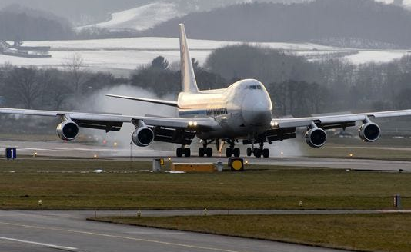
Are you a Researcher?
How did you choose your Smartphone?
How would you select the best flight?

Slide 13

Research In Business
Business is based on decision-making
How do we know if we are making good decisions?
An important part is the INFORMATION that we are using
This develops our KNOWLEDGE
The Information is based on data from RESEARCH
A common example is Market Research
  Companies need to know what customers may want so gather data

Slide 14

Academic Research
The main aim is the same as Business Research
  To find out more about something
We talk about GOOD and BAD research
We will explore methods in this module that help to produce a GOOD piece of research
GOOD research tells us something of value about a subject area
It can be trusted because it has been correctly produced
There is an Ethical approval
  We will look at this in future sessions

Slide 15
Research Qualities and Skills
Communication Skills
Intellectual skills
Information Technology Skills
Organisational Skills
Motivation
Interdependence
Perseverance

