Slide 1
Digital Skills and Research Methods
(BMSW4003_BIRM)
Group 4
Neli Miteva – 2113297 – Team Leader
Radostina Rusenova - 2015829
Aisha Evans - 2113978
Penka Hristova - 2108956

Slide 2

Radostina Rusenova
ID 2015829
Digital Skills and Research Method, BMSW4003

Slide 3
1
The biggest PowerPoint
presentation trend
MESSAGE
per slide

Slide 4
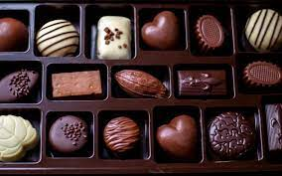

Slide 5

Why it is important ?
People came TO HEAR YOU
The audience RETAINS LIMITED INFORMATION
Too much information can OVERHELM AND BORE
Notes:
No one come to a presentation to read. Providing one point on each slide allows the audience to quickly digest and then turn their focus back on you so you can elaborate on the point. They should be able to comprehend each slide in 10 seconds and use it to support to your verbal presentation.
Your audience will only remember pieces of your presentation so it is important that your slides present them with the key points you want them to walk away with. With too much information all at once, you dilute your message and cause each person to remember something different. With one key point you would like to have stick in their mind helps them to absorb it and ensures everyone is taking away the same message.
Being presented a block of text is uninspiring and once they have read it, they will zone out until the next slide because they already know what you are about to say. Having just one point allows you to utilize different mediums to convey the message- like an impactful visual or motion graphic. This keeps your presentation interesting and stimulating.
5

Slide 6
Tips to create a one message per slide presentation:
Condense the idea into ONE SENTENCE/KEY WORD
Make sure IT FLOWS
Try NOT TO USE BULLETED LIST
MIX UP your approach
KNOW your material
Notes:
The slide should contain enough words to help the audience understand what you want to elaborate on.
Just because each slide has one idea doesn’t mean it stands in isolation. Your slides should flow from one to the text and have a clear transition.
Avoid multiply bullet points on a slide because they signify a list. Instead, place each bullet into its own slide and focus on one ide at a time.
Use shock or humor to grab your audience^s interest. With no text the audience will need you to help them understand what they are seeing.
The one point per slide layout focus on you as a presenter and tells the audience that you really know your topic. This allows you to speak naturally and express the enthusiasm that is difficult to show when you are reading from your slides.
6

Slide 7

Neli Miteva
Digital Skills and Research Methods (BMSW4003_BIRM)
Id – 2113297

Slide 8

Working memory
1 of 5 design principles
For a good presentation
Notes:
Equation based on John Sweller and Mayer called “the redundancy effect” (reading text displayed on the screen) where 1+1=0
Experiment has maid with two types of presentations:
1 – typical PowerPoint presentation with bulleted text
2 – without any text
Result: 28% more information retained and 79% more creative solutions are used.

Slide 9
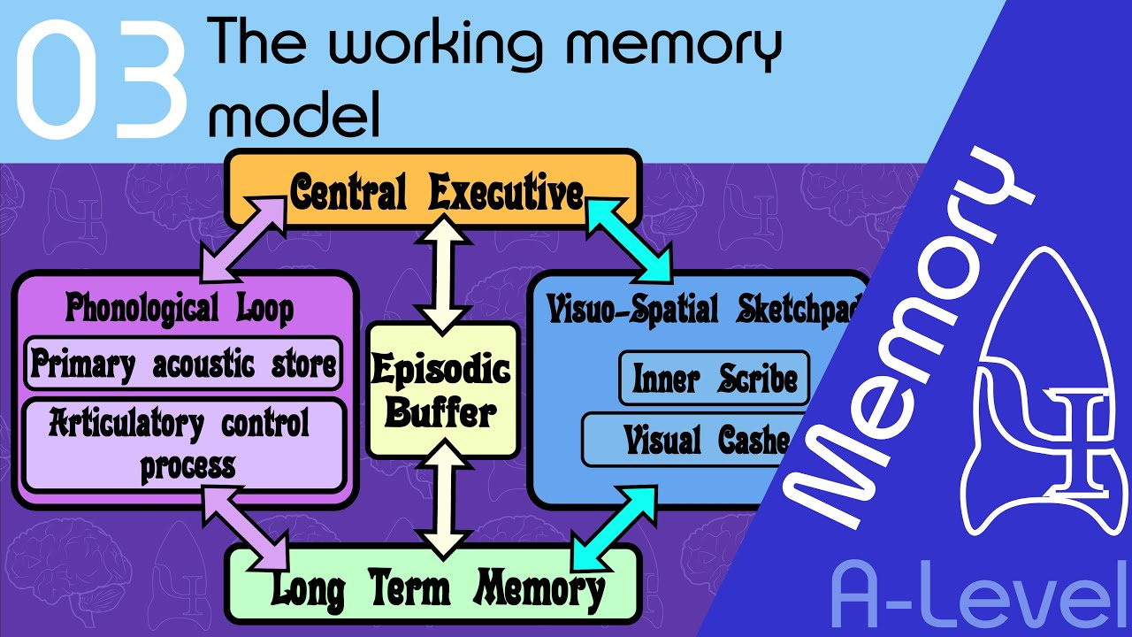
Notes:
This is an example of how exactly one presentation it should not look like!
It`s against all the principles we should follow as a guidance for a good looking presentation.
What you can do to use the working memory as best as you can?
Choose a nice picture, picture connected to the context with a meaning!
Use a simple message!
Make it attractive, interesting, memorable, entertained and but not least combine with all other design principles.

Slide 10
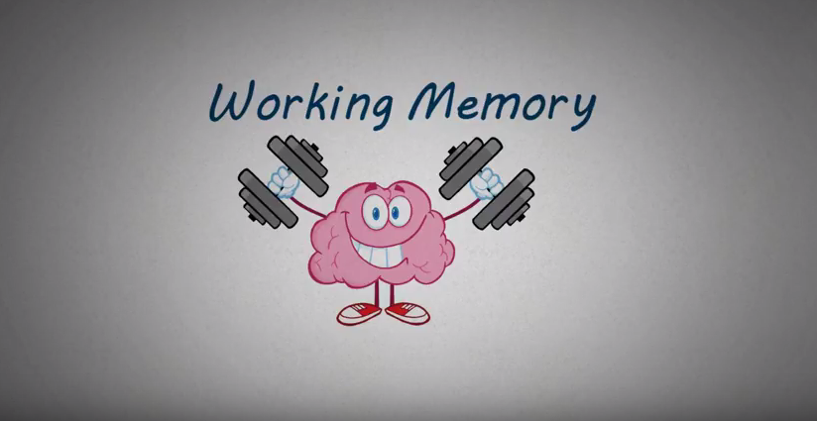
Temporarily
Small capacity
Cognitive
Manipulate
Notes:
What is working memory?
Working memory is temporary. Holds the information only for a few seconds.
Working memory can hold in the same time only five to seven items because it has a small capacity.
Working memory not just holds the information, but also manipulate it.
Working memory depends on a cognitive as control of attention and mental effort.

Slide 11



Penka Hristova
2108956
Digital Skills and Research Methods
(BMSW4003_BIRM)

Slide 12

CONTRAST
Control your focus
Helps drive our attention

Slide 13
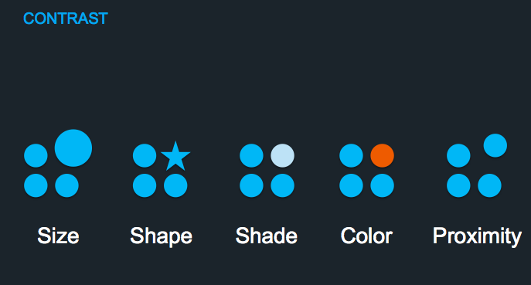
Types of contrast
Size
Shape
Shade
Color
Proximity

Slide 14
Three common scenarios
Gradient steps or blend
Green text
Colors on a dark background

Slide 15

Miss Aisha Evans
2113978
Digital Skill & Research Method

Slide 16
Text Size
Make it big and bold if there isn’t much writing
_{Appealing and bright}
_{Dark background light writing}
_{Light background dark writing}

Slide 17
Comparison
As you guys can see but not read this is an example of poor text colour and text size not only are you squinting to read what this says you are also being hit with a blinding text colour.
An example of a good text colour and good text size
The text size is a big part of a presentation weather its powerpoint, word or edexcel if you have the wrong text size and/or colour your presentation will not be a success.
Notes:
As you guys can see but not read this is an example of poor text colour and text size not only are you squinting to read what this says you are also being hit with a blinding text colour
On the other side you can see a good example of text and colour, as you can understand what it says you will want to read more on what is being spoken about

Slide 18




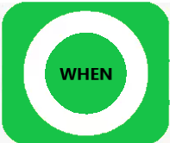
6 objects

