Slide 1

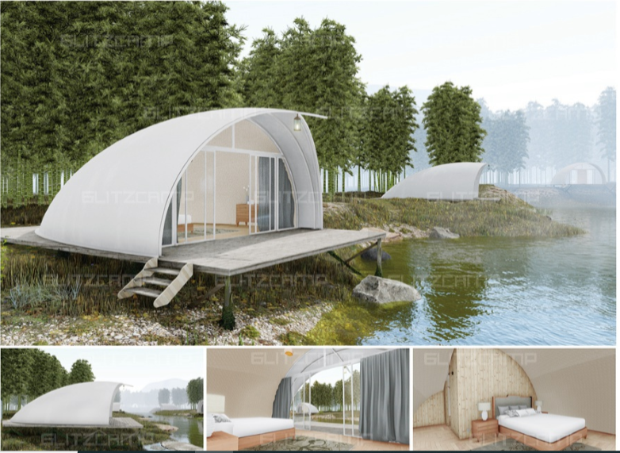
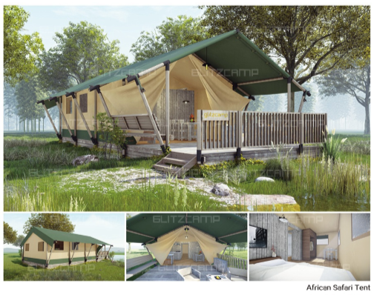
WELCOME
BA international Hotel Management
entrepreneurship
Lecturer: Dr David Jenkins

Slide 2
EMS
Business Plan
Created by:
EMS Experience Group
Elza Soares (1815430)
Monuar Moni (1818185)
Stilyana Mincheva (1816276)

Slide 3
About us
EMS Experience Group
Mission
Company offers first rate, Luxurious and glamorous experience in camping.
Vision
first and top glamping company in the country.
Phone: 01963214587
Email: info@emscampyrelax.com
Website: www.emscampyrelax.com
Address : 8 Dunnottar Church, Stonehaven AB39 3UJ, Scotland

Slide 4
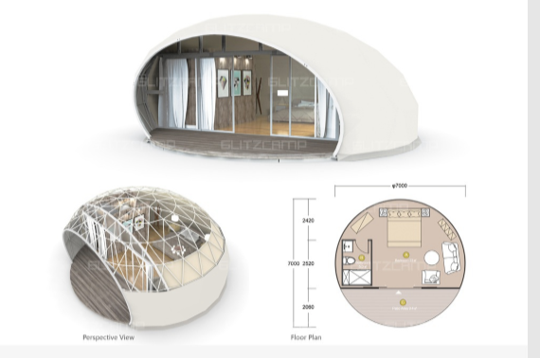
Goals and Objectives
To gain more clients and spread the idea.
To expand the business from 3 employees to 100.
To build multiple branches of the company.
To become number one in the glamping industry.
To get more investors.

Slide 5
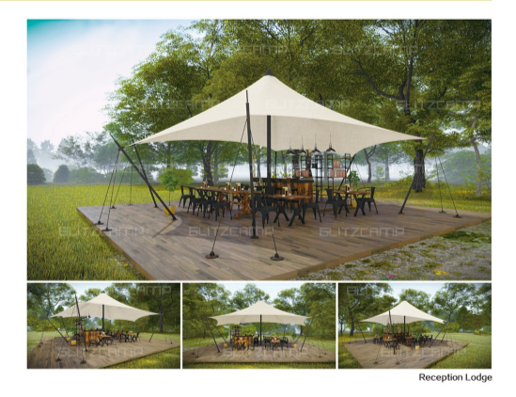
What and Why
Glamping is a combination from the word "glamorous" and "camping" which means that the style of camping is like a hotel or inn compared to the classical one.
The glamping industry expected to boom before 2030.
That is a great business to invest because the niche will surely be profitable in the following years.

Slide 6
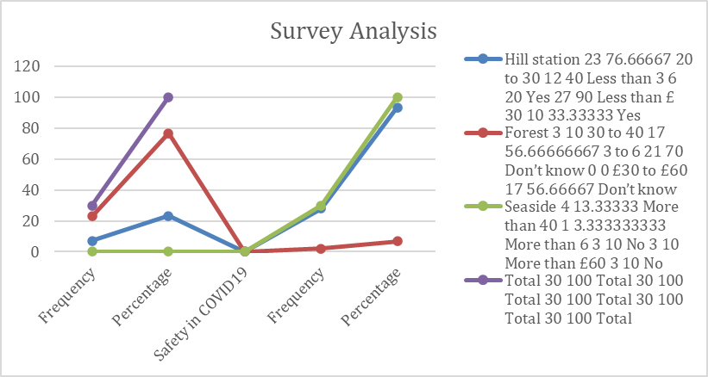
Market segmentation and Marketing Strategy
Product
Ecologically camp
Price
£ 30 to £ 60 per night for a maximum of 6 people
Promotion
EMS club
Place
100% organic food
Social Media
Website
Expand in a different location in UK
SEO Experts
Pick up and drop service
Personal rented vehicle
Health and safety-related services
Scotland
£ 40 to £ 50 for opting pickup and drop services
Food £ 10 to £ 20 per person for each time
The target audience of this company is people aged between 30 years to 40 years like to travel hill stations more than any other travel destination. Customers who are willing to pay £ 30 to £ 60 per night for a camp. Groups or individuals that would like to have a fantastic camping experience.

Slide 7
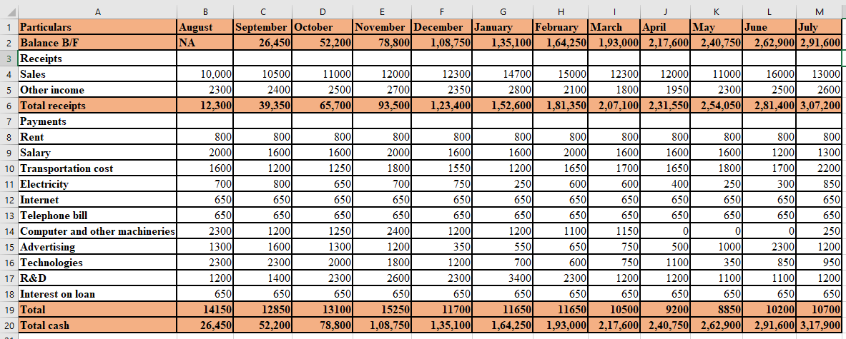
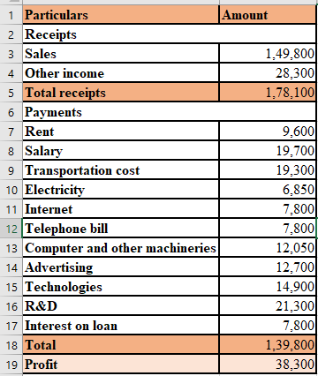
FINANCIAL ANALYSIS
A 12-month cash budget and a 12-month profit budget shows that the company will achieve a profit of £ 38,300 in its first 12 months.

Slide 8
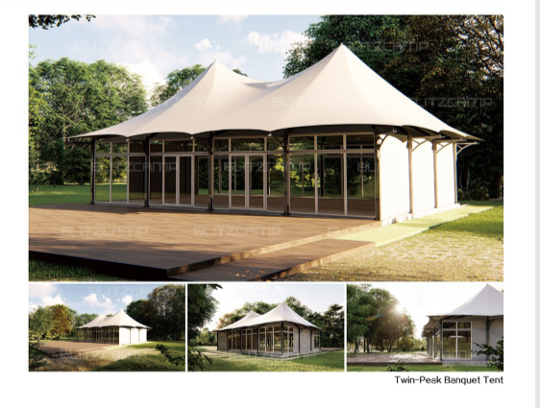
Conclusion
EMS Experience Group is a company that provides a luxury camping experience for the customers.
The business plan, shows the projected rent, utilities needed in order to run the business smoothly, equipment, salaries and benefits.
The glamping industry will continue to growth in the next years, which means that there is a higher chance that the provided data in this business plan could significantly increase more than expected.
The business plan also shows the mission and vision of the company, their goals and objectives. EMS Experience Group will continue to hire people and expand the business. They also continue to get investors to join and invest in the company.

Slide 9
References
Baker, MJ and Hart, S. eds., (2016). The marketing book. Abingdon, UK: Routledge.
Kingsnorth, S. (2019). Digital marketing strategy: an integrated approach to online marketing. London, UK: Kogan Page Publishers.
Gössling, S., Scott, D., and Hall, C.M., (2020). Pandemics, tourism, and global change: a rapid assessment of COVID-19. Journal of Sustainable Tourism, pp.1-20.
Mulley, C., Ho, C., Ho, L., Hensher, D. and Rose, J., (2018). Will bus travellers walk further for a more frequent service? An international study using a stated preference approach. Transport policy, 69, pp.88-97.
Ramya, N. and Ali, S.M., (2016). Factors affecting consumer buying behaviour. International journal of applied research, 2(10), pp.76-80.

Slide 10
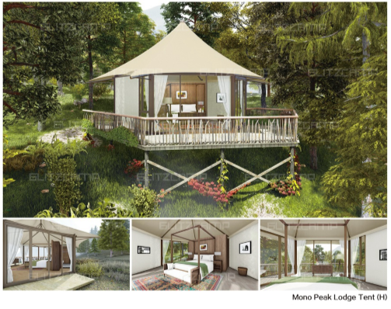
Thank You! Any Questions?

