Slide 1
Performance Practices
Performance as Context.
ADFW4024

Slide 2
What is a context?
the circumstances that form the setting for an event, statement, or idea, and in terms of which it can be fully understood.

Slide 3
What is a performance?
‘ I can take any empty space and call it a bare stage. A man walks across this empty space whilst someone is watching him, and this is all is needed for an act of theatre to be engaged.’ (Brook, 1968:12)

Slide 4
What is a performance?
‘In spite of myself, my hands, arms, legs, face, facial muscles and something inside me all began to move. I declaimed the text.’ (Stanisklavski, 1937:2)
Notes:
Read Leach page 2

Slide 5
What is Contextual Studies?
These are educational experiences designed to encourage students to make initial connections between theory and practice or ideas and people.
The intention is to engage in critical analysis, to improve academic communication skills and establish a voice of their own within new versions of regularly understood work.

Slide 6
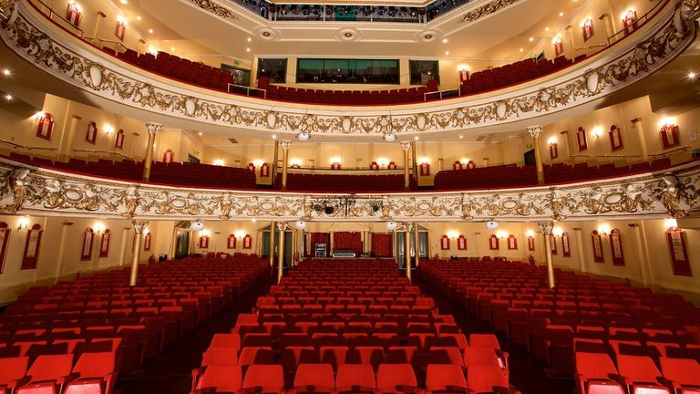
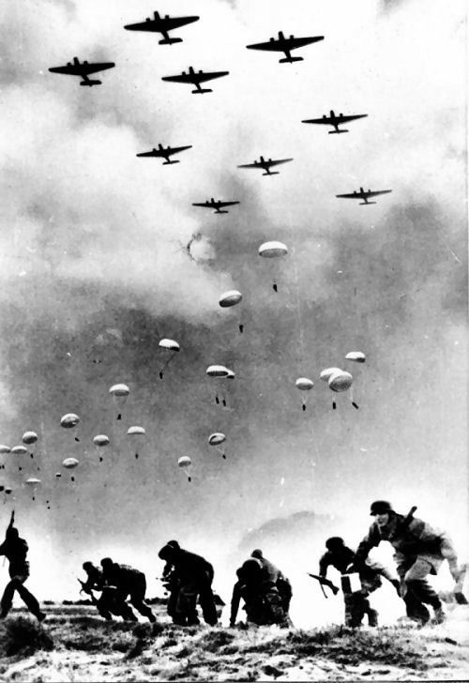
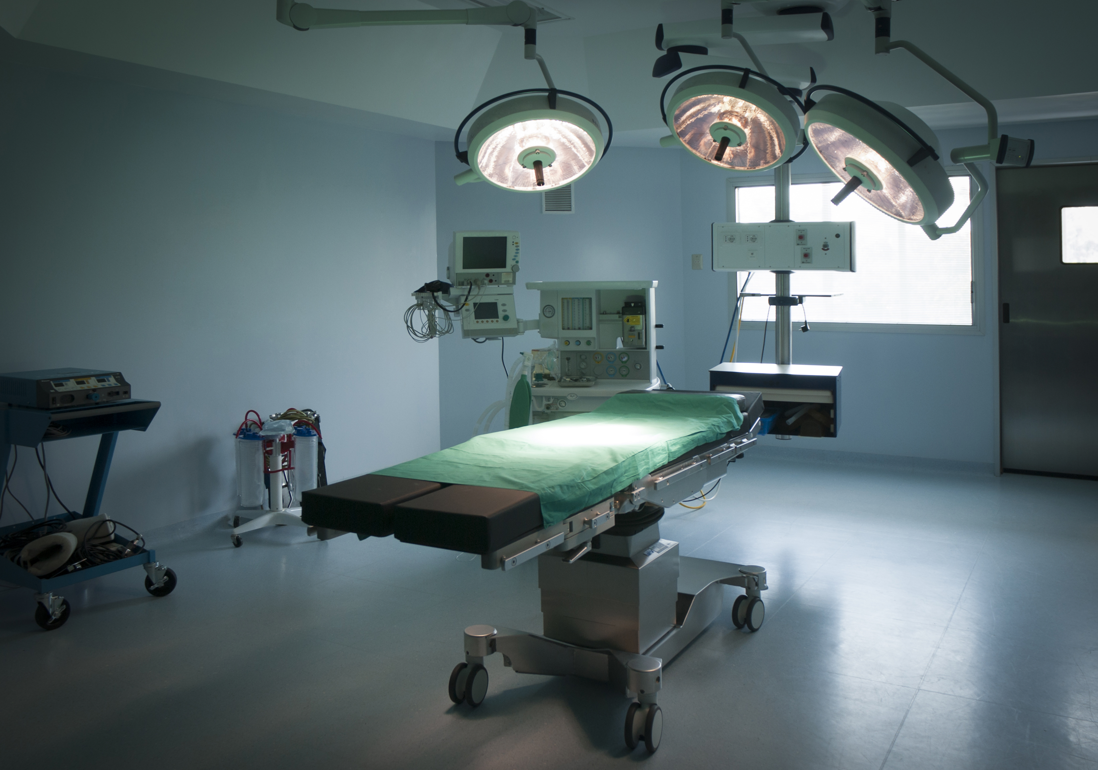
Theatre

Slide 7
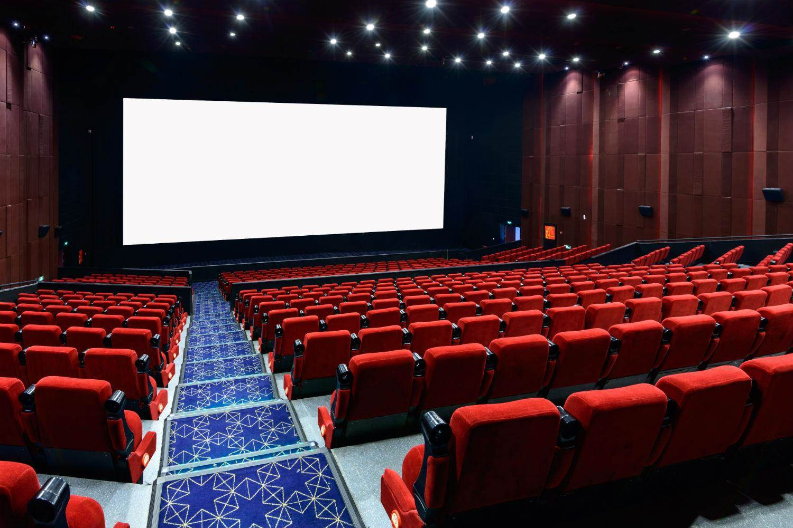
Theatre

Slide 8

Theatre

Slide 9
Performance Practices: Module Aims
To introduce key analytical and critical concepts of performance in a contemporary context.
Encourage the development of communication skills and promote critical thinking.
Equip students with the subject-specific terminologies, knowledge and skills necessary for carrying out analysis in theatre and performance.

Slide 10
Learning Outcomes
identify and discuss the main ideas and critical points in the development of performance during the 20th Century;
define and describe critically the key discourses and theories – including roles and opportunities- in contemporary performance;
communicate an analytical response to theories of live performance in context.

Slide 11
Assessment
Students will be assessed on their ability to analyse and apply recognised theatre styles and practitioners to current contemporary performance situations. This will be explored using both academic and practical assessment methods.
Coursework (2000 words) – 50%
Exemplar
A critical reflection and analysis of the styles of performance discussed during the module. Coursework should include evidence of reading, research, practical investigation and reflection upon individual development.

Slide 12
Assessment
Practical (10 minutes) – 50%
Exemplar
Produce a performative lecture demonstrating two contrasting forms of performance from the period studied.
Full brief and discussion tomorrow.

Slide 13
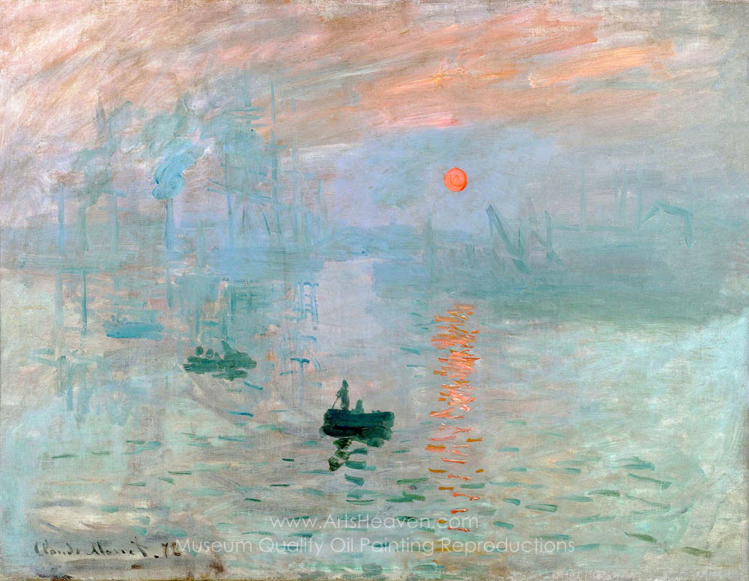
The Beginning…
Notes:
Monet: Impression, Sunrise 1872

Slide 14
The Beginning…
Narrative is the soul of drama…

Slide 15
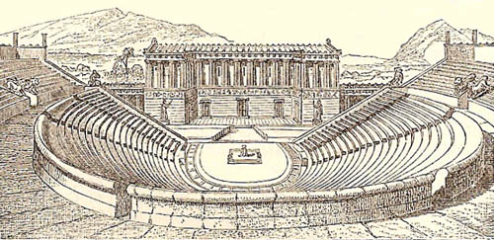
What do we know about Greek theatre?

Slide 16
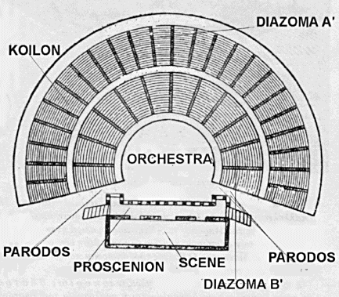
What do we know about Greek theatre?

Slide 17
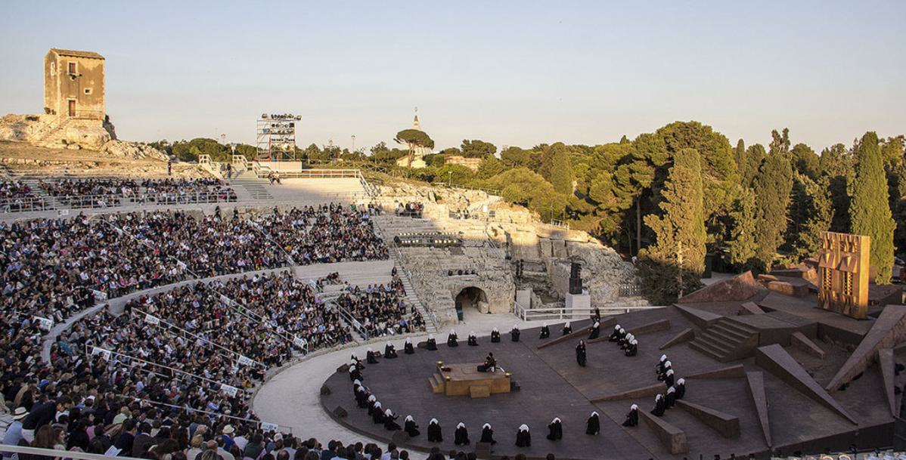
What do we know about Greek theatre?

Slide 18
What do we know about Greek theatre?
Less than we actually think.

Slide 19
What do we know about Greek theatre?
Less than we actually think.
Who watched theatre?

Slide 20
What do we know about Greek theatre?
Less than we actually think.
Who watched theatre?
When was theatre presented?

Slide 21
What do we know about Greek theatre?
Less than we actually think.
Who watched theatre?
When was theatre presented?
What was it for?

Slide 22
Some words:
Theatr(e) – Greek – literally ‘to see or watch’
Drama – Greek – literally ‘to do’ / action/ deed
Stage – separates actors from spectators
Festival – Times when no work is done, can include processions, dancing, drink and general merriment. (Taylor, 2004:1-5)

Slide 23
Dionysus
God of wine, revelry, goats, fertility, wild nature, disguise, illusion, transformation.
Had four large festivals attributed to him:
Anthesteria (Jan-Feb)
Lenaia (January-ish)
Country or Rural Dionysia (December-ish)
Great Dionysia (end of March)
(and many smaller local ones)

Slide 24
And how is he connected to theatre?
The woman followers of Dionysus – Bacchants and Maenads - would desert their homes and go on a revel in the mountains which had an orgiastic ending, where masks may be worn and the revelers ate raw meat.
By eating the meat they ‘transformed’ into someone else – essentially not themselves, and so Dionysus became associated with the transformation. (Taylor, 2004:7)

Slide 25
What else do we know?
Comedies – to make you laugh.
Tragedies – not what we think ‘goat-song’.
…but of course to include human suffering and audience catharsis. Popular and competitive.
Satyr Plays – very little known – rude.

Slide 26
What do we know about Greek theatre?
‘We can only understand what Greek theatre was like in the past by looking through the eyes of the present. Conversely, our view of the present is shaped by the past, thanks to assumptions about ‘theatre’ that we have inherited.’
(Wiles, 2010:179)

Slide 27
What do we know about Greek theatre?
Can a Greek theatre performance be ‘authentic’?
‘What seems authentic to one generation seems stilted, ill-researched and irrelevant to the next’

Slide 28
What do we know about Greek theatre?
Who watched theatre?
When was theatre presented?
What was it for?

Slide 29
‘Theatre was seen as the total art form which ‘harmonizes all the faculties of man, Poetry, Music, Dancing, Acting, Architecture, Painting, Sculpture.’ (Wiles, 2010:183)

Slide 30
‘…Greek theatre required the right social relationships as well as the right spatial relationships.’ (Wiles, 2010:188)

Slide 31
Discussing a 1927 production of Prometheus at Delphi by Eva Palmer-Sikelianos:
‘The goal of recreating the past for its own sake is doomed to failure; the only useful and intellectually valid activity is to create a performance that engages an audience in the present.’ (ibid)

Slide 32
Performance context
A director may attempt to ‘assert his or her dominant role in the creative process by setting up a dialogue between some well known text and a new directorial interpretation.’ (Wiles, 2010:190)

Slide 33
Electra (for 80’s director Vitez) allowed him to support Brechtian ideas such as ‘it is impossible to be moral in an immoral society’ in production.
Because of the seemingly continual cycle of death Electra was ‘devoid of any emotional resolution or moral statement.’ (Wiles, 2010:191)

Slide 34
The interest of the director of the 1986 production of Electra – Vitez- ‘had shifted …from the gap between past and present to the active processes of remembering the past and reconstituting it in the imagination.’
(Wiles, 2010:193)

Slide 35
Txt me!
Translation
We would not have access to many significant works of theatrical importance without translation.
Can translation ever be absolutely correct?

Slide 36
Txt me!
Peter Brook:
‘..the translation of a foreign text into another language is far from being a last resort. It is not the necessary evil claimed by those who stress the inevitability of loss. Translation is an opportunity, the chance to establish a live contact with a work that has become unapproachable in its original tongue.’ (Wiles, 2010:196)

Slide 37
Txt me!
A definition to put things into a context:
When you fit the play to the audience, you are making an adaptation. When you transport an audience into the play, you are translating. (para:ibid)

Slide 38
Great perspective!
‘No amount of dictionaries or grammar books will teach you how plays communicate in the theatre. There are other skills besides language relevant to understanding Greek drama.’
(Wiles, 2010:197)

Slide 39
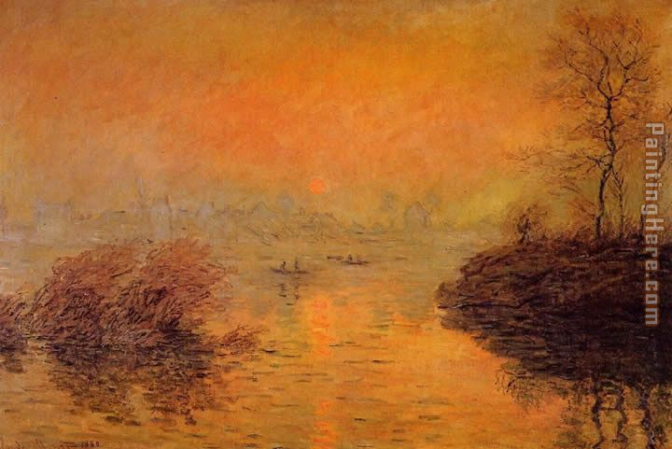
Notes:
Sunset on the Seine, Monet 1880

Slide 40
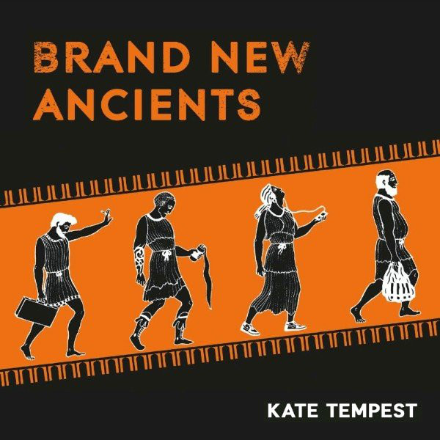
Greek reinvention - Kate Tempest

Slide 41
Greek reinvention - Kate Tempest
https://www.youtube.com/watch?v=JLWlB3ib7ZM
‘There's a moment halfway through Tempest’s spoken-word theatre show when the gloom intensifies and the vaulted ceiling is lit up by the glow from the streetlights outside, pouring in through squares cut in the blacked-out window…’

Slide 42
Greek reinvention - Kate Tempest
‘..Suddenly it feels as if we are not in a theatre but a church, not in a Victorian debating chamber but gathered around a hearth, hearing the age-old stories that help us make sense of our lives. We're given the sense that what we are watching is something sacred.’
https://www.theguardian.com/stage/2012/sep/10/brand-new-ancients-review

Slide 43
Text

Slide 44
Text

Slide 45
Text

Slide 46
Text

Slide 47
Text
What is a text?
A text is something that can be involved in discourse, or is inscribed with the means to order experiences (Leach,2000:19).
Theatre text is unstable as many signs and symbols happen at once.

Slide 48
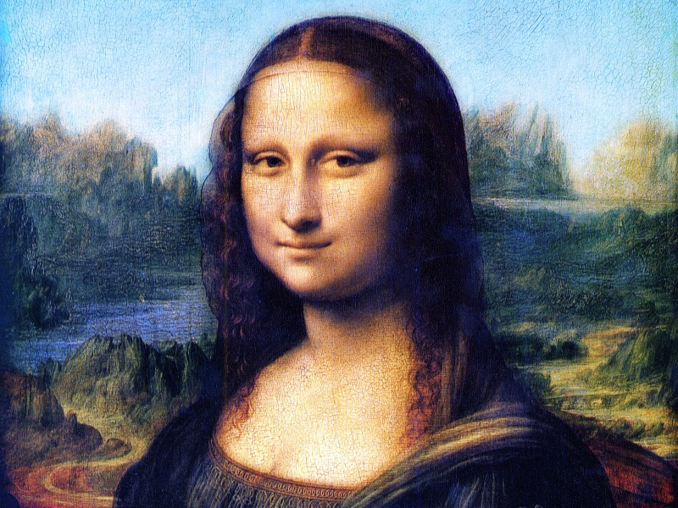

Slide 49
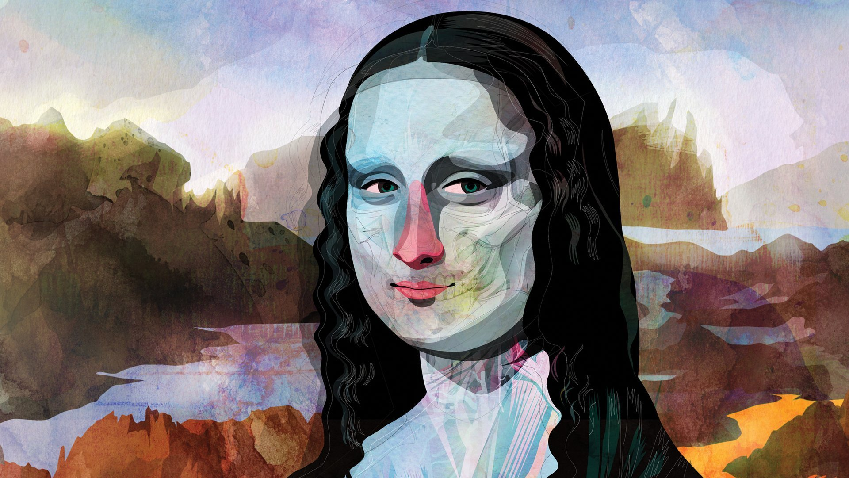

Slide 50
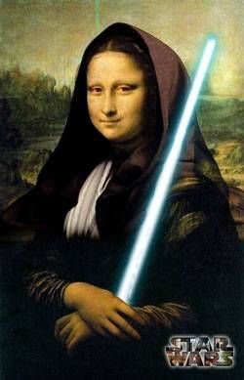

Slide 51
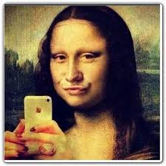

Slide 52
Text
Creating a text means inscribing meaning – and there’s politics and powers in this process.
‘Creating a text may be a bid for authority, but meaning only happens in the process of communicating, the series of image produced by the text only acquire significance when the spectator reacts to them.’ (Leach, 2000:19)

Slide 53
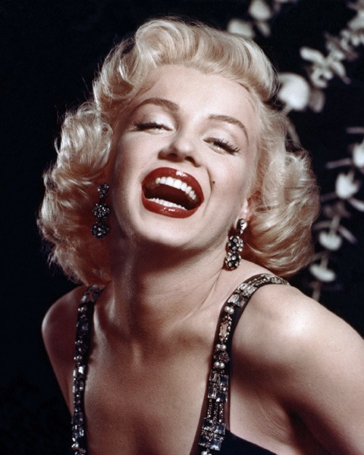

Slide 54
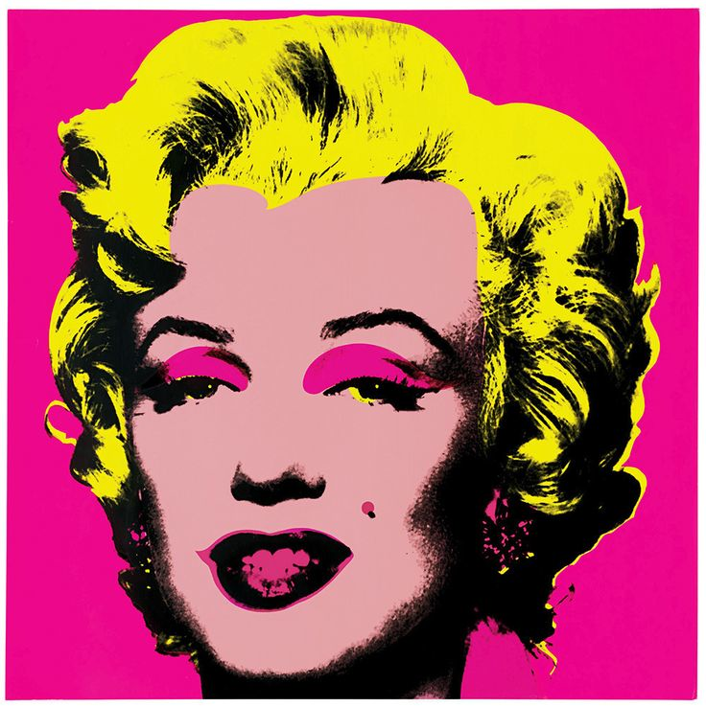

Slide 55


Slide 56
Text
Dramatic text exists as a written ‘thing’ and as a performance according to Leach. The performer ‘intervenes between the two’ (Ibid).
This is the unstable part – the re-enactment is subject to many different features of theatrical production.
What are these?

Slide 57
List as Text
Name some of the elements that can be perceived as text in theatre.
These can be aspects that add or frame the performative act with some kind of meaning.

Slide 58
List as Text
Lighting sound video set costume music mics
Actors dancers singers chorus performers
Language writing current ancient old
Familiar strange contemporary traditional
Rake traverse proscenium laboratory site
Round outdoor livestreamed durational
Style ethnicity improv script performance art
Cost location seated standing immersive

Slide 59
List as Text
Lighting sound video set costume music mics
Actors dancers singers chorus performers
Language writing current ancient old
Familiar strange contemporary traditional
Rake traverse proscenium laboratory site
Round outdoor livestreamed durational
Style ethnicity improv script performance art
Cost location seated standing immersive
I could go on…

Slide 60
Affect
Consider how a theatrical performance has affected you?
What is the difference between affect and effect?

Slide 61
What's the difference?
The main use of 'affect' - with an 'a' - is as a verb meaning to have an influence. So you could say: 'Your emotional state affects how you remember things'.
The word with an 'e' - effect - is usually used as a noun and it means the result of an influence. So: 'What effect will the new law have on road use?'
Part of the problem, you see, is not only that these two words are spelt very similarly, often pronounced the same, but their meanings are also very similar - one's a noun, one's a verb.
There is a rarer and more formal use of 'effect' as a verb - that's the one with the 'e' - meaning 'to make something happen'. So you could say: 'It is pointless to try and effect a chance in policy now'.
Notes:
http://www.bbc.co.uk/worldservice/learningenglish/radio/specials/1535_questionanswer/page37.shtml

Slide 62
Read a drama
Everybody needs to read. Full stop.
Please read a drama by Monday – I will need the titles by tomorrow. As a suggestion, it should come from the 20th or 21st century.
Consider the themes, period of drama, period and location of writing, connection to content.

Slide 63
Bibliography
Taylor, D. 2004. The Greek and Roman Stage. Bristol Classical Press: London.
Wiles, D. 2010. Greek Theatre Performance: An Introduction. Cambridge University Press: Cambridge
https://www.youtube.com/watch?v=JLWlB3ib7ZM Accessed 30/01/18
https://www.theguardian.com/stage/2012/sep/10/brand-new-ancients-review Accessed 30/01/18

Slide 64
Bibliography
https://www.pinterest.com/explore/marilyn-monroe-artwork/
http://www.juularts.com/B09_March20_25th_2011.html
https://www.allure.com/story/marilyn-monroe-beauty-routine
Leach, R. 2008. Theatre Studies: The Basics. Routledge: London.
https://www.theatlantic.com/magazine/archive/2017/11/leonardo-da-vinci-mona-lisa-smile/540636/
http://www.wallpaper.ge/view-mona_lisa-800x600.html
https://www.pinterest.com/teachkidsart/mona-lisa/
https://www.flickr.com/photos/xclusiveballer/9459226538

