Slide 1
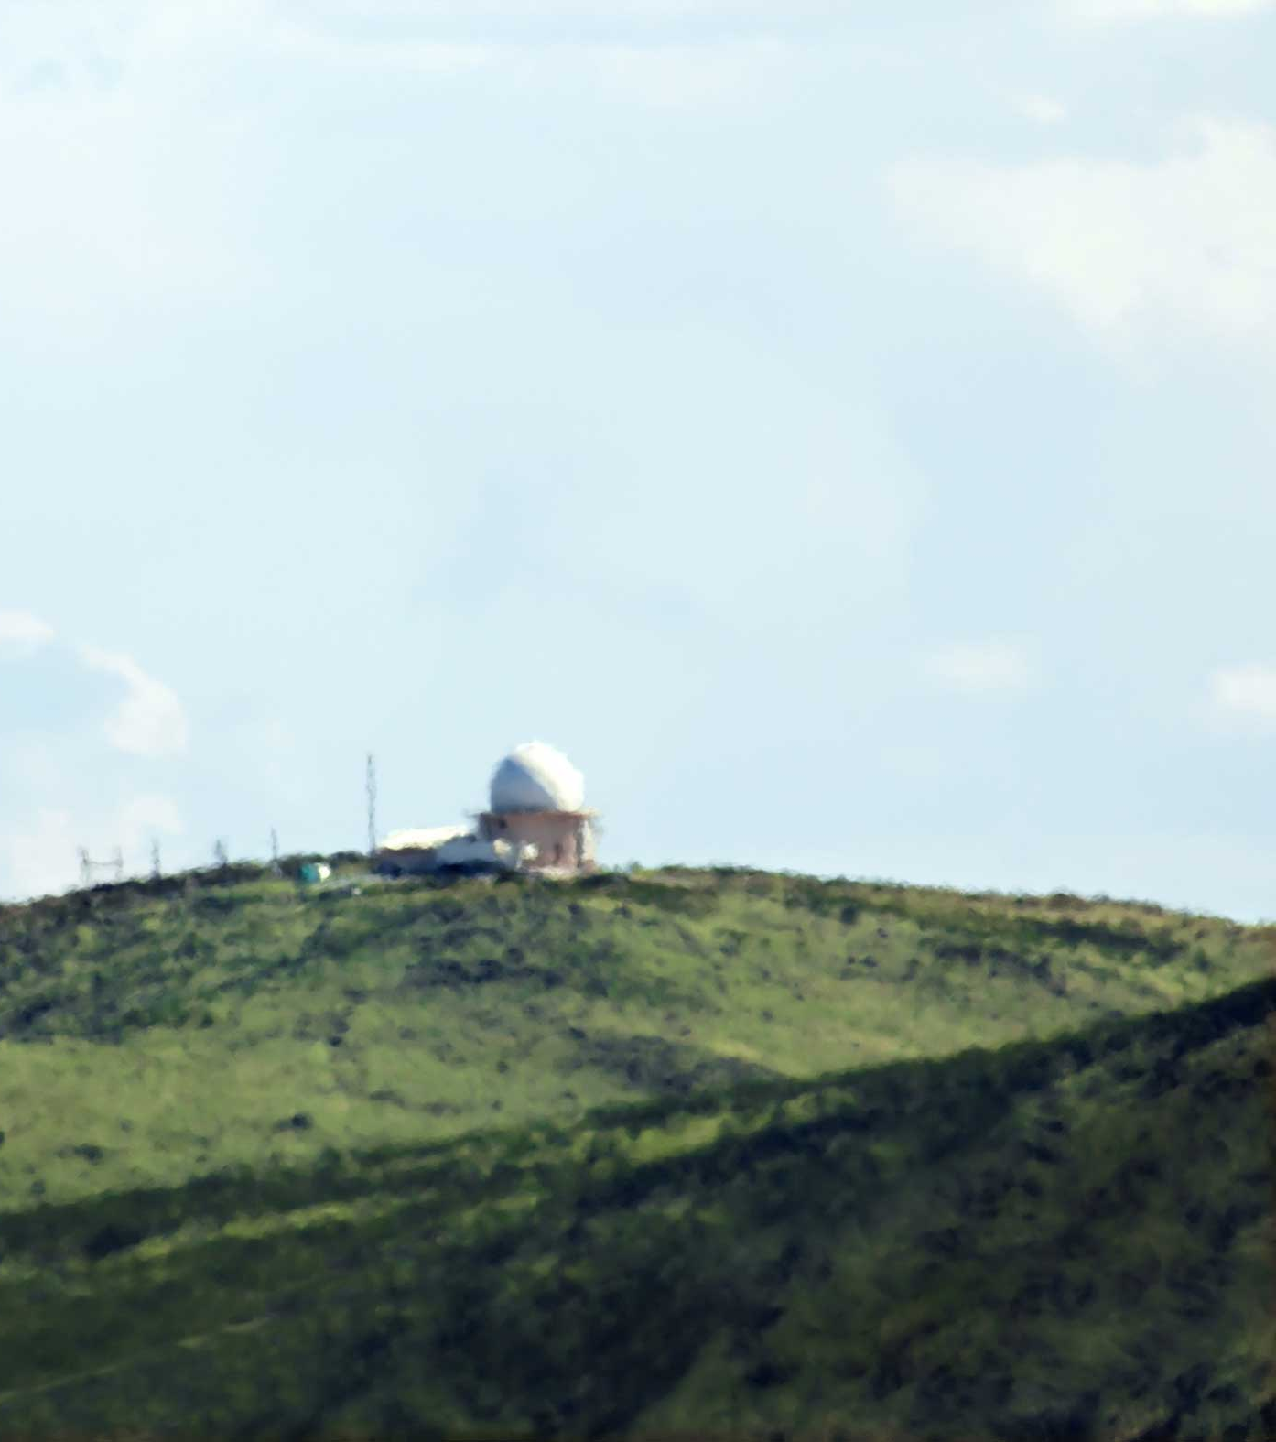
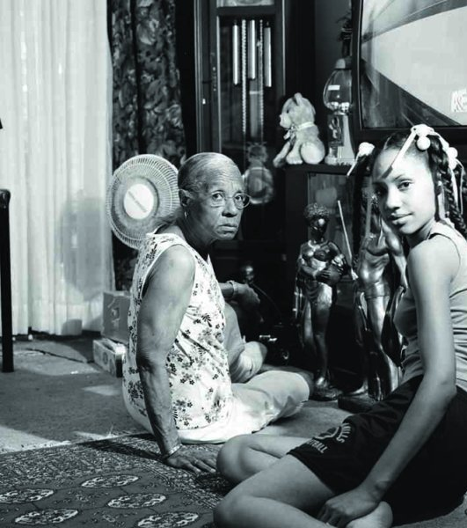
ARTWORK STUDY
SEMINAR

Slide 2
Tips
Task
Complete the following slides.
Start by recapping the seminar using your notes.
What did you contribute to the discussion?
What did you learn?
Use your notes and information learned from the seminar to complete your full artwork study.
Avoid unnecessary facts- this isn’t a biography of the artist.
Organise your writing. Make notes, then draft and rearrange your work.
Don’t include this slide

Slide 3
Context - definition
100-300 recapping the seminar.
Assess your contribution and what you learned. Include your notes on the following:
Start by using the descriptive words to describe the image – justify it by discussing content and composition. How did others describe it, do you agree or disagree.
What visible contexts do you uncover as a group. How did the content and composition make people read the image.
What research did people share and how did these invisible contexts impact the image?
Knowing this, what do you think about it and how do you connect with it? Have you “killed the author”?
How has the way it’s been made and/or displayed impacted how we read it/what it means.
Include either Paglen’s or Frazier’s image

Slide 4
Title. Author. Year.
Include either Paglen’s or Frazier’s image
Now, using these notes complete your artwork study for this image. Rather than repeat your notes from the previous slide, format your notes into powerful paragraphs!
Connect content and composition with visible contexts. Try to write at least 2 of the following.
Introduce research which you’ve completed including quotes which help to explain:
The visible contexts
The invisible contexts
Your relationship to the image – your personal contexts.
The contexts created by their methods and presentation .
Reminders:
Avoid unnecessary facts- this isn’t a biography of the artist.

Slide 5
Title. Author. Year.
Include a photograph of your choosing from one of our usual sources:
British Journal Of Photography
Huck Magazine
1000 Words Magazine
Lensculture
ArtDoc
* Optional you can use this slide to complete a second, independent study as practice. You can choose either to submit for your Task 1.
Now, using these notes complete your artwork study for this image. Rather than repeat your notes from the previous slide, format your notes into powerful paragraphs!
Connect content and composition with visible contexts. Try to write at least 2 of the following.
Introduce research which you’ve completed including quotes which help to explain:
The visible contexts
The invisible contexts
Your relationship to the image – your personal contexts.
The contexts created by their methods and presentation .
Reminders:
Avoid unnecessary facts- this isn’t a biography of the artist.

