Slide 1

‘The question is not, can they reason, nor can they talk, but can they suffer’
Bentham’s quote in relation to equality of animals today

Slide 2
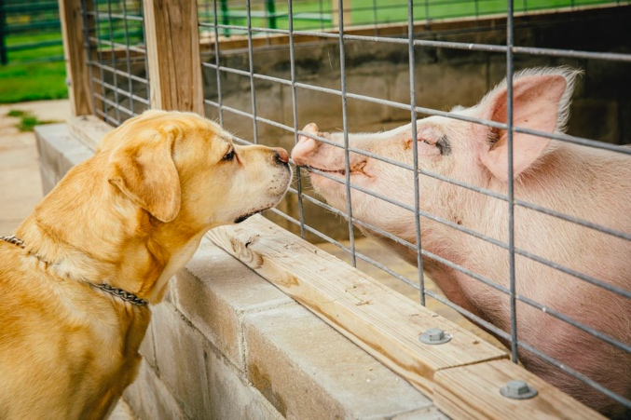
‘The question is not, can they reason, nor can they talk, but can they suffer’
Singer, Equality cannot be applied to animals however equal consideration can.
The study of behaviourism and biology
(Image 1)

Slide 3
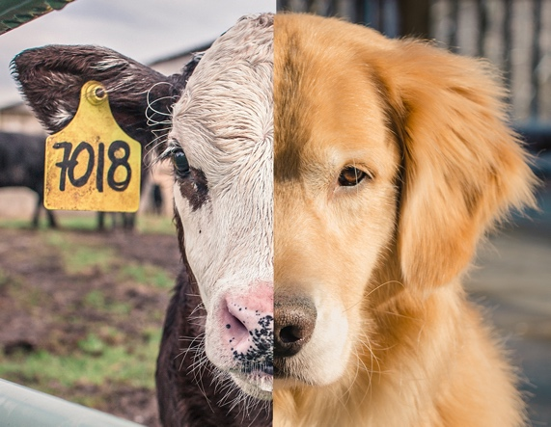
‘Why should the law refuse its protection to any sensitive being?’
(Image 2)
The Animal Welfare (Sentience) Act passed in 2022
Uses words such as ‘consider’ in their welfare plan
Institutionalised speciesism
How carnism and the Meat Paradox help the factory
Farming and speciesism agender

Slide 4
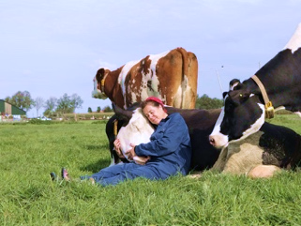
’The time will come when humanity will extend its mantle over everything which breathes’
(Image 3)

Slide 5

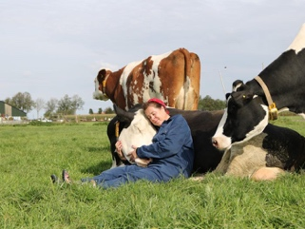
References
Photos used
Aaltola, Elisa, The Meat Paradox, Ominvore’s Akrasia, And Animal Ethics, 2019,
https://www.ncbi.nlm.nih.gov/pmc/articles/PMC6940846/ <Accessed on 8.11.2022>
Beyond Carnism, What Is Carnism?, https://carnism.org/carnism/ <Accessed on 8.11.2022>
Budiansky, Stephen, If A Lion Could Talk, Animal Intelligence And The Evolution Of Consciousness, 1998,
Humphreys, Rebekah, Animal Thoughts On Factory Farms: Micheal Leahy, Language And Awareness Of Death, Between The Species, Issue VIII, (2008), PP. 2-3, www.cla.calpoly.edu/bts/, <accessed on 4.11.2022>
Jeremy Bentham, On The Suffering Of Non-Human Animals, https://www.utilitarianism.com/jeremybentham.html, <accessed on 9.11.2022>
Policy Paper Action Plan For Animal Welfare, 2021,
https://www.gov.uk/government/publications/action-plan-for-animal-welfare/action-plan-for-animal-welfare#farm-animals <Accessed on 8.11.2022>
Riley, Sophie, Brighton V Will: The Legal Chasm Between Animal Welfare And Animal Suffering, Animals, 2020, PP. 3-4, P. 11, https://doi.org/10.3390/ani10091497 <Accessed on 2.11.2022>
Singer, Peter, Animal Liberation, 2ND ed., 1990, Ecco, New York, P.703.
Image 1: Vox, Pigs Are As Smart As Dogs. Why Do We Eat One And Love The Other? https://www.vox.com/21363401/pigs-dogs-smart-animal-intelligence <Accessed on 9.11.2022>
Image 2:
Wikipedia, Speciesism, https://upload.wikimedia.org/wikipedia/commons/3/3d/Speciesism.jpg <Accessed on 9.11.2022>
Image 3:
Insider, Cow Hugging Has Emerged As The Latest, Global Wellness Trend To Help Reduce Stress And Increase Positivity, Farmsurvial, https://www.insider.com/cow-hugging-becomes-the-latest-global-wellness-trend-2020-10 <Accessed on 9.11.2022>

