Slide 1


Sgiliau Ymchwil ac
Ymholi Uwch /
Advanced Research and Enquiry Skills
Sesiwn 2 / Session 2
Meddwl am eich cynnig ymchwil
Thinking about your research proposal

Slide 2
Sesiwn 2: Nodau / Session 2: Aims
Deall a chymhwyso'r tri chysyniad cyd gysylltiedig canlynol i'ch ymarfer a'ch ymholiad addysgegol eich hun:
Ymarfer Myfyriol
Adweithedd
Beirniadaeth
Ac i ddod yn gyfarwydd â gofynion cyfeirnodi academaidd.
To understand and apply the following three, interconnected concepts to your own practice and pedagogical enquiry:
Reflective Practice
Reflexivity
Criticality
And to become familiar with academic referencing requirements

Slide 3
Beth wyddon ni am ymarfer myfyriol?
What do we know about reflective practice?
“RP is about looking back at our practice, making sense of it, and using that learning to affect future practice”
(Ghaye, 2011)

Slide 4
BETH YW YMARFER MYFYRIOL?
What is reflective practice?
Themâu cyffredin o fewn y diffiniad hwn:
Bwriadol
Symbylir drwy gwestiynu
Cynnwys yr hunan
Ceir newid fel canlyniad
Proses gymhleth sy’n cynnwys y person cyfan
Common themes within definition:
Purposeful
Instigated through questioning
Include the self
Result in change
Complex process involving the whole person

Slide 5
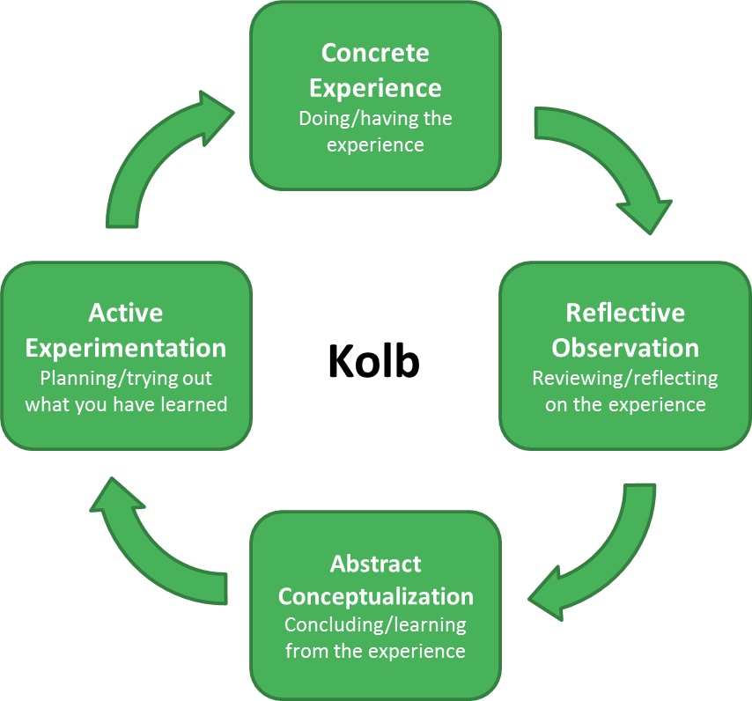
Sut mae Cylch Myfyriol Kolb yn perthyn i’ch meddylfryd a’ch ymchwil?
How does Kolb’s reflective relate to your refletions on research?

Slide 6
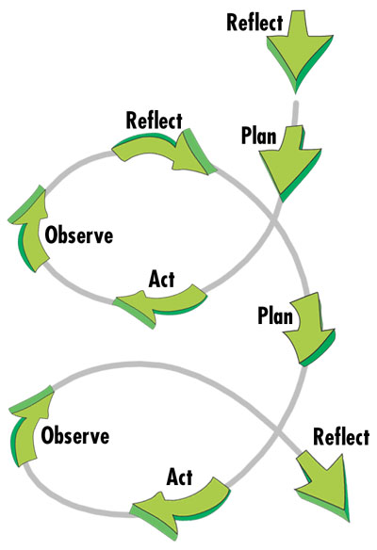
Cylch Ymchwil Weithredol
Action Research Cycle
Centre for Education Innovation, Hong Kong University
http://cei.ust.hk/teaching-resources/action-research
Notes:
Reflective Practice Cycle mimics the Action Research cycle:
Identifying an issue,
Taking time and space to think about that issue in some depth,
Considering an action that responds to the issue, and
Evaluating that response.
Starting again?
Welsh Gov NPEP Action Research Professional Enquiry ( page 17 ) https://hwb.gov.wales/api/storage/aeb2810d-f670-4718-87a1-299696ce5156/guide-to-undertaking-professional-enquiry.pdf
Welsh Version https://hwb.gov.wales/api/storage/92ad9966-0370-41f2-a19c-58e12f51f1cc/guide-to-undertaking-professional-enquiry-cy.pdf
ENQUIRY similar to Action research

Slide 7
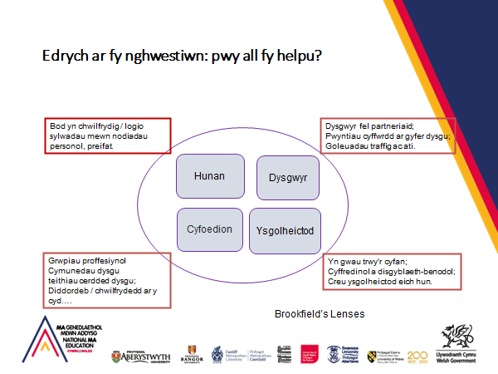

Slide 8
Exploring my question: who can help me?
Being curious/ logging noticings in personal, private notes.
Learners as partners;
Touch-points for learning;
Traffic lights etc.
Self
Learners
Peers
Scholarship
Professional groups
Communities of learning
Learning walks;
Collective nosiness /curiosity….
Weaves through whole;
Generic and discipline-specific;
Creating own scholarship.
Brookfield’s Lenses

Slide 9

Syniadau cychwynnol am ddatblygu eich cynnig ymchwil
Initial thoughts about developing your research proposal

Slide 10
Beth yw’r ‘garreg yn eich esgid?’
What is ‘the stone in your shoe?’
Y garreg yn eich esgid….
Rhywbeth sydd yn eich pryderu
Rhywbeth sydd yn eich diddori
Rhywbeth rydych wedi dechrau sylwi arno
Rhywbeth sydd werth yr ymdrech
The stone in the shoe….
Something that is bothering you
Something that is interesting you;
Something that you have begun to notice
Something you think is worthy of effort.
Baumfield, Hall and Wall (2013)

Slide 11
MC 1 - Meysydd allweddol i'w hystyried
CS 1 - Key areas for reflection
Beth yw’r dadleuon diweddar yn y maes Addysg ac a hoffech eu harchwilio ymhellach yn nghyd-destun eich ymarfer eich hunan?
Beth sydd gennych chi ddiddordeb mewn ymchwilio ac ydych chi’n gallu darganfod llenyddiaeth i gefnogi y maes hwn?
Ystyriwch mathau gwahanol o gwestiynau.
What are some of current debates in education and would you like to explore them in your own practice?
What are you interested in exploring and can you find literature to underpin the area?
Think about the different question types

Slide 12
MC 1 - Meysydd allweddol i'w hystyried
CS 1 - Key areas for reflection
Ystyriwch werth ymarfer myfyriol a sut y gall hyn gefnogi eich ymchwil. Mae modd i’r dyddlyfr myfyrio eich cynorthwyo gyda hyn.
Oes yna unrhyw ystyriaethau moesegol?
Ystyriwch eich sgiliau a’ch gwybodaeth chi ac beth allech chi gyfrannu i’r ymchwil.
The value of reflective practice and how this supports your research. The reflective journal can help with this.
Are there any ethical considerations?
Think about your own skills and knowledge and what you bring to the research.

Slide 13

Tasg / Task
Gwnewch restr o gwestiynau posib fel syniadau posib ar gyfer prosiect.
Make a list of the potential research questions for your project

Slide 14
O ymarfer myfyriol i ymarfer atblygol
From reflective to reflexive practice
Ymarfer atblygol/Reflexive practice:
“striving to be aware of the impact our actions might be having on others and on the systems in which we work … [and] recognising the external factors which constrain or shape our actions” (Door, 2015, p.13)

Slide 15
Adweithedd / Reflexivity …
Mae angen ymwybyddiaeth o’n…
Demands awareness of our:
Epistemoleg (ein safbwynt ar beth yw gwybodaeth)
Ontoleg (sut rydyn ni'n diffinio realiti)
Axioleg / moeseg (pa werthoedd sydd gennym ar addysg)
Epistemology (our position on what knowledge is)
Ontology (how we define reality)
Axiology / ethics (what values we hold on education)
(Door, 2015, p.13)

Slide 16
Gweithgaredd: Adweithedd
Activity - Reflexivity
Lluniwch ddiagram/map meddwl/ysgrifennwch restrau sy’n ateb y canlynol:
Pa ffactorau mewnol neu allanol sy'n effeithio ar eich ymarfer?
Sut gallai eich credoau a'ch gwerthoedd ddylanwadu ar eich ymarfer?
Sut ydych chi'n effeithio ar eich disgyblion, cydweithwyr, lleoliad?
Draw a diagram/mind map/write lists that answer the following:
What internal or external factors impact on your practice?
How might your beliefs and values influence your practice?
How do you impact on your pupils, colleagues, setting?

Slide 17
Adweithedd mewn ymchwil
Reflexivity in Research
Ymwybyddiaeth o ac ymateb i
y sylweddoliad bod safle’r ymchwilydd yn y maes yn dylanwadu ar y data y mae’n ei gynhyrchu a’i ddehongli
derbyniad beirniadol bod ymchwilwyr yn datblygu ‘dealltwriaethau’ nid ‘gwirioneddau’
(Alvesson & Skoldberg, 2000)
An awareness of and response to
the realisation that the researcher's position in the field influences the data that they generate and interpret
a critical acceptance that researchers develop ‘understandings’ not ‘truths’
(Alvesson & Skoldberg, 2000)

Slide 18
Adweithedd mewn ymchwil: esiampl
Cyfweliad gyda chyfranogwr => dadansoddiad => canfyddiadau
Beth oeddech chi'n ei feddwl / deimlo ar y pryd?
Cydnabod eich lleoliad: cefndir, tybiaethau, credoau, safbwynt (e.e. gwleidyddol, cymdeithasol, diwylliannol, crefyddol)
Pa ddylanwad y gallai hyn ei gael ar eich data? Dadansoddi? Canfyddiadau?
Ail-werthuso eich canfyddiadau
Pa fewnwelediad ydych chi wedi'i gael, am eich sefyllfa?
Bwydwch y mewnwelediad atblygol hwn yn ôl i'ch camau nesaf (1)

Slide 19
Reflexivity in research: example
Interview with participant => analysis => findings
What were you thinking / feeling at the time?
Acknowledge your positionality: background, assumptions, beliefs, standpoint (e.g. political, social, cultural, religious)
What influence might this have on your data? Analysis? Findings?
Re-evaluate your findings
What insight have you gained, about your position?
Feed this reflexive insight back into your next steps (1)

Slide 20
Beirniadaeth yw… / Criticality is…
Gofyn cwestiynau
A gofyn cwestiynau o'r cwestiynau hynny
Tueddiad i fynnu a chwestiynu tystiolaeth am bolisi ac ymarfer, gan ddefnyddio eich crebwyll a’ch sgiliau ymholi eich hun i gwestiynu’r ffordd y mae pethau, sut y cânt eu disgrifio a’u deall, a’r tybiaethau a wneir
Asking questions
And asking questions of those questions
A disposition to demand and interrogate evidence about policy and practice, using your own judgement and skills of enquiry to question the way things are, how they are described and understood, and the assumptions that are made
Notes:
Door, 2015:
Also useful books for critical writing:
Biggam, J. (2008). Succeeding with Your Master’s Dissertation: A practical step-by-step Handbook. London: Open University Press.
Wallace, M. and Wray, A., 2021. Critical reading and writing for postgraduates. Sage Publications Limited.

Slide 21
Saith Cwestiwn Beirniadol
(Door, 2015)
Ydw i'n meddwl yn weithredol am yr hyn rydw i'n ei ddarllen?
Ydw i mewn gwirionedd yn ystyried yr hyn y mae'r awdur yn ei ddweud, neu ydw i'n rhy brysur gyda fy syniadau fy hun?
Ydw i'n deall cyd-destun yr hyn rydw i'n ei ddarllen?
A yw'r darn ysgrifennu yn gydlynol? A yw'n gwneud synnwyr?
Sut mae'n cyd-fynd â'm profiad fy hun?
A yw safbwyntiau eraill wedi'u cynnwys?
Beth yw gwerthoedd yr awdur? Ydyn nhw'n eglur neu'n ymhlyg? Sut maen nhw'n gosod eu hunain fel addysgwr mewn perthynas â dysgwyr?

Slide 22
Seven Critical Questions
(Door, 2015)
Am I thinking actively about what I read?
Am I actually taking on board what the writer is saying, or am I too busy with my own ideas?
Do I understand the context of what I am reading?
Is the piece of writing coherent? Does it make sense?
How does it fit my own experience?
Are other perspectives included?
What are the writer’s values? Are they explicit or implicit? How do they position themselves as an educator in relation to learners?

Slide 23
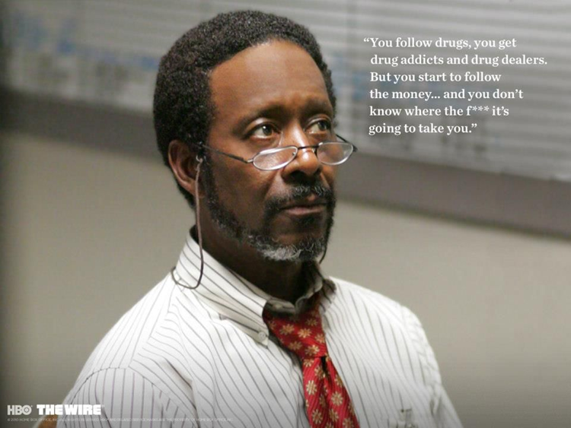
Cwestiwn rhif 8/Question number 8
(Alex, 2022)
8. Cui bono? (Pwy sy'n elwa?/Who benefits?)

Slide 24
Crynodeb
Mae ymchwil addysgol yn gofyn am gylchoedd o gynllunio, gweithredu a myfyrio
Dylai Ymarfer Myfyriol fod yn rhan o'ch ymyriadau, eich ymarfer a'ch ymchwil
Mae adweithedd yn cydnabod eich effaith ar yr ymchwil, a'r cyd-destun ehangach
Mae beirniadaeth yn dueddiad o gwestiynu myfyriol ac atblygol

Slide 25
Summary
Educational research requires cycles of planning, action, and reflection
Reflective Practice should be part of your interventions, practice, and research
Reflexivity is acknowledging your impact on the research, and the wider context
Criticality is a disposition of reflective and reflexive questioning

Slide 26
Cyfeirnodi mewn gwaith MA
Yn dangos ysgolheictod da ac yn caniatáu i eraill archwilio eich gwaith ymhellach
Peidiwch â chopïo’n uniongyrchol o destunau ysgrifenedig, gan gynnwys papurau ymchwil, gwefannau, blogiau, os nad ydych yn defnyddio dyfyniad uniongyrchol.
Nid yw aralleirio yn golygu newid un neu ddau o eiriau. Ysgrifennwch yn eich geiriau eich hun yr hyn y mae awdur neu ymchwilydd yn ei ddweud yn eich barn chi. Byddwch yn drylwyr yn y ffyrdd yr ydych yn dyfynnu syniadau pobl eraill. Mae rhaid defnyddio cyfeirnod bob tro.
Os ydych chi'n defnyddio dyfynbris uniongyrchol, rhaid i chi ddarparu'r awdur, y dyddiad a rhif y dudalen
Os byddwch yn cyflwyno aseiniad a'i bod yn ymddangos ei bod yn bosibl ei fod wedi'i ysgrifennu gan drydydd parti, gellir cyfeirio hyn hefyd at gamymddwyn academaidd.

Slide 27
Referencing for MA work
Shows good scholarship and allows others to explore your work further
Don’t copy directly from written texts, including research papers, websites, blogs unless you are creating a direct quote.
Paraphrasing does not involve changing one or two words. Write in your own words what you think an author or researcher is saying. Be rigorous in the ways you cite the ideas of others. Always add a citation.
If you use a direct quote, you must provide the author, date and page number
If you submit an assignment and it appears that maybe it has been written by a third party, this can also be referred to academic misconduct.

Slide 28
Cyfeirnodi / Referencing
Ystyriwch y gwahaniaeth rhwng y canlynol:
‘Mae Smith (2016) yn ychwanegu dimensiynau pellach at ddiben tybiannol addysg…’
‘Ni ellir lleihau pwrpas addysg yn yr oes fodern i gyflawni dangosyddion perfformiad syml (Smith, 2016).’
Consider the difference between the following:
‘Smith (2016) adds further dimensions to the notional purpose of education…’
‘The purpose of education in the modern age cannot be reduced to the fulfilment of simple performance indicators (Smith, 2016).’

Slide 29
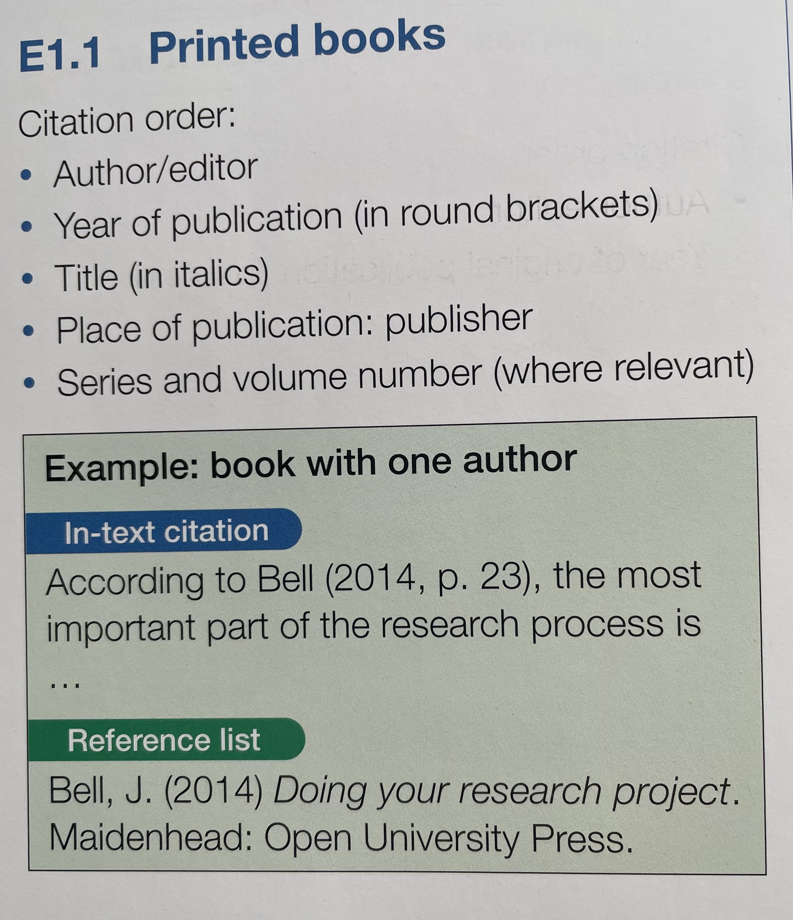
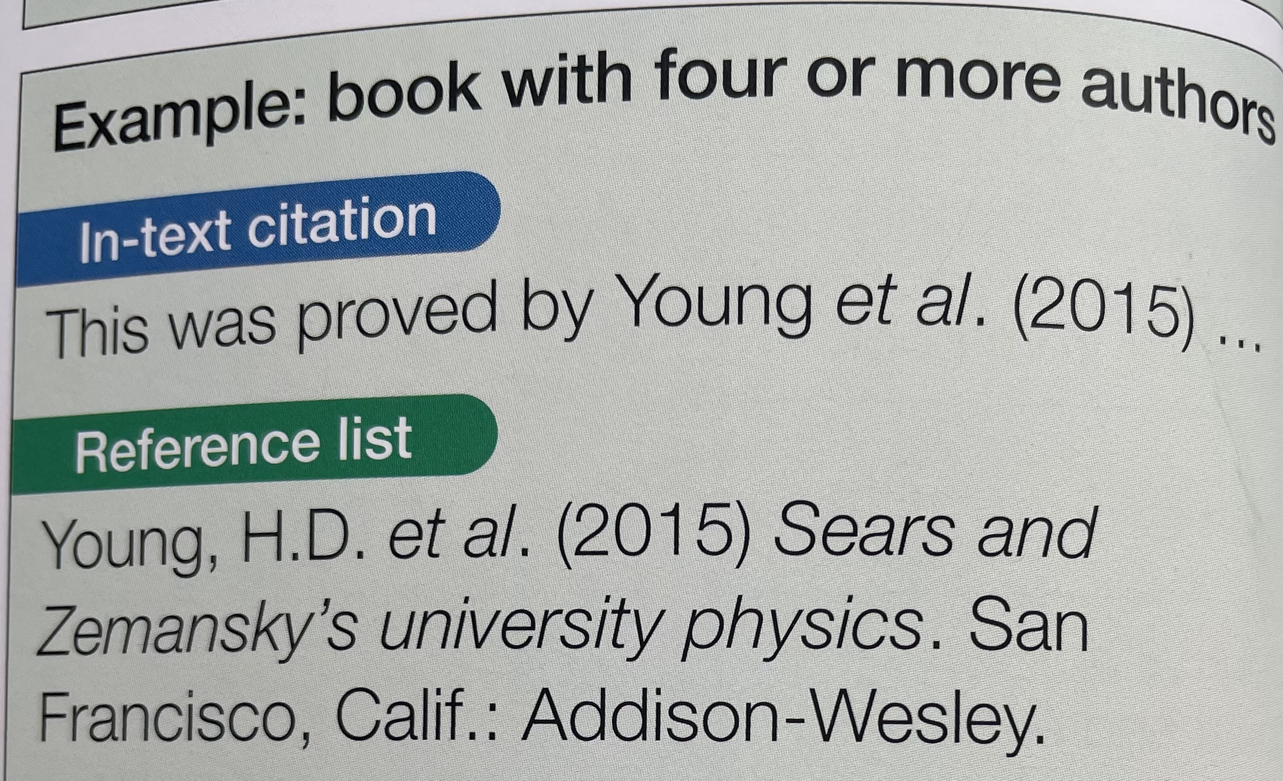
Cyfeirnodi: Enghreifftiau Harvard
Referencing: Harvard Examples
Pears, R. and Shields, G. (2022) Cite Them Right: The Essential Referencing Guide (Bloomsbury Study Skills), Palgrave, London p22
Notes:
Pears, R. and Shields, G. (2022) Cite Them Right: The Essential Referencing Guide (Bloomsbury Study Skills), Palgrave, London p22.
trinity https://uwtsd.ac.uk/media/uwtsd-website/content-assets/documents/library-and-learning-resources/infoskills/Harvard-eng_v.1.2.pdf

Slide 30

Cyfeirnodi / Referencing
Cyfeiriwch at ganllawiau addas ar gyfeirnodi yn null Harvard e.e. https://www.mendeley.com/guides/harvard-citation-guide/)
Cyfeiriwch hefyd at ganllawiau sefydliadol er mwyn gweld pa feddalwedd cyfeirnodi sydd ar gael.
Please refer to a suitable Harvard referencing guide (e.g. https://www.mendeley.com/guides/harvard-citation-guide/)
Please also refer to you institution guidelines to see what referencing software may be available to you.
Notes:
Useful textbook:
Pears, R. and Shields, G. (2022) Cite Them Right: The Essential Referencing Guide (Bloomsbury Study Skills), Palgrave, London
https://www.citethemrightonline.com/
https://www.citethemrightonline.com/

Slide 31
Darllen â Argymhellir / Recommended Reading
Alvesson, M., & Skoldberg, K. (2000). Reflexive Methodology: New Vistas for Qualitative Research. London, Thousand Oaks, CA and New Delhi: Sage.
Biggam, J. (2008). Succeeding with Your Master’s Dissertation: A practical step-by-step Handbook. London: Open University Press.
Bolton, G. (2006). Reflective practice: Writing and professional development. London: Sage.
Ewens, T. (2014) Reflective Primary Teaching. Northwich: Critical Publishing
Ghaye, T. (2011). Teaching and learning through reflective practice. London: David Fulton.
Kolb, D.A. (1984). Experiential learning: experience as the source of learning and development. Englewood Cliffs, NJ: Prentice Hall.
Pollard, A. (ed) (2014) Reading for Reflective Teaching in schools. London: Bloomsbury
Pears, R. and Shields, G. (2022) Cite Them Right: The Essential Referencing Guide (Bloomsbury Study Skills), Palgrave, London
Smith, R. A., Andrews, A., Oliver, C., Chambers-Evans, J. (2018) Putting Reflective Practice into action: A case study. Journal of Nursing Education and Practice. Vol 8 (10) 36-47.
Wallace, M. and Wray, A., 2021. Critical reading and writing for postgraduates. Sage Publications Limited.

Slide 32
Asesiad / Assessment
Mae’r asesiad crynodol ar gyfer y modiwl hwn yn gynnig ymholiad ymchwil o 4,000 o eiriau.
Mae'r meysydd a gwmpesir yn y modiwl yn cefnogi datblygiad y cynnig a datblygiad y traethawd hir sy'n ffurfio blwyddyn olaf y cwrs.
Dyddiad cyflwyno: diwedd Awst 2024 trwy Turnitin
The summative assessment for this module is a research enquiry proposal of 4,000 words.
The areas covered in the module support the development of the proposal and the development of the dissertation that forms the final year of the course.
Submission date: end August 2024 through Turnitin

Slide 33
Fframwaith Cynnig Ymchwil
TEITL
Dylai'r teitl roi arwydd clir o'ch dull ymchwil arfaethedig neu gwestiwn allweddol
CEFNDIR A RHESYMEG
Cefndir eich ymchwil arfaethedig
Adolygiad byr o lenyddiaeth
CWESTIWN(AU) YMCHWIL
Esboniad o'r cwestiynau i'w harchwilio a pham eu bod yn werth eu harchwilio
METHODOLEG YMCHWIL
Y dull ymchwil (fframwaith damcaniaethol)
Y dulliau ymchwil sy'n briodol ar gyfer yr ymchwil arfaethedig
Trafodaeth o fanteision yn ogystal â chyfyngiadau dulliau a dulliau penodol
CYNLLUN GWAITH AC AMSERLEN
Amlinelliad o'r camau amrywiol a'r llinellau amser cyfatebol ar gyfer datblygu a gweithredu'r ymchwil,
LLYFRYDDIAETH
Rhestr o gyfeiriadau at erthyglau a thestunau allweddol a drafodwyd yn eich cynnig ymchwil

Slide 34
Areas to be covered in the research proposal
TITLE
The title should give a clear indication of your proposed research approach or key question
BACKGROUND AND RATIONALE
The background of your proposed research
A short literature review
RESEARCH QUESTION(S)
An explanation of the questions to be explored and why they are worth exploring
RESEARCH METHODOLOGY
The research approach (theoretical framework)
The research methods appropriate for the proposed research
A discussion of advantages as well as limits of particular approaches and methods
PLAN OF WORK & TIME SCHEDULE
A outline of the various stages and corresponding time lines for developing and implementing the research,
BIBLIOGRAPHY
A list of references to key articles and texts discussed within your research proposal
Notes:
So a brief look at the ouline of the assessment/ Felly rhagolwg cyflym o ofynion yr aseiniad.
Basically you are planning an enquiry that will be undertaken as part of your dissertation module next year.

Slide 35
Cyn Ionawr 22ain / Before January 22nd
Gweithiwch trwy Llinyn Craidd 2 ar y modiwl SYYU yn y PLP
Ychwanegu wedi'i nodi i ardal y Cyfnodolyn ar gyfer CS 1 a 2 o fewn PLP
Work through Core Strand 2 on the ARES module in the PLP
Add noted to the Journal area for CS 1 and 2 within PLP

