Slide 1
Student name: Mabinty Kamara
Student ID: 2327089
Module Name: Digital Transformation in the Health and Care Professions
Module Code: (BMHP6026)
Lecture Name: Muhammed Khan
Component 2 Assessment

Slide 2
Table of Content
Introduction………………………………………………………………………………4
Innovation…………………………………………………………………………………5
Impact on Workforce………………………………………………………………...6
Workforce Critical Analysis…………………………………………………………7
Impact on Service Delivery…………………………………………………………8
Service Delivery Limitations……………………………………………………….9
Impact on patients…………………………………………………………...............10
Ethics and Law……………………………………………………………………..........11
Impact on community………………………………………………………….........12
Challenges of the innovation……………………………………………….........13
Recommendations……………………………………..........................................14
Conclusion……………………………………………………………………………........15
Referencs………………………………………………………………………………..........16

Slide 3
Use of AI Acknowledgement
I confirm that I have not used any AI tools in the research and creation of this assignment. I confirm that I have not presented any AI generated materials as my own work. I confirm I have copies of my drafts, notes, and other resources I used, which I may be asked to provide in evidence.

Slide 4
Introduction
Dementia is a progressive neurocognitive condition affecting memory, judgement and daily functioning. In the UK, around 900,000 people live with dementia, and this is expected to rise significantly (Alzheimer’s Society, 2023).
Wandering is a major risk, leading to missing-person incidents, injury and hospital admission (Robinson et al., 2019).
GPS tracking devices have been introduced as a digital safeguarding solution, allowing real-time location monitoring to improve safety while supporting independence.
This presentation critically evaluates their impact on the workforce, service delivery, patients and the wider community.

Slide 5

Innovation
GPS tracking devices are wearable technologies that provide real-time location data to carers and professionals.
They support:
Risk management and safeguarding
Independent living
Community-based care
This aligns with UK policy promoting ageing in place and digital transformation in health and social care (Department of Health and Social Care, 2022).

Slide 6
Impact on Workforce
GPS tracking shifts care from reactive to preventive approaches, reducing time spent on emergency searches (Robinson et al., 2019).
Positive impact:
Faster safeguarding response
Reduced physical workload
Improved monitoring
New responsibilities:
Data interpretation
Alert management
Consent documentation
Data protection awareness
Digital skills are increasingly essential in healthcare practice (NHS, 2019).

Slide 7


Workforce Critical Analysis
Although GPS reduces physical workload, it increases administrative and ethical responsibilities.
Staff must apply the Mental Capacity Act 2005 when making decisions
Increased documentation and accountability
Risk of over-reliance on technology (Niemeijer et al., 2015)
GPS provides data, but not emotional or psychological insight, meaning professional judgement remains essential (NHS, 2019).
This Photo by Unknown Author is licensed under CC BY
This Photo by Unknown Author is licensed under CC BY

Slide 8
Impact on Service Delivery
GPS supports preventive and community-based care by reducing crisis situations.
Benefits:
Fewer emergency call-outs
Reduced hospital admissions
Delayed institutionalisation (Howard et al., 2021)
Improved coordination between services
This aligns with UK health policy promoting integrated care systems (Department of Health and Social Care, 2022).

Slide 9

Service Delivery Limitations
Despite benefits, GPS has limitations:
Device failure and signal loss
Fragmentation between services
Reduced face-to-face monitoring
Inequality in access
Over-reliance on technology may reduce the quality of relational care (Niemeijer et al., 2015).
Notes:
Service Delivery Limitations GPS

Slide 10
Impact on patients
Positive:
Greater independence
Improved safety
Reduced family anxiety (Landau et al., 2018)
Negative:
Privacy concerns
Risk of surveillance
Confusion in advanced dementia
GPS can support quality of life but must be used carefully to maintain dignity (Landau et al., 2018).

Slide 11

Ethics and Law
Key legal and ethical considerations:
Human Rights Act 1998 → right to privacy
Mental Capacity Act 2005 → best-interest decisions
UK GDPR → protection of personal data
GPS may be considered restrictive when used without consent (Niemeijer et al., 2015).
This creates a key tension between autonomy and safeguarding.
Notes:
Ethics and Law

Slide 12
Impact on community
Benefits:
Reduced police involvement (NPCC, 2022)
Improved public safety
Increased family participation
Challenges:
Carer burden
Surveillance concerns
Unequal access across regions (Department of Health and Social Care, 2022)

Slide 13
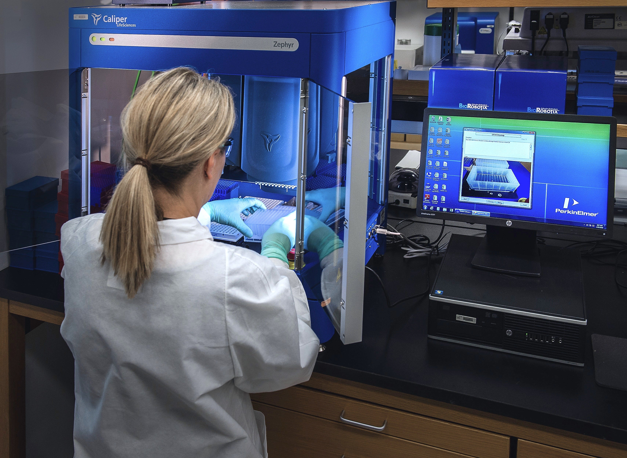
Challenges of the innovation
Data protection risks (UK GDPR, 2018)
Consent and capacity issues (Mental Capacity Act, 2005)
Technological limitations
Over-reliance on monitoring
Stigma and dignity concerns
Postcode lottery in access (Department of Health and Social Care, 2022)

Slide 14
Recommendations
Ethical frameworks aligned with MCA 2005
Workforce digital training (NHS, 2019)
Clear response protocols
Strong data governance (UK GDPR, 2018)
Person-centred implementation
Address digital inequality (Department of Health and Social Care, 2022)

Slide 15

Conclusion
GPS tracking devices improve safety, independence and service efficiency in dementia care.
However, they also raise ethical, legal and practical challenges, particularly around privacy and autonomy (Niemeijer et al., 2015).
Their effectiveness depends on:
Ethical use
Skilled workforce
Person-centred care
Technology should support care, not replace it.

Slide 16
References
Alzheimer’s Society (2023) Dementia UK: Update. London: Alzheimer’s Society
Department of Health and Social Care (2022) People at the Heart of Care: Adult Social Care Reform White Paper. London: DHSC.
Howard, R. et al. (2021) ‘Assistive technology and dementia care outcomes’, Age and Ageing, 50(3), pp. 789–795.
Human Rights Act 1998.
Landau, R., Werner, S. and Auslander, G. (2018) ‘Families’ and professional caregivers’ views of using advanced tracking technologies for people with dementia’, Qualitative Health Research, 28(3), pp. 459–469.
Mental Capacity Act 2005.
NHS (2019) The Topol Review: Preparing the Healthcare Workforce to Deliver the Digital Future. London: NHS England.
Niemeijer, A. et al. (2015) ‘Ethical considerations of surveillance technologies in dementia care’, Nursing Ethics, 22(3), pp. 307–320.
Robinson, L. et al. (2019) ‘Assistive technology for dementia: A systematic review’, International Journal of Geriatric Psychiatry, 34(4), pp. 510–523.
National Police Chiefs’ Council (2022) Missing Persons Data Report. London: NPCC.
UK GDPR (2018).

