Slide 1
The Importance of Outdoor Learning
Dafydd Rhys Lewis

Slide 2
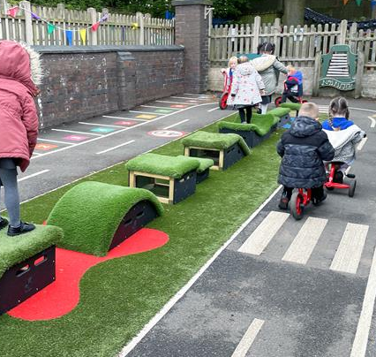

Rationale
Child-led
Teacher-led
Outdoor learning – play and adventures.
All foundation phase environments should promote outdoor learning.
However, there are limitations.
Shortages in funding, loss of green spaces, available time, weather and curriculum pressure.
Rivkin, 1995; BBC News, 2012; BBC News, 2016

Slide 3
Contents
Environments and Affordances:
- Observations with relevant research investigating strengths and limitations.
1
Inclusion of Nature:
- Observations with relevant research investigating strengths and limitations.
2
Development:
Physical
Academic
Social and Emotional
- Observations with relevant research investigating strengths and limitations.
3
Brief Conclusion with recommendations.
4

Slide 4
Environments and Affordances
Natural environemnt and designed areas which included an obstacle course, pirate ship, monkey bards
“it’s free and easy”
Play in the natural environemnt is the best form of learning.
Acar (2014)

Slide 5
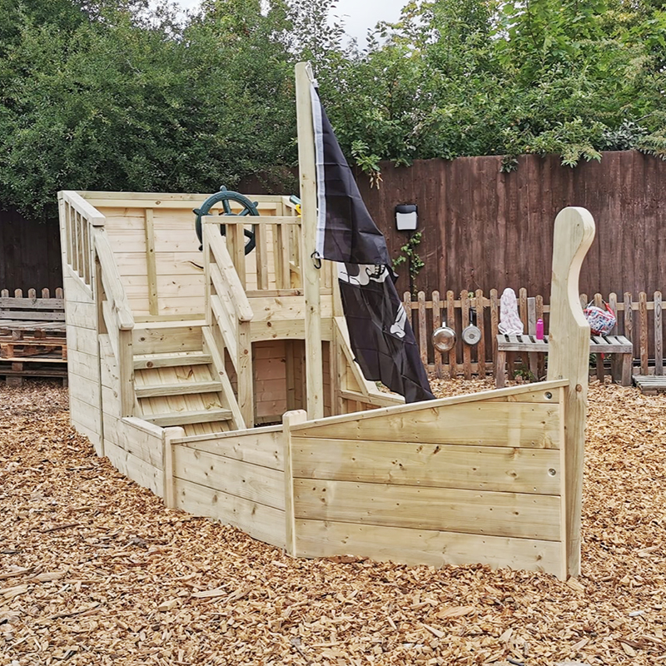
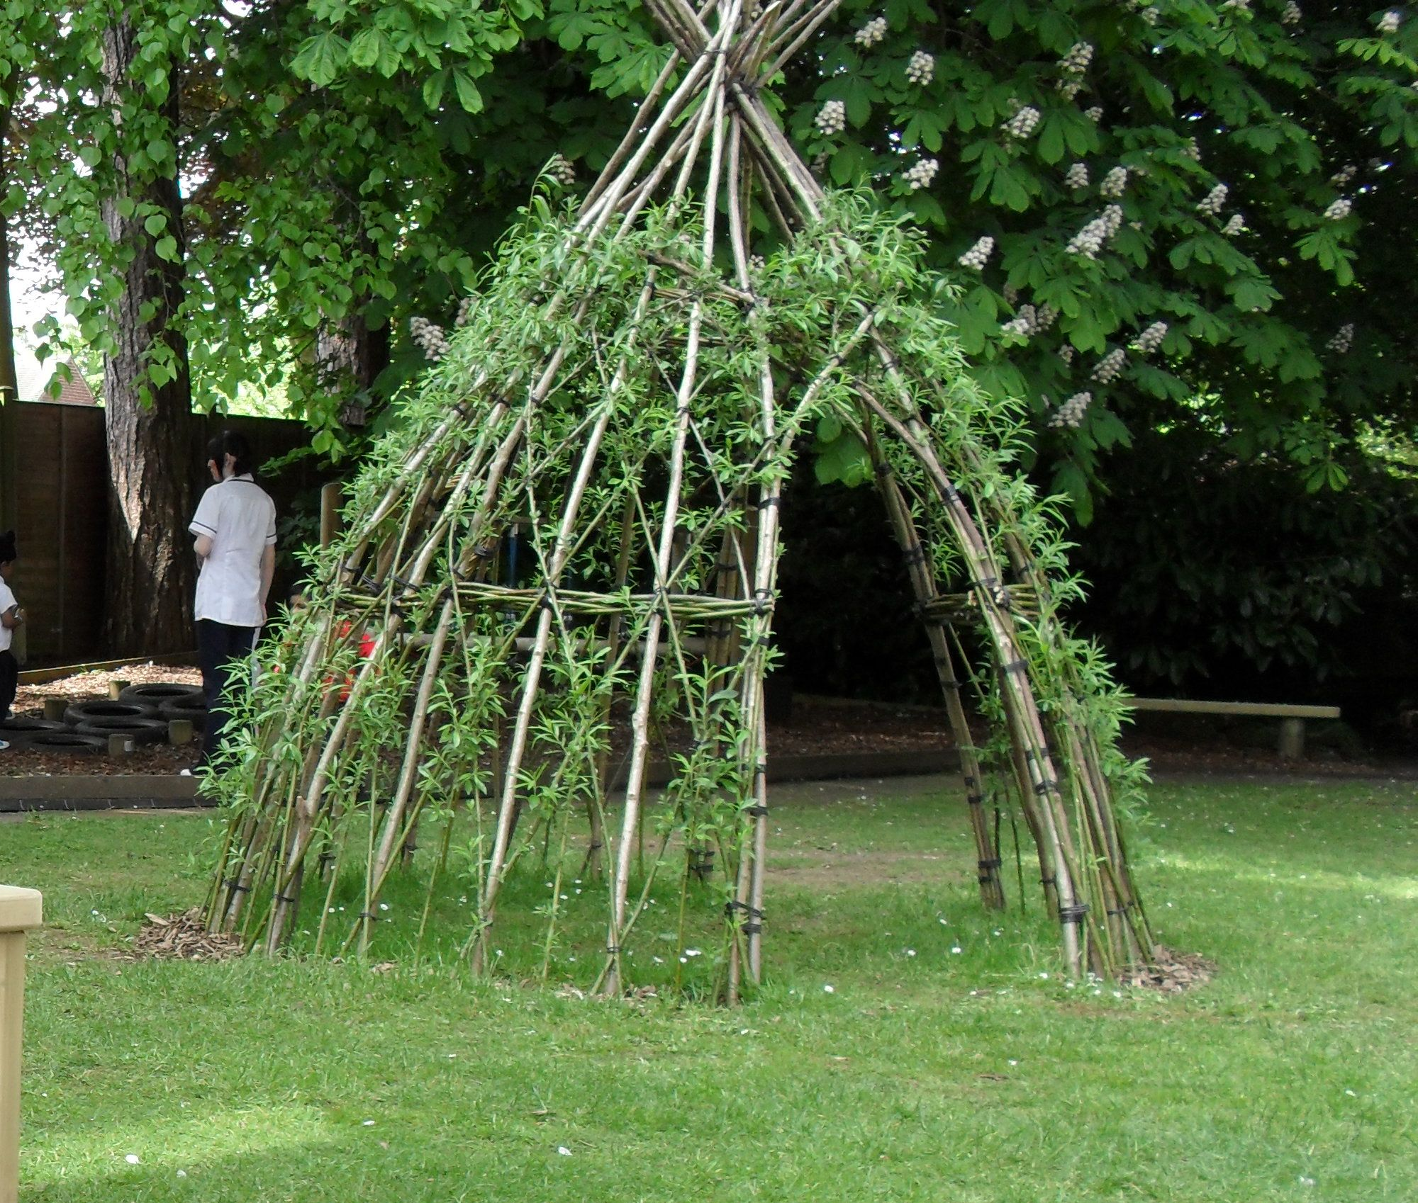
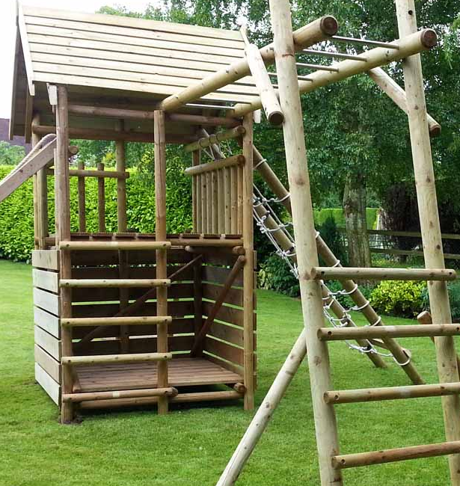
Environment and Affordances
Limitations:
Shortage of time
Shortage of resources
Lack of green space
Transportation Issues
Numerous opportunities in the outdoor environment.
However, must be a designed space > meaningful and useful.
Environments promote the learning.
Many schools have limited opportunities for outdoor learning experiences.
Acar (2014; Van Dijk-Wesselius et al., 2020).

Slide 6

Environment and Affordances
Cost of Outdoor Learning Areas:
Although School C stated it was “free”, research shows there are costs.
Design must be considered when evaluating outdoor learning.
Schools without outdoor environments have to travel = causing costs.
“free”
Acar (2014)

Slide 7

Inclusion of Nature
Clear connection of natural environments in both observations.
Sensory-rich environments.
Playing with leaves, jumping from boulders, imaginative play with natural affordances and more.
Outdoor learning CLEARLY influences a child’s connection to the natural world.
(Capaldi et al., 2014; Trost et al., 2015; Waite et al., 2016; Gelsthorpe, 2017)

Slide 8

Development
Long-term benefits
Confidence
Social-emotional Development
Healthier
Academic Achievement

Slide 9
Physical Development
Higher levels of physical activity.
Gross motor skills developed such as grabbing and catching.
Fundamental movement skills are developed through trial knowledge and experience.
These skills developed are used throughout their lifetime.
(Mygind, 2007; Acar, 2014; Jeon and Jun, 2021)

Slide 10

Academic Development
Long-term memory
Positive influence to academic achievement
Problem-solving skills
Creative Skills
(Mirrahimi et al., 2011; Nami et al., 2014; Rios and Brewer, 2014)

Slide 11
Social and Emotional Development
Social development was observed as children played in groups.
Outdoor learning develops social development at its core.
School C – clear correlation between outdoor learning experiences and social and emotional development.
Behavioural, personal and social development positively influenced.
(Higgins and Nicol, 2002; Maynard and Waters, 2007; Waite, 2009)

Slide 12
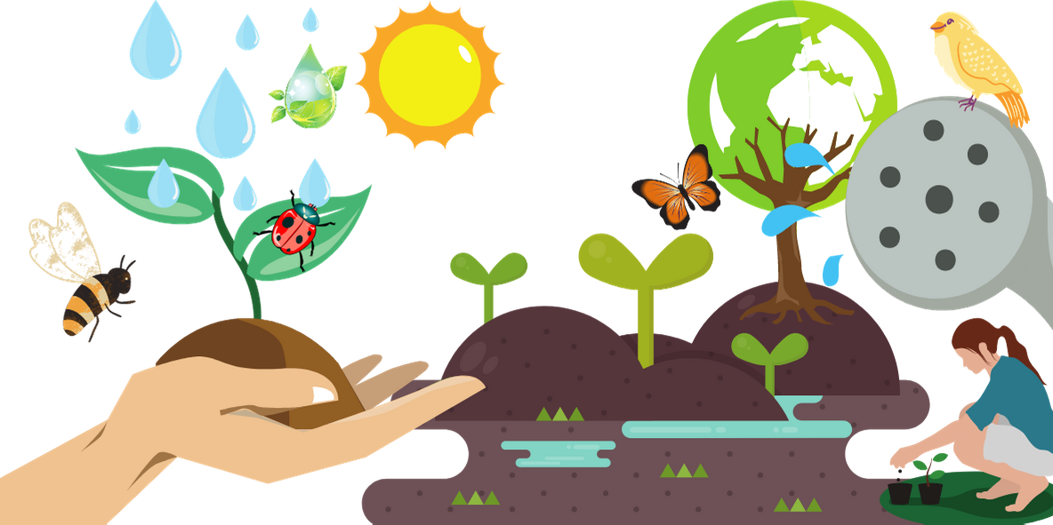
Conclusion
Clear similarities between both School A and School C.
Natural and designed areas.
Effective outdoor learning experiences.
Limitations are seen however opportunities outweigh the limitations.

Slide 13
References
Acar, H., (2014). Learning environments for children in outdoor spaces. Procedia-Social and Behavioral Sciences, 141, pp.846-853.
BBC News., (2012). ‘Does outdoor play help keep the doctor away?’. Available at https://www.bbc.co.uk/news/science-environment-16963807 [Accessed 24/01/23].
BBC News., (2016). ‘Outdoor learning boosts children’s development. Available at: https://www.bbc.co.uk/news/science-environment-36795912 [Accessed: 23/01/23].
Capaldi, C.A., Dopko, R.L. and Zelenski, J.M., (2014). The relationship between nature connectedness and happiness: a meta-analysis. Frontiers in Psychology, 5, p.976.
Froebel, F., (1886). The education of man (Vol. 5). A. Lovell & company.
Gelsthorpe, J., (2017). Disconnect from nature and its effect on health and well-being. Disconnect from Nature and Its Effect on Health and Well-Being.
Harvey, D.J., Montgomery, L.N., Harvey, H., Hall, F., Gange, A.C. and Watling, D., (2020). Psychological benefits of a biodiversity-focussed outdoor learning program for primary school children. Journal of Environmental Psychology, 67, p.101381.
Higgins, P. and Nicol, R., (2002). Outdoor learning in theory and practice. Outdoor Education, p.3.
Hunter, J., Syversen, K.B., Graves, C. and Bodensteiner, A., (2020). Balancing Outdoor Learning and Play: Adult Perspectives of Teacher Roles and Practice in an Outdoor Classroom. International Journal of Early Childhood Environmental Education, 7(2), pp.34-50.
Jeon, H. and Jun, S., (2021). Outdoor playground design criteria development for early childhood development: A delphi study from the perspective of fundamental movement skills and perceptual-motor skills. International Journal of Environmental Research and Public Health, 18(8), p.4159.
Maynard, T. and Waters, J., (2007). Learning in the outdoor environment: a missed opportunity?. Early years, 27(3), pp.255-265.
Mirrahimi, S., Tawil, N.M., Abdullah, N.A.G., Surat, M. and Usman, I.M.S., (2011). Developing conducive sustainable outdoor learning: The impact of natural environment on learning, social and emotional intelligence. Procedia Engineering, 20, pp.389-396.
Mygind, E., (2007). A comparison between children's physical activity levels at school and learning in an outdoor environment. Journal of Adventure Education & Outdoor Learning, 7(2), pp.161-176.
Nami, Y., Marsooli, H. and Ashouri, M., (2014). The relationship between creativity and academic achievement. Procedia-Social and Behavioral Sciences, 114, pp.36-39.
O'Brien, L., (2009). Learning outdoors: the Forest School approach. Education 3–13, 37(1), pp.45-60.
Rios, J.M. and Brewer, J., (2014). Outdoor education and science achievement. Applied Environmental Education & Communication, 13(4), pp.234-240.
Rivkin, M.S., (1995) The Great Outdoors: restoring children’s right to play outside. Washington, DC: National Association for the Education of Young Children.
Scottish Government,. (2010) Curriculum for excellence through outdoor learning. Available at https://education.gov.scot/Documents/cfe-through-outdoor-learning.pdf [Accessed: 24/01/23].
van Dijk-Wesselius, J.E., Van den Berg, A.E., Maas, J. and Hovinga, D., (2020). Green schoolyards as outdoor learning environments: Barriers and solutions as experienced by primary school teachers. Frontiers in Psychology, p.2919.
Waite, S., (2009), April. Outdoor learning for children aged 2–11: Perceived barriers, potential solutions. In Fourth international outdoor education research conference, La Trobe university, Beechworth, Victoria, Australia (Vol. 15, p. 18).
Waite, S., Goodenough, A., Norris, V. and Puttick, N., (2016). From little acorns..: environmental action as a source of well-being for schoolchildren. Pastoral Care in Education, 34(1), pp.43-61.
Yıldırım, G. and Akamca, G.Ö., (2017). The effect of outdoor learning activities on the development of preschool children. South African journal of education, 37(2).

