Slide 1

Internship and Volunteerism
Jessica Shore

Slide 2
What does Internship mean?
Why Work-Based Learning Matters
• Bridges academic study with real-world practice
• Helps students test career ideas and build professional identity
• Provides evidence of skills for future employers
• Enhances confidence, networks, and understanding of workplace culture
Key message: Work-based learning is not “just a job” — it is a structured learning experience.

Slide 3
Why is it important?
Internships and Career Development
Introduce students to:
• Career exploration: trying out roles, industries, and environments
• Skill development: communication, teamwork, problem-solving, digital literacy
• Professional identity formation: understanding who they are becoming as professionals
• Career capital: networks, references, portfolio evidence

Slide 4
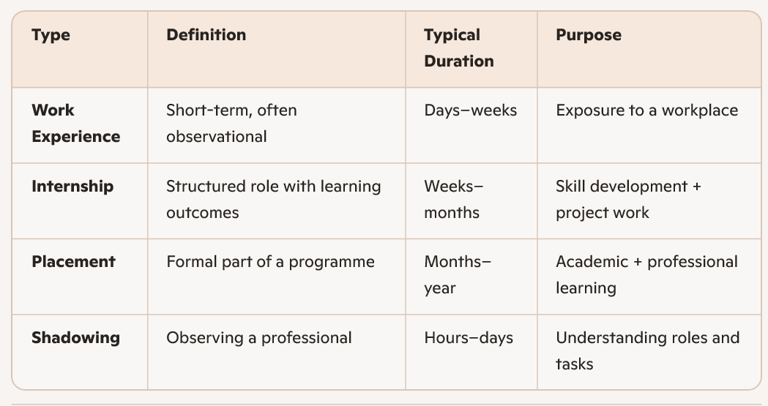
Types of WBL

Slide 5
Activity 1: “Career Development Mapping” (20 minutes)
Purpose: Help students connect internships to long-term career goals.
Instructions:
1. Students draw a simple timeline from now to 5 years post-graduation.
2. They add:
• Desired roles
• Skills needed
• Experiences required
3. In pairs, they discuss how internships or placements could support their progression.

Slide 6
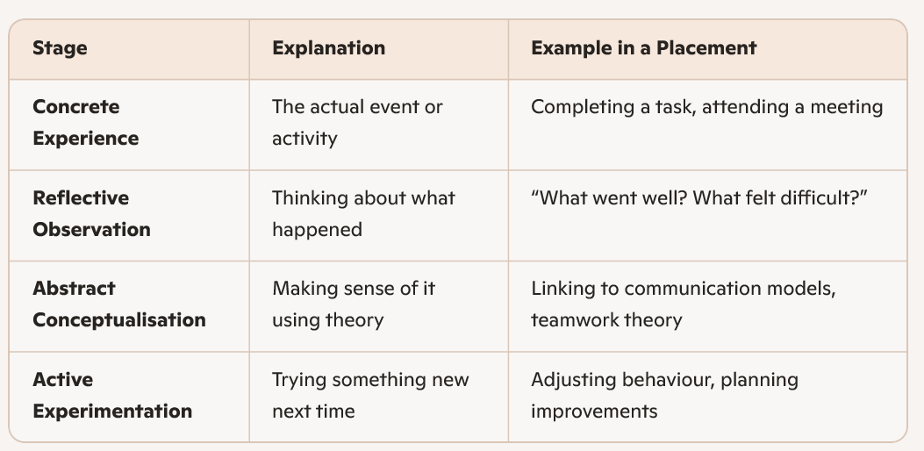
Kolb Cycle in Action
Learning is not the experience itself — it’s the reflection and adaptation that follow.

Slide 7
Activity 2
Each group take a scenario and apply it to Kolbs Cycle in action.
Scenario A: Feedback Challenge
You complete a task during your internship. Your supervisor says,
“It’s good, but you need to be more detailed next time.”
You felt confident before, but now you’re unsure what you did wrong.
Scenario B: Team Communication Issue
You’re working on a group project during placement.
Two team members disagree on how to proceed, and the atmosphere becomes tense.
Scenario C: Time Management Problem
You underestimated how long a task would take and missed a deadline.
Your manager asks you to explain what happened.
Scenario D: Shadowing a Professional
You shadow a senior staff member for a day.
You observe them handling a difficult customer with calm professionalism.

Slide 8
What are you being asked to do?
Find yourself a placement
Decide with your placement provider what your tasks and objective will be, then write assignment 1.
Complete all the relevant paperwork and placement forms
Participate in an internship post for a total of 90 hours before the final assignment date
Complete assignments 2 & 3

Slide 9
Activity
Using any experience you may have of a previous job, placement of volunteer post, consider your answers to the following questions.
1. What were you responsible for or what were you key tasks?
2. Why did you undertake the position/what was your motivation?
3. What did you learn from the experience?

Slide 10
Why are placements useful to University students?
Graduate positions are fiercely fought over
It gives students the opportunity to add practical experience to their academic achievements
It also allows students to ‘try before they buy’, try a completely different career path
Build a network of contacts
Show perspective employers what you can do.

Slide 11
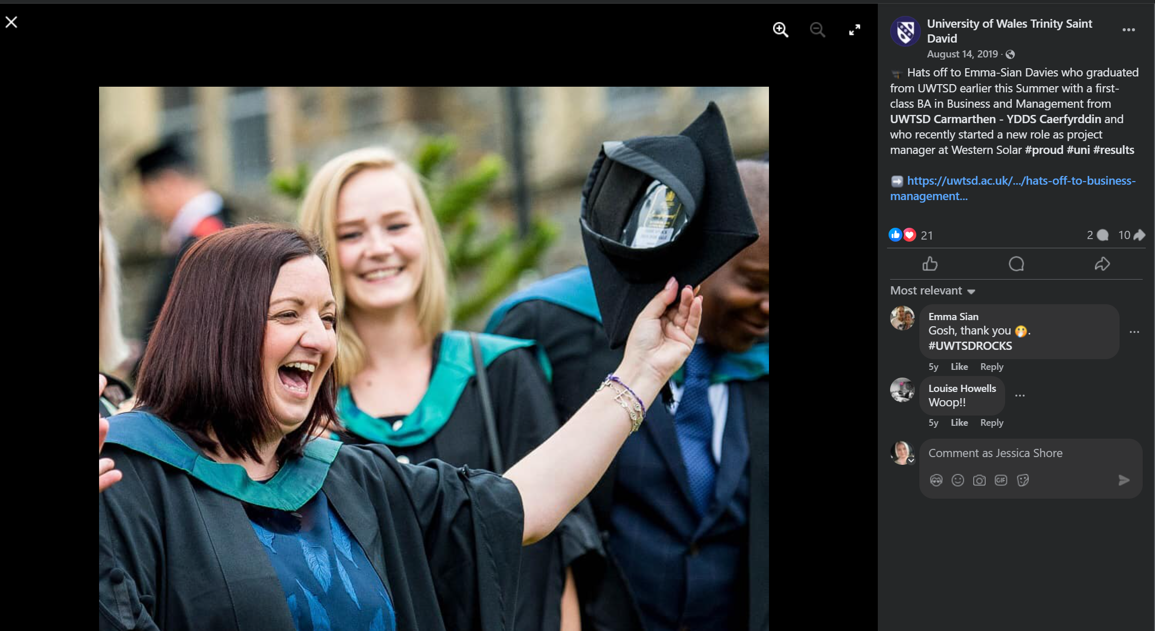

Slide 12

Placements from previous years…
Carmarthen Town Council
Building Carmarthenonline
Carmarthenshire County Council
Mapping Social Enterprises across the county
Canolfan Carwyn
Creating a programme of activity for the over 50’s
Carmarthen Business School
Marketing

Slide 13
What makes a placement so important to employers?
80% OF Employers believe that current graduates do not arrive fully equipped with the skills they need to be work-ready
Employers are increasingly looking for skills to work in a hybrid working environment
Employability skills should form part of every course – hence the addition of this module in the course.
Connection between students and employers is immeasurable

Slide 14
Video
Finding a Work Placement or Internship: 7 Top Tips - Study in the UK | Cardiff Met International

Slide 15
Process
Start to give thought to potential placements
Create your CV
Contact potential placement companies
Start applying
Send CVs and Covering letters
Complete Assignment 1
Once your placement is agreed complete the preplacement paperwork
Complete your pre-placement skills audit
Practise Interview Techniques
Start your placement
Keep a diary during your placement
Complete placement
Complete assignments 2 & 3 and your post placement skills audit

Slide 16
Research
Spent the next 20 minutes researching on your laptops, organisations locally that you would like to apply to for a placement.
We shall then discuss

Slide 17
Timings
You have now been given all the information about this module, including key dates, deadlines and placement time. For this activity you will need to write a list of the actions that you will need to take on this module, then create a ghantt chart detailing the key deadlines you need to hit. I have placed a turnitin link in this section of moodle for you to upload it.

