Slide 1
Social Entertainment
part one

Slide 2
Learning objectives
What is social entertainment? What is branded entertainment?
How can social media marketers use social entertainment to meet branding objectives?
What are the characteristics of social games and gamer segments?
In what ways are marketers using social music, social video and television, and social celebrity to share brand messaging?

Slide 3
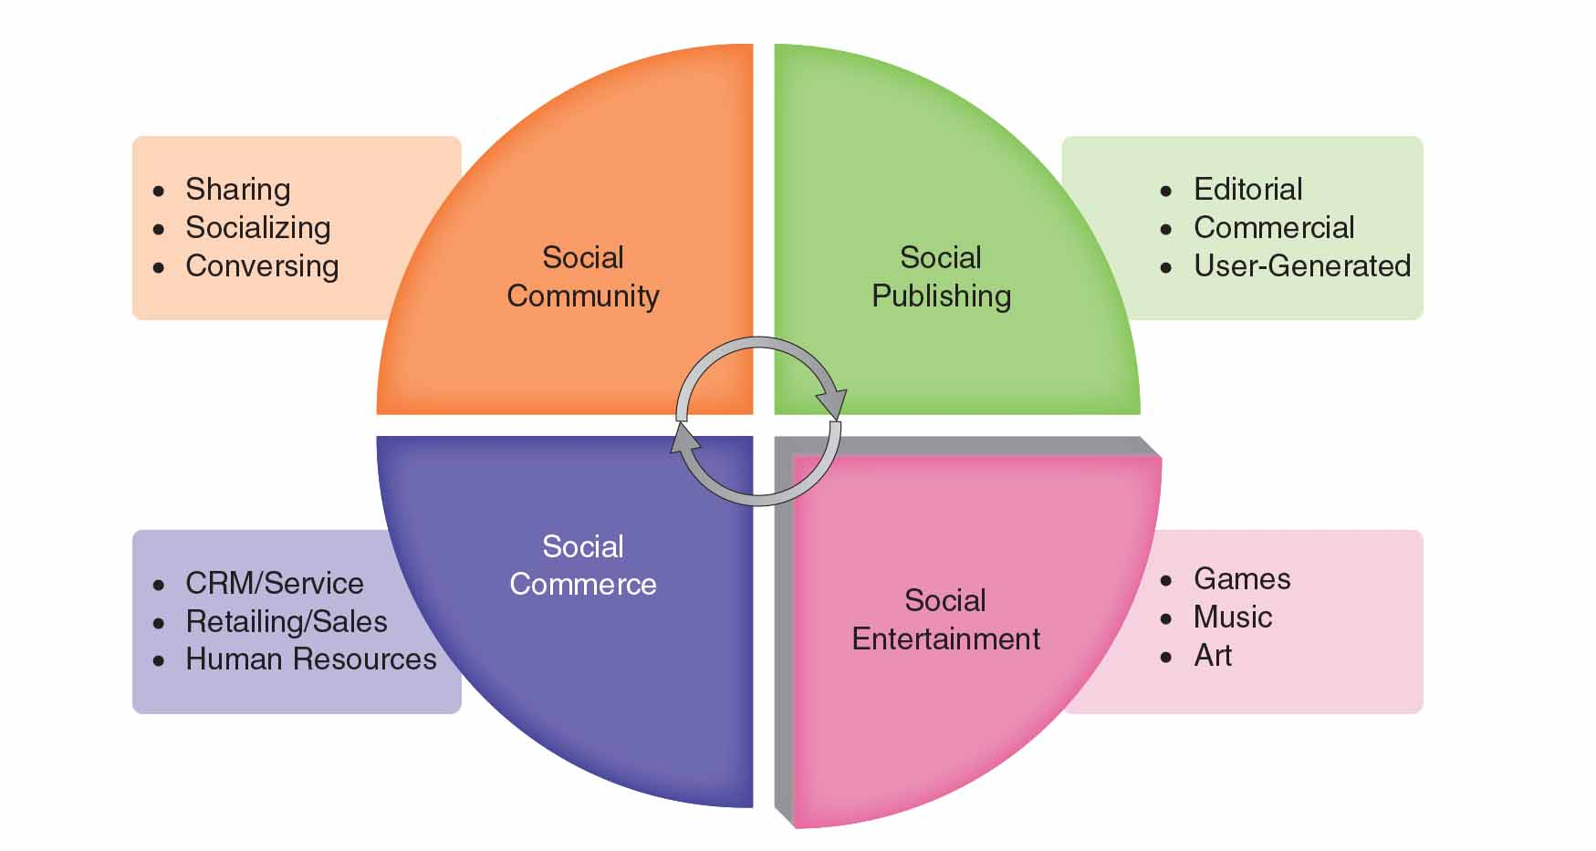
Figure 8.1 The social entertainment zone

Slide 4

Social entertainment as play
Play as power
Play as identity
Play as fantasy
Play as frivolity

Slide 5
Marketing with social entertainment
Advertising
Sponsorship
Branded
Degree of brand integration
Low
High

Slide 6
What is social branded entertainment?
When brands create owned vehicles of branded content, in the form of games, music, or film, which is participatory and shareable via digital connections, that is social branded entertainment.

Slide 7
Social games
Original digital video
Branded video
Social TV
Social music

Slide 8
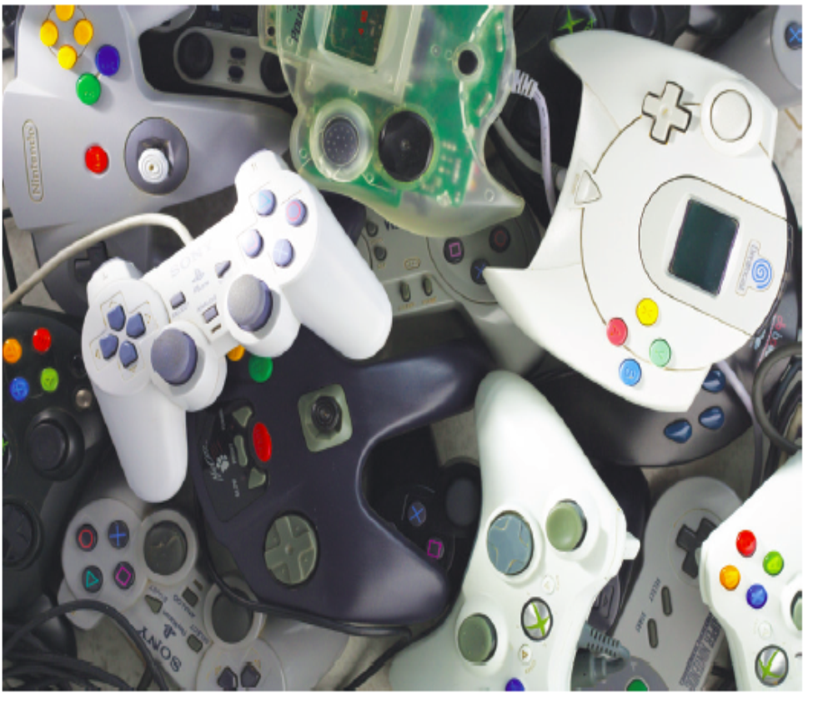
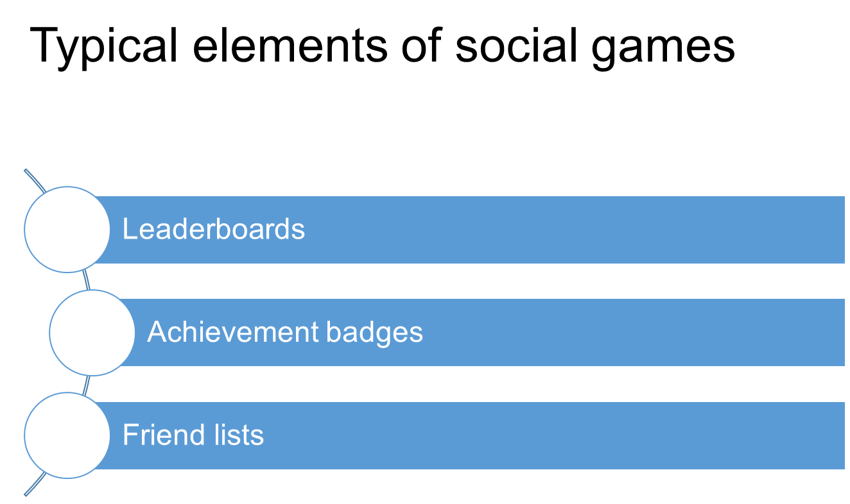
What is a social game?
Social games are multiplayer, competitive, goal-oriented activities with defined rules of engagement and online connectivity among players.

Slide 9
Gamer segments
Casual
Hardcore

Slide 10
Options for game-based marketing
Around-game and in-game advertising
Product placement
Brand integration
Advergames

Slide 11
Original digital video and branded video
Product placements enable brands to appeal to the audiences of popular influencers on video channels including YouTube, Instagram, Snapchat, and others.

Slide 12
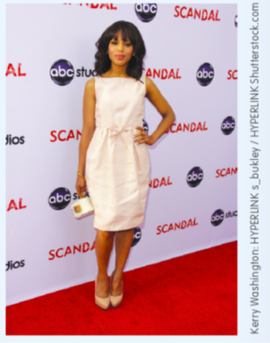
Social TV
Social TV is technology that supports communication and social interaction in either the context of watching television or related to TV content.
The experience of watching TV is enhanced by social media.
The phenomenon relates to social celebrity and the rise of “microcelebrities.”

Slide 13
Marketing with social music
In-network advertising
Immersive branding

Slide 14
Summary
What is social entertainment? What is branded entertainment?
How can social media marketers use social entertainment to meet branding objectives?
What are the characteristics of social games and gamer segments?
In what ways are marketers using social music, social video and television, and social celebrity to share brand messaging?

