Slide 1
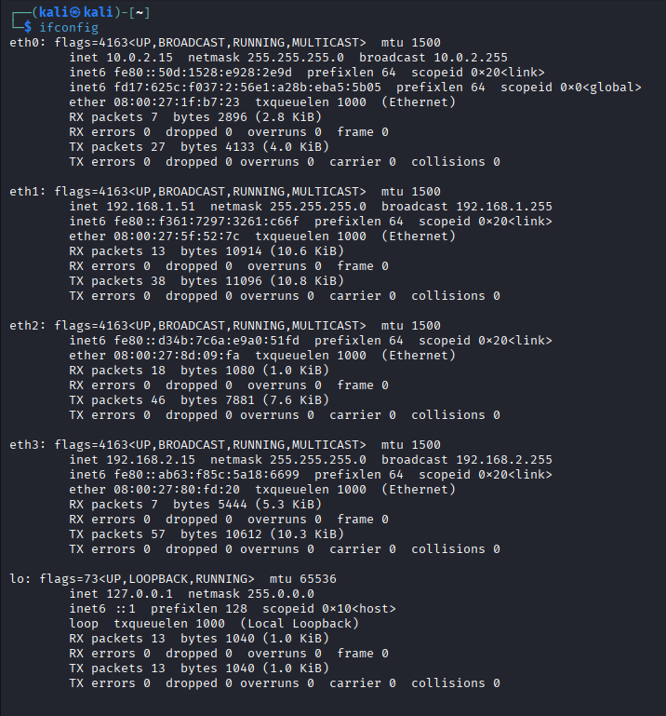
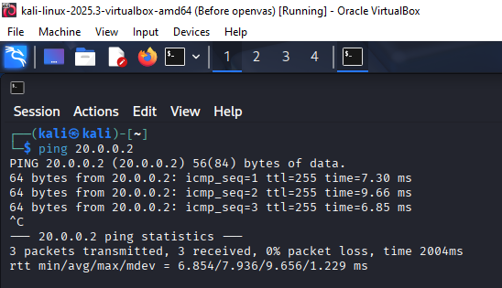
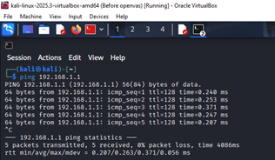
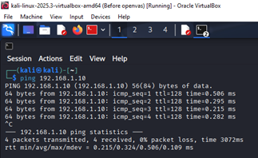
Ip address configuration and pinging
Kali
L-CD External
S-DC1
Clients1

Slide 2
Services and ports used in the network
Printer services
File share
Remote access
DHCP Enabled for the internet adapter IP address
Port 21/TCP FTP
Port 80/TCP HTTP
Port 443/TCP HTTPS
Port 515/TCP Printer

Slide 3
Vulnerabilities
High Severity
Port 445 File share - shared files can be accessed unauthorised users [1]
Port 21 FTP - FTP server can be accessed by unauthorised systems [2]
Medium Severity
Port 515 printer server port open – request can be flooded through and cause a DOS attack [3]
Clear text passwords – passwords are visible in plain text allowing for anyone to view them which gives attackers an easier job stealing passwords. [4]
Low Severity
Encryption level for remote access is set to low level and no user authentication to connect is required - allowing for outside attackers to get access remotely easier. [5]
Anti-virus does not scan new downloads – malware can go undetected though downloads infecting the system. [6]

Slide 4
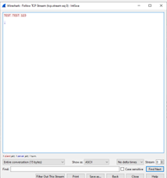
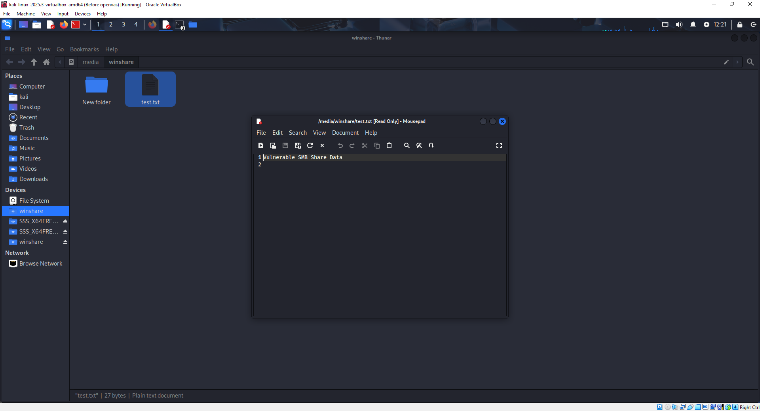
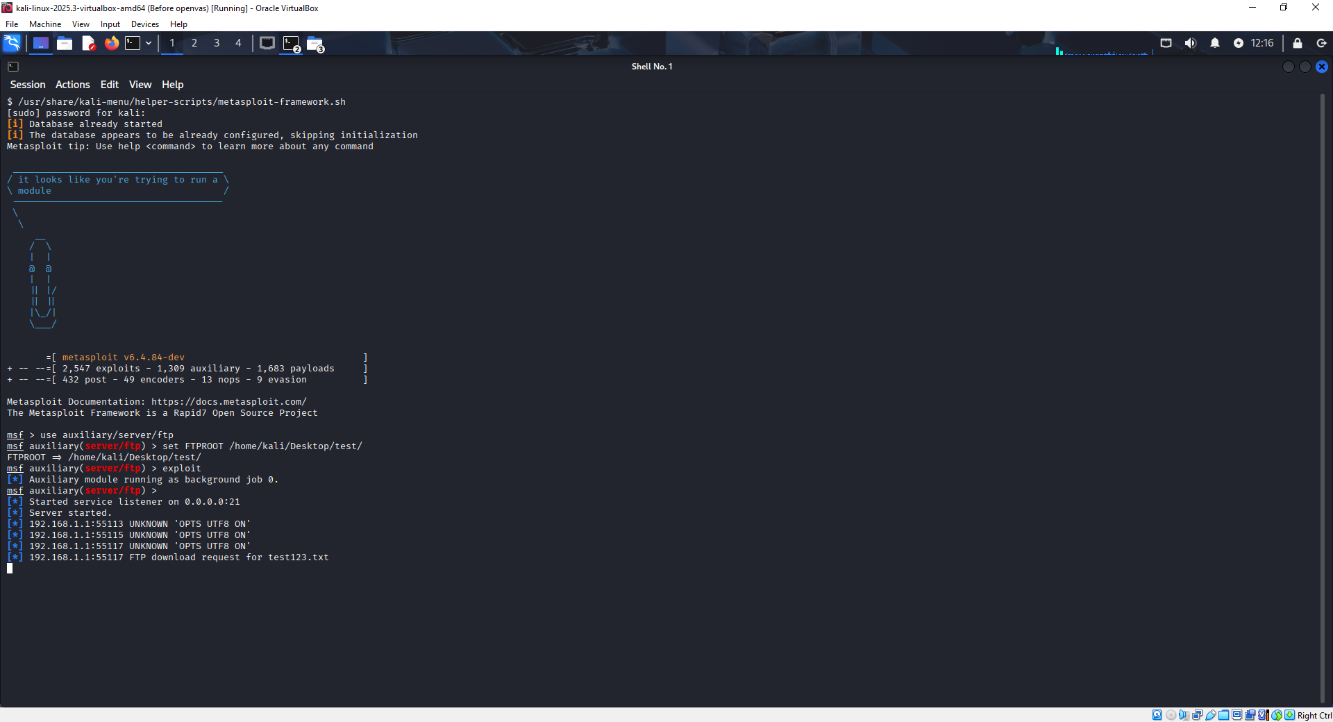
Exploitation – successful attempts
Communication with printer server on port 515
NetCat command echo “TESTING TESTING 123” | nc 192.168.1.1 515 was used.
However, the message was not added to print queue.
Being able to mount S-DC1 Vshare drive by having the command:
//192.168.1.1/Vshare /media/winshare cifs username=Administrator,password=NotebooK@123 0 0
In the /etc/ftsab file on the virtual machine.
Anonymous access and uploading a file to the network’s FTP server using Metasploit.
Notes:
In /etc/fstab the command used to gain access to Vshare files was:
//192.168.1.1/Vshare /media/winshare cifs username=Administrator,password=NotebooK@123 0 0

Slide 5
Implemented Security Measures
Installation of Wireshark – Used for regular monitoring the network for suspicious data packets and spot unneeded open ports that can be closed.
Restrictions on vShare - Changing permissions to limit access for all users so not just anyone can alter or view these files.
Disabling FTP protocol – As it goes unused it’s unnecessary to have as it prevents attackers from forming a connection to the FTP server.
Requiring user to change their password frequently - Makes attackers have a shorter window of using working login details if accessed
Adjust the encryption level from low to high – More protection.
Enable anti-virus to scan opened attachments – mitigation against malware.

Slide 6
References
[1] Government Cyber Unit (DSIT), “Open port 445: Server Message Block (SMB),” Government Security, N/A. [Online]. Available: https://www.security.gov.uk/services-resources/cyber-services-government/domain-and-vulnerability-knowledge-base/open-port-445-server-message-block-smb/. [Accessed 20 April 2026].
[2] Government Cyber Unit (DSIT), “Open port 21: File Transfer Protocol (FTP),” Government Security, N/A. [Online]. Available: https://www.security.gov.uk/services-resources/cyber-services-government/domain-and-vulnerability-knowledge-base/open-port-21-file-transfer-protocol-ftp/. [Accessed 20 April 2026].
[3] L. Costantini, “Understanding Printer Vulnerabilities: Common Attack Methods and How to Avoid Them,” Sharp, 3 January 2025. [Online]. Available: https://business.sharpusa.com/simply-smarter-blog/understanding-printer-vulnerabilities-common-attack-methods-and-how-to-avoid-them#:~:text=With%20advanced%20productivity%20features%2C%20MFPs,them%20as%20they%20become%20available.. [Accessed 20 April 2026].
[4] OWASP, “Password Plaintext Storage,” OWASP, N/A. [Online]. Available: https://owasp.org/www-community/vulnerabilities/Password_Plaintext_Storage#:~:text=Storing%20a%20password%20in%20plaintext%20can%20lead,configuration%20file%20to%20access%20the%20password%2Dprotected%20resource. [Accessed 20 April 2026].
[5] Microsoft Learn, “5.3.1 Encryption Levels,” Microsoft , 4 July 2025. [Online]. Available: https://learn.microsoft.com/en-us/openspecs/windows_protocols/ms-rdpbcgr/f1c7c93b-94cc-4551-bb90-532a0185246a. [Accessed 20 April 2026].
[6] National Cyber Security Centre, “What is an antivirus product? Do I need one?,” National Cyber Security Centre, 21 January 2019. [Online]. Available: https://www.ncsc.gov.uk/guidance/what-is-an-antivirus-product#:~:text=Detect%20and%20prevent%20malicious%20software,and%20other%20types%20of%20malware.. [Accessed 20 April 2026].

