Slide 1

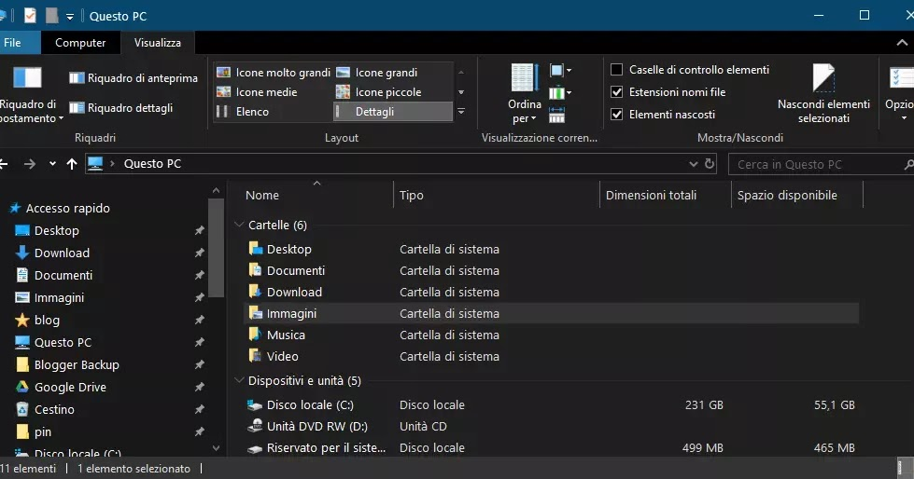
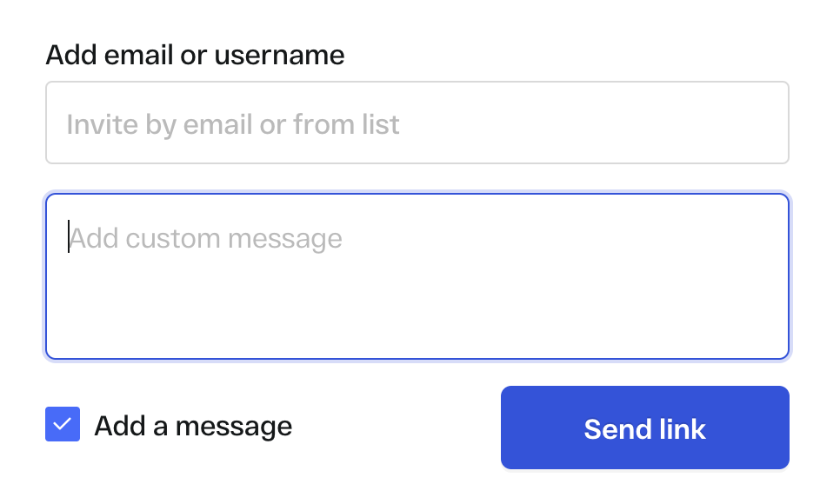
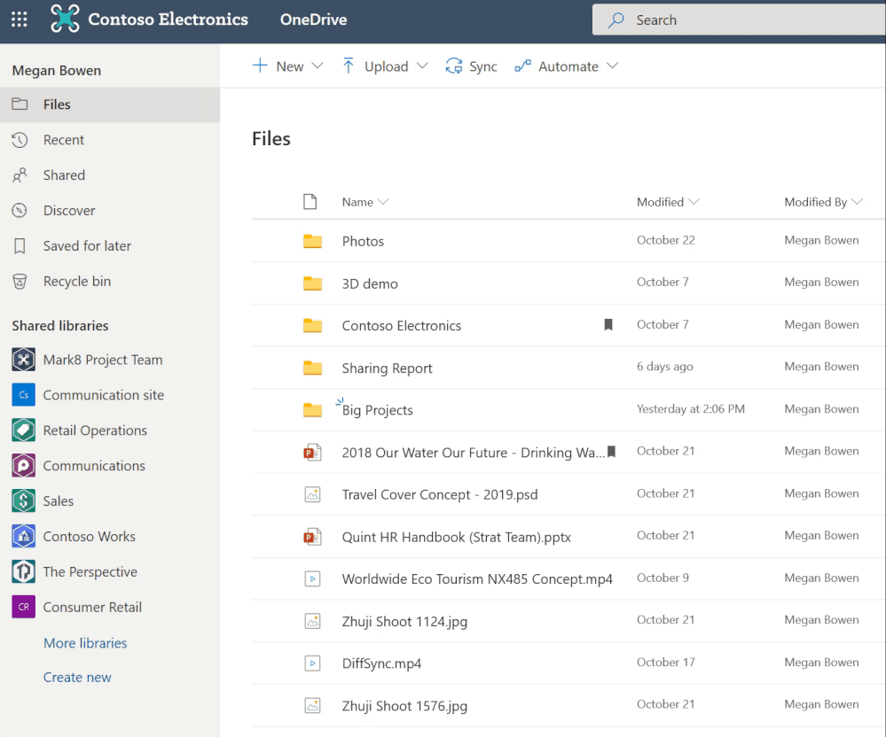
How to use OneDrive
OneDrive is an app that holds your files that you have done in the class .
As a student you should know how to use that app because it helps you save every work that you’ve made it .
How to share a file via the OneDrive
So, this picture show you how is the files look
Everything look be there until you want to delete.
On your laptop search for OneDrive.
First thing that would come out is your daily flies that you made.
Second thing is that you have to do is choose the file that has to be send to your professor.
So, if you look cafully you will see three options next to the name of the file.
Well, if you want share anything with anyone then you must press the second options over there.
When you press it , it will automatically show you other slide where there will be only two options over there to so what you need to do is to type the persons university email address and there will be space to leave a message for the person who is going to receiving.
Ones you have done with that you can have a look at the menu of OneDrive. If you see them one by one you will see your file that has been shared someone you know.

